Slide 1
General Orientation
Birth of the Social Sciences
Thinking Sociologically
Sociological Methods
Sociological Theory & Theorists

Slide 2
Sociological Imagination
(C. Wright Mills)
Understand Human Behavior in Terms of the Intersection of:
  Social Structure (& Culture)
  History
  Biography
Personal Troubles v. Public Issues

Slide 3
Modern Society
Three Great Revolutions
  Political
  Scientific
(Both were Result of Philosophical/Cultural Developments)
  Industrial
Population Growth

Slide 4
Population Growth

Slide 5
Sociological Theory &
Methods of Research
(Natural) Scientific Method Applied to Society
  Focus on Aggregates/Patterns (v. Individual)
“Social Facts” (Emile Durkheim [1855-1917])
  External to Individual
  Coercive Over Individual
Durkheim: study patterns (social structures) + relate them to other patterns

Slide 6
Sociological Theory &
Methods of Research
Scientific Method (Durkheim)
  Systematic Observation
  Hypothesis
    Testing
    Verification/Falsification
  Data are quantitative
    Aggregate Patterns
    Variations (Variables & relationships)
    Descriptive Statistics, then correlation, causation

Slide 7
"Interpretive" Sociology
Focus is on definitional processes and interaction
  occurs at the symbolic level
    at the level of meaning
Field work
  Direct observation
    Participant observation; ethnography
Data are qualitative
  "microcosmic“ (vs. aggregate or “macro”)

Slide 8
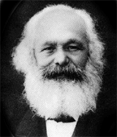
Major Theoretical Approaches & Theorists in Sociology
Conflict Theory: derived from Karl Marx (1818-1883)
  Scarce resources are unevenly distributed among different social groups
  source of conflict = inequality
Economy is the most important sector of society
  and the chief source of conflict
  owners of means of production in
  conflict with workers

Slide 9
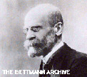
Functionalism
Focus on relations between a social whole (groups/ societies) and its parts
  Group members
  “Institutional spheres": areas of social action
    family, economy, etc.
“Function“: purpose that some action or part of society serves to maintain the whole
Emile Durkheim (1855-1917)
  Crime and “Deviance"
  plays a role in maintaining group
  identity and solidarity

Slide 10
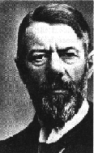
Interpretive Approach
Max Weber (1864-1920)
Weber: "verstehen“ (“Understanding”)
  Intersubjectivity
  People act on the basis of meanings
  How we define social situations

Slide 11
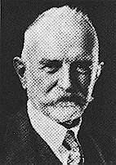
Interpretive Approach
George Herbert Mead (1863-1931)
Symbolic interaction
  The social processes involved in creating and maintaining a given reality
  Especially the creation of the social self (identity)

