Slide 1
Gender & Family
“That institution in society that arranges for: (1) Regulation of Sexual Relations; (2) Household Composition; (3) Child-Rearing”

Slide 2
Sex & Gender
Sex = Biological Fact
Gender = Cultural, Social-Psychological Fact

Slide 3
Family
Regulation of Sexual Relations
  Culture
  Changes in Gender Roles
  Divorce

Slide 4
Family & Divorce
Regulation of Sexual Relations
  Crude Divorce Rate = No. of divorces/100 married persons
    1920: 13.4
    1960: 23.1
    1990: 51.1
BUT: How the 50% rate is calculated
  Annual marriage rate per 1,000/Annual divorce rate per 1,000
  2003:
    7.5 marriages per 1,000
    3.8 divorces per 1,000 (NCHS, 2005)

Slide 5
Family & Divorce
Regulation of Sexual Relations
Better method of calculation
  How many people who have ever married subsequently divorced?
    Highest rate = ca. 41%
Factors Predicting Success & Failure
  Education
    Divorce rates lowest for college graduates
    1/3 to ¼ the rate of non-graduates
Age
  Nearly ½ under age 18
  40% under age 20
  24% over age 25
Religion
  Born-again Christians same as general population (ca. 1/3)

Slide 6
Family & Divorce
Factors Predicting Success & Failure
Region
  Highest rates
    South & Midwest
    “Red” states higher than “blue” states
    from Smart Marriages Listserv , Jan. 4, 2005
Cohabitation
  Couples cohabiting before marriage
    Significantly higher risk of divorce than couples not cohabiting before marriage

Slide 7
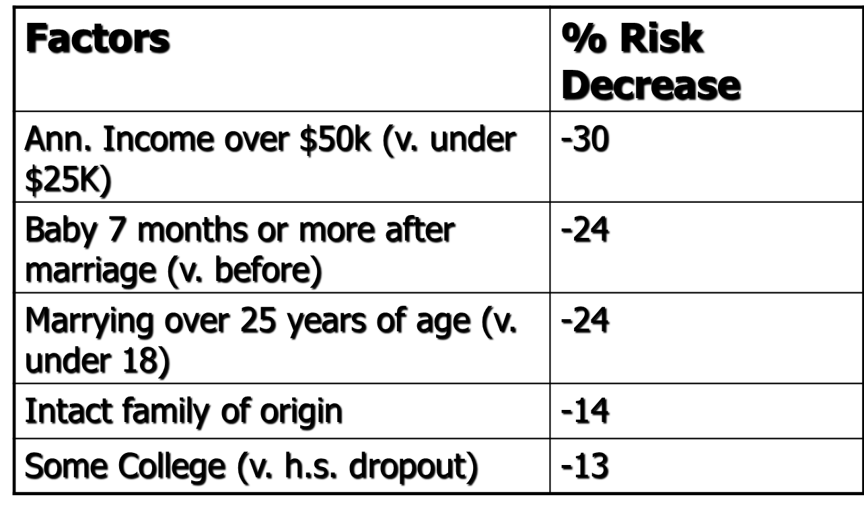
Family & Divorce
Factors Affecting Success & Failure

Slide 8
Household Composition
“Who Lives With Whom?”
Divorce (obvious effect)
Changing Household Forms
  Living together has increased > six-fold
    Often short term
    Higher divorce rate
  Staying single:
    2000: 27.2 million people, 26% of all households (in 1950, 9.3%)
    Vs. 22% married couples & their kids
    21% married couples living alone
  Waiting Longer (Older married households)
    1950:
    2004:

Slide 9
Household Composition
“Who Lives With Whom?”
Changing Household Forms
  Waiting Longer (Older married households)
Median Age at First Marriage
 | Male | Female
1950 | 22.8 | 20.8
2003 | 27.1 | 25.3

Slide 10
Household Composition
“Who Lives With Whom?”
Single Parent Households
  2000: ca. 13.5 million single parents had custody of 21.7 million children under 21 years of age
  % of population made up by married couples with children decreased from 40% in 1970 to 24% in 2000
Single parent households increased from 9% in 1990 to 16% of all households by 2000.
Of all custodial parents, 85% were mothers
  Variation by race/ethnicity

Slide 11
Household Composition
“Who Lives With Whom?”
Children in single-parent households by race/ ethnicity, 2006 (American Community Survey & Annie E. Casey Foundation, 2006)
White | 23%
Black | 65%
American Indian | 49%
Asian | 23%
Hispanic | 36%

Slide 12
Household Composition & Child-Rearing:
Lineality & Locality
Unusual Society
  Patterns of lineality & locality
  Patrilineal
    Trace blood & property lines along father’s side
  Matrilineal
    Trace blood & property lines along mother’s side

