Slide 1
Psychopharmacology
Inmaculada Ibanez-Casas, PhD
ibanezcasasi@uncw.edu

Slide 2
Psychopharmacology
SUMMARY
Basic principles of psychopharmacology: routes of administration and their fate in the body.
Sites of drug actions.
Specific neurotransmitters: physiological and behavioral effects of specific drugs

Slide 3
Psychopharmacology
SUMMARY
Basic principles of psychopharmacology: routes of administration and their fate in the body.
Sites of drug actions.
Specific neurotransmitters: physiological and behavioral effects of specific drugs

Slide 4
Principles of Psychopharmacology
Psychopharmacology
  the study of the effects of drugs on the nervous system and on behavior
Routes of administration
  the path by which a drug or other substance is taken into the body
Drug Effect
  the changes a drug produces in an animal’s physiological processes and behavior
Sites of Action
  the locations at which molecules of drugs interact with molecules located on or in cells of the body, thus affecting some biochemical processes of these cells

Slide 5
Principles of Psychopharmacology
Pharmacokinetics
  movements of drugs, including the process by which drugs are absorbed, distributed within the body, metabolized, and excreted.
Body
Drug
Bloodstream
Organ/Tissue
Molecule
Notes:
To be effective, a drug must reach its sites of action.
To do so, molecules of the drug must enter the body and then enter the bloodstream so that they can be carried to the organ (or organs) on which they act.
Once there, they must leave the bloodstream and come into contact with the molecules with which they interact.
For almost all of the drugs in which we are interested, this means that the molecules of the drug must enter the central nervous system (CNS)
Molecules of drugs must cross several barriers to enter the body and find their way to their sites of action.
Some molecules pass through these barriers easily and quickly; others do so very slowly.
And once molecules of drugs enter the body, they begin to be metabolized—broken down by enzymes—or excreted in the urine (or both).
With time, the molecules either disappear or are transformed into inactive fragments.

Slide 6
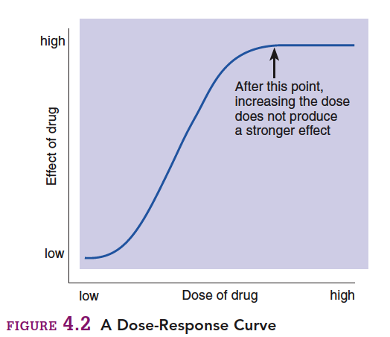
Dose-Response Curve
Notes:
Once they reach their site of action, drugs vary widely in their effectiveness.
The effects of a small dose of a relatively effective drug can equal or exceed the effects of larger amounts of a relatively ineffective drug.
The best way to measure the effectiveness of a drug is to plot a dose-response curve.
Dose-Response Curve is a graph of the magnitude of an effect of a drug as a function of the amount of drug administered
One of the important information that these curves offer is the peak where additional quantities of drug do not increase the effect, so it is pointless to give more drug at this point, specially because side effects may appear.
Minimum effective dose, to avoid side effects.

Slide 7
Principles of Psychopharmacology
Effects of Repeated Administration
Tolerance
  a decrease in the effectiveness of a drug that is administered repeatedly
Sensitization
  an increase in the effectiveness of a drug that is administered repeatedly
Withdrawal Symptom
  the appearance of symptoms opposite to those produced by a drug when the drug is administered repeatedly and then suddenly no longer taken
Placebo
  an inert substance that is given to an organism in lieu of a physiologically active drug
Notes:
Often, when a drug is administered repeatedly, its effects will not remain constant.
In most cases its effects will diminish—a phenomenon known as tolerance.
In other cases, a drug becomes more and more effective—a phenomenon known as sensitization.
Sensitization is the exact opposite of tolerance: Repeated doses of a drug produce larger and larger effects.
Sensitization is less common than tolerance.
Additionally, some of the effects of a drug may show sensitization while others show tolerance.
For example, repeated injections of cocaine become more and more likely to produce movement disorders and convulsions, whereas the euphoric effects of the drug do not show sensitization—and may even show tolerance.
PLACEBO
Although placebos have no specific physiological effect, it is incorrect to say that they have no effect.
If a person thinks that a placebo has a physiological effect, then administration of the placebo may actually produce that effect. That’s the placebo effect.

Slide 8
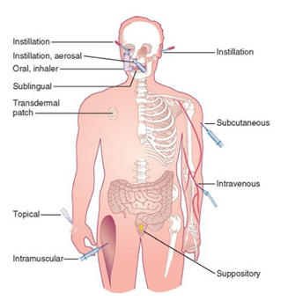
Routes of Administration
Intravenous (IV) Injection
Intraperitoneal (IP) Injection
Intramuscular (IM) Injection
Subcutaneous (SC)
Oral Administration
Sublingual Administration
Intrarectal Administration
Inhalation
Topical Administration
Intracerebral Administration
Intracerebroventricular (ICV) Administration
Notes:
Classified by the location at which the substance is applied.
Intravenous (IV) Injection
injection of a substance directly into a vein
Intraperitoneal (IP) Injection
injection of a substance into the peritoneal cavity—the space that surrounds the stomach, intestines, liver, and other abdominal organs
Intramuscular (IM) Injection
injection of a substance into a muscle
Subcutaneous (SC)
injection Injection of a substance into the space beneath the skin
Oral Administration
administration of a substance into the mouth so that it is swallowed
Sublingual Administration
administration of a substance by placing it beneath the tongue
Intrarectal Administration
administration of a substance into the rectum
Inhalation
administration of a vaporous substance into the lungs
Topical Administration
administration of a substance directly onto the skin or mucous membrane
Intracerebral Administration
administration of a substance directly into the brain
Intracerebroventricular (ICV) Administration
administration of a substance into one of the cerebral ventricles

Slide 9
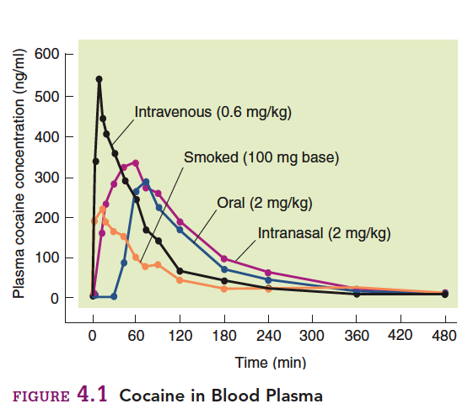
Routes of Administration (Cont’d)
Notes:
Differences in plasma concentration depending on the route of administration of Cocaine.

Slide 10
Psychopharmacology
SUMMARY
Basic principles of psychopharmacology: routes of administration and their fate in the body.
Sites of drug actions.
Specific neurotransmitters: physiological and behavioral effects of specific drugs

Slide 11
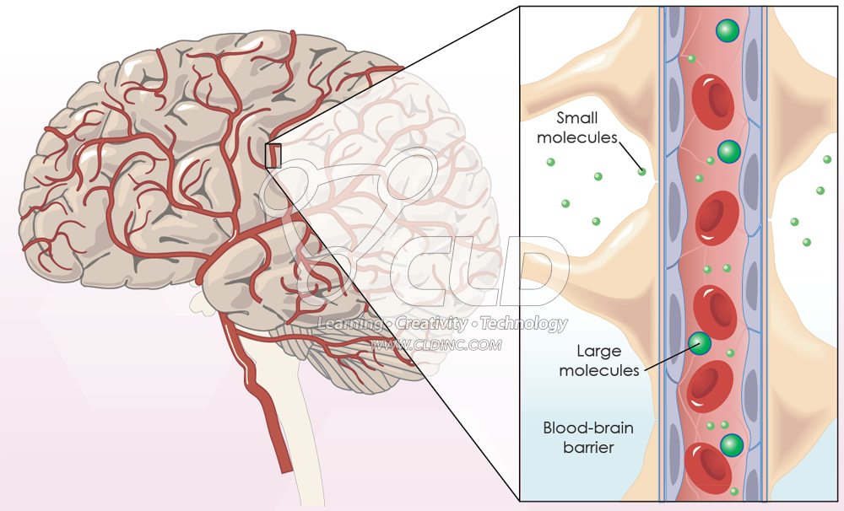
Entry of Drugs into the Brain
Blood-brain barrier
Notes:
In the case of drugs that affect behavior, most of these sites are located on or in particular cells in the central nervous system.
To reach these cells, drugs must cross the blood-brain barrier.
The most important factor that determines the rate at which a drug in the bloodstream reaches sites of action within the brain is lipid solubility.
The blood–brain barrier is a barrier only for water-soluble molecules.
Molecules that are soluble in lipids pass through the cells that line the capillaries in the central nervous system, and they rapidly distribute themselves throughout the brain.

Slide 12
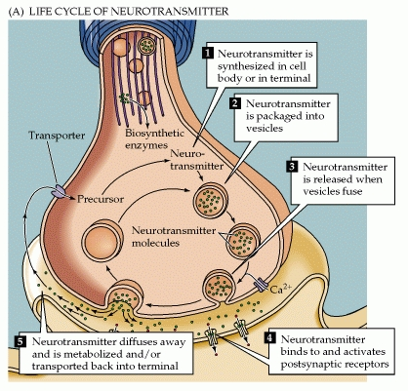
Sites of Drug Action
Notes:
Once the drug has entered the brain, it can affect one or more of many aspects of neurotransmitter synthesis and release.
VIDEO

Slide 13
Sites of Drug Action
Effects of Drugs
Antagonist
  a drug that opposes or inhibits the effects of a particular neurotransmitter
Agonist
  a drug that facilitates the effects of a particular neurotransmitter
Notes:
When they bind their specific molecules, they can have either an agonistic or an antagonistic effect.

Slide 14
Sites of Drug Action
    Effects on Production of Neurotransmitters
    Effects on Storage and Release of Neurotransmitters
    Effects on Receptors
    Effects on Reuptake or Destruction of Neurotransmitters
Notes:
Both agonistic and antagonistic effects can be obtained at different levels.

Slide 15
Sites of Drug Action
Level | AGONIST | ANTAGONIST
Synthesis | Increasing precursor (e.g. L-Dopa) | Deactivating synthetic enzymes (e.g. PCPA)
Release | Stimulating NT release (vesicles) (e.g. Black widow venom) | Inhibiting filling of vesicles (e.g. Reserpine) Inhibiting the release of NT (e.g. Botulinum toxin)
Postsynaptic receptors | Stimulating postsynaptic receptors (e.g. Nicotine) | Inhibiting postsynaptic receptors (e.g. Atropine)
Autoreceptors | Blocking autoreceptors | Stimulating autoreceptors (e.g. Apomorphine)
Reuptake | Blocking reuptake (e.g. Cocaine, SSRI’s)
Deactivation | Preventing enzymatic deactivation (e.g. Physostigmine)
Notes:
PCPA: para-chlorophenylalanine. AKA Fenclonine. Inhibitor of tryptophan hydroxylase, needed for the synthesis of Serotonin.
Black widow venom produces a dramatic release of acetylcholine that produces cramping and relax heart muscles.
Reserpine: binds and deactivates the transport proteins of monoamines (dopamine, serotonin, norepinephrine). It has been used to treat hypertension, but has many side effects.
Botulinum toxin: binds membrane protein and prevent opening of the vesicle. It produces paralysis
Nicotine: docking with acetylcholine receptors to increase stimulation.
Blocking autoreceptors: some drugs can block them without activating them. NT can thus no longer activate the autoreceptor and the presynaptic neuron continues releasing NT
SSRI: Selective Serotonin reuptake inhibitors. Antidepressants, anxiety disorders, eating disorders
Inhibiting postsynaptic receptors: Blocking the binding sites in the postsynaptic receptors.
Atropine: used in the treatment of bradycardia and poisonings.
Stimulating autoreceptors: this sends the signal to stop producing the NT

Slide 16
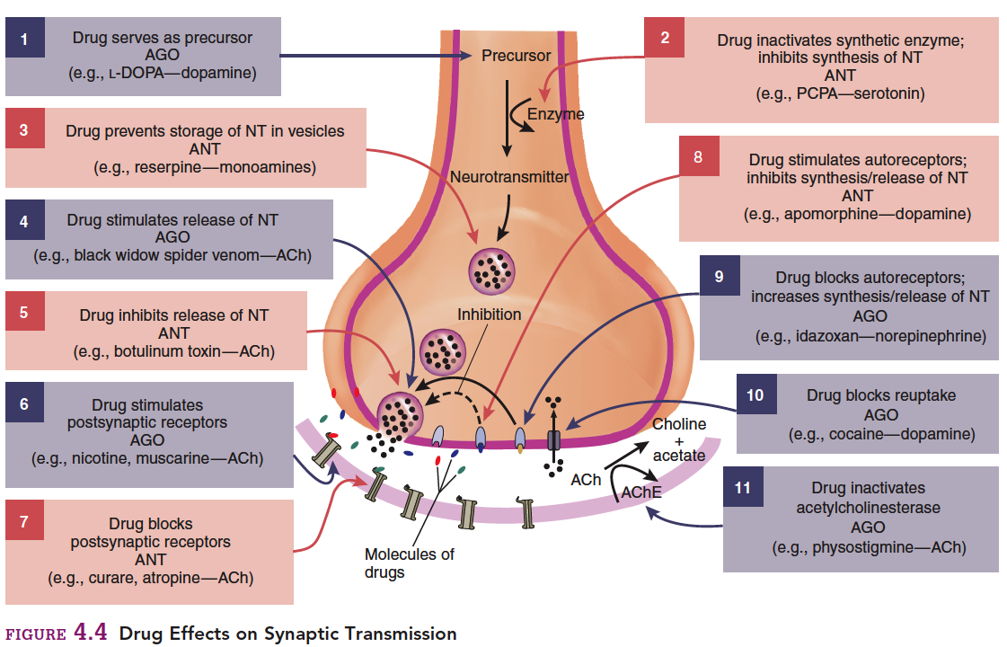

Slide 17
Psychopharmacology
SUMMARY
Basic principles of psychopharmacology: routes of administration and their fate in the body.
Sites of drug actions.
Specific neurotransmitters: physiological and behavioral effects of specific drugs

Slide 18
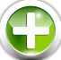
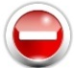
Types of Neurotransmitters
Glutamate
Aminoacids
GABA
Glicine
Opioids
Peptides
Substance P
Vasopressin
Dopamine
Catecholamines
Epinephrine
Monoamines
Norepinephrine
Serotonin
Histamine
Other
Acetylcholine
Notes:
The most common classification is by their molecule structure.
There are several aminoacids, but only a few function as NT in the CNS.
Glutamate is the most common excitatory NT in the CNS
GABA = Gamma amino butyric acid, is the most common inhibitory NT in the CNS
Glicine is also inhibitory but can be found mainly in the spinal cord and the brainstem.
The peptides are large chains of aminoacids. There is a group of peptides called the opioids that are involved in the perception of pain. Morphine acts through the binding to the same receptors of these NT. Other peptides are Substance P and Vasopressin.
Among the Monoamines there is an important group called the Catecholamines, including dopamine, epinephrine and norepinephrine.
Other Monoamines are Serotonin and Histamine. They are NT implied in consciousness, attention, cognition, emotion
Very often the group “other” includes parts that are less important, but this is not the case with this classification of NT, since Acetylcholine is included in this group, and it is one of the most important NT both in the CNS and in the ANS.

Slide 19
Peptides
Peptide | Function
Vasopressin | Stress response
Oxytocin | Uterine contractions Milk reflex
Substance P | Movement disorders Pain perception
Opioid | Pain relief

Slide 20
Dopamine
Pathways include:
  Projections from Substantia Nigra (basal ganglia)
    Parkinson’s disease
  Projections to the nucleus accumbens
    “Pleasure center” of brain
    Substance use disorders
  Schizophrenia: mesolimbic pathway
  Regulation of emotional responses
Substances: Cocaine, Amphetamine

Slide 21
Epinephrine
Energy and Emergency systems: Fight or Flight responses
ANS (Sympathetic): regulating blood pressure
CNS: forming of new memories

Slide 22
Norepinephrine
Involved in:
  Sympathetic NS: Fight or Flight
  Increases blood pressure and heart rate
  Releases glucose stores
  Emotional arousal: connected to amygdala
  Reward / Reinforcement
  Regulation of sleep and mood
Substances: Cocaine, Amphetamine

Slide 23
Serotonin
Functions
  Inhibitory NT
  Mood, emotion, appetite and sleep (Hippothalamus)
  Low levels = depression, anger, OCD → SSRI
  Temperature regulation
  Sensory perception
Substances: LSD, SSRI

Slide 24
Acetylcholine
Involved in…
  Somatic NS: Muscle contraction
  Central NS: Learning and memory
Alzheimer’s disease
Notes:
First NT to be discovered, since it is found in the Autonomic nervous system.

Slide 25
Psychopharmacology
Thank you!
Inmaculada Ibanez-Casas, PhD
ibanezcasasi@uncw.edu

