Slide 1
Combining Motivational Interviewing and Acceptance and Commitment Therapy in the Treatment of Addictions: An Integrative Best-Practice Approach
Richard L. Ogle, Ph.D.
Associate Dean, College of Arts and Sciences
Professor of Psychology
University of North Carolina Wilmington
http://people.uncw.edu/ogler/NCFADS%20Links.htm

Slide 2
The Plan For Our Time Today
Review the basics of Motivational Interviewing (MI)
Review the basics of Acceptance and Commitment Therapy (ACT)
Describe the points of integration
  Examine how integration of models can provide a more powerful source of intervention as strengths of each technique is strategically combined and implemented.
Present a format for a general integrated approach to treat addictions
  Identify which interventions in MI & ACT that can be best combined for the most effective therapeutic impact.

Slide 3



MOTIVATIONAL INTERVIEWING

Slide 4
What is MI?
  MI is a collaborative, goal oriented style of communication with particular attention to the language of change. It is designed to strengthen personal motivation for and commitment to a specific goal by eliciting and exploring the person’s own reasons for change within an atmosphere of acceptance and compassion.
  MI is a strengths-based intervention that views substance abuse as a result of difficulties in coping with one’s environment and a disconnect between values and behavior.
  Special attention is paid to client language where status-quo speech is acknowledged and contextualized and change language is selectively reinforced.

Slide 5
Spirit & Principles of MI
MI Spirit
Basic Principles
Acceptance
  Absolute worth
  Autonomy
  Accurate Empathy
  Affirmation
Collaboration
  Partners
Evocation
  Drawing out instead of putting in
Compassion
  For the other’s needs/self-interest
Express Empathy
Roll w/ Resistance
Develop Discrepancy
  Values
Support Self-Efficacy

Slide 6
The Processes of MI
Engaging - Establishing a helpful connection and a working relationship
  How comfortable is this person talking to me and how comfortable do I feel with this conversation?
  Do I understand this person’s perspective and concerns?
  Does this feel like a collaborative partnership?
Focusing - Clarifying direction – finding the horizon point toward which to move. Agenda.
  What goals for change does this person really have?
  Do I have different aspirations for change than this person?
  Are we working together with direction and a common purpose?
Evoking - Eliciting client’s own motivations to change. Harness their thoughts and feelings about why/how they might do it.
  What are this persons reasons for change?
  Is the reluctance more about confidence or importance?
  What change talk am I hearing?
Planning - Developing commitment to change and a specific plan of committed action
  What would help this person to move forward?
  Am I remembering to evoke rather that prescribe a plan?
  Am I offering needed info and advice with permission?

Slide 7
Basic Tools of MI
Open Questions
  Avoid “yes” or “no” answers
Affirm
  Strengths
Reflective listening
  Parrot
  Rephrase
  Meaning
  Emotion
Summarize
  Collecting
  Linking
  Formulative

Slide 8
ACCEPTANCE AND COMMITMENT THERAPY

Slide 9
What is ACT?
Definition
Model of “Pathology”
Model of “Recovery”
ACT is an experiential behavioral therapy that uses acceptance and mindfulness processes, and commitment and behavior change processes, to produce greater psychological flexibility.
Human pain (physical and psychological) is ubiquitous, normal, and self-restorative
Unwillingness to have pain leads to reliance on avoidance and control based strategies
Excessive use of control & avoidance leads to a loss of contact with committed actions & vital purposeful living
Contacting the present moment fully as a conscious human being, and based on what the situation affords changing or persisting in behavior in the service of chosen values.
  Accept: What is there to be experienced, fully and without defense, for what it is, not what it says it is
  Choose: Based upon your closely held values, choose what you would like to be about here
  Take Action: Engage in committed actions that embody your values, “inhaling” the distressing personal content as it appears

Slide 10
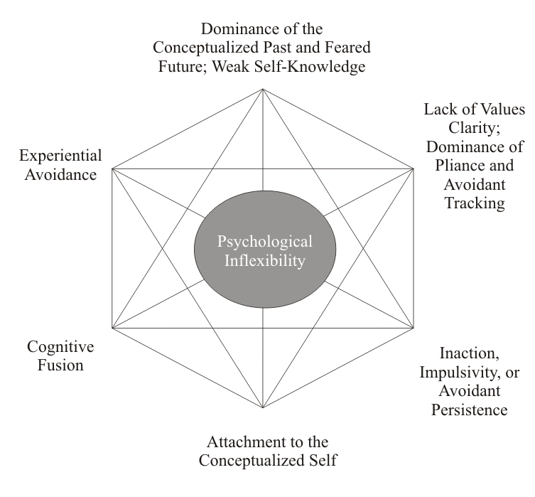
ACT Hexaflex

Slide 11
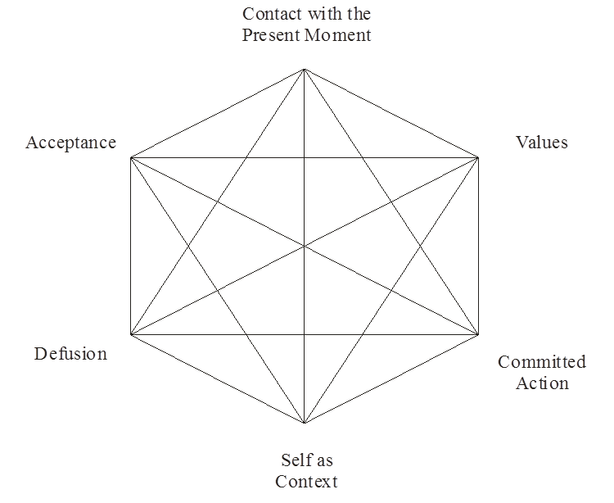

ACT Hexaflex
AWARE
OPEN
Psychological
Flexibility
ENGAGED

Slide 12
“God, grant me the serenity to accept the things I cannot change, the courage to change the things I can, and the wisdom to know the difference.”

Slide 13
ACT and the 12-Steps
We admitted we were powerless over alcohol—that our lives had become unmanageable. (Acceptance/Unworkability)
Came to believe that a Power greater than ourselves could restore us to sanity (Acceptance).
Made a decision to turn our will and our lives over to the care of God as we understood Him (Acceptance).
Made a searching and fearless moral inventory of ourselves (Values Clarification).
Admitted to God, to ourselves, and to another human being the exact nature of our wrongs.
Were entirely ready to have God remove all these defects of character.
Humbly asked Him to remove our shortcomings.
Made a list of all persons we had harmed, and became willing to make amends to them all (Values/Committed Action).
Made direct amends to such people wherever possible, except when to do so would injure them or others (Committed Actions).
Continued to take personal inventory and when we were wrong promptly admitted it (Acceptance/Defusion).
Sought through prayer and meditation to improve our conscious contact with God, as we understood Him, praying only for knowledge of His will for us and the power to carry that out (Mindfulness/Contact w/Present Moment).
Having had a spiritual awakening as the result of these Steps, we tried to carry this message to alcoholics, and to practice these principles in all our affairs (Values/Committed Action).

Slide 14
POINTS OF INTEGRATION

Slide 15
Spirit and Stance
Acceptance and Self-Compassion
Empathy and Perspective Taking
Collaborative and Egalitarian
Intervention Tailored to Client
Non-Expert Model
  Non-Confrontational
Evocation and Drawing Out the System
Self-Efficacy
Client-Language Focus
  MI – Content
  ACT – Process

Slide 16
Processes – Functional Understanding of Substance Abuse
Both have roots in a behavioral approach
Understanding the function of substance abuse is key
  ACT specifically assumes that substance abuse is a form of experiential avoidance
  MI views substance abuse from a coping perspective
ACT focuses on “drawing out the system”
MI focuses on understanding the role of substance in a persons ongoing activity

Slide 17
Processes – Rolling w/Resistance and Defusion
Both focus on therapist responses that undermine a clients rigidly held views and experienced emotion.
  MI uses simple and strategic reflection to engage empathically and create perspective change
  ACT uses metaphor and various exercises to create similar perspective change

Slide 18
Processes – Values & Discrepancy
Understanding, clarifying and connecting a client to their own core values is the strongest point of overlap in ACT & MI
  MI and ACT assert that values are the most important factor in therapeutic change
    Values are the reasons why people change
  MI and ACT strive to develop a discrepancy between a persons values and their current problematic behavior

Slide 19
Processes – Commitment to Behavior Change and Planning
MI and ACT both focus on building and reinforcing commitment to change
MI and ACT both focus on building patterns of committed action through the development of proximal and distal goals that map on to a client’s core values
MI and ACT use planning, problem solving, executing, revising and monitoring to train a pattern of committed action over time
All committed action is in the service of a client’s values
Both MI and ACT utilize other interventions to build skills, reduce barriers and increase the probability to ongoing committed action
  Education
  Skills Training
  Exposure
  Relapse Prevention

Slide 20
COMBINED INTERVENTION FORMAT

Slide 21
Joining
Genuine, transparent engagement as a collaborative equal
Willingness to appropriately express your own range of feelings and reactions without judgment, evaluation, or fusion.
Explore client’s perspective of the issue at hand
  Example - Don’t automatically start with substance abuse
Listen and use OARS
Set the nature and boundaries of the work

Slide 22
Making Contact with the Cost of Using & Workability
Engage in a functional analysis of the problem behavior
  Context
  Triggers
  Behavior
  Short-Term Positive Consequences
    Listen for avoidance
  Long-Term Negative Consequences
    Listen for disconnection from values, people, self, etc.
  Present the question of how workable this pattern is over time
    What are the larger costs over the persons history

Slide 23
Creative Hopelessness - Control as the Problem
Use reflection and rolling with resistance to help client understand that attempts at controlling uncomfortable thoughts, feelings and internal bodily sensations are the problem, not the solution.
  Empathic responding around the idea that substance abuse is an attempt at self-management
  Use information exchange to increase understanding
  Invite client to approach things from a different perspective
  Support self-efficacy

Slide 24
Information Exchange: Elicit - Provide - Elicit
Elicit
  What would you like to know/do about?
  What do you already know/do about?
Provide
  Provide information (not opinion) in manageable chunks
    Confirming
    New
    Disconfirming
Elicit
  What do you make of that?
  What does this mean for you (connected to values)?
  What more would you like to know?

Slide 25
Willingness/Acceptance
Mostly ACT interventions
  Mindfulness Exercises
    See ACT Made Simple by Russ Harris
  Exposure and Defusion
    See ACT Made Simple by Russ Harris

Slide 26
Experiential Avoidance & Barriers to Acceptance
What contextual factors are keeping clients engaging in experiential avoidance
What aspect of motivation is keeping a client engaging in experiential avoidance – Importance vs. Confidence
How able is a client at experiencing uncomfortable thoughts, feelings and internal bodily sensations

Slide 27
Explore Importance of Situation/Change
Importance Ruler
  On a scale of 0 to 10, how important is this issue to you (0=not at all, 10=extremely important)
  What makes it an X and not a Y (Y= X-2)?
  What makes it an X and not a Y (Y= X+2)?
  What might make your rating a few points higher, a bit more important?
  Tell me about a time when it was (lower than X). How did it come to be higher?
  What can you specifically do to increase?
  What might I, or others do to help it increase?

Slide 28
Exploring Confidence
Confidence Ruler
  On a scale of 0 to 10, how confident are you that you could change/take this on/be successful?
  What makes it an X and not a Y (Y= X-2)?
  What makes it an X and not a Y (Y= X+2)?
  What might make your rating a few points higher, a bit more important?
  Tell me about a time when it was (lower than X). How did it come to be higher?
  What can you specifically do to increase?
  What might I, or others do to help it increase?

Slide 29
Discrepancy, Values and Goals
Understanding Values
  Freely chosen core beliefs that drive and organize behavior that is intrinsically reinforcing.
    Values represent what one wants their life to look like, stand for and be about
      Global values
      Domain-specific values – health, family, career, etc.
    Values provide direction
    Values are different from valuing
    Values cannot be accomplished in-and-of-themselves
      Instantiated moment by moment and over time
    No matter what direction life/career takes, you still have your values

Slide 30
Working with Values
After assessing values, working from this focus depends on the individual.
  In a generally motivated person, the focus is on connecting the desired behavior to their values
    How does (Behavior) help you live out (Value)?
    Can we explore the ways in which (Behavior) can help you live out your career values?
    Explore ways to get more immediate reinforcement from a particular value
  In a less-motivated person, the focus is on developing a discrepancy between current actions/inaction and values, and then connect values to desired behavior
    How does (Behavior) get in the way of living out your (Value)?
    Explore how important values might conflict with each other and work toward balance
    Explore ways to increase the relative importance of values

Slide 32
Batteries Exercise
Have client fill out the form
Find the largest discrepancies and assess:
  The most salient reason for a discrepancy
  How does use influence this discrepancy?
  Three changes you could make to reduce it
  Three changes family, provider, friends can do reduce this discrepancy
When exploring, use your OARS.
  Listen for experiential avoidance and defusion

Slide 33
Accepting Responsibility to Change
Address issues related to dominance of the conceptualized self
Support and increase self-efficacy
  Remembering past successes exercise
Address issues of dominance of conceptualized past and fear future
Identify obstacles and barriers to change
  Education
  Skills training

Slide 34
Making/Keeping Commitments
Goal Setting & Planning
  Identify the goal in specific behavioral terms
  Connect the goal to a value or to values
  Identify the specific steps to take
  Identify the ways in which others can help
  Identify the specific evidence that will let you know you are on the right path
  Identify obstacles
  Identify workarounds
  Elicit commitment
  Execute
  Evaluate
  Revise
  Execute

Slide 35
THANK YOU

