Slide 1
Team Leadership
Chapter 12

Slide 2
Overview
Team Leadership Perspective
Team Leadership Model
Leadership Decisions
Leadership Actions
Team Effectiveness
Principled Leadership
How does the Team Leadership Model Work?

Slide 3
Historical Perspective of Team Leadership – 1920s-1980s
20-30s
40s
50s
60-70s
80s
Human
Relations
movement
Collaborative
efforts at
work
Group
dynamics
Social
science
theory
T group
Leader’s
role in
T group
Organizational
development
Team
leader
effectiveness
Quality
teams
Benchmarking
Continuous
improvement

Slide 4
Historical Perspective of Team Leadership – 1990s
90s
Parker 1990
Global
perspective
Flatter organizational
structure
Strategies for competitive
advantage
Group
dynamics
Social
science
theory
Team-based, technology enabled
Effectiveness research
The use of teams has led to:
Greater productivity, more effective use of resources, better decisions & problem solving, better-quality products & services, increased innovation & creativity
BUT organizational culture needs to support employee involvement

Slide 5
Team Leadership Description - Perspective
Team research (Ilgen, Hollenbeck Johnson & Jundt, 2005)
Focus on team variables
  Role of affective, behavioral, & cognitive processes in team success
  Team performance & viability
    Role of mediating processes such as:
    Trusting, bonding, planning, adapting, structuring, & learning
Function of Leadership in Teams
  Focus on leader-team interactions
  Focus on process by which teams develop critical capabilities
  Role of leadership to ensure team success
  Distributed leadership = team leadership capacity

Slide 6
Team Leadership Model
Model provides leader or designated team member with a mental road map to help
  Diagnose team problems, and
  Take appropriate action to correct team problems
Effective team performance begins with leader’s mental model of the situation
Mental model reflects
  Components of the problem
  Environmental & organizational contingencies

Slide 7
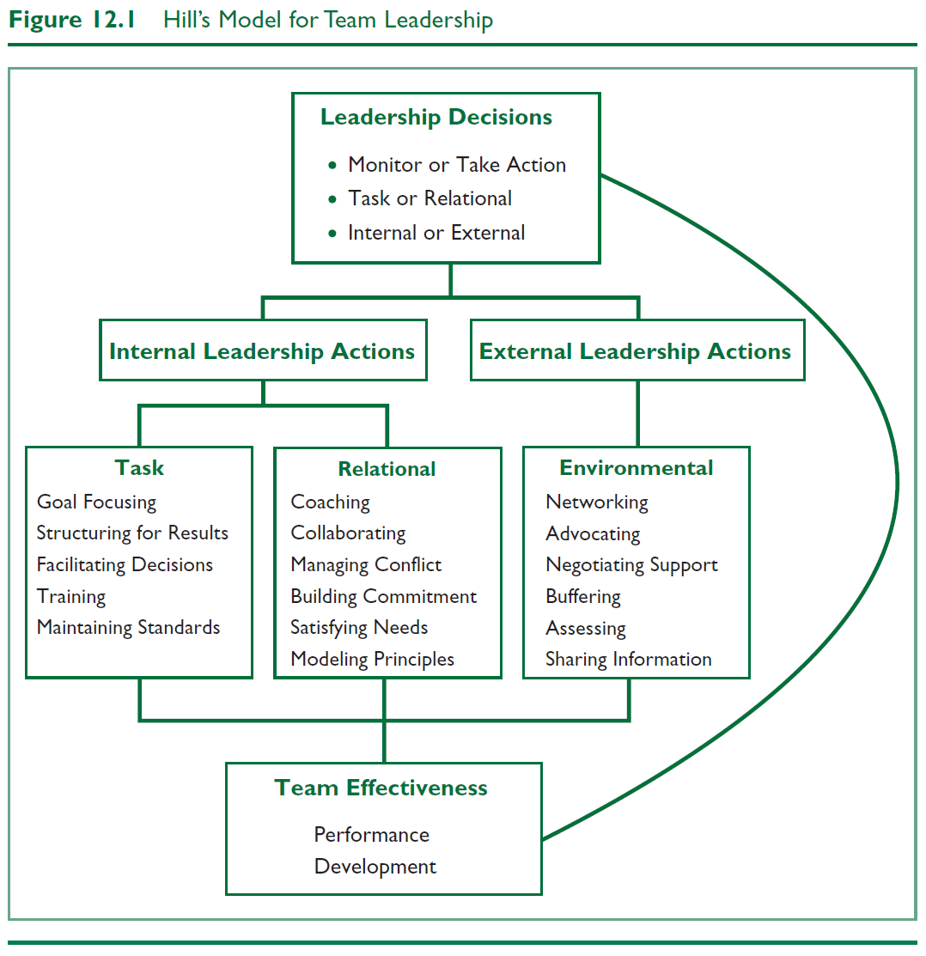
Hill’s Model for Team Leadership

Slide 8
Leadership Decision 1
Should I Monitor the Team or Take Action?
Leaders can:
  Diagnose, analyze, or forecast problems (monitoring) or take immediate action to solve a problem
  Focus on problems within the group (internal) or which problems need intervention
  Make choices about which solutions are the most appropriate
Effective leaders have the ability to determine what interventions are needed, if any, to solve team problems
All members of the team can engage in monitoring
Leaders differ in timing of taking action

Slide 9
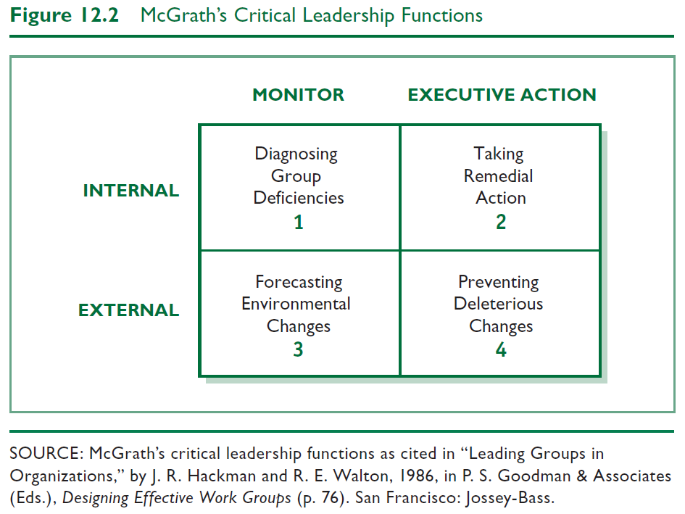
Leadership Decision 1

Slide 10
Leadership Decision 2
Should I Intervene to Meet Task or Relational Needs?
Task
Getting job done
Making decisions
Solving problems
Adapting to change
Making plans
Achieving goals
Maintenance Functions
Developing positive climate
Solving interpersonal problems
Satisfying members’ needs
Developing cohesion
Even more challenging in virtual teams

Slide 11
Leadership Decision 3
Should I Intervene Internally or Externally?
Leader must:
  Determine what level of team process needs leadership attention:
  Internal task or relational team dynamics, if:
    Conflict between group members
    Team goals unclear
  External environmental dynamics, if:
    Organization not providing proper support to team

Slide 12
Leadership Actions
Leadership Functions – performed internally or externally
Internal Leadership Actions
External Leadership Actions
Task
Goal focusing
Structuring for results
Facilitating decision making
Training
Maintaining standards
Relational
Coaching
Collaborating
Managing conflict
Building commitment
Satisfying needs
Modeling principles
Environmental
Networking
Advocating
Negotiating support
Buffering
Assessing
Sharing information

Slide 13
Internal Task Leadership Actions
Set of skills or actions leader might perform to improve task performance:
  Goal focusing (clarifying, gaining agreement)
  Structuring for results (planning, visioning, organizing, clarifying roles, delegating)
  Facilitating decision making (informing, controlling, coordinating, mediating, synthesizing, issue focusing)
  Training team members in task skills (educating, developing)
  Maintaining standards of excellence (assessing team and individual performance, confronting inadequate performance)

Slide 14
Internal Relational Leadership Actions
Set of actions leader needs to implement to improve team relationships:
  Coaching team members in interpersonal skills
  Collaborating (including, involving)
  Managing conflict and power issues (avoiding confrontation, questioning ideas)
  Building commitment and esprit de corps (being optimistic, innovating, envisioning, socializing, rewarding, recognizing)
  Satisfying individual member needs (trusting, supporting, advocating)
  Modeling ethical and principled practices (fair, consistent, normative)

Slide 15
External Environmental Leadership Actions
Set of skills or behaviors leader needs to implement to improve environmental interface with team:
  Networking and forming alliances in environment (gather information, increase influence)
  Advocating and representing team to environment
  Negotiating upward to secure necessary resources, support, and recognition for team
  Buffering team members from environmental distractions
  Assessing environmental indicators of team’s effectiveness (surveys, evaluations, performance indicators)
  Sharing relevant environmental information with team

Slide 16
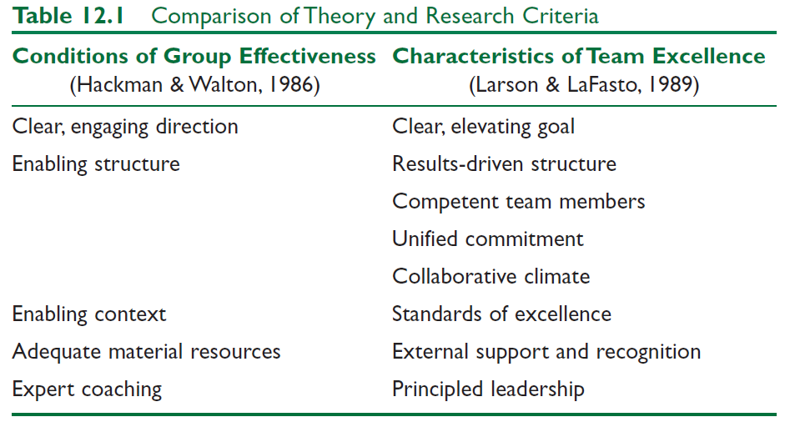
Team Effectiveness

Slide 17
Team Effectiveness
Clear, Elevating Goal
  Clear so that one can tell if performance objective has been met
  Motivating or involving so that members believe it is worthwhile and important
Results-Driven Structure
  Need to find the best structure to achieve goals
    Clear team member roles
    Good communication system
    Methods to assess individual performance
    An emphasis on fact-based judgments

Slide 18
Team Effectiveness
Competent Team Members
  Components
    Right number and mix of members
    Members must be provided:
      Sufficient information
      Education and training
    Requisite technical skills
    Interpersonal & teamwork skills
  Team Factors
    Openness
    Supportiveness
    Action orientation
    Positive personal style
  Core Competencies
  Ability to do the job well
  Problem solving ability

Slide 19
Team Effectiveness
Unified Commitment
Teams need a carefully designed and developed sense of unity or identification (team spirit)
Collaborative Climate
Trust based on openness, honesty, consistency, and respect
Integration of individual actions
Teams contribute to collective success by:
    Coordinating individual contributions
    Team leaders making communication safe
    Team leaders demanding and rewarding collaborative behavior
    Team leaders guiding the team’s problem-solving efforts
    Team leaders managing their own control needs

Slide 20
Team Effectiveness
Standards of Excellence
  Regulated Performance
    Facilitates task completion and coordinated action
    Stimulates a positive pressure for members to perform at highest levels
  How Accomplished
    Requiring results (clear expectations)
    Reviewing results (feedback/resolve issues)
    Rewarding results (acknowledge superior performance)

Slide 21
Team Effectiveness
External Support and Recognition
  Regulated Performance
  Teams supported by external resources are:
      Given the material resources needed to do their jobs
      Recognized for team accomplishments
      Rewarded by tying those rewards to team members performance, not individual achievement

Slide 22
Principled Leadership influences team effectiveness through four sets of processes (Zaccaro et al., 2001)
    Cognitive - Facilitates team’s understanding of problems confronting them
    Motivational - Helps team become cohesive & capable by setting high performance standards & helping team to achieve them
    Affective - Assists team in handling stressful circumstances by providing clear goals, assignments, & strategies
    Integrative - Helps coordinate team’s activities through matching member roles, clear performance strategies, feedback, & adapting to environmental changes

Slide 23
How Does the Team Leadership Approach Work?
Focus of Team Leadership
Strengths
Criticisms
Application

Slide 24
Team Leadership
Model provides a cognitive map to identify group needs and offers suggestions on appropriate corrective actions
Model assists leader in making sense of the complexity of groups and provides suggested actions to improve group effectiveness

Slide 25
Strengths
Provides answers to what constitutes excellent teams
Provides a cognitive guide that assists leaders in designing and maintaining effective teams
Recognizes the changing role of leaders and followers in organizations
Can be used as a tool in group leader selection

Slide 26
Criticisms
Model is incomplete. Additional skills might be needed
May not be practical as the model is complex and doesn’t provide easy answers for difficult leader decisions
Fails to consider teams that have distributed leadership, where team members have a range of skills, and where roles may change
More focus required on how to teach and provide skill development in areas of diagnosis and action taking

Slide 27
Application
Useful in leader decision making
Can be used as a team diagnostic tool

