Slide 1
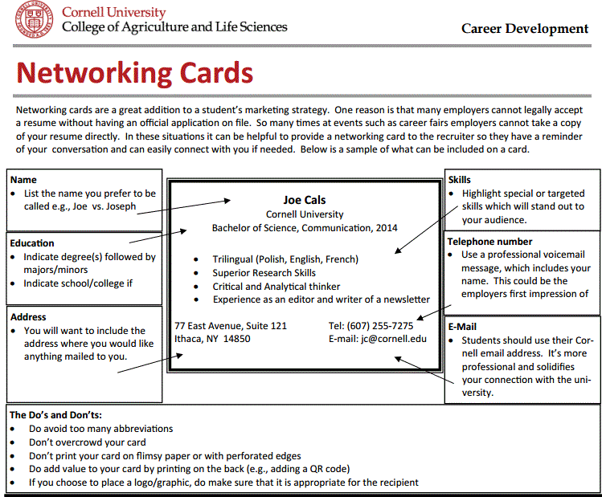
NETWORKING CARD

Slide 2

NETWORKING CARD

