Slide 1
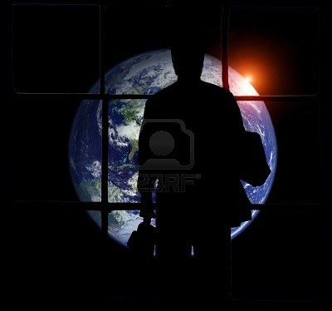
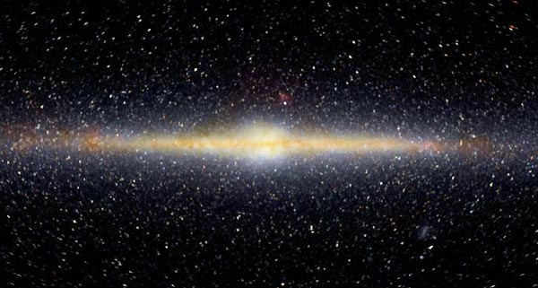
Astrophysics and Cosmology
  Dr. Russell Herman
  Physics and Physical Oceanography, UNCW
  Mathematics and Statistics, UNCW

Slide 2
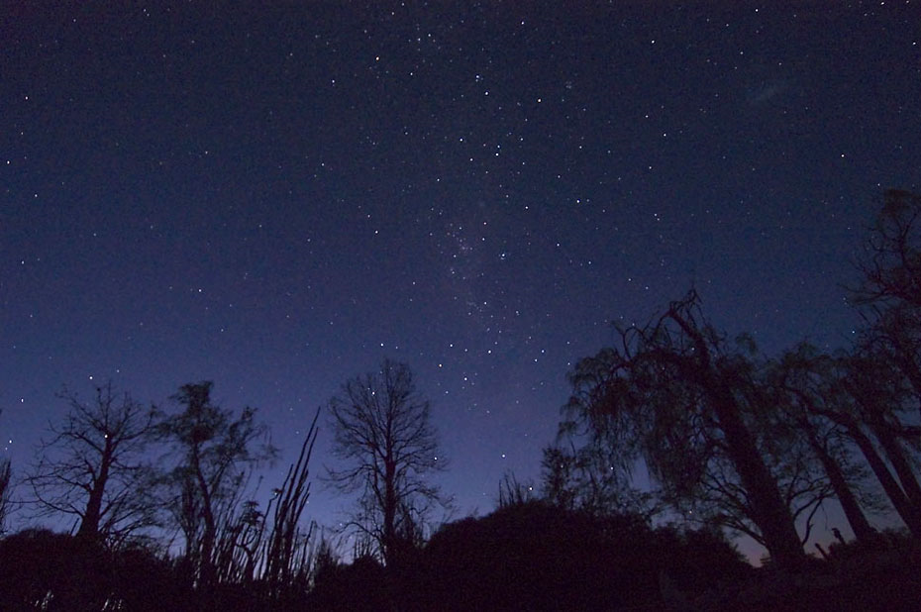
http://www.dimijianimages.com/More-p20-Madagascar-p7/night-sky-from-Madagascar-gallery.htm

Slide 3
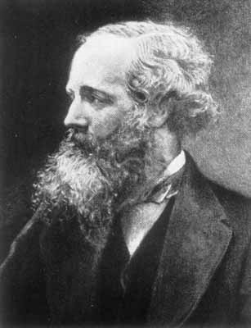
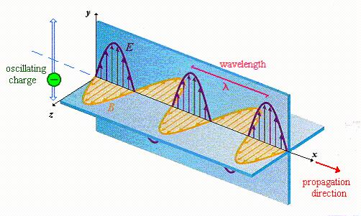
Electromagnetic Waves
James Clerk Maxwell (1831-1879)
- Theory of electromagnetism.
- Predicted the electromagnetic waves.
- Electromagnetic waves travel at
c = 299,792,458 m/s = 186,000 mi/s
Heinrich Hertz (1857-1894)
- sent the first radio waves (1888)
What is the medium?
Luminiferous Aether
Michelson-Morley (1887)
- could not detect it.

Slide 4
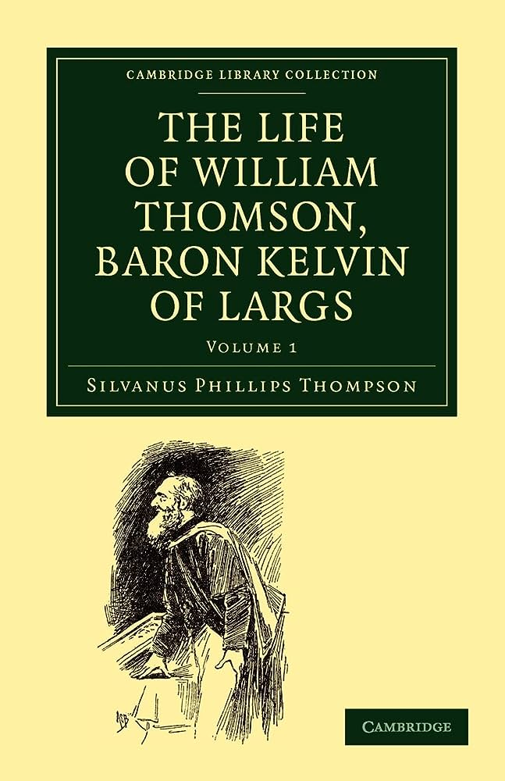
From Faraday to Heaviside

Slide 5

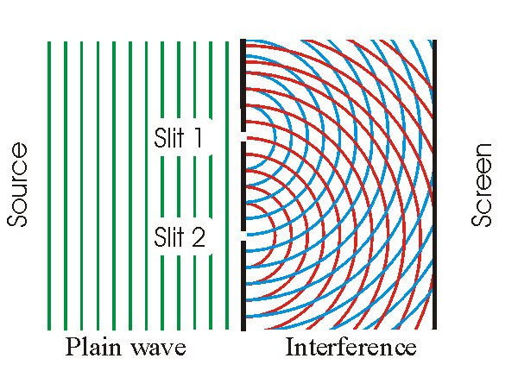
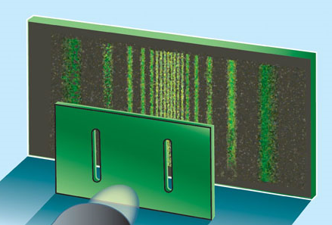
Waves
Characteristics
  Wavelength
  Frequency
  Wavespeed
Behavior
  Superposition
  Interference
  Diffraction

Slide 6
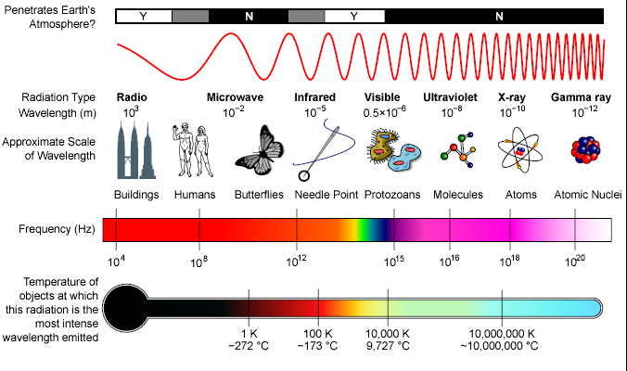
EM Spectrum
http://en.wikipedia.org/wiki/Electromagnetic_spectrum

Slide 7
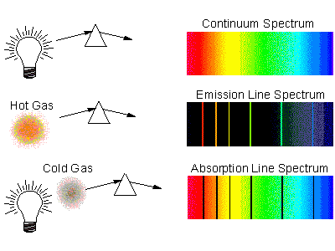
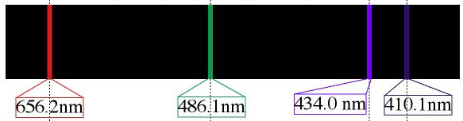
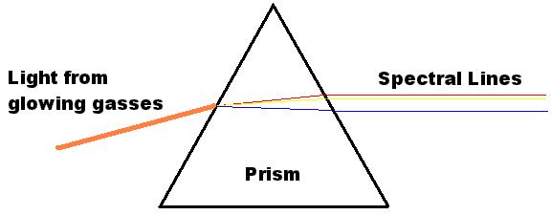
Spectroscopy
Ionized gas gives off radiation
Johann Balmer 1885
Spectral Lines: Hydrogen
410, 434, 486, 656 nm
Empirical Formula:
λ = R (1/4 – 1/n²)
Predicted 5th-7th lines
Lyman and Paschen Series

Slide 8
  Reaching for the Stars

Slide 9
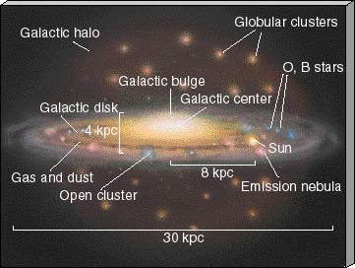
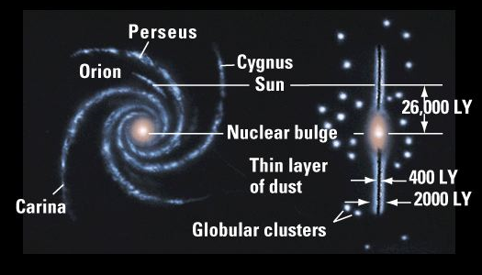
The Milky Way
4x10¹¹ stars
>6x10¹¹ sun mass
M_{ave} = 0.3 sun
How do we know?
http://zebu.uoregon.edu/~imamura/123/lecture-2/lecture-2.html

Slide 10
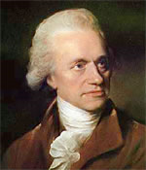
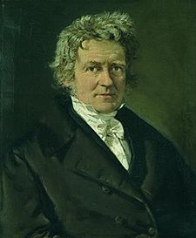
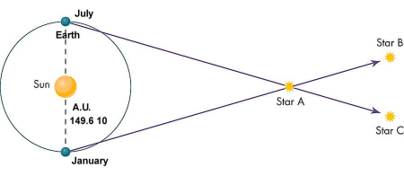
Distances & the Milky Way Galaxy
Frederick William Herschel (1738-1822)
  Built telescopes, discovered Uranus
  Measured stellar distances
  Stars distributed in a pancake shape – Milky Way
  1000 siriometers x 100 siriometers
  Asteroids, infrared radiation ...
Friedrich Wilhelm Bessel (1784-1846) – 28 years
  Established stellar distances using parallax

Slide 11
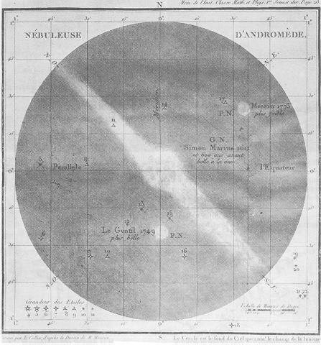
The Search for Nebulae
Charles Messier (1730-1817)
  Catalog of 103
    Crab Nebulae M1
    Andromeda N. M31
Are they in Milky Way or beyond?
William/Caroline Hershel
  Cataloged 2500 nebulae
  Sited a star in some
  – perhaps solar system birth
  Therefore, in Milky Way
Immanuel Kant (1724-1804)
  Believed nebulae (island universes) were beyond Milky Way
  Messier Catalog http://www.seds.org/MESSIER/data2.html

Slide 12

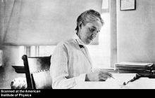
Stellar Spectra
Joseph Fraunhofer (1787-1826)
  Dark lines in Sun's spectrum
Christian Doppler (1803-1853)
  Moving objects – shift in wavelength
Vesto Slipher (1875-1969)
  Discovered red shift in spiral nebulae
Henrietta Leavitt (1868-1921)
  Cepheid variables, better distances

Slide 13
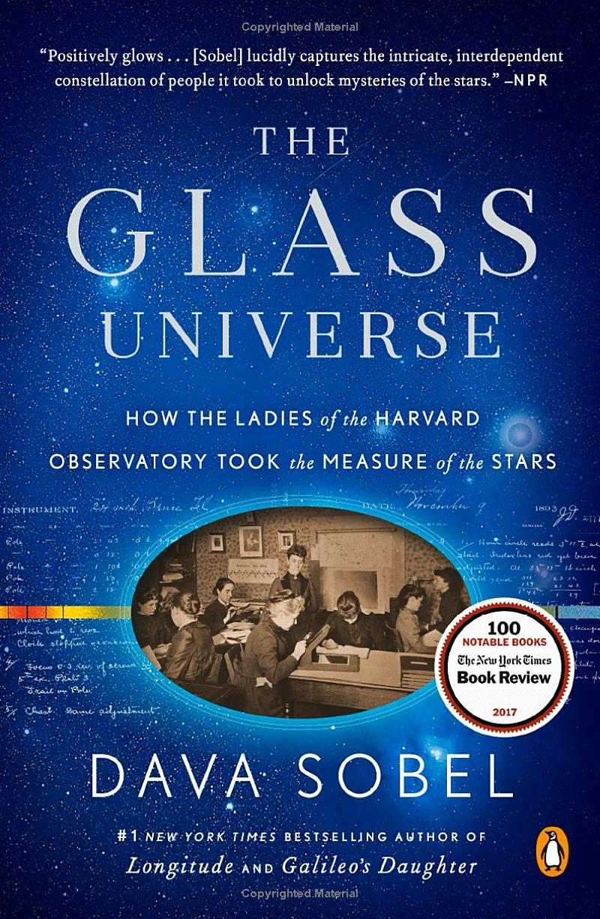

Harvard Computers
Henry Draper (1837-1882)
photography – picked up by
Edward Charles Pickering
(1846-1919) – images of over
220,000 stars
Stellar classification with
Williamina Fleming and
Annie Jump Cannon
> 80 Harvard Computers, including Henrietta Leavitt

Slide 14
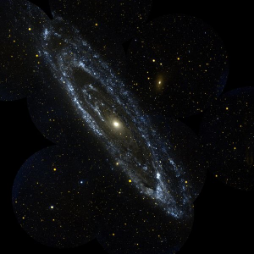
“The Great Debate”Shapley-Curtis Debate - 1920
Are distant nebulae relatively small and within our galaxy,
or are they large, independent galaxies?
Harlow Shapley (1885-1972)
  Nebulae part of galaxy
  Sun in outer regions of galaxy
Herbert Doust Curtis (1872-1942)
  Nebulae outside galaxy
  Sun at center
Walter Baade (1893-1960) – Milky Way is typical galaxy!
http://en.wikipedia.org/wiki/Image:Andromeda_galaxy.jpg

Slide 15


Why is the night sky dark?
Before leaving the skies ....
Olber's Paradox - 1823
Assumptions:
Universe is infinite.
Stars are uniformly distributed in all directions.
Universe was and always will be around.
Consequence:
Every line of sight would cross a star, and
the night sky should be lit up in all directions!
http://en.wikipedia.org/wiki/Olbers'_paradox

Slide 16
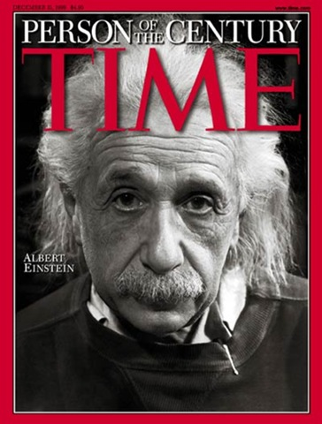
  The Birth of Cosmology

Slide 17
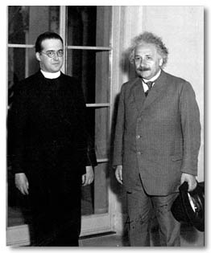
Pre-Modern Cosmology
1915 General Relativity
1916 Schwarschild
1917 Einstein Model
1922 Friedman
1927 Lemaitre
1929 Hubble
1932 Einstein-de Sitter
1948 Gamow - CMB
1950 Hoyle – Steady State
1965 Penzias and Wilson - CMB
Lemaitre and Einstein
http://www.catholiceducation.org/articles/science/sc0022.html

Slide 18
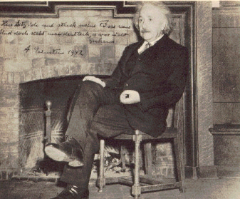
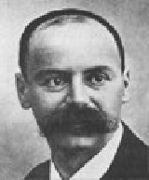
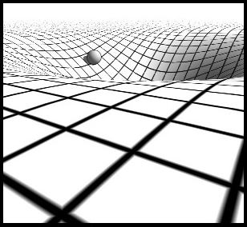
General Relativity
Einstein - 1915
  Newton's gravitational attraction replaced
  Curvature of spacetime tells bodies how to move
  Bodies tell spacetime how to curve
Karl Schwarzschild (1873-1916)
  Papers on spherical solution sent from WWI front
  Einstein presented Feb 24, 1916

Slide 19
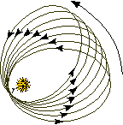
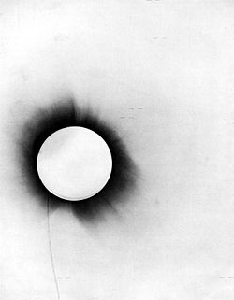
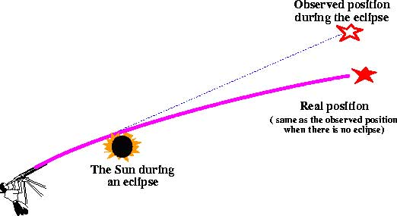
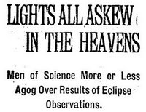
Testing of General Relativity
New Theories need to derive known results & predict new results
Mercury's Orbit Precession
  1858 Urbain Le Verrier – 531/574 arcsec/century
  Nov 18, 1915 Einstein – GR gives 574!
Bending of Light
  Erwin Freundlich – 1912
    Crimea – Aug 21, 1914
  Sir Arthur Eddington
    Brazil – May 29, 1919

Slide 20
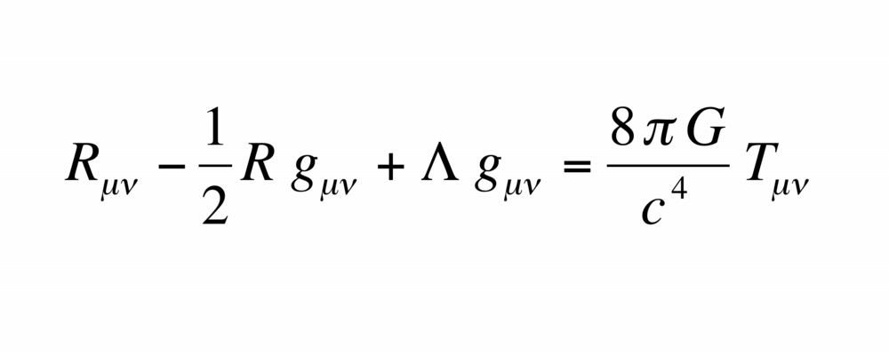
1917- Cosmological Considerations
Cosmological Considerations of the General Theory of Relativity, Einstein
  Cosmological Principle
    The universe is the same everywhere
  Homogeneous
    The universe looks the same from every point
  Isotropic
    The universe looks the same in every direction
Einstein's Model – Not Static!
  All bodies attract leading to collapse – unstable universe!
Fudge Factor - “his greatest blunder”
  Einstein adds cosmological constant, Λ
  Provides a repulsion of masses

Slide 21
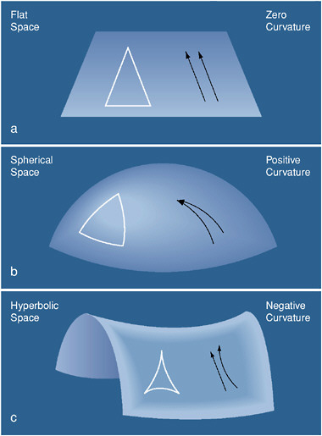
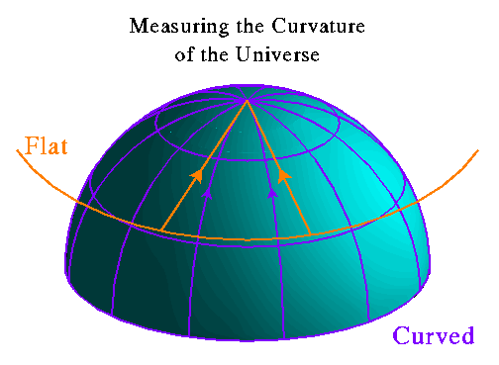

Curved Space

Slide 22
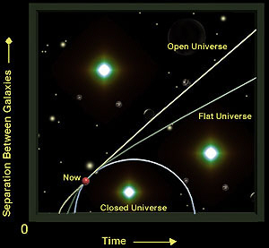
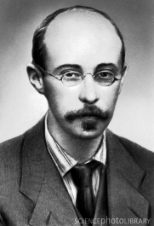

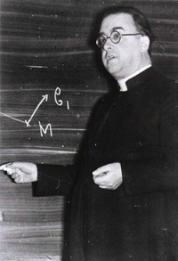
Cosmology Theories
Aleksandr Friedmann (1888-1925) - 1922
  Gave universe an initial kick
  Initial density scenarios
  Low density – forever expands
  High density – re-contracts
  Critical density – slows without halting
George Lemaitre (1894-1966) - 1927
  Physicist and Priest, worked with Eddington
  Rederived Friedmann's work
  Consequence - traced back in time to moment of creation
  Proposed cosmic rays came from early universe

Slide 23
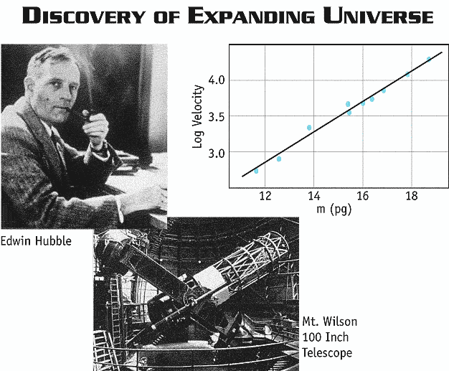
Edwin Powell Hubble (1889-1953)
http://map.gsfc.nasa.gov/media/ContentMedia/990044b.gif

Slide 24
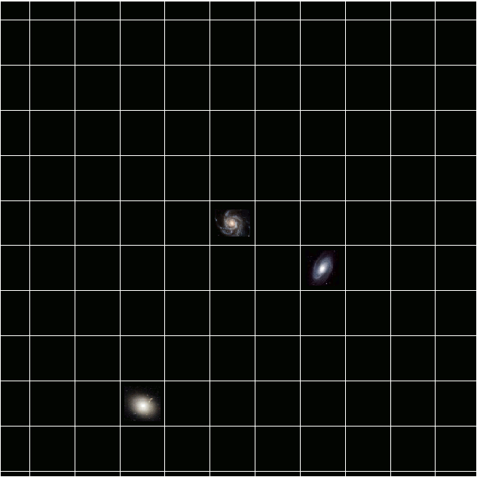
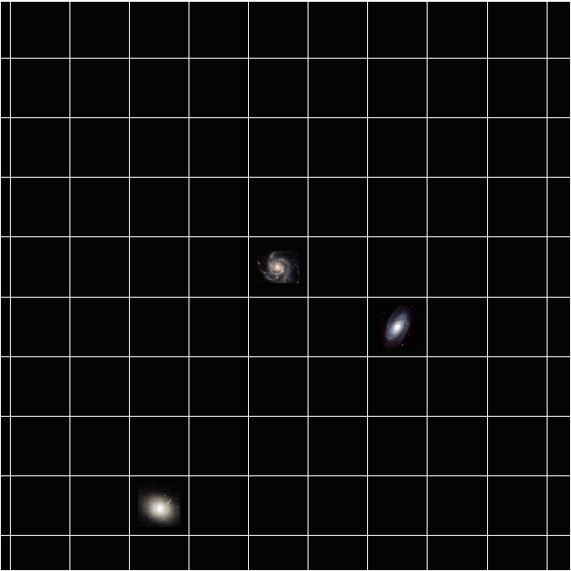
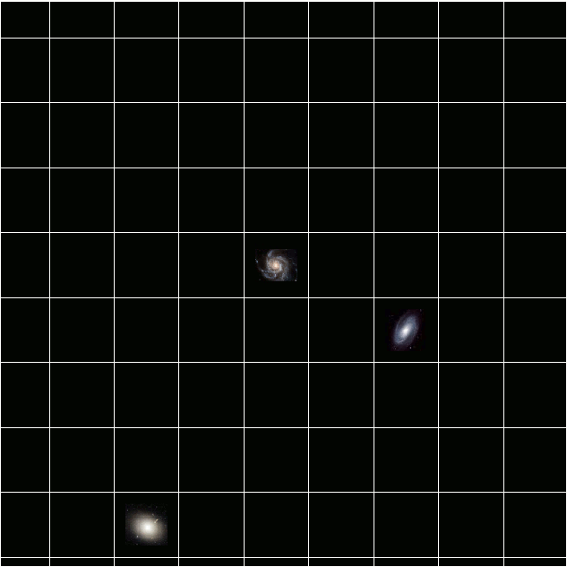
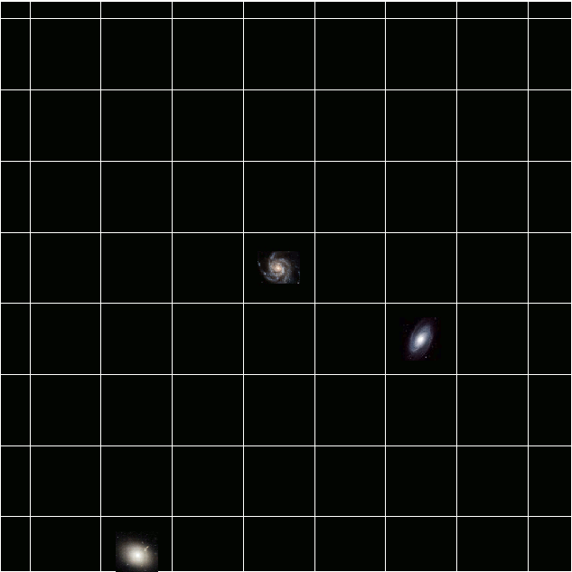
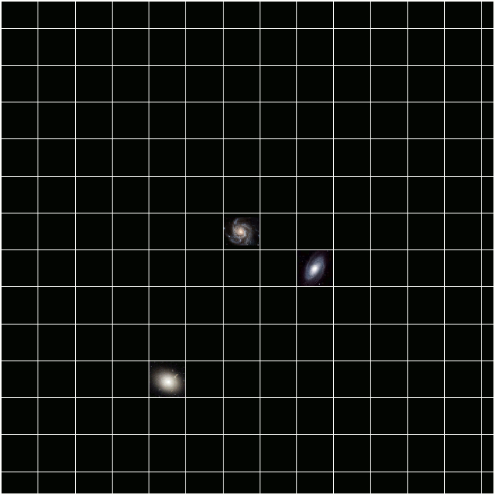
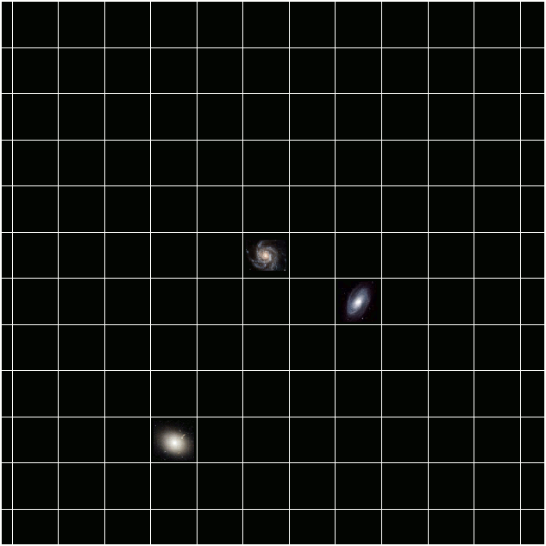
Expanding Spacetime

Slide 25
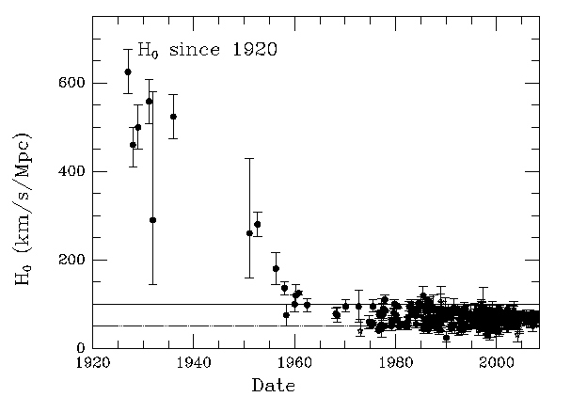
H0 and the Age of the Universe
Age = 1/H₀ = 1/500 km/s/Mpc = 2 billion yrs
BUT – 1930 - Geologists, “Earth 3 billion yrs old!”
http://cfa-www.harvard.edu/~huchra/hubble/

Slide 26
Age of Universe
Current Value H₀: 72 +/- 8 km/s/Mpc
1 Mpc = 3.086 x 10²² m
1 km/s/Mpc = 3.24 x 10⁻²⁰ 1/s
1/H₀ = 4.286 x 10¹⁷ s
= 13.6 Gyr
WMAP – 13.7 +/- 0.13 Gyr
If flat and matter dominated – 2/(3H₀) – 9 Gyr

Slide 27
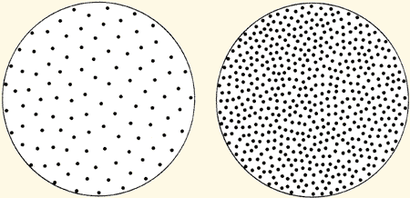
Big Bang vs Steady State Models
Gamow, Alpher, Herman - 1948
Expansion and cooling of universe
Initial state - infinite density and temperature.
"Ylem" = protons, neutrons, and electrons in an ocean of radiation.
Computer calculation of nuclear processes
Gave off radiation => the universe is now 5K
Hoyle, Bondi, Gold - 1950
In a steady state universe the density would remain constant.
1 – Age of Universe
2 - The rate of expansion of the universe.
Big Bang - rate would slow
Steady State-rate would remain constant.
http://www.aip.org/history/cosmology/ideas/bigbang.htm

Slide 28
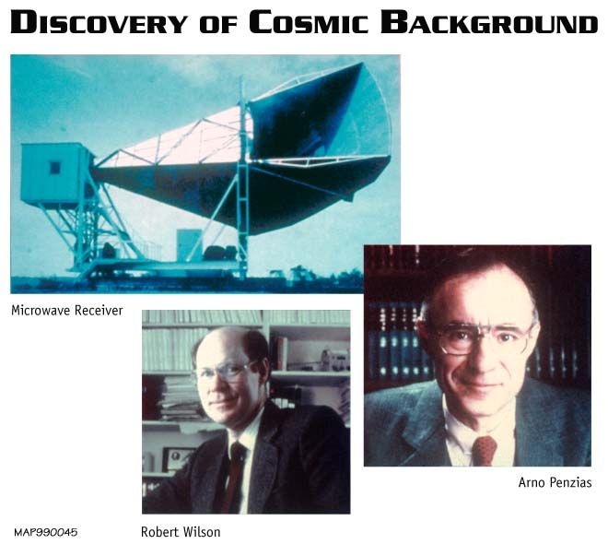
Arno Penzias and Robert Wilson - 1965
http://www.jca.umbc.edu/~george/images/cosmology/penzias_wilson_pic.jpg

Slide 29
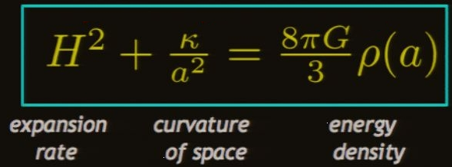
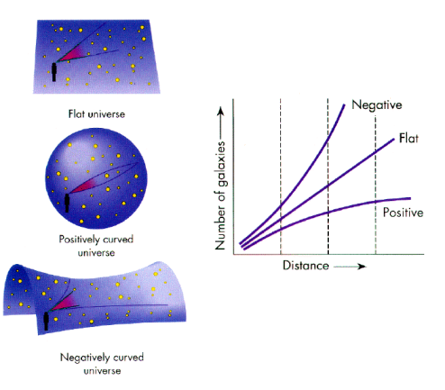
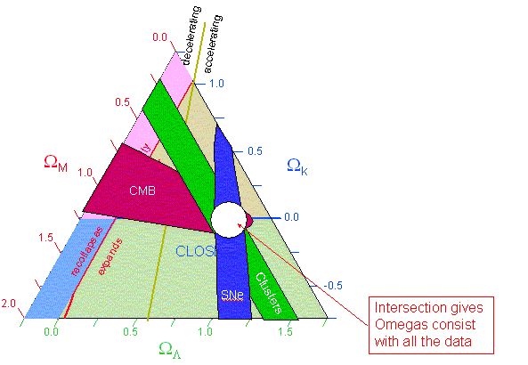
Nature of Expansion
What drives expansion?
Is it constant, increasing, decreasing?
What is the geometry?

Slide 30
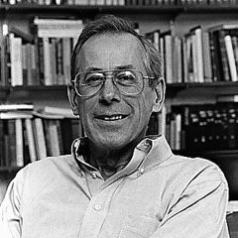
Formation of Galaxies and Clusters
James Peebles
CMB Photons came from opaque wall
Abundances of He, Deuterium depend on present density of baryons
Formation of Structure
  After decoupling of photons from baryons
  Gravitational collapse starts 300,000 yrs
  After inflationary period
Seek fluctuations in CMB

Slide 31

Cosmic Microwave Background
http://www.space.com/scienceastronomy/map_mission_basics_030211.html

Slide 32


COBE - 1991
Detected fluctuations (anisotopies)
2006 Nobel
John Mather and George Smoot
"for their discovery of the blackbody form and anisotropy of the cosmic microwave background radiation"
http://lambda.gsfc.nasa.gov/product/cobe/

Slide 33


BOOMERanG
Balloon Observations Of Millimetric Extragalactic Radiation and Geophysics
2000 – Universe is flat!
30% Matter (5% Baryonic)
http://science.nasa.gov/science-news/science-at-nasa/2000/ast27apr_1/

Slide 34


WMAP – launched 2001
Wilkinson Microwave Anisotropy Probe
7 yrs of data
Fine resolution full sky map
Age 13.73 +/- 1%
Flat within 1%
Ordinary atom 4.6%
Dark Matter 23.3%
Dark Energy 73.1%

Slide 35

  The New Cosmology

Slide 36

Galaxies
Stars mostly at center
Circling center
Orbital speed greater at center
Speed vs distance decreases

Slide 37



Dark Matter
Fritz Zwicky, 1933
  Coma Cluster – galaxies moving too fast!
  Mass 100x too little
  Must be dark matter
Vera Rubin & Kent Ford, 1970 M31
Dark Halos
Galaxies embedded in spherical cloud of DM
Hot vs Cold DM
Candidates – Neutrinos, WIMPs, supersymmetric particles ...

Slide 38



Coma Cluster
How do we see dark matter?

Slide 39


Gravitational Lensing

Slide 40

Colliding Galaxies

Slide 41


The Energy of Empty Space – Dark energy
Saul Perlmutter, Adam Riess, Brian Schmidt
1998 – Expansion is accelerating!
In 1998, published observations of Type Ia supernovae ("one-A") by the High-z Supernova Search Team followed in 1999 by the Supernova Cosmology Project suggested that the expansion of the universe is accelerating. This work was awarded by the Nobel Prize in Physics in 2011.

