Slide 1
Creating and
Managing Change
Chapter 18
McGraw-Hill/Irwin
Copyright © 2011 by the McGraw-Hill Companies, Inc. All rights reserved.

Slide 2
Learning Objectives
LO 1 Discuss what it takes to be world class
LO 2 Describe how to manage change successfully
LO 3 List tactics for creating a successful future
Notes:
What does change mean to you?

Slide 3

Becoming World Class
Being world class requires applying the best and latest knowledge and ideas and having the ability to operate at the highest standards of any place anywhere
World-class companies create high-value products and earn superior profits over the long run
The result is an organization capable of competing successfully on a global basis

Slide 4
Sustainable, Great Features
Great companies
  Have strong core values
  Are driven by goals
  Change continuously
  Focus on beating themselves, not on beating the competition
Notes:
Jack Nicholas in golf always tried to do his best. Strong believer in visualization.

Slide 5
The Genius of the And
Genius of the and; organizational ambidexterity
  Ability to achieve multiple objectives simultaneously.
Examples
  Purpose beyond profit and pragmatic pursuit of profit
  Relatively fixed core values and vigorous change and movement
  Clear vision and direction and experimentation
Notes:
Accomplish a lot

Slide 6
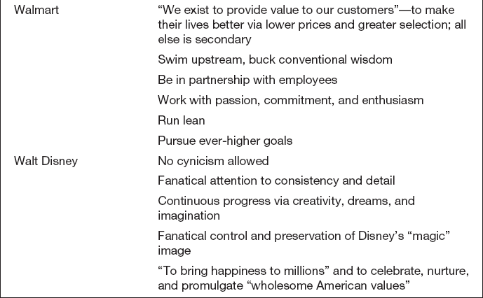
Core Ideologies in Built-to-Last Companies
Table 18.1
Notes:
No killer statements i.e. we’ve never done it that way. Stick to their knitting( peters)

Slide 7
Organization Development
Organization development (OD)
  The system wide application of behavioral science knowledge to develop, improve, and reinforce the strategies, structures, and processes that lead to organizational
  effectiveness.

Slide 8
Organization Development
Strategic interventions,
  helping organizations conduct mergers and acquisitions, change their strategies, and develop alliances
Technostructural interventions
  relating to organization structure and design, employee involvement, and work design

Slide 9
Organization Development
Human resources management interventions
  Attracting good people, setting goals, and appraising and rewarding performance
Human process interventions
  Conflict resolution, team building, communication, and leadership.

Slide 10
Achieving Greatness
Strategy
  focused on customers, continually fine-tuned based on marketplace changes, and clearly communicated to employees.
Execution
  good people, with decision-making authority on the front lines, doing quality work and cutting costs.
Notes:
Add these to your management bookas items you strive for in a company

Slide 11
Achieving Greatness
Culture
  one that motivates, empowers people to innovate, rewards people appropriately, entails strong values, challenges people, and provides a satisfying work environment
Notes:
What is the culture of UNC W.? What was the culture of your high school? Where is the culture of your fraternity? Your business

Slide 12
Achieving Greatness
Structure
  making the organization easy to work in and easy to work with, characterized by cooperation and the exchange of information and knowledge throughout the organization
Notes:
Fortune Magazine’s best companies to work for

Slide 13
Ex. 8.1 Model of Change Sequence of Events
0
Environmental
Forces
Monitor global competition,
customers, competitors,
and other factors.
Need for
Change
Initiate
Change
Implement
Change
Evaluate problems and
opportunities, define
needed changes in
technology, products,
structure, and culture.
Facilitate search,
creativity, idea
champions, skunkworks,
and idea incubators.
Use force-field
analysis, tactics for
overcoming
resistance.
Internal Forces
Consider plans, goals,
company problems, and
needs.

Slide 14
Managing Change
Shared leadership is crucial to the success of most change efforts—people must be not just supporters of change but also implementers
Change agents
  People who create change
Notes:
Wwhat are the steps to create change

Slide 15
Motivating People to Change
General reasons for resistance
  Inertia
  Timing
  Surprise
  Peer pressure
Notes:
Why are people resistant to change?WIIFM

Slide 16
Motivating People to Change
Change-specific reasons for resistance
  Self-interest
  Misunderstanding
  Different assessments
  Management tactics

Slide 17
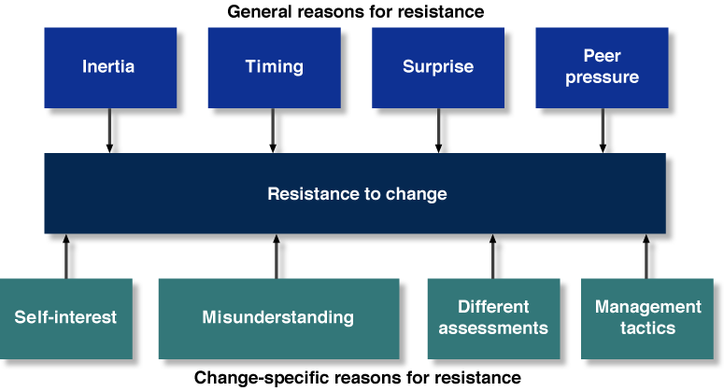
Reasons for Resistance to Change
Figure 18.1

Slide 18
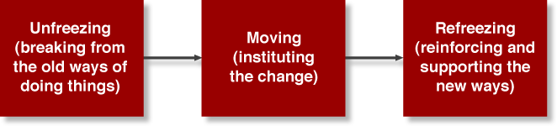
Motivating People to Change
Figure 18.2

Slide 19
A General Model for Managing Resistance
Unfreezing
  Realizing that current practices are inappropriate and that new behavior is necessary
Performance gap
  The difference between actual performance and desired performance.

Slide 20

A General Model for Managing Resistance
Moving
  Instituting the change
Refreezing
  Strengthening the new behaviors that support the change

Slide 21
Force-field Analysis
Force-field analysis
  An approach to implementing the unfreezing/ moving/refreezing model by identifying the forces that prevent people from changing and those that will drive people toward change
Notes:
Do the hand push exercise here

Slide 22
Specific Approaches to Enlist Cooperation
Education and communication
Participation and involvement
Facilitation and support
Negotiation and rewards
Manipulation and cooptation
Explicit and implicit coercion
Notes:
Need to explain the whowhat when where why and how

Slide 23
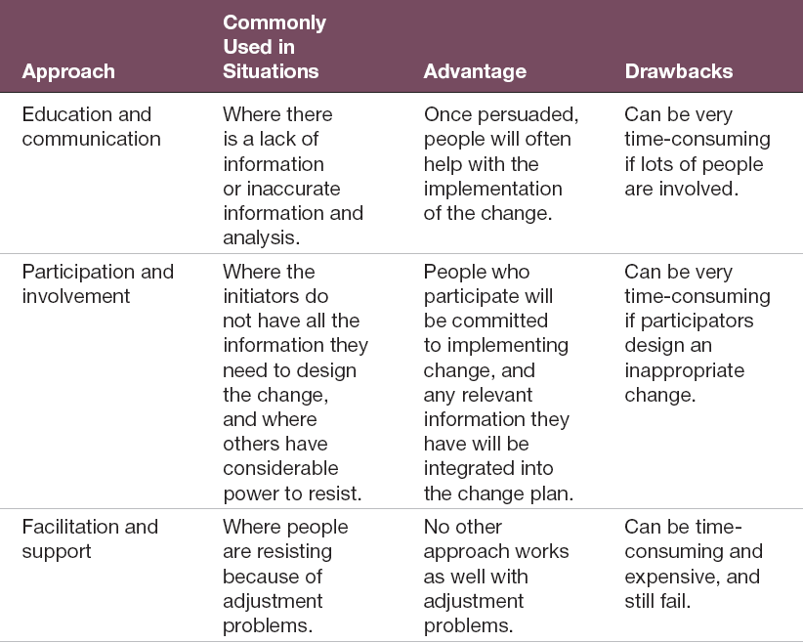
Methods for Managing Resistance to Change
Table 18.2

Slide 24
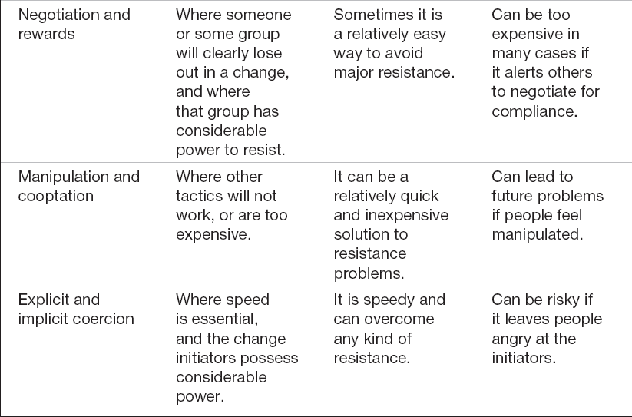
Methods for Managing Resistance to Change
Table 18.2

Slide 25
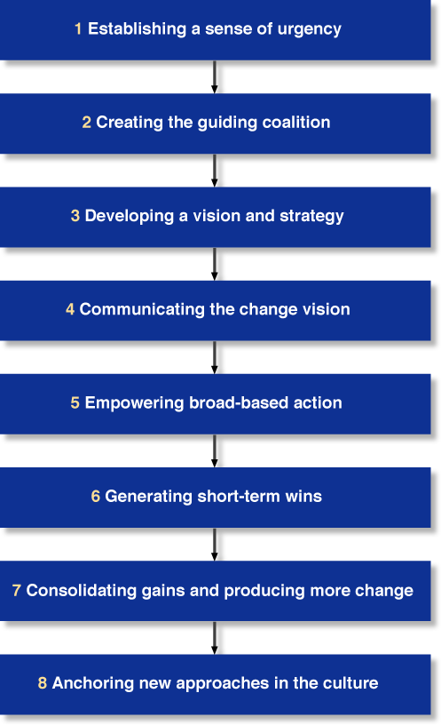
Leading Change
Figure 18.3

Slide 26
13 tips
EDUCATE
SYSTEM
TEAMS
EMPOWER
PLAN
RECOGNIZE TENSION
TRAIN

Slide 27
13 TIPS
RESEARCH
EMOTIONS
ANTICIPATE PROBLEMS
INTELLECTUAL WHY
IDEA CHAMPIONS
LONG VIEW

Slide 28
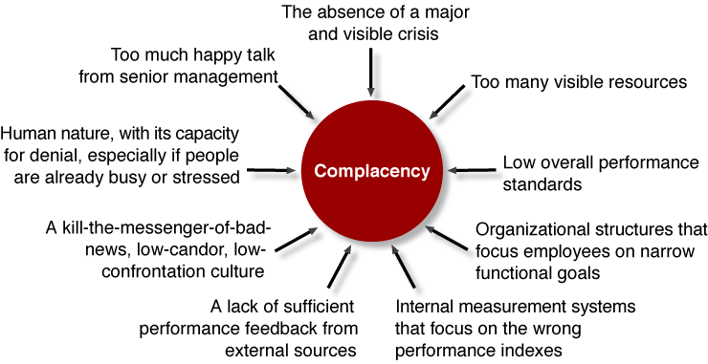
Sources of Complacency
Figure 18.4

Slide 29
Shaping the Future
Reactive change
  A response that occurs under pressure; problem driven change.
Proactive change
  A response that is initiated before a performance gap has occurred.
Notes:
Forced or a vision

Slide 30
Creating the Future
Adapters
  Companies that take the current industry structure and its evolution as givens, and choose where to compete
Shapers
  Companies that try to change the structure of their industries, creating a future competitive landscape of their own design.

Slide 31
What Should You and Your Firm Do?
Preserve old advantages or create new advantages?
Lock in old markets or create new markets?
Take the path of greatest familiarity or the path of greatest opportunity?
Be only a benchmarker or a pathbreaker?

Slide 32
What Should You and Your Firm Do?
Place priority on short-term financial returns or on making a real, long-term impact?
Do only what seems doable or what is difficult and worthwhile?
Change what is or create what isn’t?
Look to the past or live for the future?

Slide 33
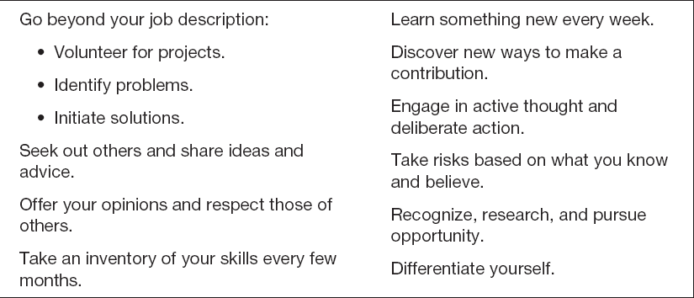
Adding Value, Personally
Table 18.3

Slide 34
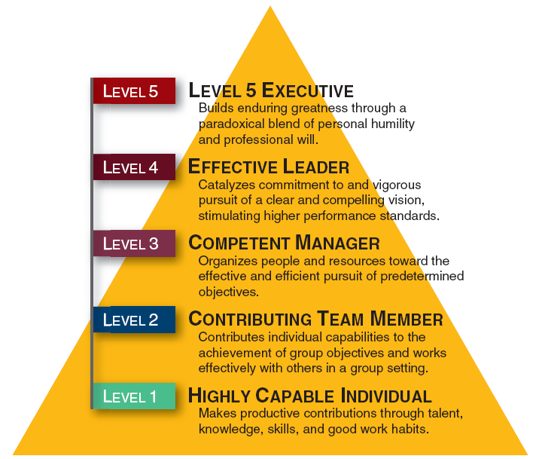
Level 5 Hierarchy
Figure 18.7

