Slide 1
Teamwork
Chapter 14
McGraw-Hill/Irwin
Copyright © 2011 by the McGraw-Hill Companies, Inc. All rights reserved.

Slide 2
Learning Objectives
LO 1 Discuss how teams can contribute to an organization’s effectiveness
LO 2 Distinguish the new team environment from that of traditional work groups
LO 3 Summarize how groups become teams
LO 4 Explain why groups sometimes fail
LO 5 Describe how to build an effective team
LO 6 List methods for managing a team’s relationships with other teams
LO 7 Identify ways to manage conflict

Slide 3

The Contributions of Teams
Building blocks for organizational structure
Increase quality and productivity while reducing costs
Enhance speed and be powerful forces for innovation and change
SYNERGY
Notes:
BRAINSTORM

Slide 4
The New Team Environment
Team
  A small number of people with complementary skills who are committed to a common purpose, set of performance goals, and approach for which they hold themselves
  mutually accountable.
Notes:
Breakdown words
Purpose,
Goals
Skills
accountable

Slide 5
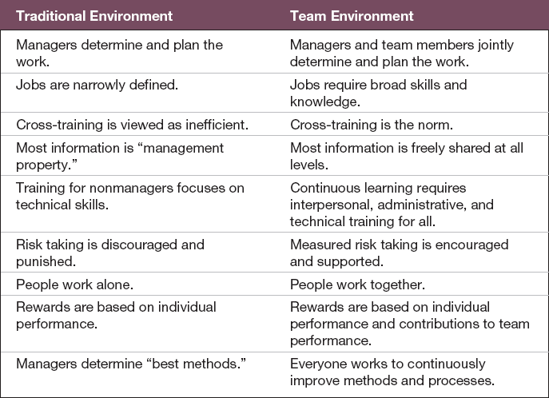
The New Team Environment
Table 14.1
Notes:
Cross departments—HR_FINANCE-accounting-marketing-sales

Slide 6
Ex. 14.2 Work Team Effectiveness Model
0

Slide 7
Team Characteristics
0
Size--
  Ideal size is thought to be 7.
  Variations of from 5 to 12 typically are associated with good team performance.
  Small teams (2-4 members) show more agreement, ask more questions.
  Large teams (12 or more) tend to have more disagreements.

Slide 8
Causes of Team Conflict
0
Scarce resources
Jurisdictional ambiguities
Communication breakdown
Personality clashes
Power and status differences
Goal differences
Slacker
Lack of Planning

Slide 9
Types of Teams
Work teams
  Teams that make or do things like manufacture, assemble, sell, or provide service.
Project and development teams
  Teams that work on long term projects but disband once the work is completed.

Slide 10
Types of Teams
Parallel teams
  Teams that operate separately from the regular work structure, and exist temporarily.

Slide 11
Types of Teams
Management teams
  Teams that coordinate and provide direction to the subunits under their jurisdiction and integrate work among subunits.

Slide 12
Types of Teams
Transnational teams
  Work groups composed of multinational members whose activities span multiple countries.
Virtual teams
  Teams that are physically dispersed and communicate electronically more than face-to-face.

Slide 13
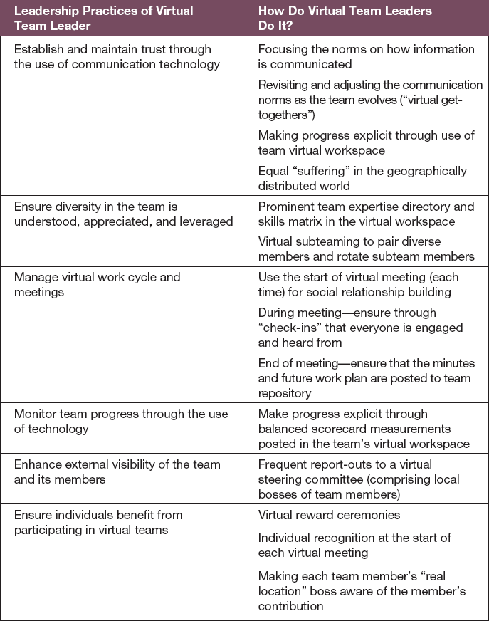
Practices of Effective Virtual
Team Leaders
Table 14.2

Slide 14
Self-Managed Teams
Self-managed teams
  Autonomous work groups in which workers are trained to do all or most of the jobs in a unit, have no immediate supervisor, and make decisions previously made by frontline supervisors.

Slide 15
Self-Managed Teams
Traditional work groups
  Groups that have no managerial responsibilities.
Quality circles
  Voluntary groups of people drawn from various production teams who make suggestions about quality.

Slide 16
Self-Managed Teams
Semiautonomous work groups
  Groups that make decisions about managing and carrying out major production activities but get outside support for quality control and maintenance.
Autonomous work groups
  Groups that control decisions about and execution of a complete range of tasks.

Slide 17
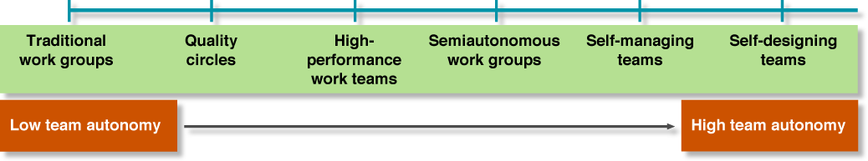
Team Autonomy Continuum
Figure 14.1

Slide 18
Group Activities
Forming
  group members attempt to lay the ground rules for what types of behavior are acceptable.
Storming
  hostilities and conflict arise, and people jockey for positions of power and status.
Notes:
What rules?
Slacker
Skills
Organization
Procrastinator vs get it done

Slide 19
Group Activities
Norming
  group members agree on their shared goals, and norms and closer relationships develop.
Performing
  the group channels its energies into performing its tasks.
  Rewards

Slide 20
Group Activities
Groups that deteriorate move to a declining stage, and temporary groups add an adjourning or terminating stage.
Groups terminate when they complete their task or when they disband due to failure or loss of interest

Slide 21
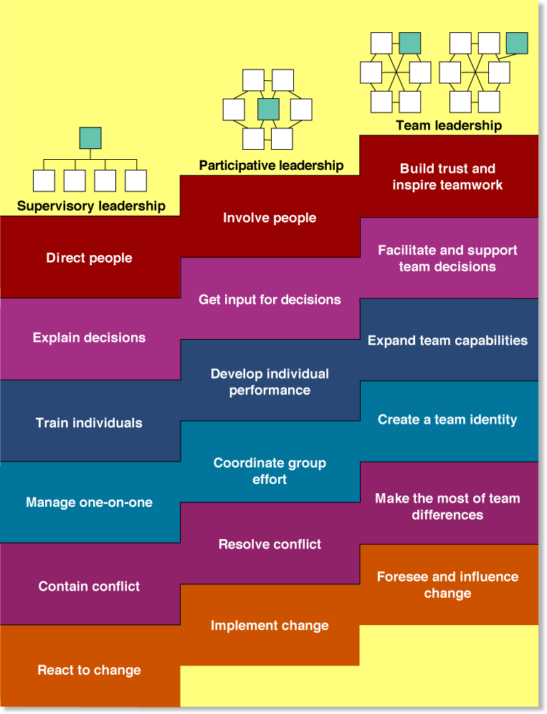
Stepping up to Team
Leadership
Figure 14.2
Notes:
Value to employer

Slide 22
Building Effective Teams
Team effectiveness is defined by three criteria:
Productive output of the team meets or exceeds standards of quantity and quality
Team members realize satisfaction of their personal needs and a job well done--grade
Team members remain committed to working together again

Slide 23
Motivating Teamwork
Social loafing
  Working less hard and being less productive when in a group.
  Better term?

Slide 24
Motivating Teamwork
Social facilitation effect
  Working harder when in a group than when working alone.
  Why?

Slide 25
Roles
Task specialist
  An individual who has more advanced job-related skills and abilities than other group members possess.
Team maintenance specialist
  Individual who develops and maintains team harmony.

Slide 26
Cohesiveness
Cohesiveness
  The degree to which a group is attractive to its members, members are motivated to remain in the group, and members influence one another.

Slide 27
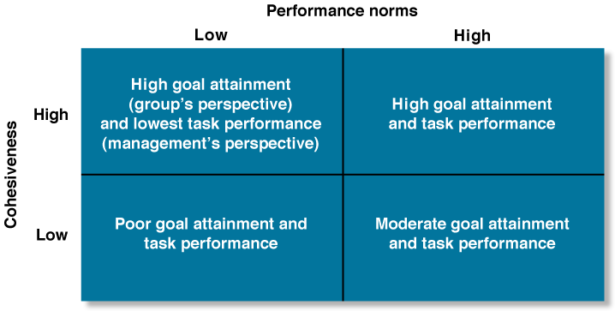
Cohesiveness, Performance Norms, and Group Performance
Figure 14.3
Notes:
Where do you fit?

Slide 28
Building Cohesiveness and High-Performance Norms
Recruit members with similar attitudes, values, and backgrounds
Maintain high entrance and socialization standards
Keep the team small
Help the team succeed, and publicize its successes
Be a participative leader
Present a challenge from outside the team.
Tie rewards to team performance
Notes:
Visualize what?
communication

Slide 29
Managing Outward
Gatekeeper
  A team member who keeps abreast of current developments and provides the team with relevant information.
  Organize

Slide 30
Managing Outward
Informing
  A team strategy that entails making decisions with the team and then informing outsiders of its intentions.
Parading
  A team strategy that entails simultaneously emphasizing internal team building and achieving external visibility.

Slide 31
Managing Outward
Probing
  A team strategy that requires team members to interact frequently with outsiders, diagnose their needs, and experiment with solutions.

Slide 32
Lateral Role Relationships
Work-flow relationships
  emerge as materials are passed from one group to another
Service relationships
  exist when top management centralizes an activity to which a large number of other units must gain access
Advisory relationships
  created when teams with problems call on centralized sources of expert knowledge

Slide 33
Lateral Role Relationships (cont.)
Audit relationships
  develop when people not directly in the chain of command evaluate the methods and performances of other teams
Stabilization relationships
  involve auditing before the fact
Liaison relationships
  involve intermediaries between teams

Slide 34
Conflict Styles
Avoidance
  A reaction to conflict that involves ignoring the problem by doing nothing at all, or deemphasizing the disagreement.
Accommodation
  A style of dealing with conflict involving cooperation on behalf of the other party but not being assertive about one’s own interests.
Notes:
Taking control

Slide 35
Conflict Styles (cont.)
Compromise
  A style of dealing with conflict involving moderate attention to both parties’ concerns.
Competing
  A style of dealing with conflict involving strong focus on one’s own goals and little or no concern for the other person’s goals.

Slide 36
Conflict Styles (cont.)
Collaboration
  A style of dealing with conflict emphasizing both cooperation and assertiveness to maximize both parties’ satisfaction.

Slide 37
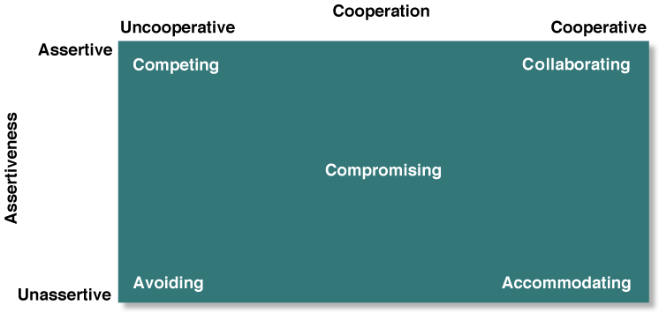
Conflict Management Strategies
Figure 14.4

Slide 38
Managing Conflict
Superordinate goals
  Higher-level goals taking priority over specific individual or group goals.

Slide 39
Being a Mediator
Mediator
  A third party who intervenes to help others manage their conflict.

