Slide 1
Communicating
Chapter 15
McGraw-Hill/Irwin
Copyright © 2011 by the McGraw-Hill Companies, Inc. All rights reserved.
Notes:
Message exercise.

Slide 2
Learning Objectives
LO 1 Discuss important advantages of two-way communication
LO 2 Identify communication problems to avoid
LO 3 Describe when and how to use the various communication channels
LO 4 Summarize ways to become a better “sender” and “receiver” of information

Slide 3
Interpersonal Communication
Communication
  The transmission of information and meaning from one party to another through the use of shared symbols
Notes:
What are symbols

Slide 4
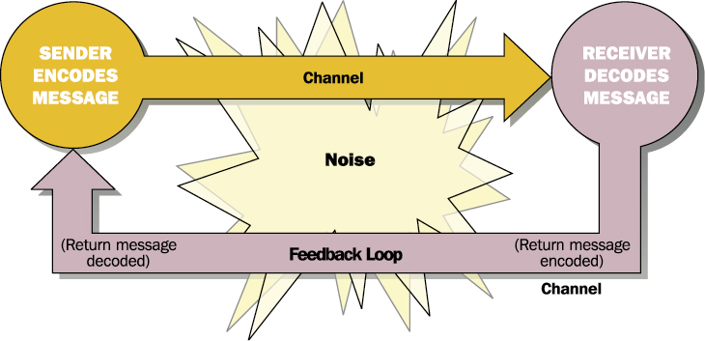
Ex. 13.2 A Model of the Communication Process
0
Notes:
Oral/written

Slide 5
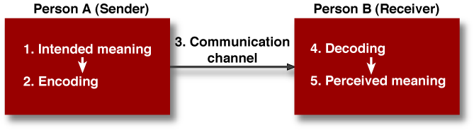
A Model of One-Way Communication
Figure 15.1

Slide 6

One-Way versus Two-Way Communication
Two-way communication
  A process in which information flows in two directions—the receiver provides feedback, and the sender is receptive to the feedback.
Notes:
How do you do this?

Slide 7
Communication Pitfalls
Perception
  The process of receiving and interpreting information
Filtering
  The process of withholding, ignoring, or distorting information
Notes:
Your background—body language—culture—status-fear

Slide 8
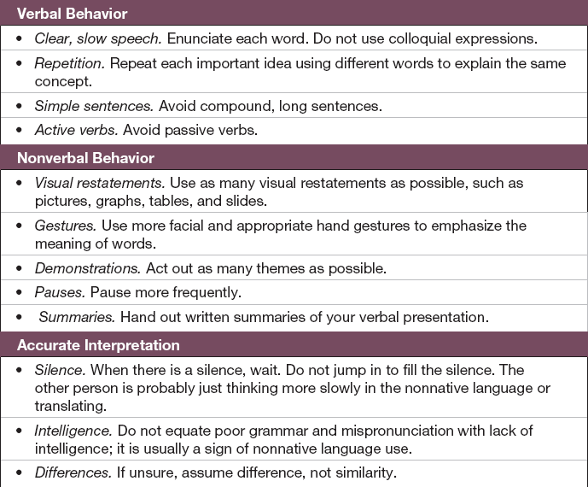
What Do I Do if They Don’t
Speak My Language?
Table 15.1

Slide 9
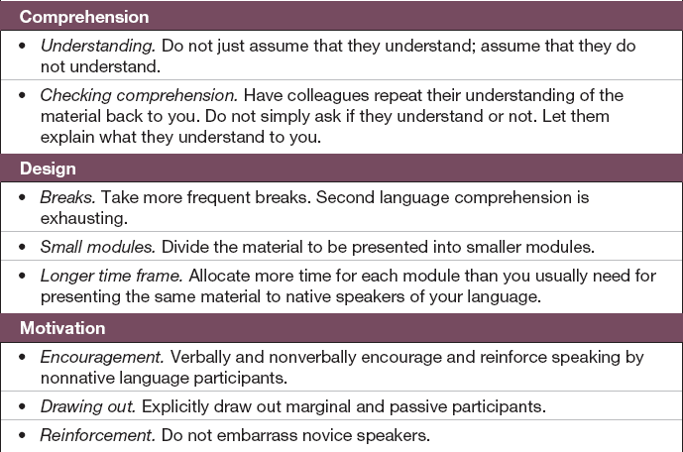
What Do I Do if They Don’t
Speak My Language?
Table 15.1

Slide 10
Oral Communication
Advantages
Disadvantages
Questions can be asked and answered
Feedback is immediate and direct
More persuasive
Face to face
Inflection
Body language
It can lead to spontaneous, ill-considered statements (and regret)
There is no permanent record of it

Slide 11
Written Communication
Advantages
Disadvantages
Message can be revised several times
Permanent record that can be saved
Message stays the same even if relayed through many people
Receiver has more time to analyze the message
Sender has no control over where, when, or if the message is read
Sender does not receive immediate feedback
Receiver may not understand parts of the message

Slide 12
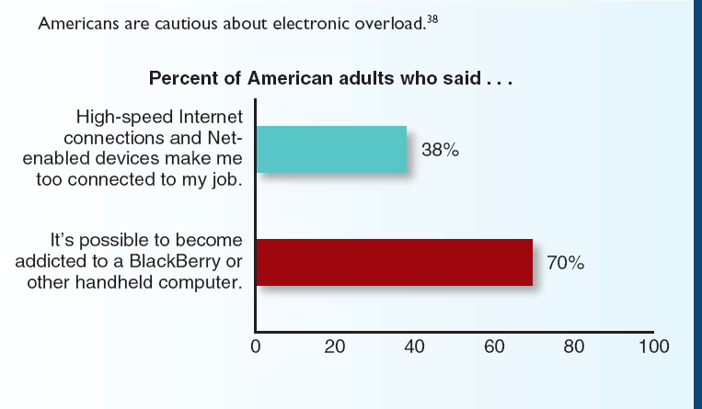
Information Overload

Slide 13

Electronic Media
Web 2.0
  A set of Internet-based applications that encourage user-provided content and collaboration
  social networking, podcasts, RSS, and wikis

Slide 14
Advantages of Electronic Communication
The sharing of more information
The speed and efficiency in delivering routine messages to large numbers of people across vast geographic areas
Can reduce time and expenses devoted to traveling, photocopying, and mailing

Slide 15
Disadvantages of Electronic Communication
Difficulty of solving complex problems that require more extended, face-to-face interaction
Inability to pick up subtle, nonverbal, or inflectional clues about what the communicator is thinking or conveying
Electronic messages sometimes are monitored or seen inadvertently by those for whom they are not intended
Record (plus and minus)—Freedom of Information

Slide 16
Virtual Office
Virtual office
  A mobile office in which people can work anywhere, as long as they have the tools to communicate with customers and colleagues.

Slide 17
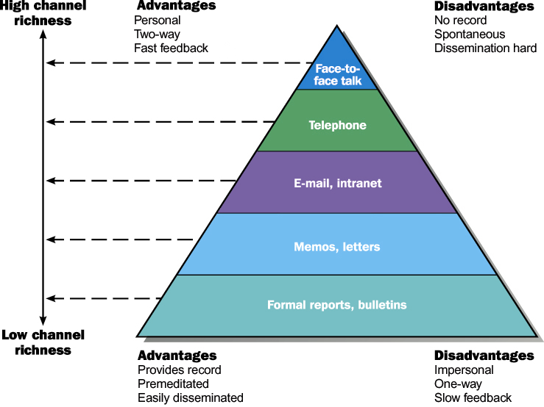
Ex. 13.3 The Pyramid of Channel Richness
0

Slide 18
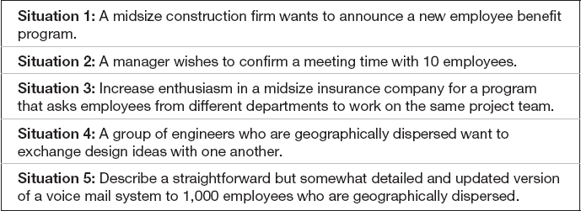
What Communication
Channel Would You Use?
Table 15.2

Slide 19
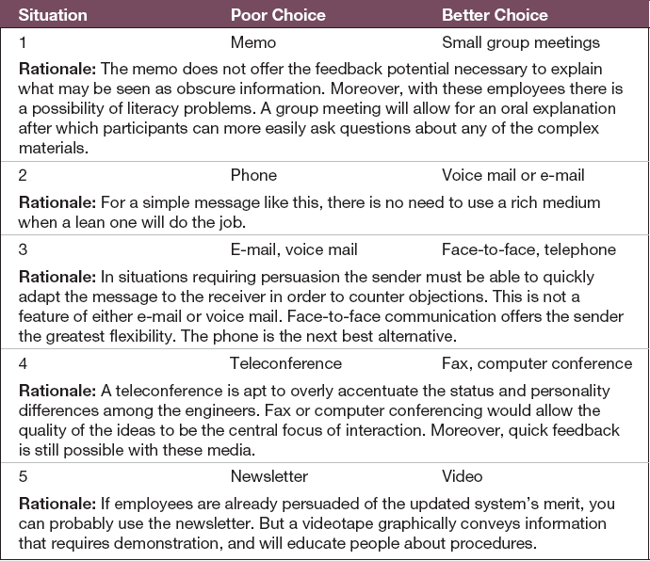
Suggested Media Choices
Table 15.3

Slide 20
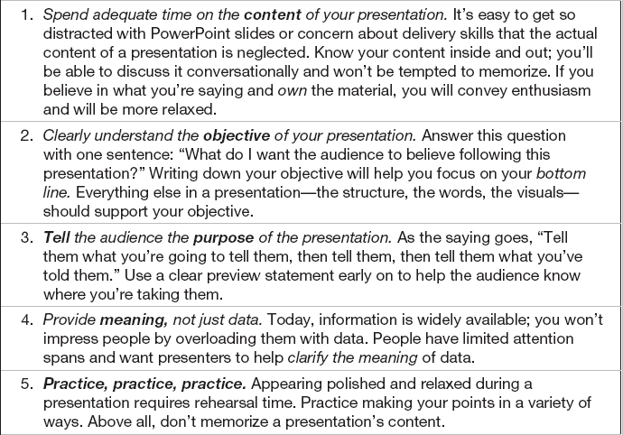
Adding Power to Your Presentation
Table 15.4

Slide 21
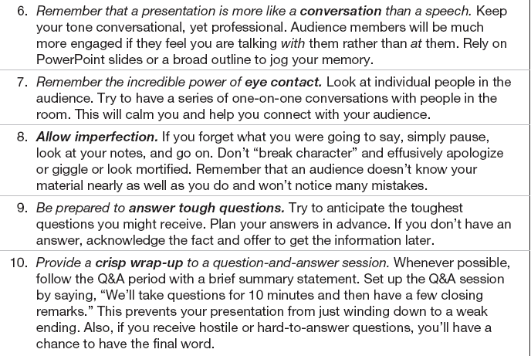
Adding Power to Your Presentation
Table 15.4

Slide 22
Ten Keys to Effective Listening
Find an area of interest
Judge content, not delivery
Hold your fire
Listen for ideas
Be flexible
Resist distraction
Exercise your mind.
Keep your mind open
Capitalize on thought speed
Work at listening

Slide 23
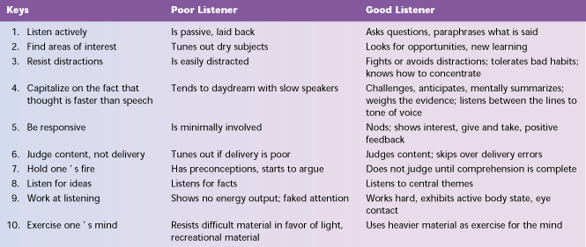
Ex. 13.4 Ten Keys to Effective Listening
0
SOURCE: Adapted from Sherman K. Okum, “How to Be a Better Listener,” Nation’s Business (August 1975), 62 and Philip Morgan and Kent Baker, “Building a Professional Image; Improving Listening Behavior,” Supervisory Management (November 1985), 34-38.

Slide 24

Organizational Communication
Open-book management
  Practice of sharing with employees at all levels of the organization vital information previously meant for management’s eyes only
Boundaryless organization
  Organization in which there are no barriers to information flow
  implies information available as needed moving quickly and easily enough so that the organization functions far better as a whole than as separate parts.

Slide 25
Informal Communication
Grapevine
  the social network of informal communications.
  provides people with information
  helps them solve problems
  teaches them how to do their work successfully

Slide 26
Ex. 13.9 Communication Barriers & Ways to Overcome Them
0
Barriers
How to Overcome
Individual
Interpersonal dynamics
Active listening
Channels and media
Selection of appropriate channel
Defense mechanisms
Question underlying assumptions
Semantics
Knowledge of other’s perspective
Inconsistent cues
MBWA
Organizational
Status and power differences
Climate of trust, dialogue
Departmental needs and goals
Development and use of formal channels
Lack of formal channels
Encouragement of multiple channels, formal and informal
Communication network unsuited
to task
Changing organization or group structure to fit communication needs
Poor coordination
Feedback and learning

