Slide 1
Motivating for Performance
Chapter 13
McGraw-Hill/Irwin
Copyright © 2011 by the McGraw-Hill Companies, Inc. All rights reserved.

Slide 2
Learning Objectives
LO 1 Identify the kinds of behaviors managers need to motivate people
LO 2 List principles for setting goals that motivate employees
LO 3 Summarize how to reward good performance effectively
LO 4 Describe the key beliefs that affect peoples’ motivation
Notes:
Think of yourself what motivates you. Is it important?

Slide 3
Learning Objectives (cont.)
LO 5 Discuss ways in which people’s individual needs affect their behavior--WIIFM
LO 6 Define ways to create jobs that motivate
LO 7 Summarize how people assess fairness and how to achieve it
LO 8 Identify causes and consequences of a satisfied workforce
Notes:
That’s not fair. What is fair?

Slide 4
Motivating for Performance
Motivation
  Forces that energize, direct, and sustain a person’s efforts.
Managers must motivate people to:
  join the organization,
  remain in the organization
  come to work regularly
Notes:
Way more than what they have on this slide. What’s in it for me. Is this the manager’s job to get people to join, remain and come to work?
Isn’t a lot more than that. What is it?

Slide 5
Ex. 12.1 A Simple Model of Motivation
0
NEED-Creates desire to fulfill needs (food, friendship, recognition, achievement).
BEHAVIOR-Results in actions to fulfill needs.
REWARDS-Satisfy needs; intrinsic or extrinsic rewards.
FEEDBACK-Reward informs person whether behavior was appropriate and should be used again.

Slide 6

Setting Goals
Goal-setting theory
  A motivation theory stating that people have conscious goals that energize them and direct their thoughts and behaviors toward a particular end.
  WIIFM

Slide 7
Setting Goals
Stretch goals
  Targets that are particularly demanding, sometimes even thought to be impossible.
  Why?
  Minimum
  Reward
  Realistic
  Important
  Achievable
Notes:
What is a stretch goal? Is it important

Slide 8
Reinforcing Performance
Law of effect
  A law formulated by Edward Thorndike in 1911 stating that behavior that is followed by positive consequences will likely be repeated.
Reinforcers
  Positive consequences that motivate behavior.
Notes:
Rewards versus punishments. Carrott Versus stick

Slide 9
Reinforcing Performance
Positive reinforcement
  Applying consequences that increase the likelihood that a person will repeat the behavior that led to it.
Negative reinforcement
  Removing or withholding an undesirable consequence.

Slide 10
Reinforcing Performance
Punishment
  Administering an aversive consequence.
Extinction
  Withdrawing or failing to provide a reinforcing consequence.

Slide 11
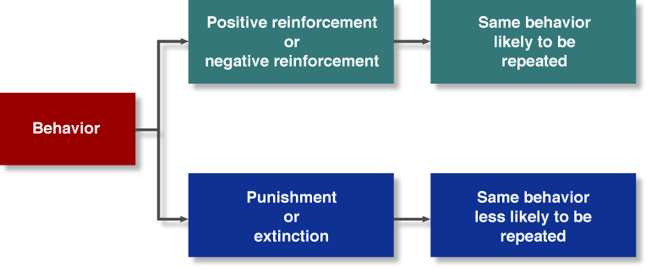
The Consequences of Behavior
Figure 13.1

Slide 12
Reinforcement Perspective on Motivation
0
Positive reinforcement in the administration of a pleasant and rewarding consequence.
Avoidance learning is the removal of an unpleasant consequence following a desired behavior.
Reinforcement Tools
Punishment is the imposition of unpleasant outcomes on an employee.
Extinction is the withdrawal of a positive reward; behavior is no longer reinforced and hence is less likely to occur in the future.

Slide 13
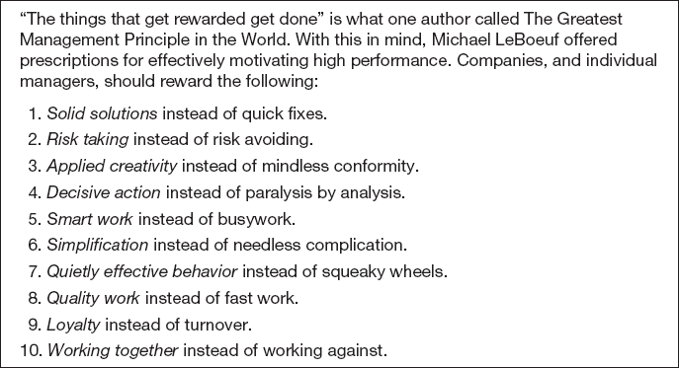
The Greatest Management
Principle in the World
Table 13.1
Notes:
What would you add to this list? How about feelings of importance? What’s in it for me? Understanding what motivates different employees.

Slide 14
Figure 12.6 Changing Behavior With Reinforcement

Slide 15
Performance -Related Beliefs
Expectancy theory
  A theory proposing that people will behave based on their perceived likelihood that their effort will lead to a certain outcome and on how highly they value that outcome.
Notes:
If I do X then Y will result.

Slide 16
The Effort-to-Performance Link
Expectancy
  Employees’ perception of the likelihood that their efforts will enable them to attain their performance and personal goals.

Slide 17
The Performance-to-Outcome Link
Instrumentality
  The perceived likelihood that performance will be followed by a particular outcome.
Valence
  The value an outcome holds for the person contemplating it.
Notes:
Is it important? Important to who? What are their perceived other outcomes? Is it important

Slide 18
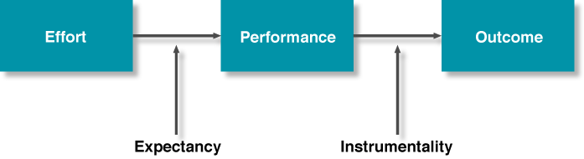
Basic Concepts of Expectancy Theory
Figure 13.2

Slide 19
Managerial Implications of
Expectancy Theory
Increase positive expectancies
Identify positively valent outcomes
Make performance instrumental toward positive outcomes
Lessen the perceived negative outcomes.
Create importance

Slide 20
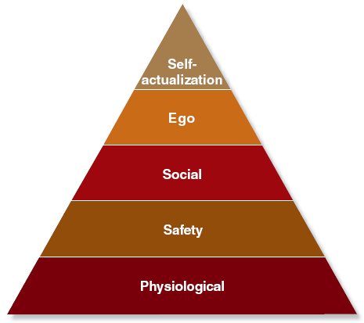
Maslow’s Need Hierarchy
Maslow’s need hierarchy
  A conception of human needs organizing needs into a hierarchy of five major types.

Slide 21
Maslow’s Need Hierarchy
Physiological (food, water, and shelter).
Safety or security (protection against threat and deprivation).
Social (friendship, affection, belonging, and love).
Ego (independence, achievement, freedom, status, recognition, and self esteem).
Self-actualization (realizing one’s full potential, becoming everything one is capable of being).
Notes:
Don’t cough
Be all that you can be
Isn’t that just like me
Self talk

Slide 22
Alderfer’s ERG Theory
Existence needs
  all material and physiological desires.
Relatedness needs
  involve relationships with other people and are satisfied through the process of mutually sharing thoughts and feelings.
Growth needs
  motivate people to productively or creatively change themselves or their environment.
Notes:
Another theory

Slide 23
McClelland’s Needs
Need for achievement
  characterized by a strong orientation toward accomplishment and an obsession with success and goal attainment.
Need for affiliation
  reflects a strong desire to be liked by other people
Need for power
  a desire to influence or control other people
Notes:
Another theory

Slide 24

Designing Motivating Jobs
Extrinsic rewards
  Rewards given to a person by the boss, the company, or some other person.
Intrinsic reward
  Reward a worker derives directly from performing the job itself.
Notes:
Examples of extrinsic rewards
What is an intrinsic reward? Feelings of self-worth be all that you can be.

Slide 25
Job Rotation, Enlargement, and Enrichment
Job rotation
  Changing from one routine task to another to alleviate boredom
Job enlargement
  Giving people additional tasks at the same time to alleviate boredom.
Notes:
Do these work? How do you motivate employees with these practices

Slide 26

Job Rotation, Enlargement, and Enrichment
Job enrichment
  Changing a task to make it inherently more rewarding, motivating, and satisfying.

Slide 27
Herzberg’s Two-Factor Theory
Hygiene factors
  Characteristics of the workplace, such as company policies, working conditions, pay, and supervision, that can make people dissatisfied.
Motivators
  Factors that make a job more motivating, such as additional job responsibilities, opportunities for personal growth and recognition, and feelings of achievement
Notes:
Another theory divided into two.
Gorman rule is that don’t make of reward not motivational.

Slide 28
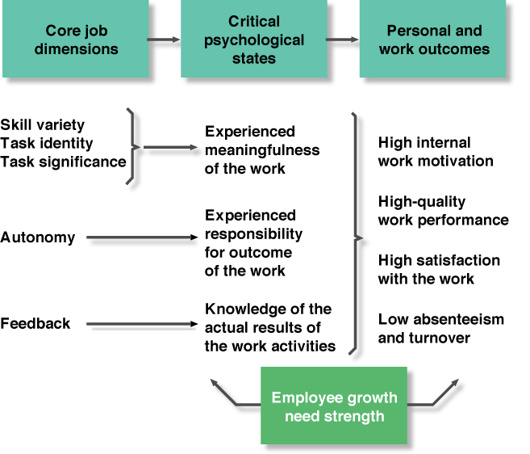
The Hackman and Oldham Model of Job Design
Figure 13.4
Notes:
Can they do the job? Do they feel they need training? How much looking over their shoulder? What’s in it for me?

Slide 29
The Hackman and Oldham Model of Job Design
Skill variety
  different job activities involving several skills and talents.
Task identity
  the completion of a whole, identifiable piece of work
Task significance
  an important, positive impact on the lives of others

Slide 30
The Hackman and Oldham Model of Job Design
Autonomy
  independence and discretion in making decisions.
Feedback
information about job performance
Growth need strength
  The degree to which individuals want personal and psychological development.

Slide 31
Empowerment
Empowerment
  The process of sharing power with employees, thereby enhancing their confidence in their ability to perform their jobs and their belief that they are influential contributors to the organization.
Notes:
You make a decision. What’s best

Slide 32

Achieving Fairness
Equity theory
  A theory stating that people assess how fairly they have been treated according to two key factors: outcomes and inputs.
Notes:
Jealousy--- teacher’s pet--- bosses favorite--- they can get away with---why always picking on me.

Slide 33
Equity Theory
Outcomes
  refer to the various things the person receives on the job: recognition, pay, benefits, satisfaction, security, job assignments, and punishments
Inputs
  refer to the contributions the person makes to the organization: effort, time, talent, performance, extra commitment, and good citizenship
Notes:
Perception of fair. Discuss brothers and sisters. The unfair father

Slide 34
Quality of Work Life
Quality of work life (QWL) programs
  Programs designed to create a workplace that enhances employee well-being.
  What would they be?

Slide 35
QWL Programs
Adequate and fair compensation
A safe and healthy environment
Jobs that develop human capacities
A chance for personal growth and security
A social environment that fosters personal identity, freedom from prejudice, a sense of community, and upward mobility
Constitutionalism, or the rights of personal privacy, dissent, and due process
A work role that minimized infringement on personal leisure and family needs
Socially responsible organizational actions
Getting ahead
Notes:
Discuss each of these items with the class

Slide 36
Psychological Contracts
Psychological contract
  A set of perceptions of what employees owe their employers, and what their employers owe them.
Notes:
How should an employer treat employees? What is loyalty?

Slide 37
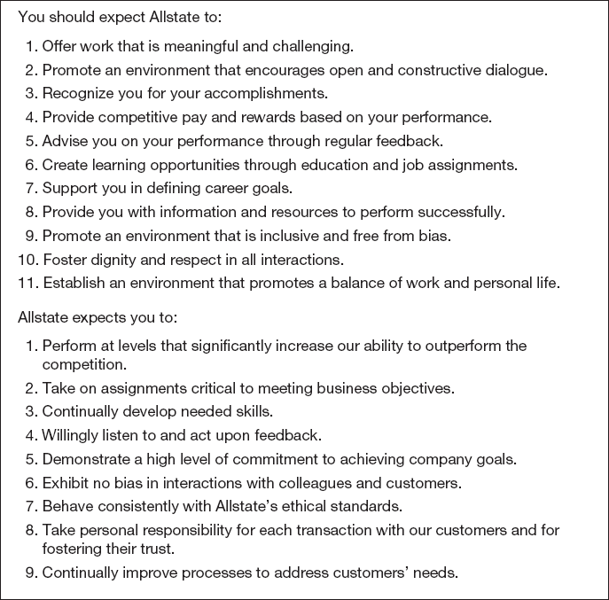
Allstate Employability Contract
Table 13.2

