Slide 1
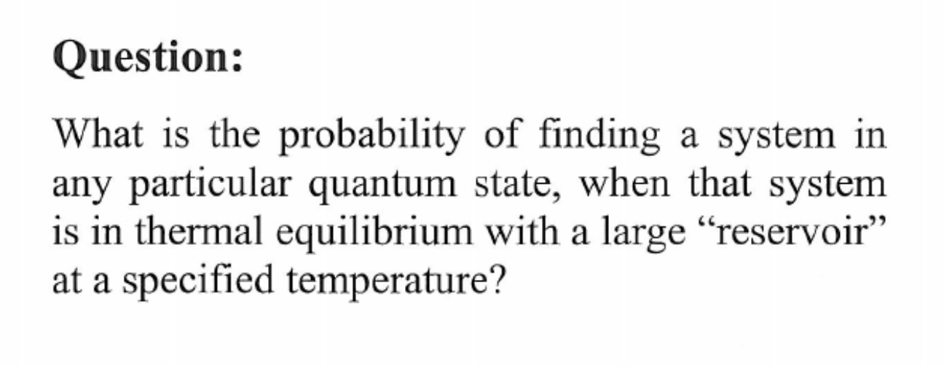
A Closed system decomposed into a reservoir in thermal contact with a small system

Slide 2
A small system in two different states

Slide 4
Energy and heat capacity of a two state system

Slide 10
Ideal Gas Heat capacity at constant volume

Slide 11
Mixing Entropy of a random binary alloy

