Slide 3
Thermal Contact between two systems

Slide 4
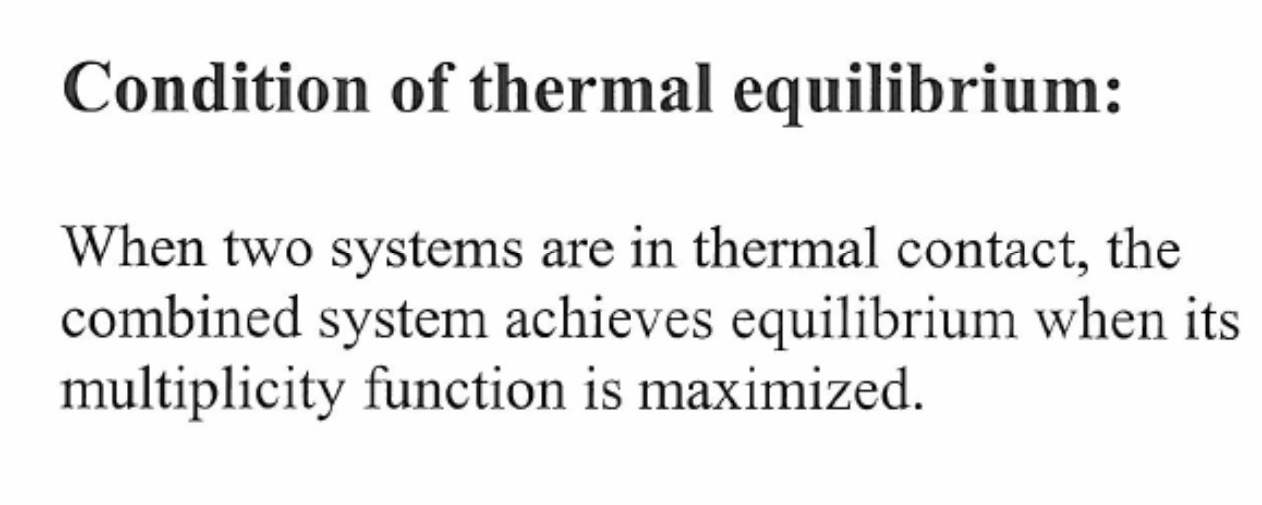

Slide 5
How to increase the entropy?

Slide 7
What is probability for air molecules coming to one end of room simultaneously?

Slide 8
Equilibrium for any types of contact

