Slide 1
Nuclear Energy in the 21st Century
Liping Gan
University of North Carolina Wilmington

Slide 2
Outline
Introduction
What is nuclear energy?
Early history of nuclear power
Current status
Critical Issues
Future of nuclear energy

Slide 3
Global challenges in the 21st century
Energy crisis
Global warming
- the generation of electricity from fossil fuels is a major and growing contributor to the emission of carbon dioxide

Slide 4
Possible solutions
increase efficiency in electricity generation and use;
expand use of renewable energy sources such as wind, solar, biomass, and geothermal;
capture carbon dioxide emissions;
increase use of nuclear power: carbon-free source of power

Slide 5
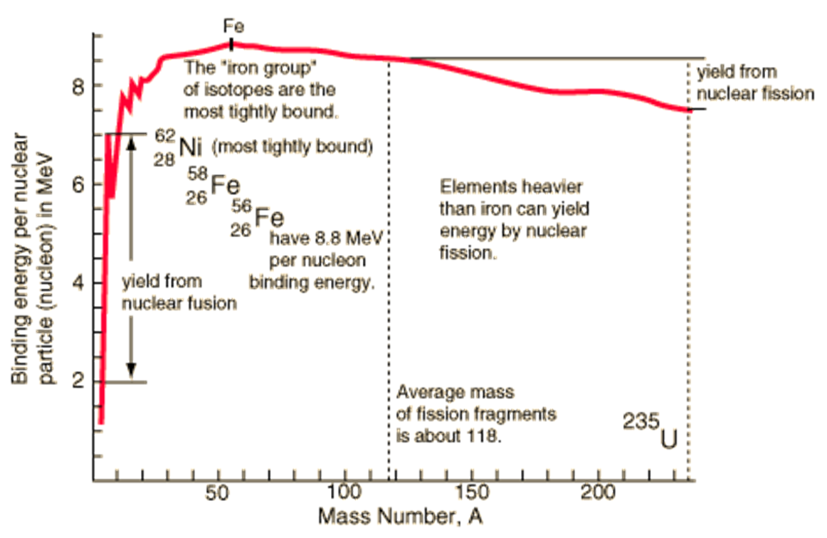

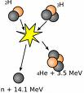
What is nuclear energy?
Fission
Fusion

Slide 6
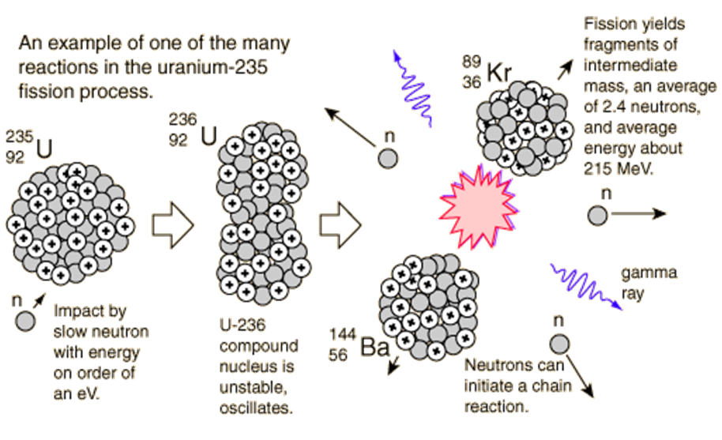
Fission Chain Reactions

Slide 7
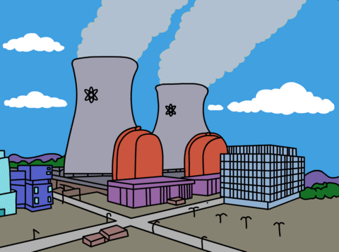
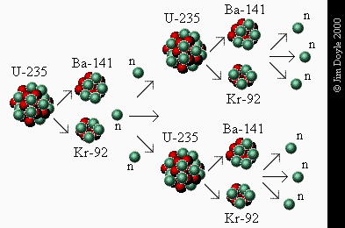
Close Look at How a Nuclear Reactor works (LWR)
Fuel: ²³⁵U is enriched from its 0.7% in nature to about 3% to produce the reaction. ²³⁵U fissions by absorbing a slow neutron and producing 2 to 3 neutrons, which initiate more fissions to make a controlled chain reaction.
Moderator: normal water is used as a moderator to slow the neutrons since slow neutrons take longer to pass by a ²³⁵U nucleus and have more time to be absorbed
Boron control rods are inserted to absorb neutrons when it is time to shut down the reactor
Energy transfer: the hot water is boiled or sent through a heat exchanger to produce steam. The steam then powers turbines.

Slide 8
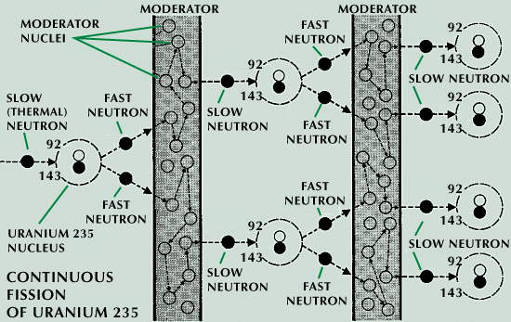
Nuclear Fission from Slow Neutrons and Water Moderator

Slide 9
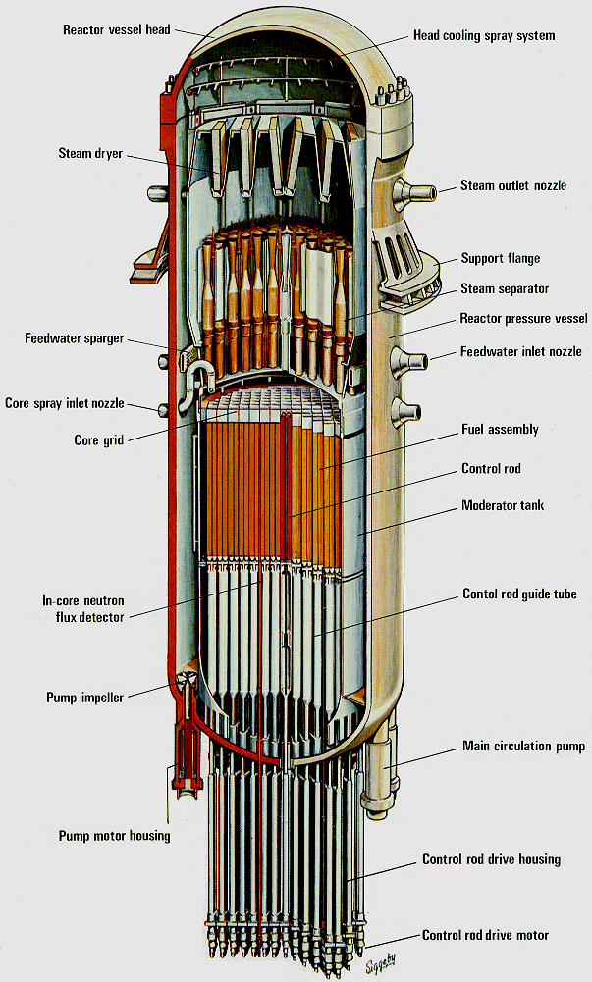
Inside a Nuclear Reactor
Steam outlet →
Fuel Rods →
Control Rods →

Slide 10
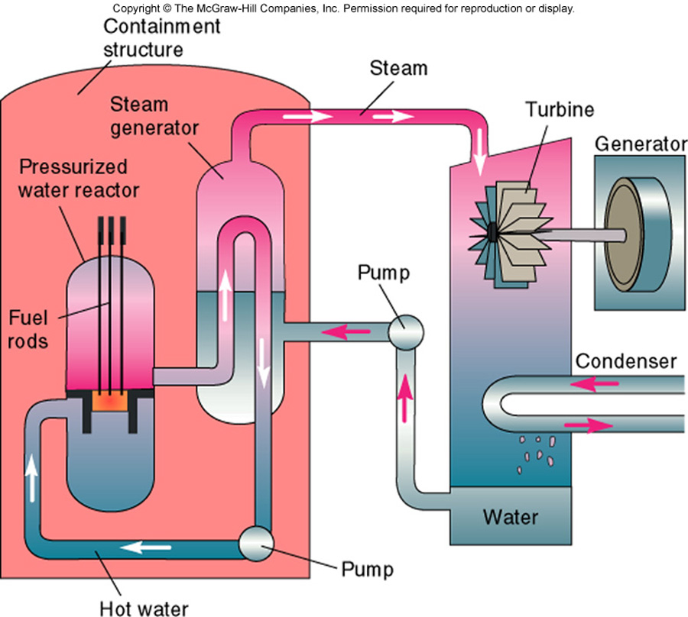

Slide 11
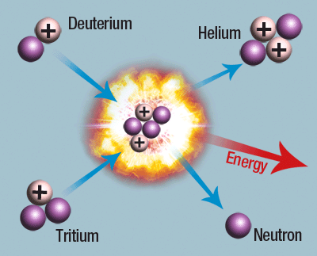
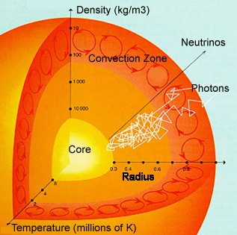
Fusion reaction
Conditions for fusion: very high temperature and high density

Slide 12
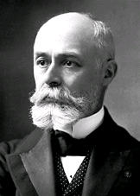
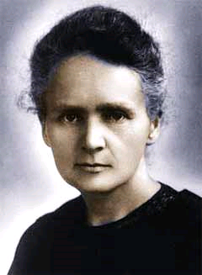
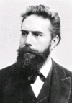
Early history of nuclear power
Discover of radioactivity
Henry Becquerel discovered radioavtivity from uranium salts in 1896
Wilhelm Röntgen discovered x-ray in 1895
Madam Curie in1898 discovered the radioactive elements polonium and radium

Slide 13
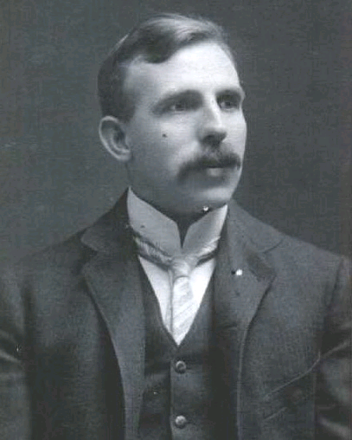
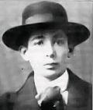
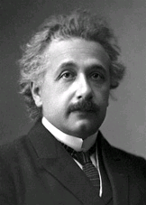
From 1900 to 1933
Ernest Rutherford
discovered nucleus in 1909
Leo Szilard
predicted nuclear fission in 1933
Albert Einstein discovered E=mc² in 1905

Slide 14
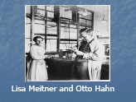

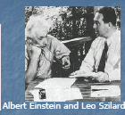
During 1930’s
Enrico Fermi discovered slow neutron induced fission in Uranium in 1939
Lisa Meitner and Otto Hahn discovered fission in Uranium in 1938
Einstein and Szilard wrote a letter to president F.D. Roosevelt in 1939. In 1941, Manhattan project started

Slide 15
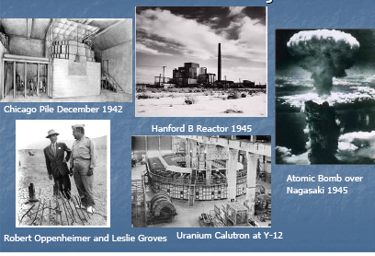
Manhattan Project
(fueled by Uranium -235 and Plutonium-239)

Slide 16
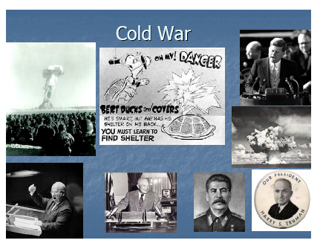
Nuclear Arms Race (1946- early 1990’s)

Slide 17
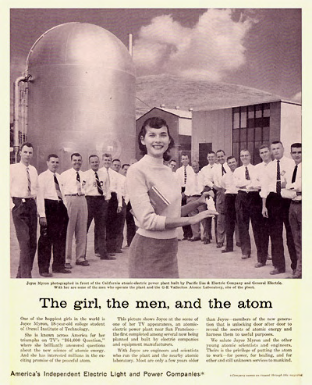
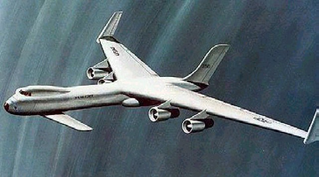
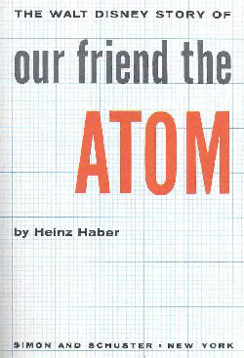
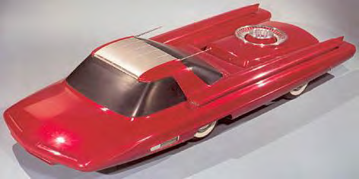
Origins of civilian nuclear program
December1953, President Eisenhower announced the “Atoms for Peace” program.
International Atomic Energy Agency to promote nuclear energy applications and to safeguard against weapons proliferation.

Slide 18
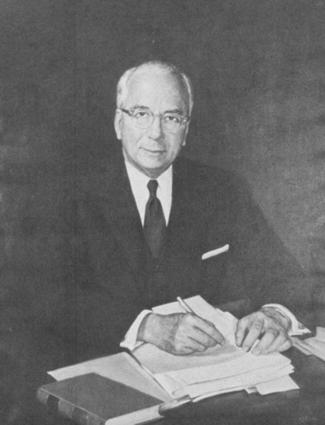
The Vision
“It is not too much to expect that our children will enjoy in their homes [nuclear generated] electrical energy too cheap to meter.”
– Lewis Strauss, Chairman of the U.S.
Atomic Energy Commission (1954)

Slide 19
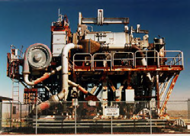
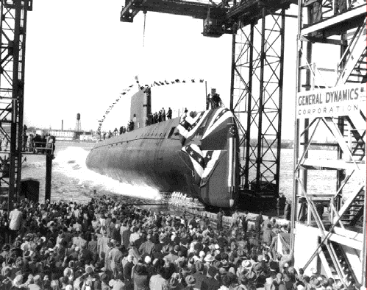
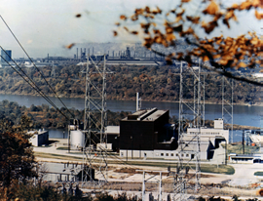
Early Development of Nuclear Power Plants
America’s First Power Reactor EBR 1 Idaho
1955
Shippingport: 1st Full scale U.S. Nuclear Power Plant (PWR) In 1957. Its capacity was 60 megawatts
U.S. S Nautilus 1954
In late 1960’s, other nations, such as France, Britain and Russia also started to build nuclear power plants based their designs on weapons material production reactors using graphite as a moderator.

Slide 20
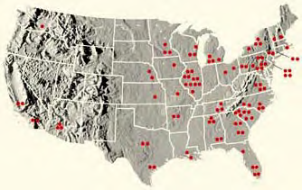
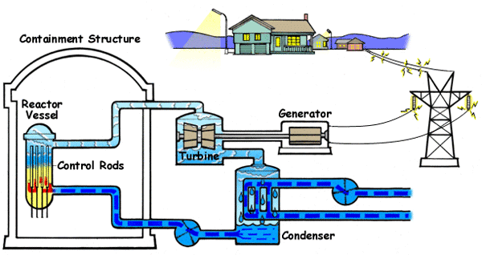
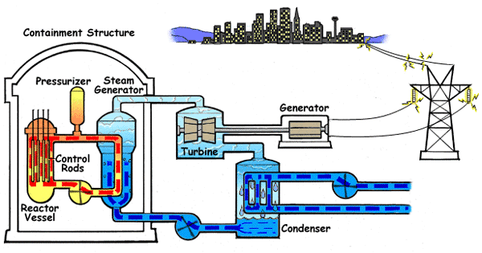
Nuclear power growth in the U.S.
From 1959 to the early 1970’s, nuclear power growth in the U.S. was large. During this period 112 reactors were constructed.
The Pressurized Water Reactor (PWR) has water passing over the reactor core to act as moderator and coolant. A pressurized primary loop heats the secondary loop to produce steam for the turbine.
The Boiling Water Reactor (BWR) has the same water loop serve as a moderator, coolant for the core, and steam source for the turbine.

Slide 21
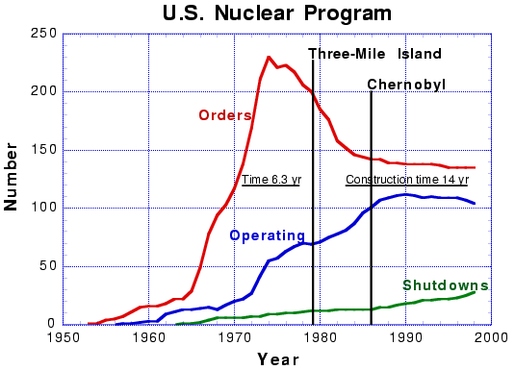
Nuclear Power: 1970’s- Present
New nuclear power plant orders ceased in 1974. Dozens of partially constructed reactors were never completed.
Causes:
Cost inflation – On the average capital costs for nuclear power plants increased nearly 10 times between the early 1970’s and 1983.
Immaturity of the technology – Even though, the first power reactors were deployed in the late 1950’s and early 1960’s, key aspects of the technology required further research and Development. The AEC ceased much of its R&D on light water reactors after the early 1960’s
The Three Mile Island Accident in 1979, Chernobyl in 1986.
Nuclear Waste Uncertainties

Slide 22
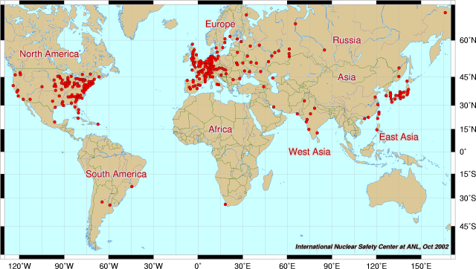
World Nuclear Power Plants

Slide 23
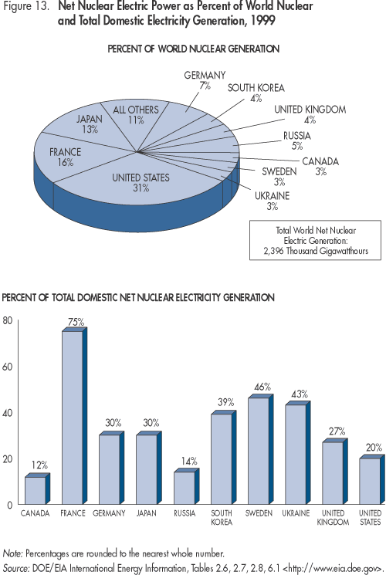
Nuclear Electricity Production by Countries and Regions in Gigawatts (World Total 350 Gigawatts) and percent of electricity
US | 97 , Declining
North America Region | 109
France | 63 Increasing
Germany | 21 Being phased out
U. K. | 12
Western Europe Region | 126
Japan | 44 Increasing
Asia Region | 66 Increasing
Eastern Europe Region | 11
Former Soviet U. Region | 34

Slide 24
Critical Issues for future nuclear power expansion
Cost
Safety
Waste
Proliferation

Slide 25
(1) Costs
Status:
Currently, nuclear power is not cost competitive with coal and natural gas.
Outlook:
plausible reductions by
industry in capital cost, operation and maintenance costs, and construction time could reduce the gap.
Carbon emission credits, if enacted by government,

Slide 26
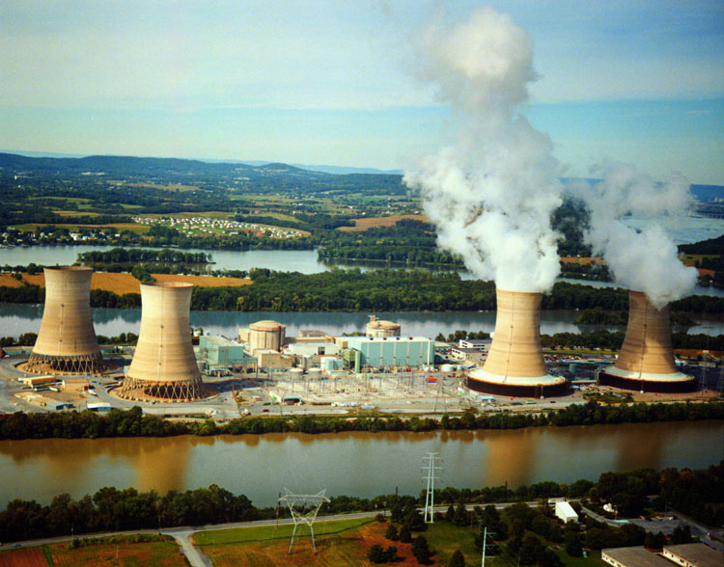
(2) Safety
Outlook:
Improve modern reactor designs to achieve a very low risk of serious accidents
“best practices” in construction and operation are essential
Three-Mile Island, PA, 1979

Slide 27
(3) Waste
Status:
Geological disposal is technically feasible but execution is yet to be demonstrated or certain.
Nuclear power has unresolved challenges in long-term management of radioactive wastes.
Outlook:
Successful operation of the planned disposal facility at Yucca Mountain would ease, but not solve, the waste issue if nuclear power expands substantially.
Continuing and substantial progress towards solution to the waste disposal problem are expected.

Slide 28


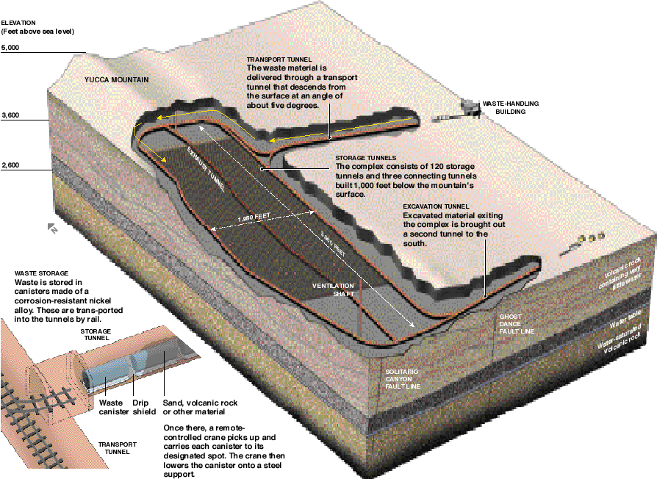

Yucca Mountain

Slide 29
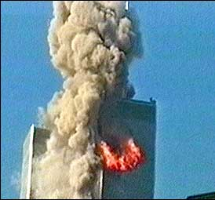

(4) Proliferation
Status:
The current international safeguards regime is inadequate to meet the security challenges of the expanded nuclear deployment contemplated in the global growth scenario.
Fuel cycles that involve the chemical reprocessing of spent fuel to separate weapons-usable plutonium and uranium enrichment technologies are of special concern, especially as nuclear power spreads around the world.
Outlook:
Continuing and substantial works involving international community towards solution are expected.

Slide 30
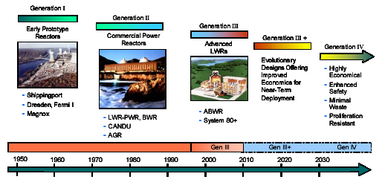
Path to the future

Slide 31
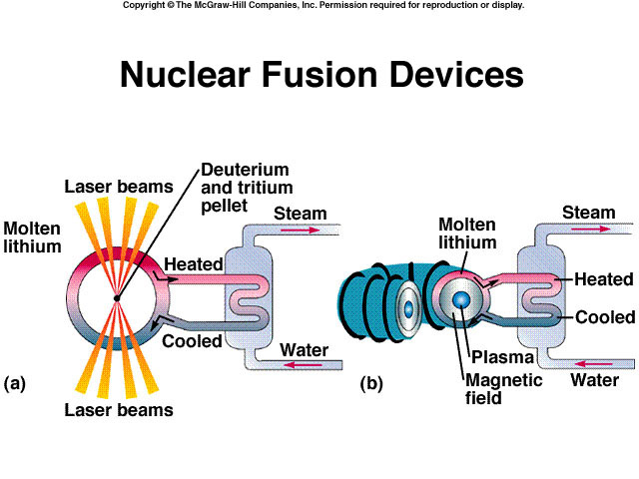

Slide 32
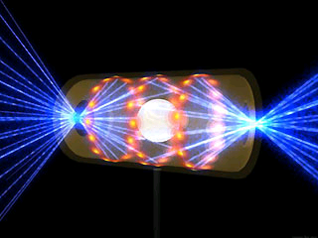
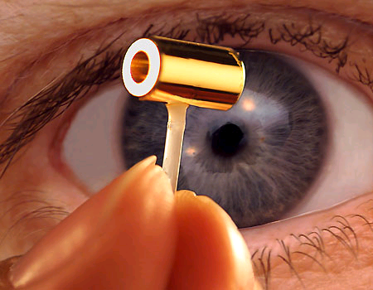
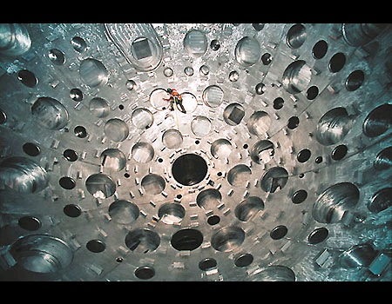
The National Ignition Facility at Lawrence Livermore National Laboratory, CA
Nuclear fusion, the Holy Grail of energy sources.
The 'hohlraum' cylinder which contains the NIF fusion fuel capsule, is just a few millimeters wide, with beam entrance holes at either end. The fuel capsule is the size of a small pea.
Inside a 10-meter-wide target chamber, 192 laser beams on a hydrogen pellet the size of a bead, heating it to incredible temperatures in an attempt to recreate the power of the sun.

Slide 33
Summary
The nuclear energy option should be retained as one of the options to resolve the global warming and energy crisis, because it is an important carbon-free source of power.
There are still some important issues remain unsolved. The U.S. public is unlikely to support nuclear power expansion without substantial improvements in costs, technology, and safety.
Future development of technology, such as controlled nuclear fusion may shade light on the fate of successful expansion of nuclear energy.

Slide 34
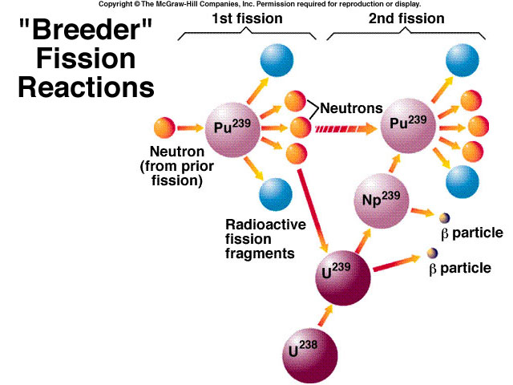

Slide 35
Production of Plutonium (Pu) in Nuclear Reactors
²³⁹Pu is produced in nuclear reactors by the absorption of a neutron on ²³⁸U, followed by two beta decays
²³⁹Pu also fissions by absorbing a thermal neutron, and on average produces 1/3 of the energy in a fuel cycle.
²³⁹Pu is relatively stable, with a half life of 24 thousand years.
It is used in nuclear weapons
It can be bred for nuclear reactors

Slide 36
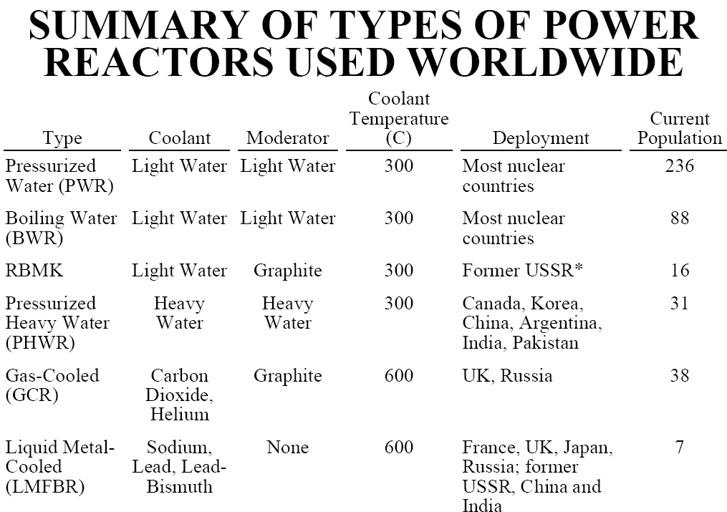

Slide 37
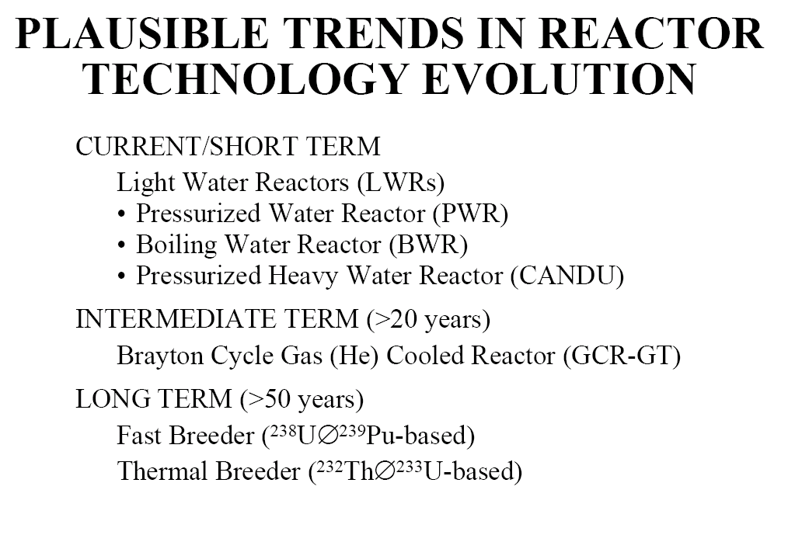

Slide 38
