Slide 1
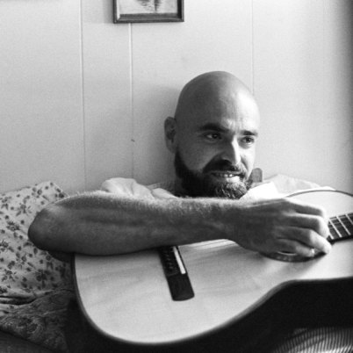
Shel Silverstein
Author Study
By:
Brittany Eason & Kala Ballance

Slide 2
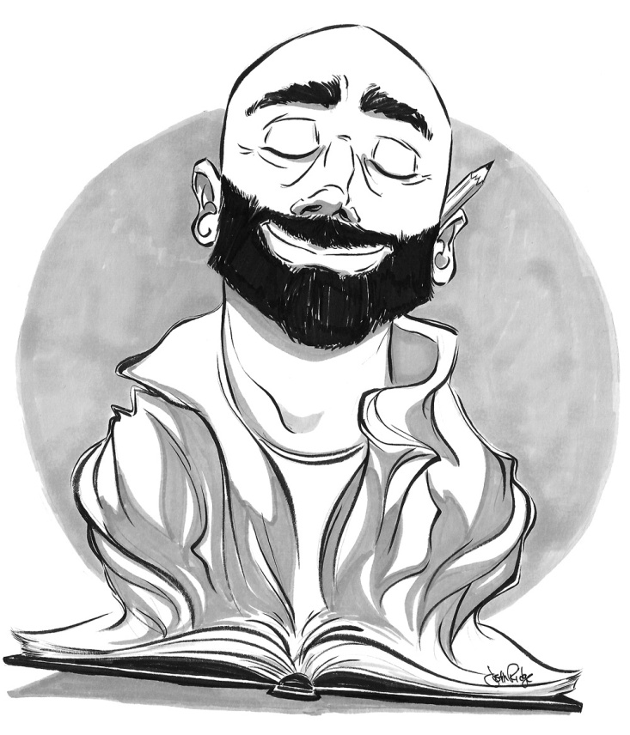
About Shel
His real name is Sheldon Allan, known as “Shel Silverstein”
Born on September 25, 1930
Grew up in Chicago, Illinois
Began writing at the age of 12
He’s an author, short story writer, artist, song writer and play writer.
His work is translated in more than 30 languages
He had two children: a girl named Shoshanna
and a boy named Mathew.
Died in May of 1990 of a heart attack

Slide 3
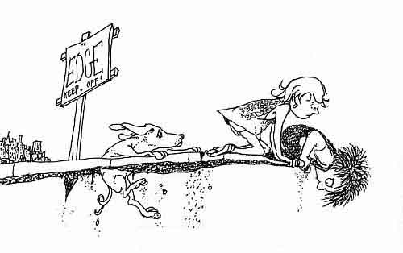
Characteristics/Trends
of Shel’s Work
He writes and illustrates all his work
Most of his work has rhythm and rhymes
Creates simple, understandable poems for both adults and children
His poems hold different meanings
depending upon the reader
His writing is imaginative and unique
He uses slang in his writing
Writes about all topics
Illustrations are always simple, black and white pictures

Slide 4
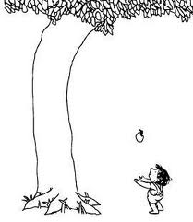
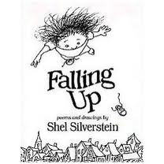
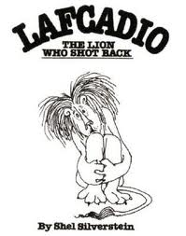
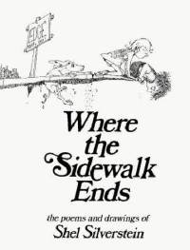
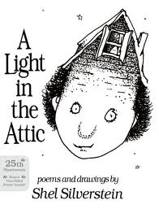
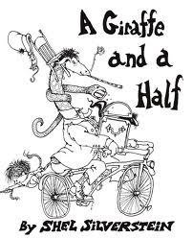
Popular Works
The Giving Tree, book
Lafcadio, The Lion Who Shot Back, book
A Giraffe and a Half, book
Falling Up, book
A Light in the Attic, book
Where the Sidewalk Ends, book
A Boy Named Sue, song
The Cover of the Rolling Stones, song
The Lady or the Tiger Show, movie
Things Change, movie

Slide 5
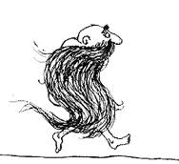
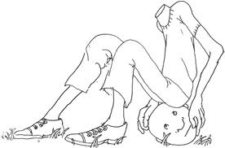
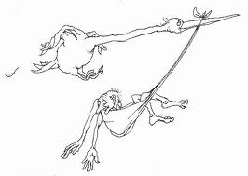
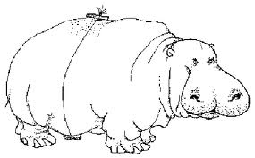
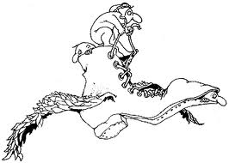
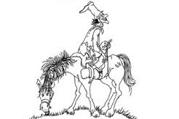
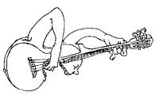
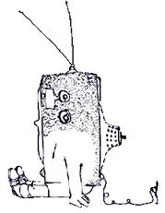
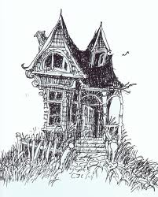
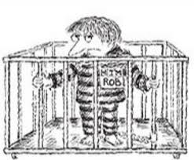
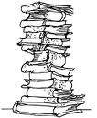
Illustrations

Slide 6
Ickle Me, Pickle Me,
Tickle Me Too
http://www.youtube.com/watch_popup?v=CNiaYHZme_U&vq=medium#t=119

Slide 7
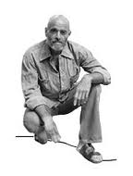
Shel on
“The Johnny Cash Show”
http://www.youtube.com/watch?v=7e5ZVIpB4sw

Slide 8
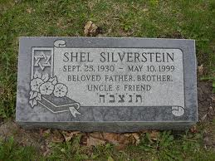
References
http://freedownload.is/ppt/shel-silverstein-8808665.html
http://shelsilverstein.com
http://www.youtube.com/watch?v=7e5ZVIpB4sw
http://www.youtube.com/watch?v=CNiaYHZme_U

