Slide 1
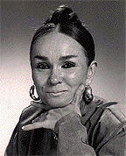
Patricia Polacco
By: Megan Wolkomir
and
Amanda Holmes

Slide 2
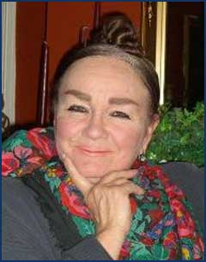
Introducing the Author
-Born in Lansing Michigan in 1944
-Parents got divorced when she was
3.
-Both parents moved back in with
their parents (her grandparents)
This is why she is so close to her grandparents.
-Grandparents huge influence.
-She loved hearing their
stories.
-She grew up on a farm in Union City.
-Union City was magical for her.
-Where she heard many wonderful stories.

Slide 3
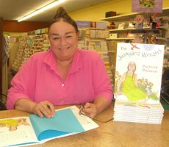
During her life:
-For a time she restored ancient pieces at museums.
-Didn’t start writing children’s books until she was 41.
-Has two kids.
-She now lives back in Union City and now that she is there again she wants to open her house and community and invite people to take part in writing seminars, story telling, literature conferences and lots of other events.

Slide 4
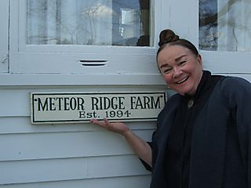
Influences in her life:
-Came from a family of incredible storytellers.
- A lot of books from her childhood inspired her writing and illustrating like: Beatrix Potter’s Peter Rabbit, The Tall Mother Goose, Grim’s Fairytales.
-Her artistic hero is Norman Rockwell.

Slide 5
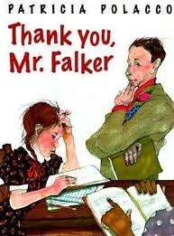
What you didn’t know about her
Polacco is dyslexic, disnumeric, and disgraphic.
-Her struggle trying to read was a horrible battle.
-She also got teased by a young boy who shook her world and made her feel extremely unsafe.
-Pollaco was helped by a teacher Mr. Falker who she dedicated the book "Thank you Mr. Falker." This is my favorite of all her books, it's an amazing story.

Slide 6
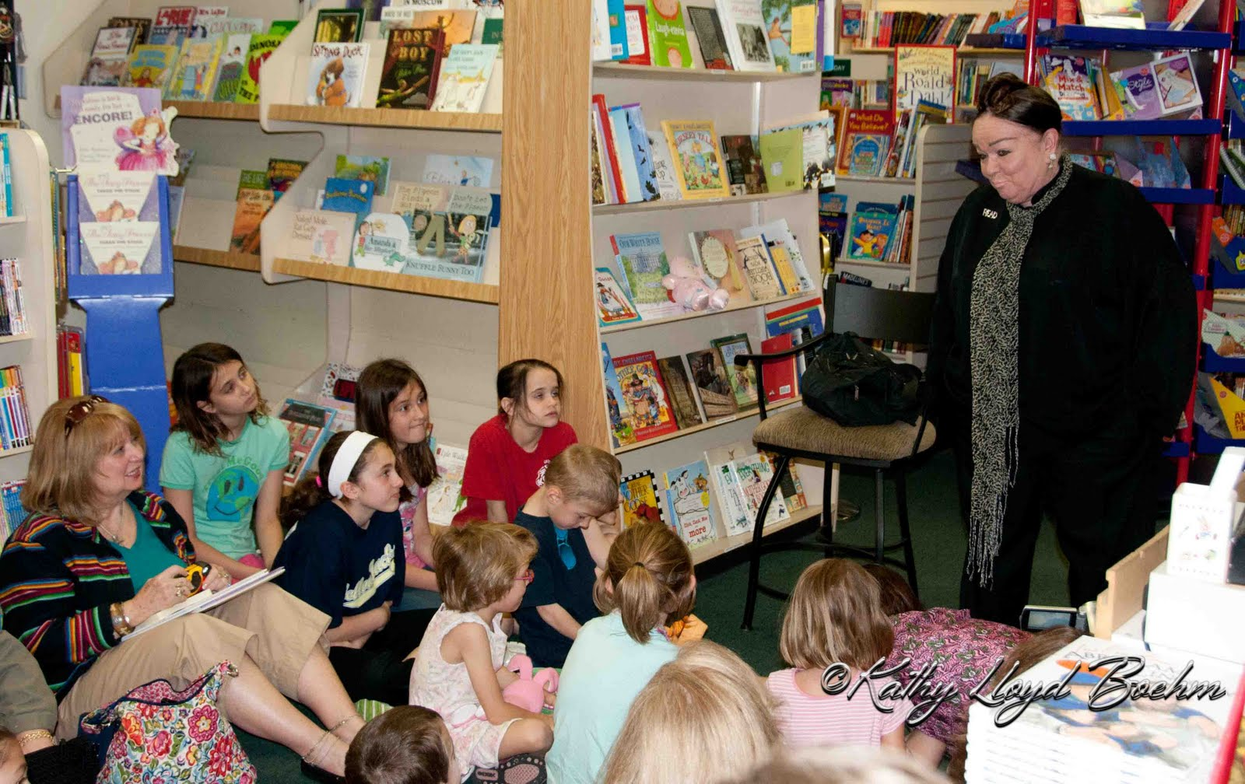
Patterns in Polacco’s books
-Patricia uses real life stories to tell children
-Incredibly influence by her relationship with grandparents.
-She appears as a child in almost every one of her books.
-The books use multicultural situations as well as multigenerational settings.
-Books are mixed with racism problems, multiculturalism and the idea of good and bad.

Slide 7
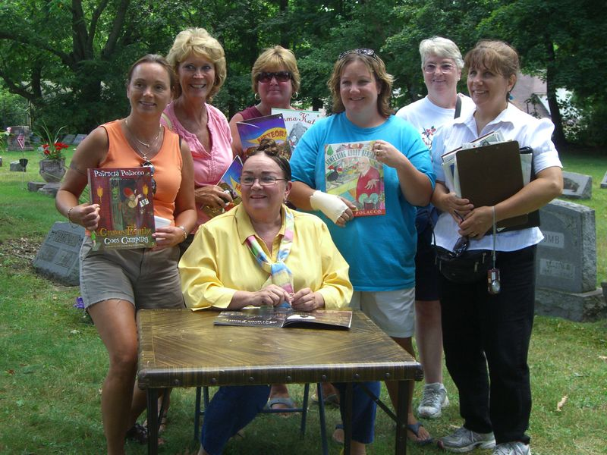
What is she doing now?
-Now Polacco is at her home in Union City.
“Now that I have moved back to Union City I am intending to open my house and community and invite people to come there to take part in writing seminars, story telling festivals, literature conferences and various events that celebrate children's literature."

Slide 8
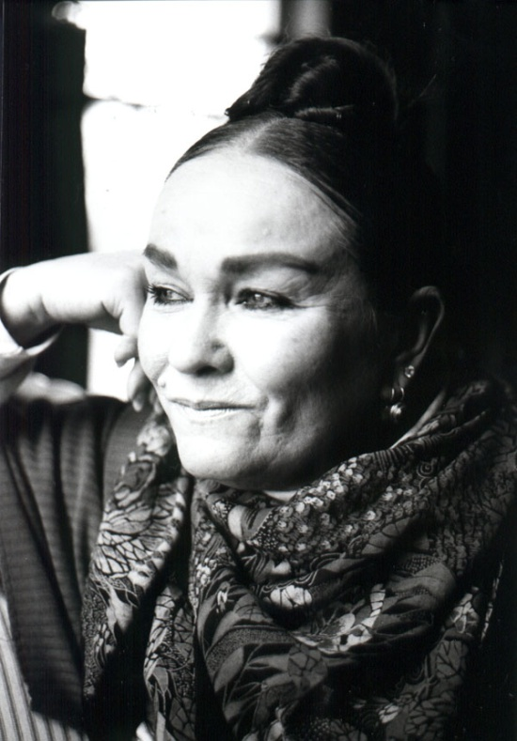
What she wants people to know
http://www.youtube.com/watch?v=4uxlMV8uJAs&feature=relmfu
“I hope that by reading these stories and doing the activities your students will recognize personal connections with family that will help them create new memories and traditions."
"I believe with all my heart that the American classroom teachers are one of our greatest and most heroic treasures. "

