Slide 1
Age of Augustus

Slide 2
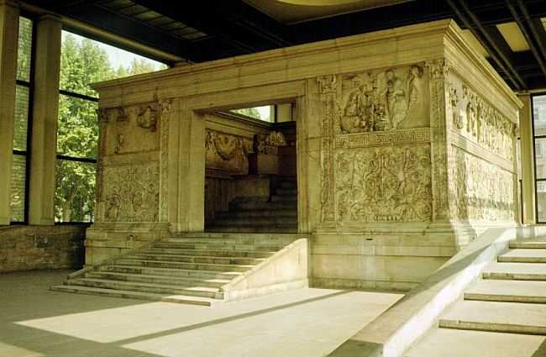
Ara Pacis

Slide 3
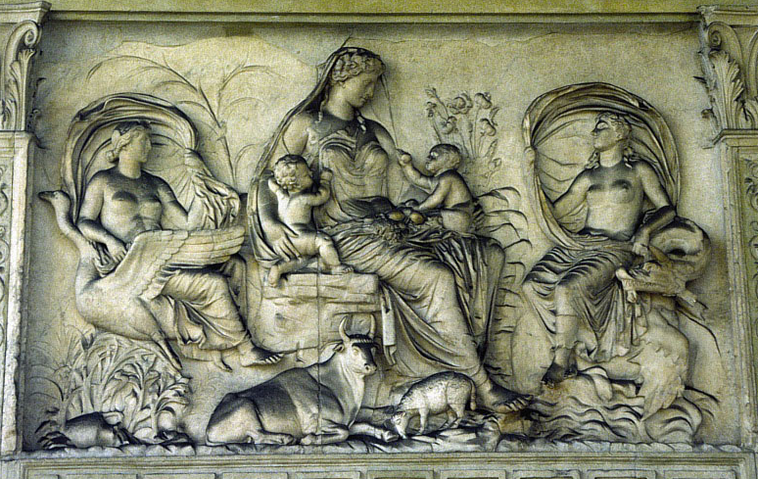
Ara Pacis
Tellus

Slide 4
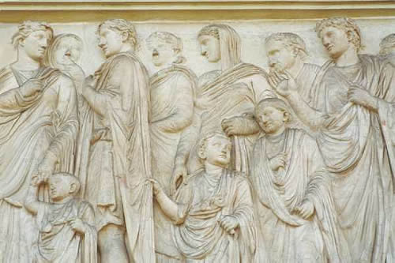
Ara Pacis

Slide 5
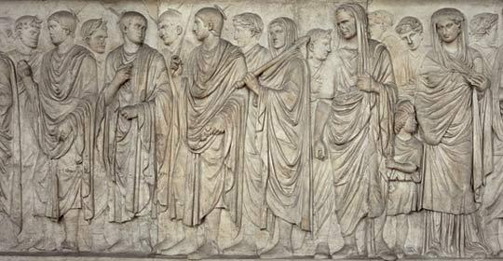
Ara Pacis

Slide 6
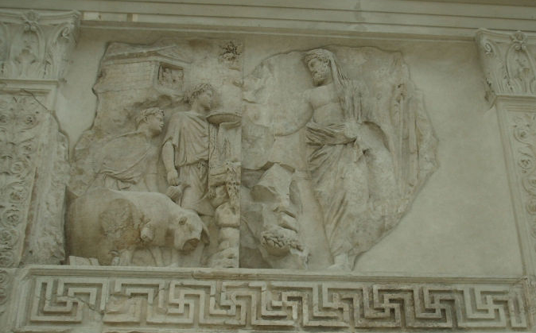
Ara Pacis

Slide 7
Royal Women
Livia (wife)
Octavia (sister)
Julia (daughter)
Agrippina (Elder) Caligula’s mother
Agrippina (Younger) (Nero’s mother)
Meeting ambassadors
Writing memoirs
Influencing policy
Establishing veteran’s colony
Setting up temples (also political)
Inheritance of power through extended family including daughters

Slide 8
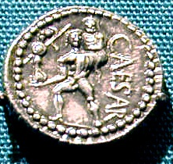
Virgil, Aeneid
Virgil commissioned to compose it in praise of Augustus
Heroic but sensitive to the loss associated with the new world order
Aeneas, “pius Aeneas” as leader who gets his men there alive
Self-sacrifice in retreat from Troy (Creusa)
Dido as a tragic figure

Slide 9
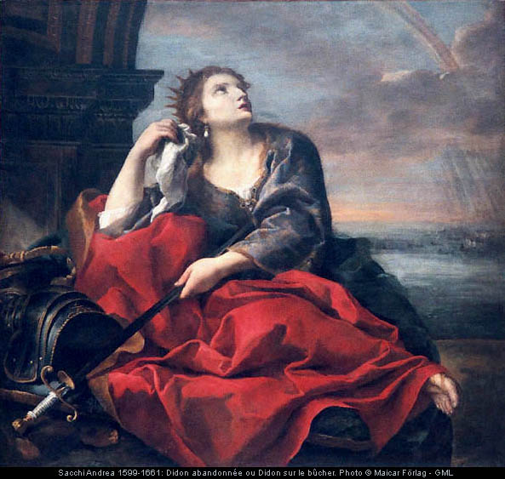
Virgil, Aeneid
Dido:
Former univira
Was she married to Aeneas?
Driven mad by love
Suicide, resentment in the afterlife
Similarity to Cleopatra? (foreign queen tempting “Roman” leader)

Slide 10
Lex Iulia,
Lex Papia Poppaea
Lex Julia (18 BCE)
Lex Papia Poppaea (9 CE)
Whom do these laws benefit??

Slide 11
Lex Iulia,
Lex Papia Poppaea
Senators and their descendants are forbidden to marry freedwomen, or women who have themselves followed the profession of the stage, or whose father or mother has done so; other freeborn persons are forbidden to marry a common prostitute, or a procuress, or a woman manumitted by a procurer or procuress, or a woman caught in adultery, or one condemned in a public action, or one who has followed the profession of the stage.
Ulpianus

Slide 12
Lex Iulia,
Lex Papia Poppaea
The lex Julia for the suppression of adultery punishes with death not only those who dishonor the marriage bed of another man, but also those men who indulge their ineffable lust with males. It punishes the offense of seduction when a male person, without the use of force, deflowers a virgin or seduces a respectable widow. The penalty invoked by the statute against offenders is confiscation of half their estate if they be of respectable standing, corporal punishment and relegation in the case of baser persons.
Justinian

Slide 13
Lex Iulia,
Lex Papia Poppaea
[Augustus] assessed heavier taxes on unmarried men and women without husbands, and by contrast offered awards for marriage and childbearing. And since there were more males than females among the nobility, he permitted anyone who wished (except for senators) to marry freedwomen, and decreed that children of such marriages be legitimate.
Dio Cassius, 3c CE

Slide 14
Lex Iulia,
Lex Papia Poppaea
He reformed the laws and completely overhauled some of them, such as the sumptuary law, that on adultery and chastity, that on bribery, and marriage of the various classes. …As a result of the agitation of its opponents he was unable to get it approved except by abolishing or mitigating part of the penalty, conceding a three-year grace-period (before remarriage) and increasing the rewards (for having children).
Nevertheless, when, during a public show the order of knights asked him with insistence to revoke it … Moreover, when he found out that the law was being sidestepped through engagements to young girls [19] and frequent divorces, he put a time limit on engagement and clamped down on divorce.
Suetonius, Life of Augustus

Slide 15
Lex Iulia,
Lex Papia Poppaea
(1) In the second chapter of the lex Julia concerning adultery, either an adoptive or a natural father is permitted to kill with his own hands an adulterer caught in the act with his daughter in his own house or in that of his son-in-law, no matter what his rank may be.
(2) If a son under paternal power, who is the father, should surprise his daughter in the act of adultery, while it is inferred from the words of the law that he cannot kill her, still, he ought to be permitted to do so.
(3) Again, it is provided in the fifth chapter of the lex Julia that it is permitted to detain an adulterer who has been caught in the act for twenty hours, calling neighbors to witness.

Slide 16
Lex Iulia,
Lex Papia Poppaea
(4) A husband cannot kill anyone taken in adultery except persons who are infamous, and those who sell their bodies for gain, as well as slaves. His wife, however, is excepted, and he is forbidden to kill her.
(5) It has been decided that a husband who kills his wife when caught with an adulterer should be punished more leniently, for the reason that he committed the act through impatience caused by just suffering.
(6) After having killed the adulterer, the husband should at once dismiss his wife, and publicly declare within the next three days with what adulterer, and in what place he found his wife.
(7) A husband who surprises his wife in adultery can only kill the adulterer when he catches him in his own house.

Slide 17
Lex Iulia,
Lex Papia Poppaea
(8) It has been decided that a husband who does not at once dismiss his wife whom he has taken in adultery can be prosecuted as a pimp.
(10) It should be noted that two adulterers can be accused at the same time with the wife, but more than that number cannot be.
(11) It has been decided that adultery cannot be committed with women who have charge of any business or shop. [20]
(12) Anyone who has sexual relations with a free male without his consent shall be punished with death.

Slide 18
Lex Iulia,
Lex Papia Poppaea
(14) It has been held that women convicted of adultery shall be punished with the loss of half of their dowry and the third of their goods, and by relegation to an island. The adulterer, however, shall be deprived of half his property, and shall also be punished by relegation to an island; provided the parties are exiled to different islands.
(15) It has been decided that the penalty for incest, which in case of a man is deportation to an island, shall not be inflicted upon the woman; that is to say when she has not been convicted under the lex Julia concerning adultery.
(16) Sexual intercourse with female slaves, unless they are deteriorated in value or an attempt is made against their mistress through them, is not considered an injury.

Slide 19
Ovid
“A man is really a bumpkin who takes his wife’s unfaithfulness seriously: he doesn’t know enough about the morals of Rome.”
“It’s safer to go second class, I mean go with a freedwoman ..” and never worry about
“her husband just dropping in from the country, the door Splitting open, the dog yapping, the house in an uproar … the wife, thinking now to herself, ‘there goes my dowry,’ while I eye myself sprinting off in a panic, tunic undone …”

Slide 20
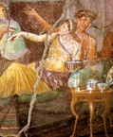
Ovid
“It’s all right to use force – force of that sort goes down well with the girls: what in fact they love to yield They’d often rather have stolen. Rough seduction delights them … the girl who … somehow Got away unscathed, may feign delight, but in fact Feels sadly let down.”

Slide 21
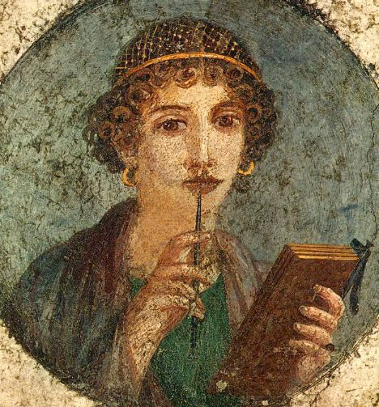
Sulpicia
As a Roman girl of good family, Sulpicia had to maintain her reputation while still expressing passion and love. How does she do it? Consider:
Emotions she expresses
What impression does she give of how she wants to spend her time with Cerinthus?
What does she actually do in the poems (actions she describes or implies)
Life circumstances she describes

