Slide 1
Life Stages
Juvenile to Adulthood

Slide 2
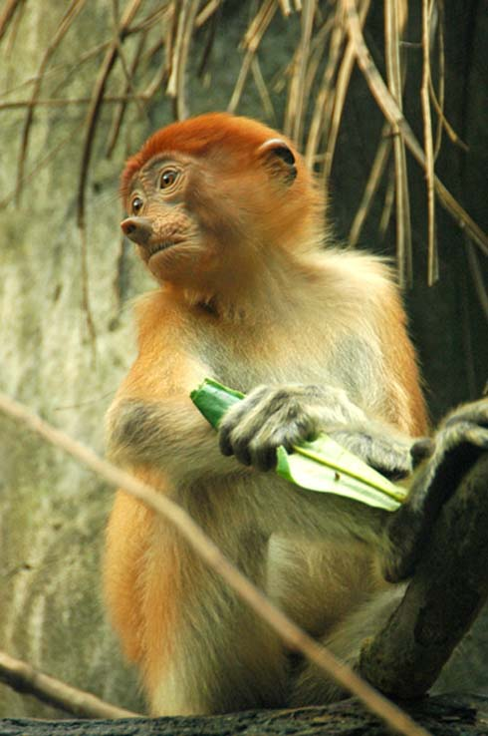
Juvenile
Juvenile: phase of life from weaning to the onset of puberty or sexual maturity
“Phenotypic Limbo” phase
Too old to be treated like infants
Too small to behave like adults
Juvenile proboscis monkey

Slide 3
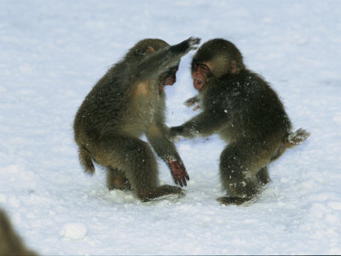
Juvenile
Likely to survive death of primary caregiver
Vulnerable to starvation and predation due to small size
Play declines

Slide 4
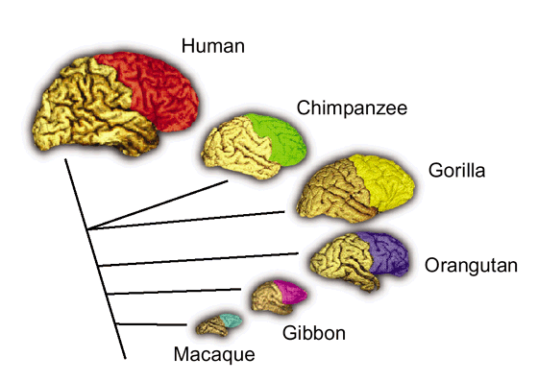
Juvenile
Primates have longest juvenile periods for their body size than other mammals
Why? Hypotheses include:
Primate social systems are complex
Brains take longer to develop
Growth patterns related to adult body size and age at first reproduction

Slide 5
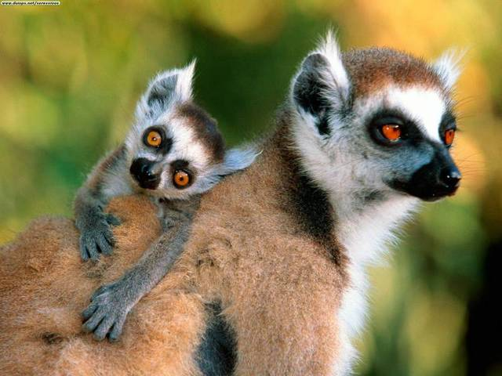
Juvenile
Strategies for reducing risk of death
Minimize juvenile period
Grow fast
Example: lemurs
High infant mortality
Highly seasonal and unpredictable habitats
Rapid growth is key to survival

Slide 6
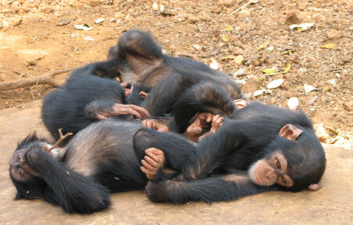
Juvenile
Strategies for reducing risk of death
Maximize juvenile period
Grow slowly
Example: anthropoids
Reduced metabolic needs and less food required
Sacrifice rapid growth to stay alive longer

Slide 7
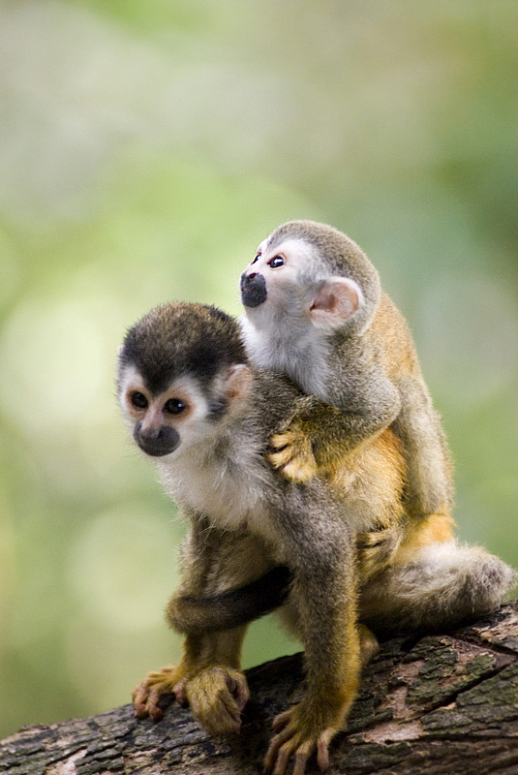
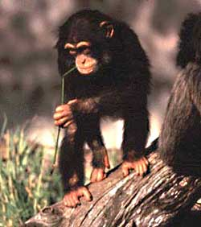
Juvenile
What juvenile primates do
Play
Learn
Female chimps observe mothers “termite fishing”
Male chimps learn later, play more
Gain experience
Detecting predators
Responding to alarms

Slide 8
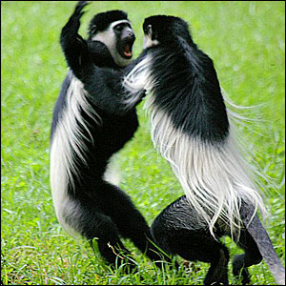
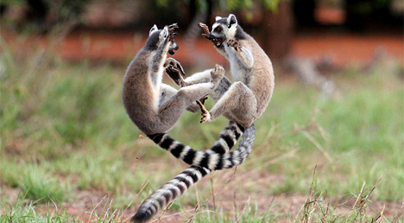
Juvenile
Play
Develop and practice social and motor skills
Rough contact games
Hitting
Biting
Wrestling

Slide 9
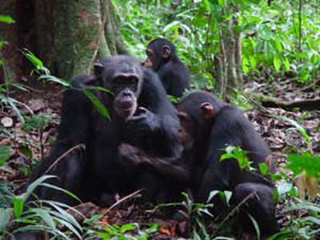
Juvenile
Social skills
Matrilocal groups
Females become more central; males peripheral
Patrilocal groups
Males shift their affiliations from mothers and peers to adult males
Following
Sitting nearby
Embracing
Juvenile and adult male chimp eating nuts

Slide 10
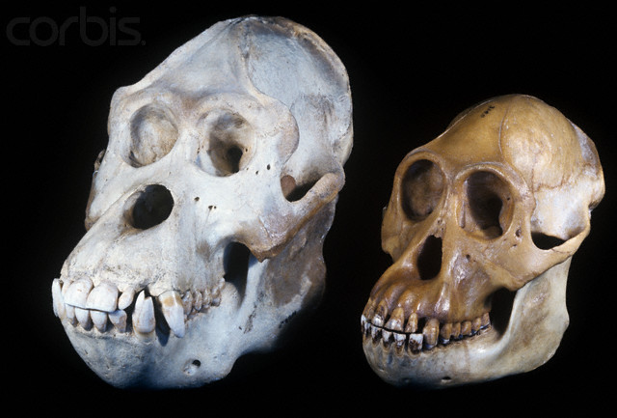
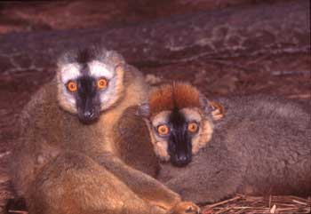
Puberty
Process of sexual maturation
Sexually dimorphic species: females mature faster
Sexually monomorphic species: more comparable
Orangutans
Female (l) and male (r) red-fronted lemur

Slide 11
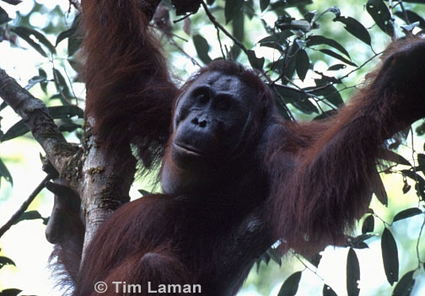
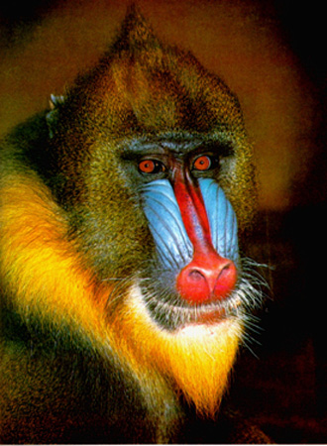
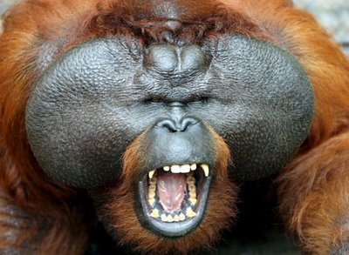
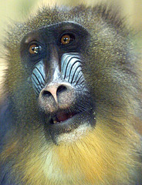
Puberty
Arrested development of secondary sexual traits can occur
Orangutans
Mandrills

Slide 12
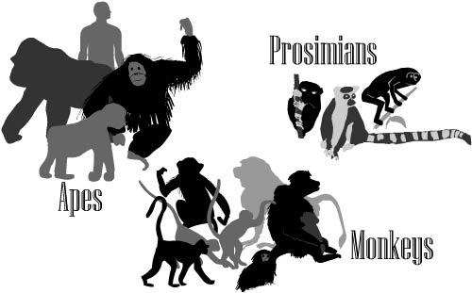
Adulthood
Reproductive lifespan: puberty through death; reproductively active period
Variation in mortality within and between species
Drought: e.g., lactating ring-tailed lemur mothers
Infectious disease: e.g., young, reproductively active Japanese macaques; less in older post reproductive females
Predation: e.g., dispersing adult male yellow baboons; lower in males living in groups

Slide 13
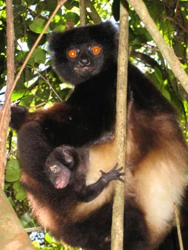
Adulthood
Effects of aging
Females: e.g., Milne-Edwards’ sifakas
Later births, lower infant survival
Canine dental wear: around age 18; lifespan ~late 20’s
Affects food-getting and feeding infants

Slide 14
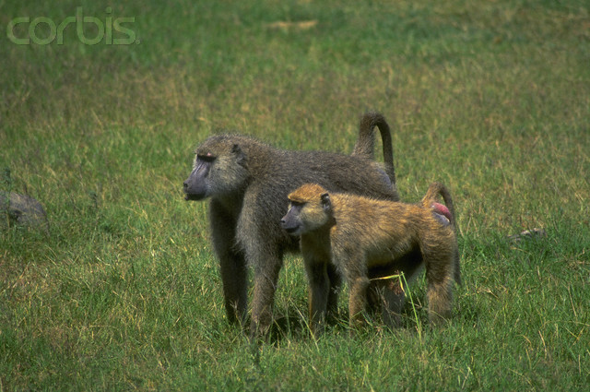
Adulthood
Effects of aging
Males: competition is risky; behavior changes
During their prime: aggressive challengers toward other males
As they age: social benefactors toward females, allies of their sons, or transients who mate whenever they can
Examples: yellow and olive baboons
Male and female yellow baboons

Slide 15
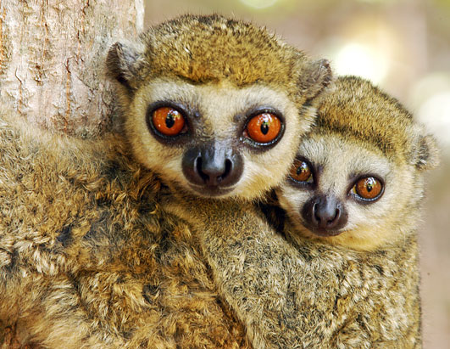
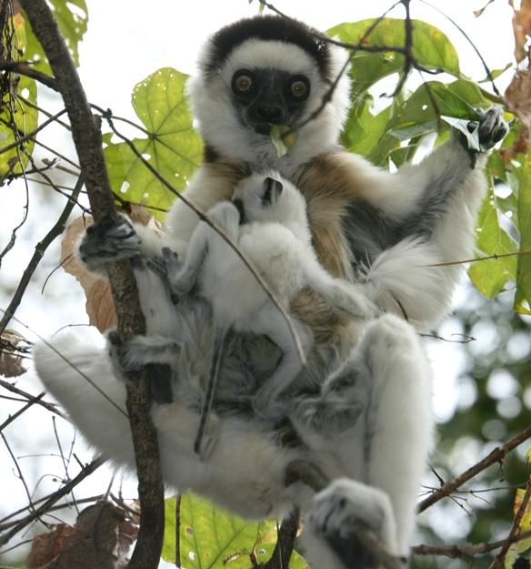
Life Histories and Populations
Western woolly lemurs
Income breeders
Convert available resources into immediate reproductive effort (e.g., most lemurs)
Faster life history
Capital breeders
Store resources for future reproductive effort (e.g., sifaka)
Slower life history
Sifakas

Slide 16
The End
Review: Female and Male Relationships and Life Stages

