Slide 1
Top-down breadth-first Parse

Slide 2
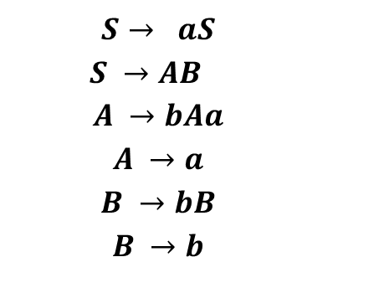
Example Grammar
Example String to Parse
$$S→ aS$$
$S →AB$
$$A →bAa$$
$$A →a$$
$$B →bB$$
$$B →b$$
S
baab

Slide 3
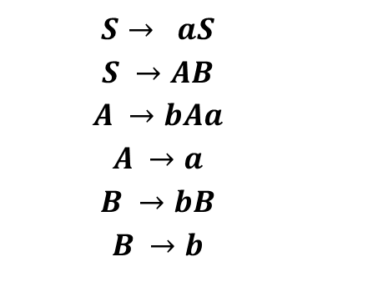
Example Grammar
$$S→ aS$$
$$S →AB$$
$$A →bAa$$
$$A →a$$
$$B →bB$$
$$B →b$$
1
2
S
baab
1
2
baab
aS
AB

Slide 4
Example Grammar
$$S→ aS$$
$$S →AB$$
$$A →bAa$$
$$A →a$$
$$B →bB$$
$$B →b$$
S
baab
3
4
baab
aS
AB
3
4
baab
baab
bAaB
aB

Slide 5
Example Grammar
$$S→ aS$$
$$S →AB$$
$$A →bAa$$
$$A →a$$
$$B →bB$$
$$B →b$$
S
baab
3
4
baab
aS
AB
baab
baab
bAaB
aB
baab
3
4
baab
bbAaaB
baaB

Slide 6
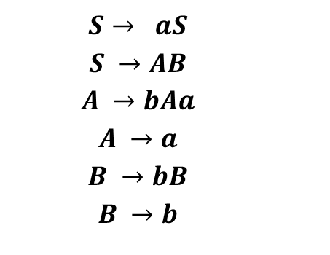
Example Grammar
$$S→ aS$$
$$S →AB$$
$$A →bAa$$
$$A →a$$
$$B →bB$$
$$B →b$$
5
6
S
baab
1
2
baab
aS
AB
3
4
baab
baab
bAaB
aB
3
4
baab
baab
bbAaaB
baaB
5
6
baab
baab
baabB
baab

Slide 7
Example Grammar
$$S→ aS$$
$$S →AB$$
$$A →bAa$$
$$A →a$$
$$B →bB$$
$$B →b$$
1
2
3
4
5
6
S
baab
1
2
baab
aS
AB
3
4
baab
baab
bAaB
aB
3
4
baab
baab
bbAaaB
baaB
5
6
baab
baab
baabB
baab

