Slide 1
Bottom-Up breadth-first Parse

Slide 2
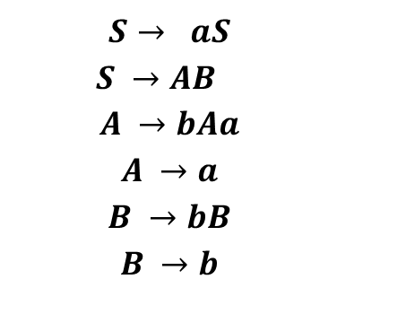
Example Grammar
Example String to Parse
$$S→ aS$$
$S →AB$
$$A →bAa$$
$$A →a$$
$$B →bB$$
$$B →b$$
baab
baab

Slide 3
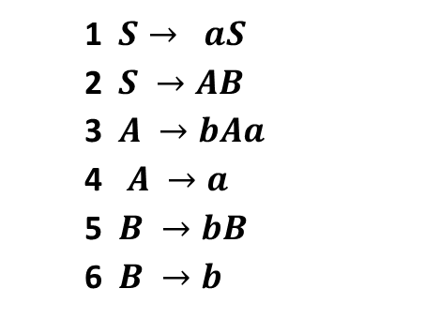
Example Grammar
Example String to Parse
1 $S→ aS$
2 $S →AB$
3 $A →bAa$
4 $A →a$
5 $B →bB$
6 $B →b$
baab
baab
6
4
4
6
baaB
baAb
bAab
Baab

Slide 4
Example Grammar
Example String to Parse
1 $S→ aS$
2 $S →AB$
3 $A →bAa$
4 $A →a$
5 $B →bB$
6 $B →b$
baab
baab
6
4
4
6
baaB
baAb
bAab
Baab
6
6
4
3
6
4
4
baAB
bAaB
bAAb
Ab
BaaB
BaAb
BAab

Slide 5
Example Grammar
Example String to Parse
1 $S→ aS$
2 $S →AB$
3 $A →bAa$
4 $A →a$
5 $B →bB$
6 $B →b$
baab
baab
6
4
4
6
baaB
baAb
bAab
Baab
6
6
4
3
6
4
4
baAB
bAaB
bAAb
Ab
BaaB
BaAb
BAab
2
6
6
6
6
4
baS
bAAB
AB
BaAB
BAaB
BAAb

Slide 6
Example Grammar
Example String to Parse
1 $S→ aS$
2 $S →AB$
3 $A →bAa$
4 $A →a$
5 $B →bB$
6 $B →b$
baab
baab
6
4
4
6
baaB
baAb
bAab
Baab
6
6
4
3
6
4
4
baAB
bAaB
bAAb
Ab
BaaB
BaAb
BAab
2
6
6
6
6
4
baS
bAAB
AB
BaAB
BAaB
BAAb
1
2
2
bS
bAS
S

Slide 7
Example Grammar
Example String to Parse
1 $S→ aS$
2 $S →AB$
3 $A →bAa$
4 $A →a$
5 $B →bB$
6 $B →b$
baab
baab
6
4
4
6
baaB
baAb
bAab
Baab
6
6
4
3
6
4
4
baAB
bAaB
bAAb
Ab
BaaB
BaAb
BAab
2
6
6
6
6
4
baS
bAAB
AB
BaAB
BAaB
BAAb
1
2
2
bS
bAS
S

