Slide 1
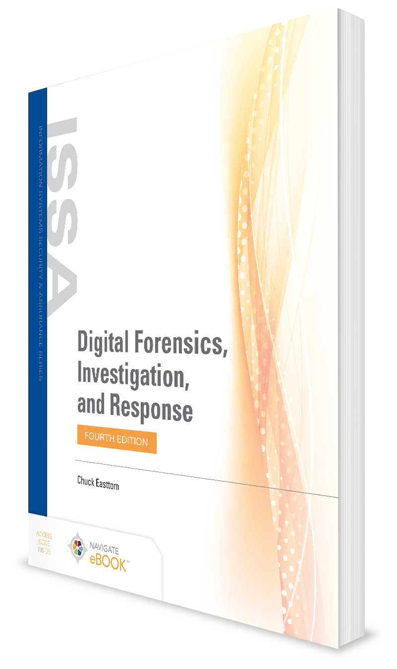
Understanding Techniques for Hiding and Scrambling Information
CHAPTER 5

Slide 2
Learning Objective(s) and Key Concepts
Learning Objective(s)
Key Concepts
Explain techniques for hiding and scrambling information as well as how data is recovered.
Steganography
Cryptography and encryption
General cryptanalysis techniques

Slide 3
Steganography
The art and science of writing hidden messages
The goal is to hide information so that even if it is intercepted, it is not clear that information is hidden there
Most common method of performing this technique is the least significant bit (LSB) method

Slide 4
Steganography (Cont.)
LSB method:
  Consider 11111111
  Change last digit to 0
  11111110=254 in decimal
  The last bit, or least significant bit, is used to store data

Slide 5
Steganography (Cont.)
Example: Colored pixels in a computer stored in bits
The Windows color palette in the Edit Colors dialog box
<Insert Figure 5-1>

Slide 6
Steganography (Cont.)
Windows color
Windows color changed by one bit

Slide 7
Steganography (Cont.)
Payload
Carrier
Channel
Basic steganography terms

Slide 8
Historical Steganography
Ancient Chinese wrapped notes in wax and swallowed them for transport
In ancient Greece, message written on slave's shaved head, then hair allowed to grow back
During World War II, French Resistance sent messages written on the backs of couriers using invisible ink

Slide 9
Other Forms of Steganography
Steganophony
Hiding messages in sound files
Video steganography
Hiding information in videos files
Advanced steganography
Bit-Plane Complexity Segmentation Steganography (BPCS)

Slide 10
Steganalysis
The process of analyzing a file or files for hidden content
Can show a likelihood that a given file has additional information hidden in it
Common method for detecting LSB steganography is to examine close-color pairs

Slide 11
Invisible Secrets
Choose to hide a file or extract a hidden file in the Invisible Secrets Select Action dialog box

Slide 12
Invisible Secrets (Cont.)
Select an image to use as the carrier file in the Invisible Secrets Select Carrier File dialog box

Slide 13
Invisible Secrets (Cont.)
Select the file to hide in the Invisible Secret Select Source Files dialog box

Slide 14
Invisible Secrets (Cont.)
Select a password in the Invisible Secrets Encryption Settings dialog box

Slide 15
Invisible Secrets (Cont.)
Name the new file in the Invisible Secrets Target File Settings dialog box

Slide 16
MP3Stego and Deep Sound
MP3Stego
MP3Stego hides data in MP3 files
Deep Sound
Free download that allows one to hide files in MP3, WAV, CDA, and other file formats
MP3Stego readme file provides instructions
Simple program freely available on the internet
Easy to use, self-explanatory
Its ease of use makes finding steganographically hidden evidence more likely than in the past

Slide 17
MP3Stego and Deep Sound (Cont.)
Deep Sound main screen

Slide 18
Encryption
Encryption obfuscates a message so it cannot be read
Cryptography is the study of writing secret messages
The word cryptography is derived from the word kryptós, which means hidden, and the verb gráfo, which means write

Slide 19
Encryption vs. Steganography
Steganography
Message hidden
Encryption/Cryptography
Message present but obfuscated

Slide 20
The History of Encryption
The Caesar cipher:
  Referred to as a substitution cypher
  A simple encryption method that is very easy to crack
  Choose some number by which to shift each letter of a text
  Substitute the new alphabetic letter for the letter being encrypted
  Example:
  Text is:
    A CAT
  You choose to shift by two letters, then A replaces C, E replaces C, C replaces A and V replaces T; encrypted message is:
    C ECV
  If shift by three letters, message is:
    D FDW
  Key terms:
    Text you want to encrypt is plaintext
    After the algorithm and key: ciphertext

Slide 21
Other Ciphers
The Atbash Cipher
Reverses the alphabet—substituting the first letter of the alphabet for the last letter, the second letter for the second-to-last letter, and so on
Is primitive and easy to break
The ROT13 Cipher
A permutation of the Caesar cipher
All characters are rotated 13 characters through the alphabet
A CAT becomes N PNG
The Scytale Cipher
Encrypts messages by wrapping a leather strip around a cylinder or baton, and writing across the leather
Turning cylinder produced different ciphertexts
Message decrypted by reading the message once placed over the same leather “key” wrapped around the same size cylinder

Slide 22
The Playfair Cipher
Works by encrypting pairs of letters, also called digraphs, at a time
Uses a 5 × 5 table that contains a keyword or key phrase
To use the Playfair cipher, one need only memorize that keyword and four rules
Example: “Attack at dawn” becomes "At ta ck at da wn"

Slide 23
The Playfair Cipher (Cont.)
F | A | L | C | O
N | B | D | E | G
H | I/J | K | M | P
Q | R | S | T | U
V | W | X | Y | Z

Slide 24
The Playfair Cipher (Cont.)
A | L | C
B | D | E
I/J | K | M
R | S | T

Slide 25
The Playfair Cipher (Cont.)
A | L | C
B | D | E
I/J | K | M

Slide 26
Multialphabet Substitution
Uses multiple numbers by which letters in plaintext are shifted
Multiple substitution alphabets are created
Represents a slight improvement on the Caesar cipher but is still easily cracked
Example:
  If you select three substitution alphabets (+2, -2, +3)
  A CAT becomes C ADV

Slide 27
The Vigenère Cipher
Vigenère table

Slide 28
The Enigma Machine
World War II, electromechanical rotor-based cipher system
Is a multialphabet substitution cipher using machinery to accomplish the encryption
When operator pressed a key, encrypted ciphertext for plaintext was altered each time

Slide 29
Modern Cryptography
Two main types:
symmetric and asymmetric
Symmetric cryptography uses the same key to encrypt and decrypt plaintext
Asymmetric cryptography uses different keys to encrypt and decrypt plaintext

Slide 30
Symmetric Cryptography
Uses the same key to encrypt and decrypt plaintext
Can use two different encryption keys, one from sender and one from receiver to sender
Same key is still used for encryption and decryption
Having different keys in both directions provides additional security if keys are learned or disclosed

Slide 31
Substitution and Transposition
Substitution is changing some part of the plaintext for some matching part of the ciphertext
Transposition is the swapping of blocks of ciphertext
All modern block-cypher algorithms use both substitution and transposition
Combination of substitution and transposition increases security of resultant ciphertext by making cryptanalysis more complex

Slide 32
Block Ciphers and Stream Ciphers
Block cipher
Encrypts data in groups of bits, also known as blocks
Stream cipher
Encrypt data as a stream, one bit at a time

Slide 33
The Feistel Function
Feistel function

Slide 34
Data Encryption Standard (DES)
Data is divided into 64-bit blocks
Data is manipulated by 16 separate steps of encryption involving substitutions, bit-shifting, and logical operations using a 56-bit key
Data is then further scrambled using a swapping algorithm
Data is transposed one last time

Slide 35
Triple DES (3DES)
Created as an interim solution to DES
Does DES three times, with three different keys

Slide 36
Advanced Encryption Standard (AES)
Also known as the Rijndael block cipher
Can have three different key sizes:
  128, 192, or 256 bits
  All three operate on a block size of 128 bits
Referred to as AES 128, AES 192, and AES 256

Slide 37
Advanced Encryption Standard (AES) Steps
Key expansion
Initial round
AddRoundKey
Rounds
SubBytes
ShiftRows
MixColumns
AddRoundKey
Final round
SubBytes
ShiftRows
AddRoundKey

Slide 38
Cryptographic Hashes
Hashing is a type of cryptographic algorithm with some specific characteristics:
It is one-way, not reversible
It is a fixed-length output no matter what input is given
The algorithm must be collision resistant

Slide 39
Asymmetric Cryptography
Cryptography wherein two keys are used
One to encrypt the message
Another to decrypt it

Slide 40
RSA
Described in 1977 by Ron Rivest, Adi Shamir, and Leonard Adleman at MIT
Perhaps one of the most widely used asymmetric algorithms today
Is based on relationships of prime numbers
Security of RSA derives from fact that it is difficult to factor a large integer composed of two or more large prime factors

Slide 41
Diffie-Hellman
A cryptographic protocol that allows two parties to establish a shared key over an insecure channel
Often used to allow parties to exchange a symmetric key through some insecure medium, such as the internet
Enabled all secure communications between parties that did not have a pre-established relationship, such as e-commerce

Slide 42
Breaking Encryption
Cryptanalysis is using techniques other than brute force to attempt to uncover a key
  Also referred to as academic or knowledge-based code breaking
Cryptographic techniques may be used to test the efficacy of a cryptographic algorithm
  Such as to test hash algorithms for collisions
Methods
Frequency analysis
Kasiski examination
Modern methods
  Known plaintext attack
  Chosen plaintext attack
  Ciphertext-only
  Related-key attack

Slide 43
Frequency Analysis
In natural languages, certain letters of alphabet appear more frequently than others
By examining frequencies, can derive some information about the key used
Method effective against classic ciphers, but not modern methods of cryptography

Slide 44
Kasiski Examination
A method of attacking polyalphabetic substitution ciphers, such as Vigenère
Can be used to deduce the length of the keyword used in a polyalphabetic substitution cipher
When length of keyword is discovered, ciphertext is lined up in n columns, where I is keyword length
Each column
  Treated as a monoalphabetic substitution cipher
  Can be cracked with frequency analysis
Involves looking for repeated strings in the ciphertext

Slide 45
Cracking Modern Cryptographic Methods
Known plaintext attack
Chosen plaintext attack
Ciphertext-only
Related-key attack

Slide 46
Rainbow Tables/Ophcrack
Ophcrack

Slide 47
John the Ripper
A password cracker popular with network administrators and hackers
Enables user to select text files of word lists to attempt cracking a password
Command-line based, no Windows interface

Slide 48
Quantum Computing and Cryptography
Quantum computers store data in quantum states rather than in traditional bits
Quantum computers are good at factoring large integers into their prime factors and solving discrete logarithm problems
RSA security is based on the difficulty of factoring large integers into their prime factors
Diffie-Hellman (and variations like ElGamal and MQV) security is based on the difficulty of solving the discrete logarithm problem
When we have a fully working quantum computer, these algorithms will no longer be secure

Slide 49
Summary
Steganography
Cryptography and encryption
General cryptanalysis techniques

