Slide 1
DAFOSTest way to do an exam (But certainly not the fastest!)
Digital Analysis with Free and Open Source Tools

Slide 2
We can begin the examination by listing our what tools we need.
FTK Imager (Free)
RegRipper (Free)
Registry Explorer (Free and Open Source)
Cain (Free)
WinPrefetch View (Free)
PhotoRec (Free)
Autopsy (Free and Open Source)
DB Browser (Free)
Bulk Extractor (Free)
Windows Explorer (Free-ish)
Event Viewer (Free-ish)
Dcode (Free)
…and Others (Free/Free and Open Source)

Slide 3
Assumptions
This lecture assumes that:
The original evidence item has been properly tracked by chain of custody, protected by write blocking and the examiner has legal authority in the matter.
Further, that the original evidence item and the copy, called a forensic image, match each other by hash validation. MD5 and SHA1 being commonly used for this purpose, the image examined here matches by MD5.
Examinations can be (and are) performed on live evidence, but when this occurs examiners must understand and be able to articulate the many changes to the evidence they themselves are making.

Slide 4
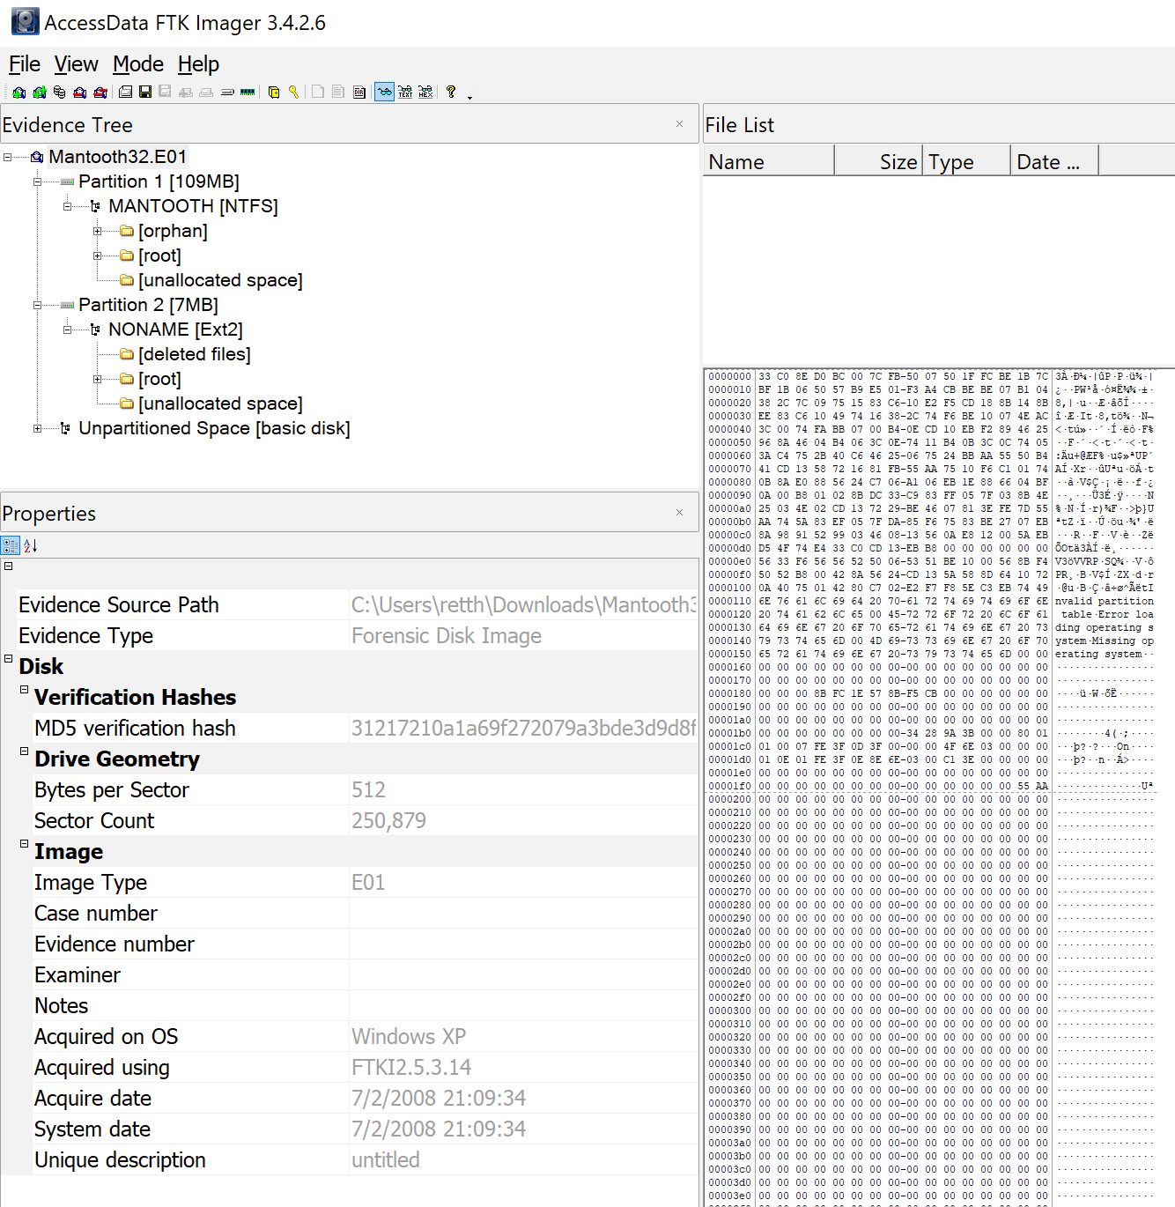
Verify our image and account for all space.
Account for Partition sizes and unallocated space, determine how much of each by calculating total disk size
(BPS * SC).

Slide 5
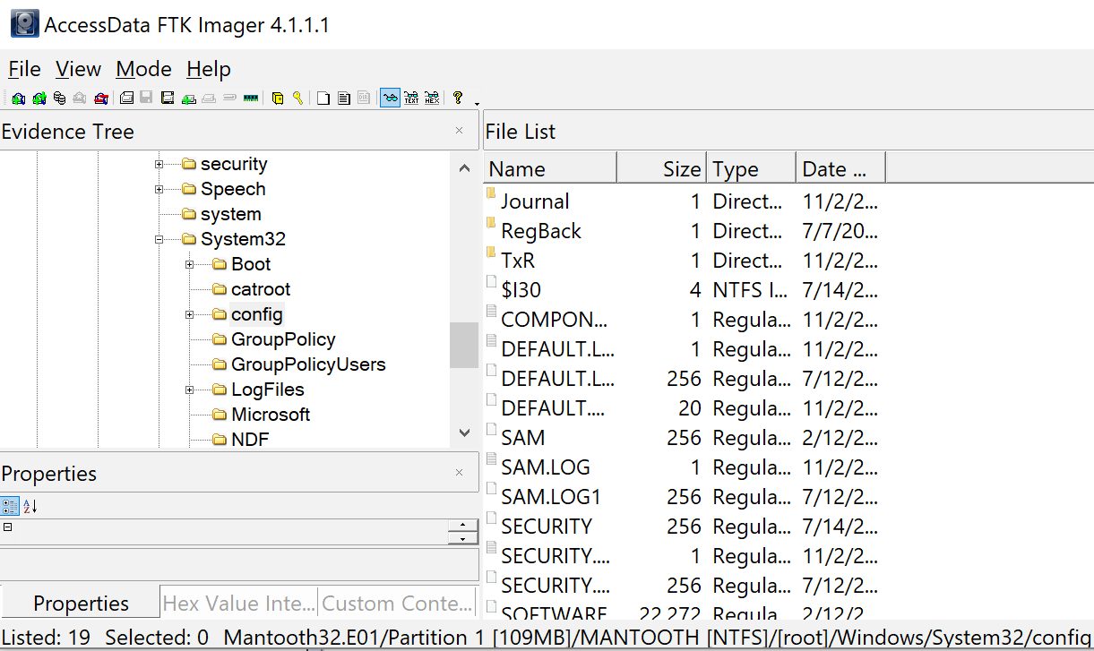
Orient our knowledge of system times and usage
Export relevant registry files (SAM, Software, System) from \Windows\System32\Config\

Slide 6
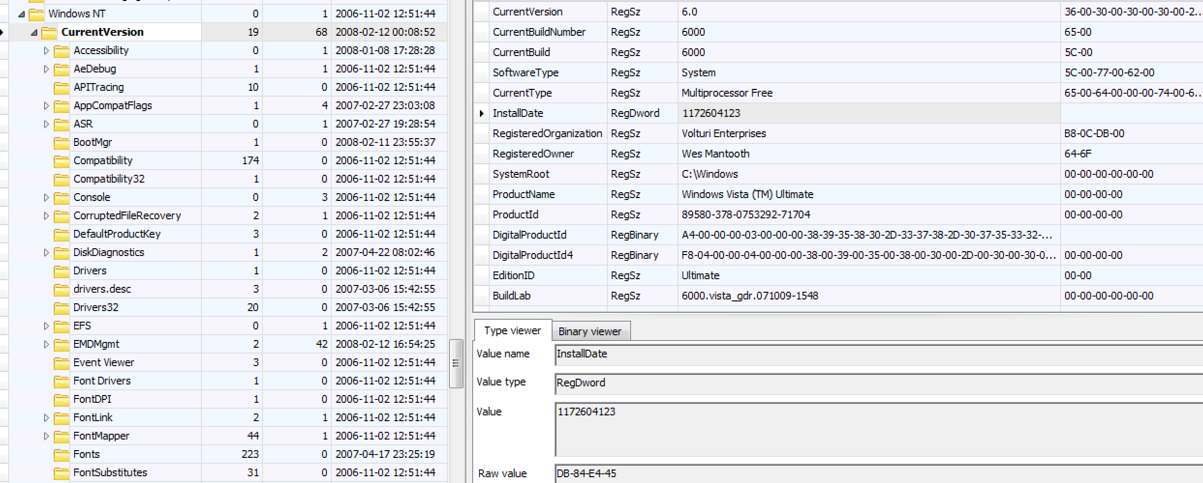
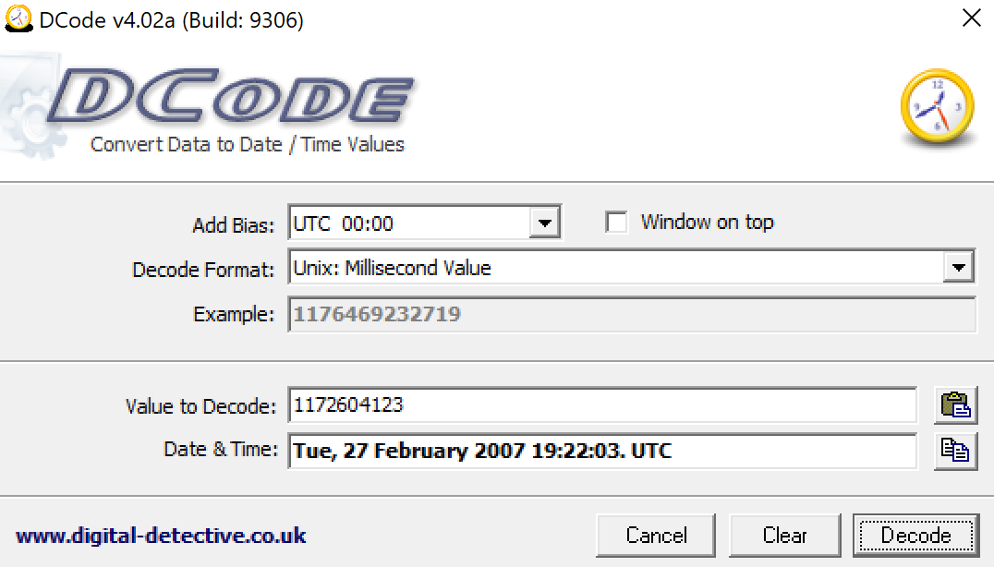
Software can tell us install date

Slide 7
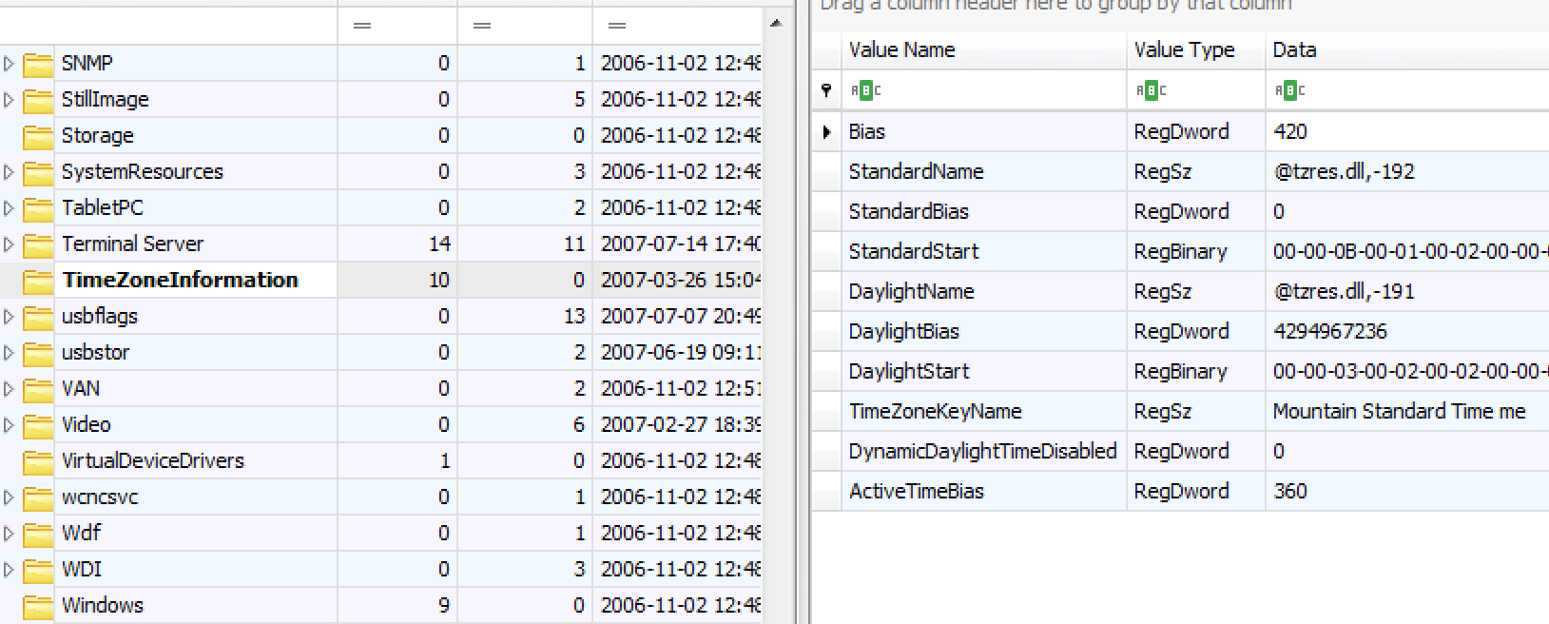
System gives us Time Zone
If we are in Eastern time and assumed the evidence was set to Eastern, all dates would be off by 2 hours!!

Slide 8
The system “Owner” from Software
Registry Explorer and Autopsy both provide this information. Most processes can be performed with multiple tools.

Slide 9
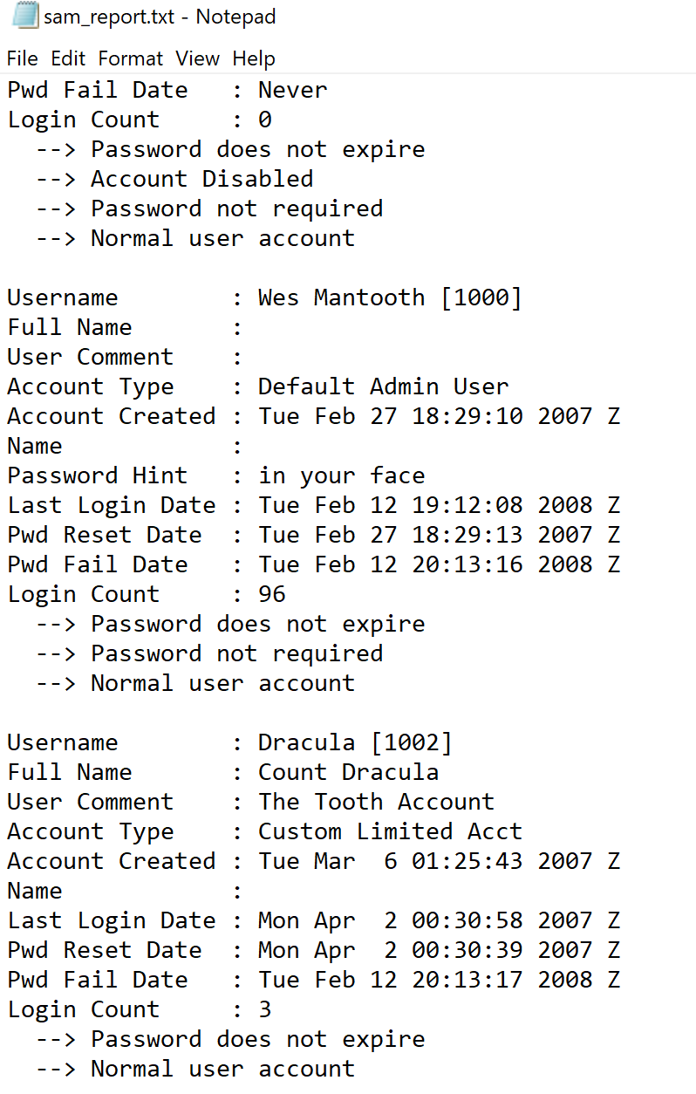
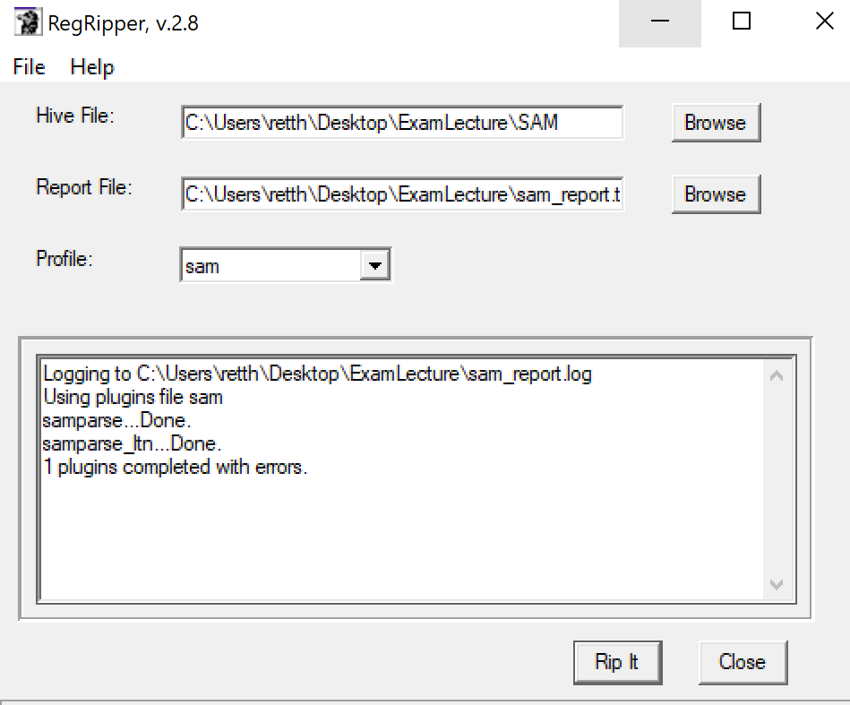
SAM gives us the most active user (by logins)
RegRipper profile for SAM gives us Wes Mantooth as most active user.

Slide 10
How else can we know?
User\Names will have a value stored under each name showing us which key contains that user name’s data. For Wes, it is 0x3E8
For Vista Ultimate, at 0x42 we find the hex value 60. In decimal this is 96, our login count for Wes Mantooth.

Slide 11
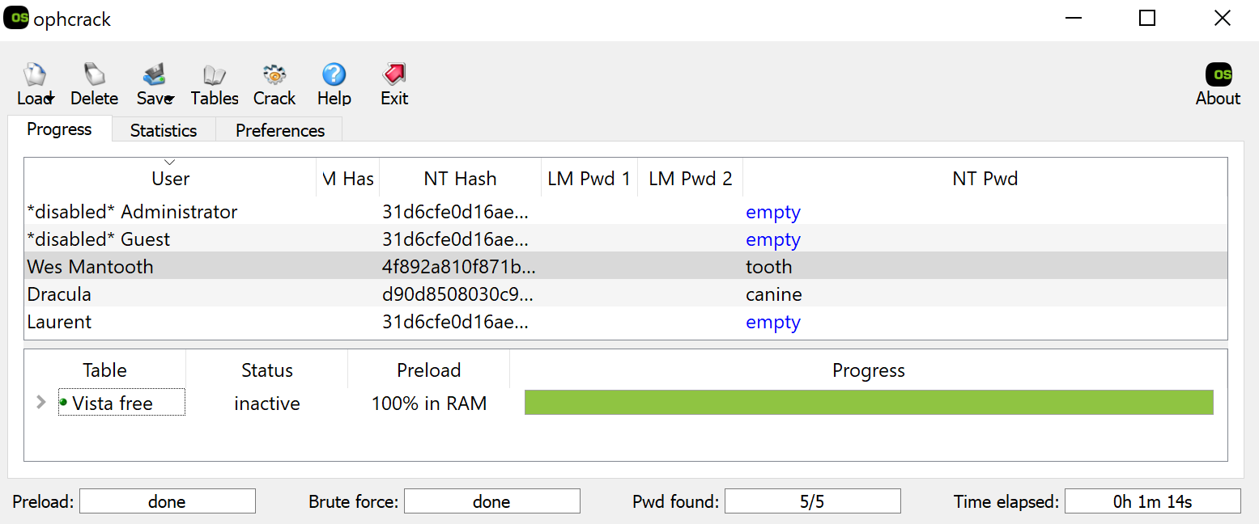
Cracking local passwords (This doesn’t apply for Domain or Microsoft Live login)
You will need the SAM and System registry files for this process.

Slide 12
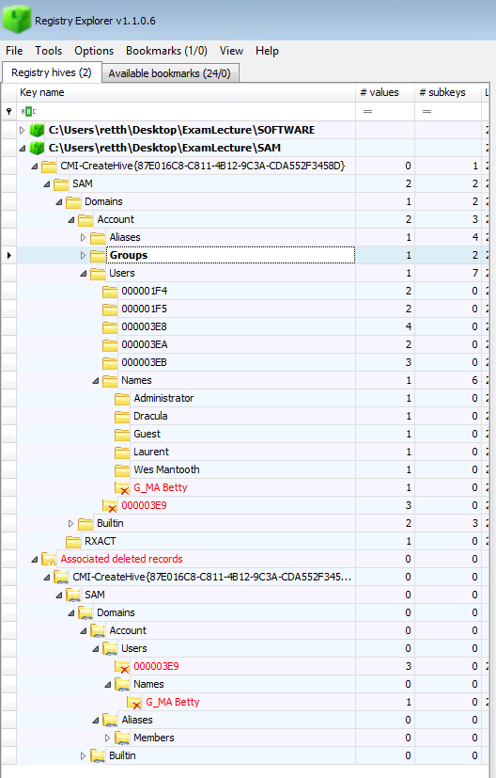
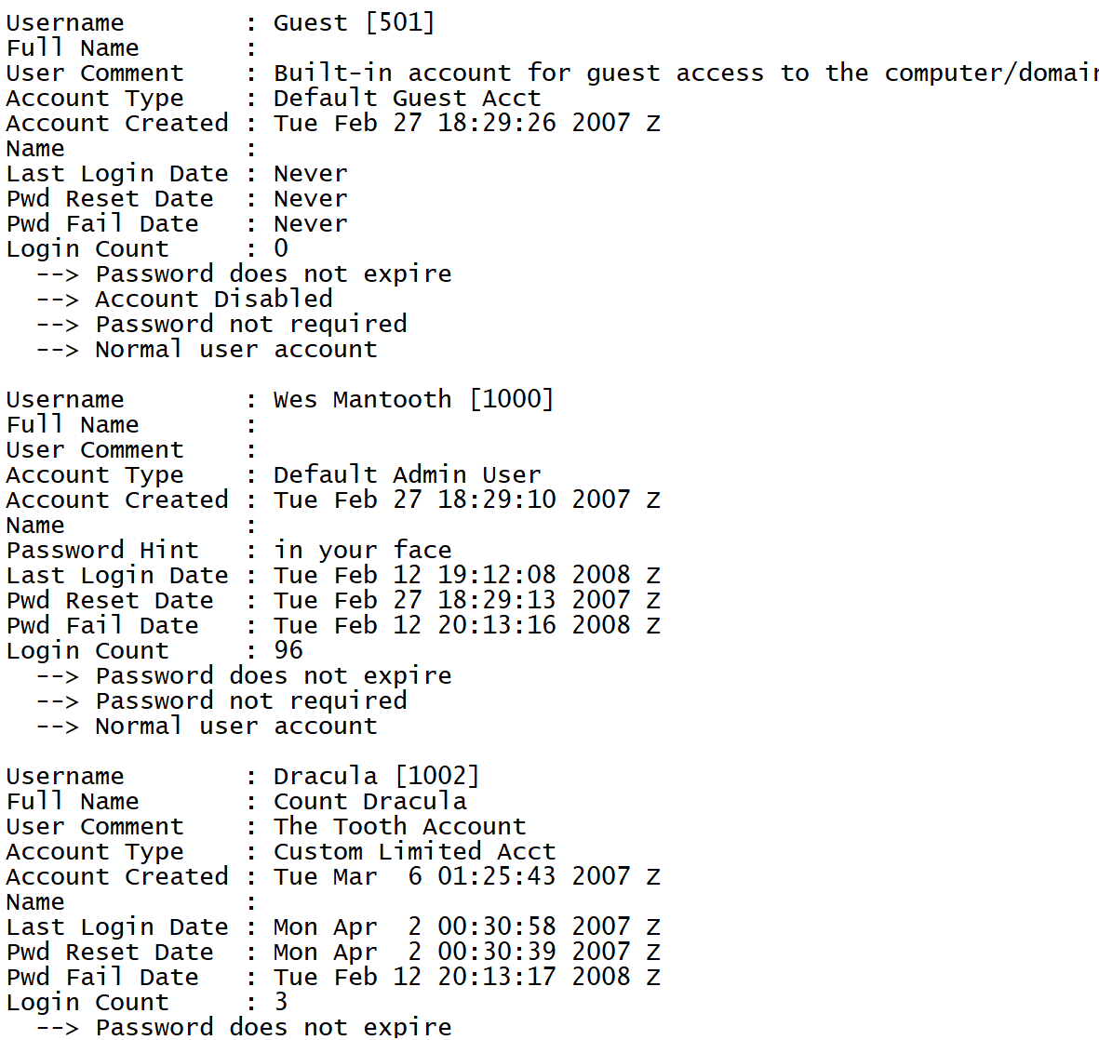
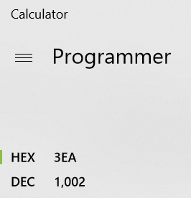
User Security Identifier
The SID for the account in Hex from Registry Explorer and in Dec from RegRipper.

Slide 13
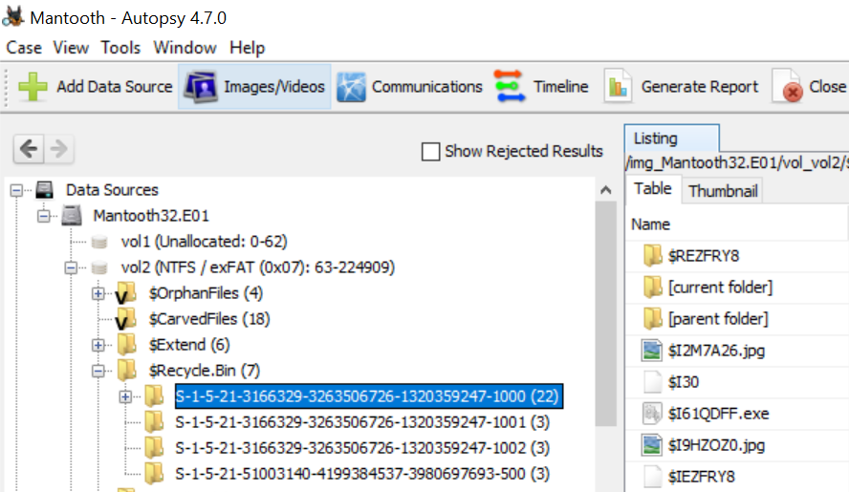
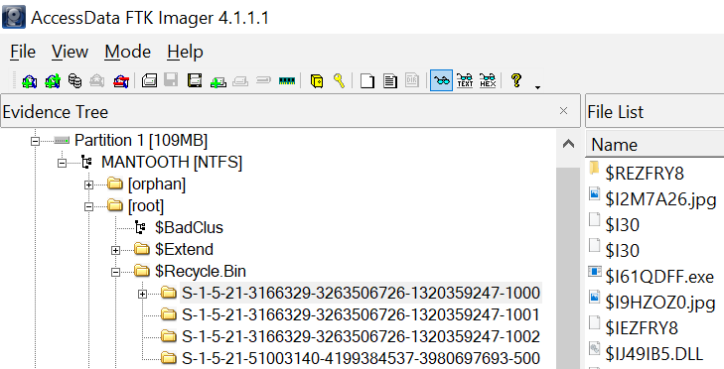
Recycle Bin folders are per user and end with the SID.
Browsing to the files in FTK Imager and in Autopsy.

Slide 14
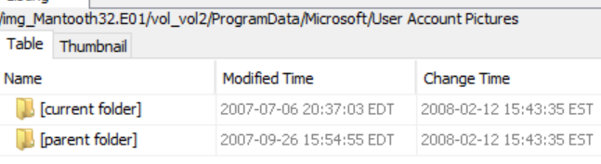
User tile
The picture isn’t located where it should be, but we can find a copy in the SAM.

Slide 15
Recovery of Tile from SAM
The hex data obtained from the SAM will need to be put into notepad so that the “-” characters are removed before pasting it into a hex editor.
Remove the hex before the file signature 42 4D and save the file as a .bmp

Slide 16
Autopsy Linux Installation
Learn to use Yum
yum update, yum upgrade, yum install
Get the appropriate packages installed:
yum install libewf, yum install sleuthkit, etc
Download remainder from www.sleuthkit.org
May require using rpm to install a .rpm package
Recommended java libraries may be from Azul
https://www.azul.com/downloads/zulu-community/
Check latest Autopsy/Sleuthkit release install instructions for specific versions.
Set JAVA_HOME environment variable
Sleuthkit (./configure, make, make install)
Autopsy (sh unix_setup.sh)
May require sudo su -

Slide 17
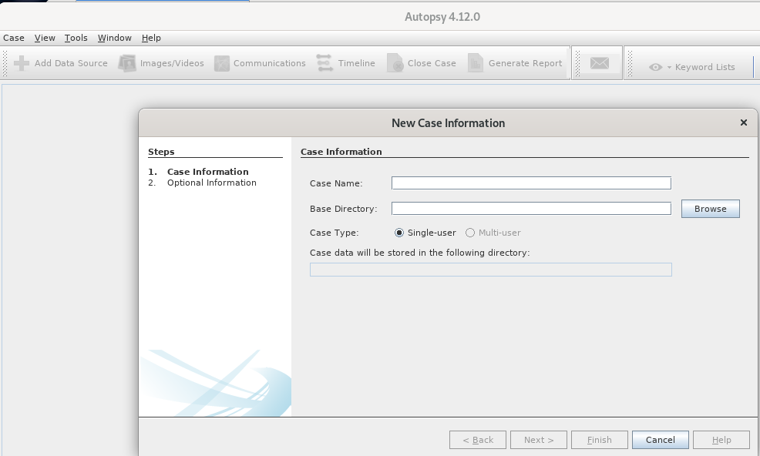
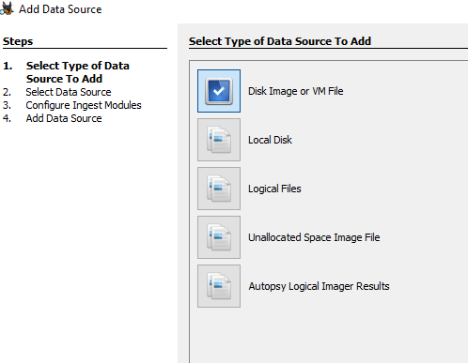
Similar process to suites you may be familiar with; Open New Case, Add Evidence, Select Processing parameters, go get lunch.
Autopsy

Slide 18
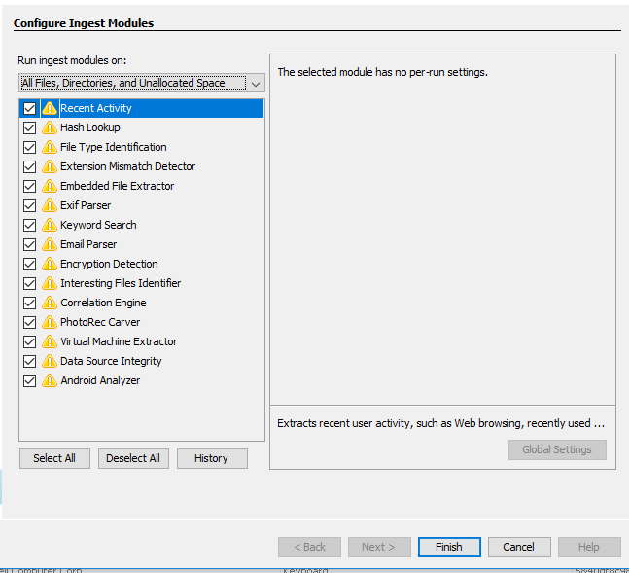
Autopsy Do the things
All our forensics tasks we can have Autopsy do for us. Note: Probably a good idea to double check its work with another tool

Slide 19
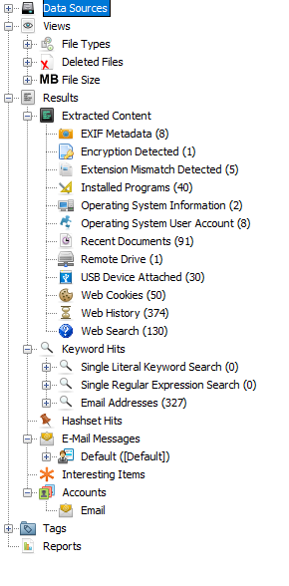
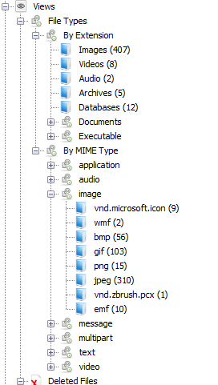
Autopsy What can it do for me?
We can browse the filesystem under Data Sources, look at the count of files by type, by MIME (subtype) or artifacts that relate to the ingest modules.
TXT file actually a JPG? Extension Mistmatch! Need to see the USB devices the user plugged in?
USB Device Attached!

Slide 20
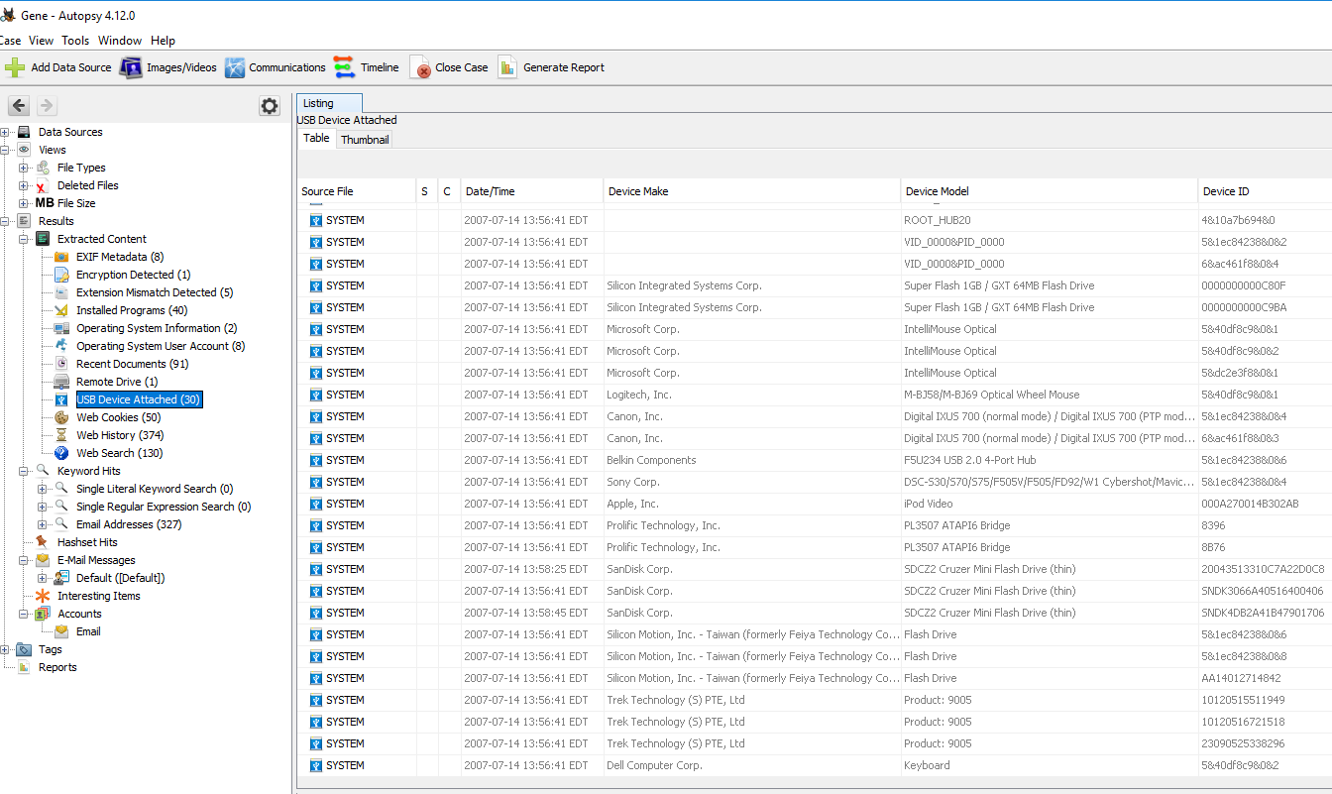

Slide 21
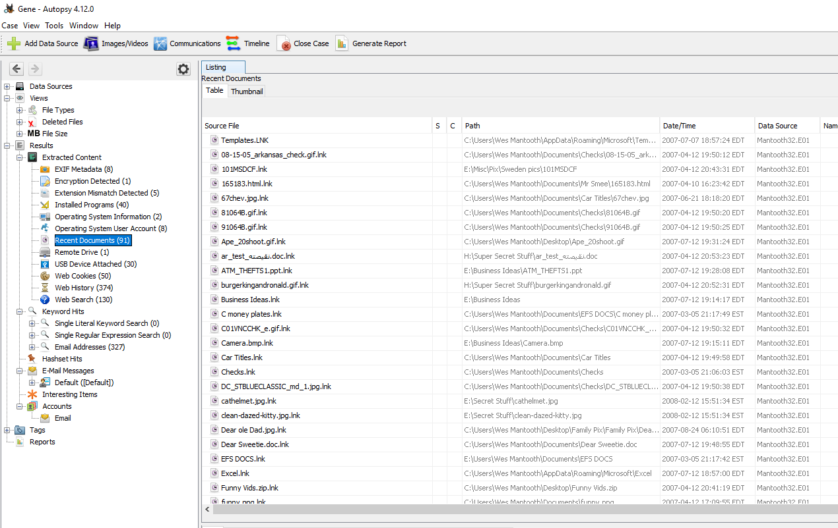

Slide 22
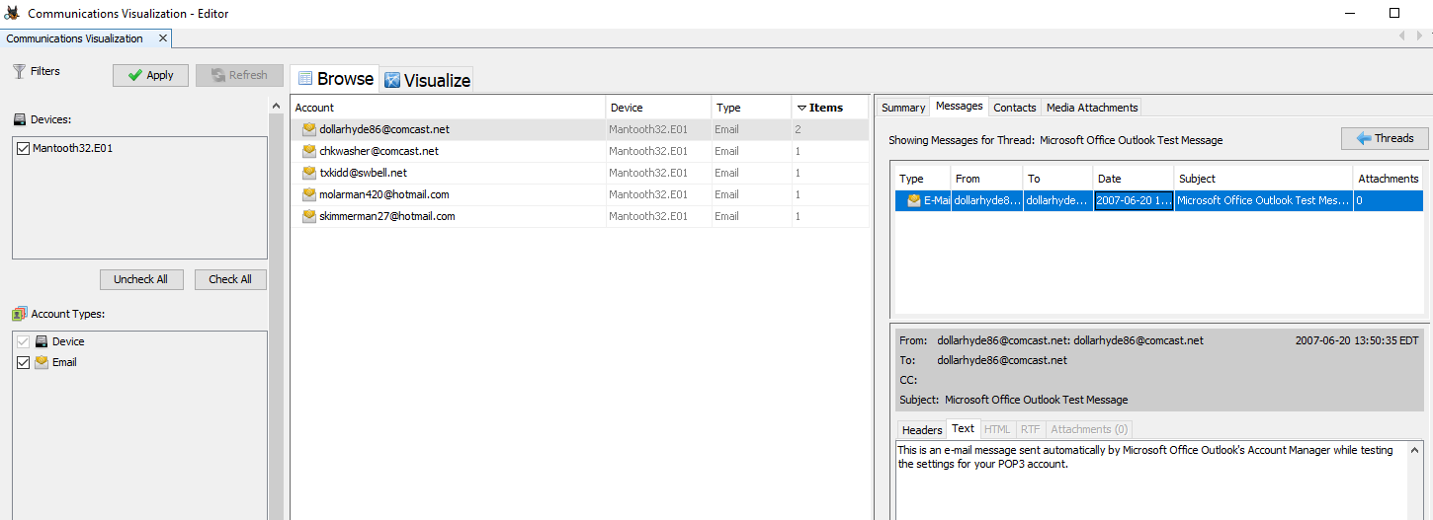
Viewing PST content

Slide 23
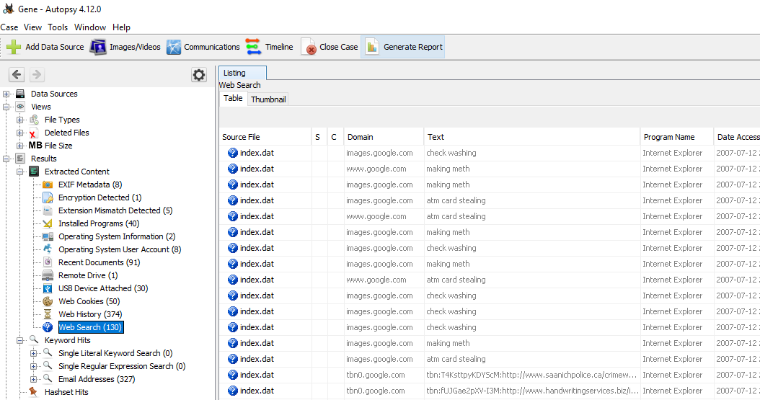

Slide 24
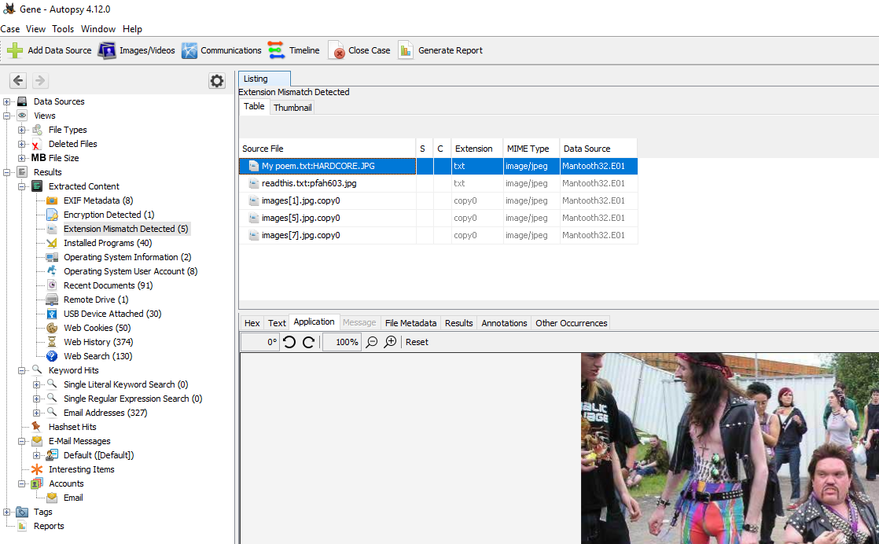
Alternate Data Streams
The ADS data is a JPG, shown as being attached to a txt file using the ‘:’.

Slide 25
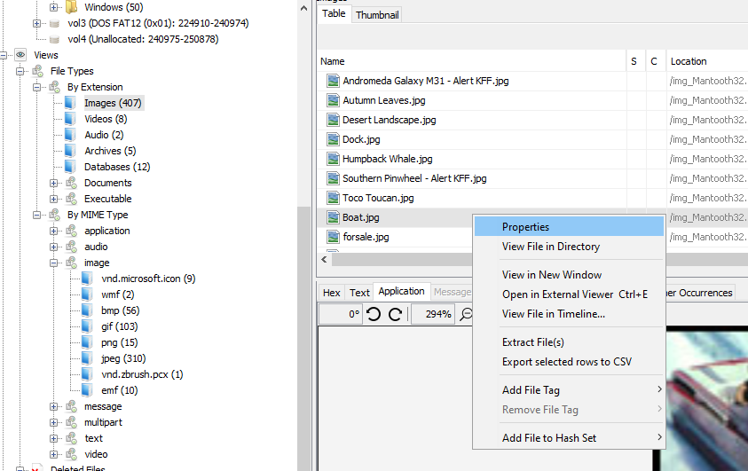
About that file…
View file properties for example.
You can Extract the file to the desktop for analysis with another tool.
View File in Directory will take you to where it sat on the original machine.
Add notes to your review with Add File Tag.

Slide 26
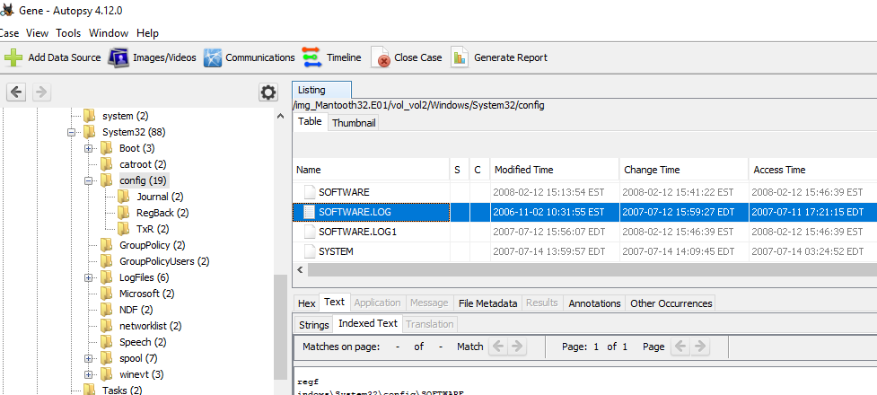
Registry
Many OS, User and App settings are stored in the Regsitry. Most registry “hives” will be in System32\Config, except for user specific hives in the users folder..

Slide 27
OS version, Install Date, Owner, the registered Company can all be found in Software under Windows NT\CurrentVersion.
Autopsy will put some hive data in Extracted Content for you though.
Installation Information

Slide 28
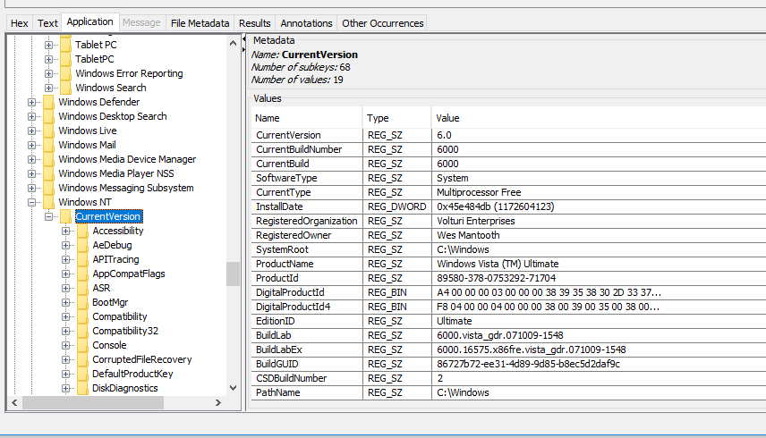
Registry
Even though Autopsy pulled this information for us, we can locate the appropriate Registry hive “software” in Windows\System32\Config and Autopsy parses this for us as well.
Advantage is you can browse all keys in all hives for other artifacts!

Slide 29
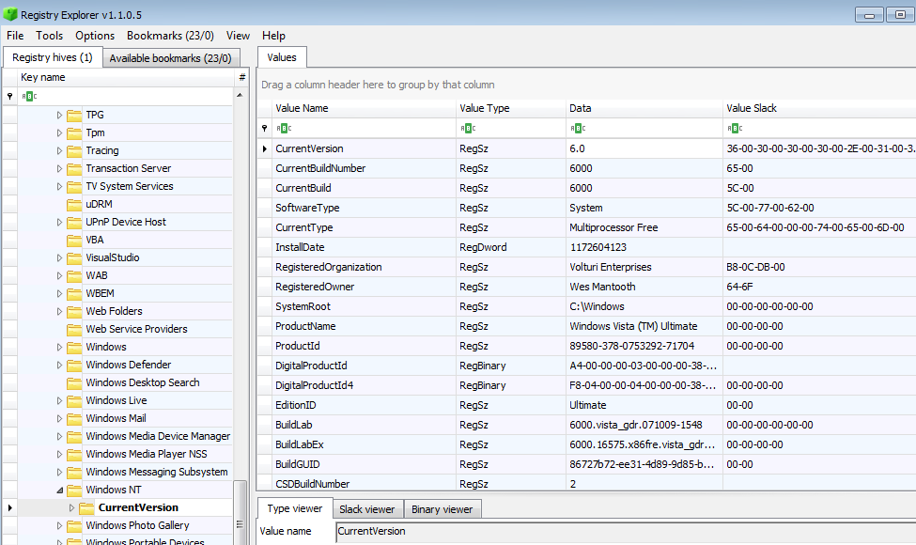
Registry
Or Eric Zimmerman’s Registry Explorer tool can also be used if you export the hive you wish to work with from Autopsy.

Slide 30
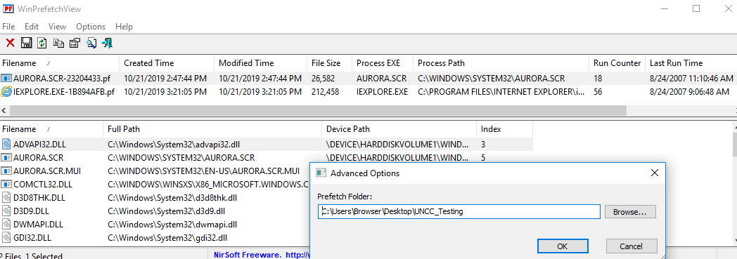
Prefetch
Windows Prefetch files exist to load common run states into memory for faster first runs of your programs.
Each file represents the executable by name, as it was run in a given directory. Run from Program Files and from Desktop, you get two Prefetch files for that program.
A run count and up to the last 8 times the program was run will be available through tools like NirSoft’s WinPrefetchView
This tool uses your exam machine unless you specify the location of the .pf files using Advanced Options!!

Slide 31
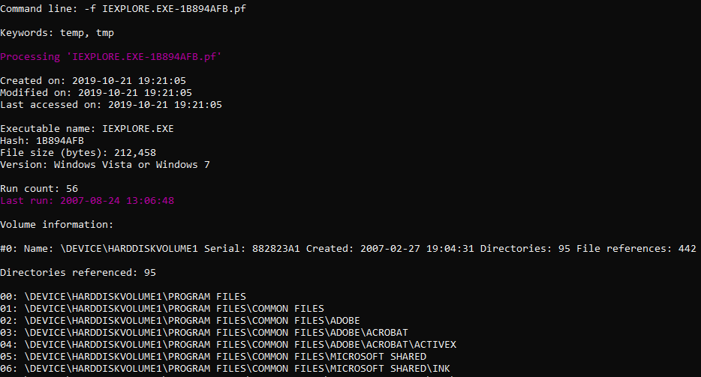
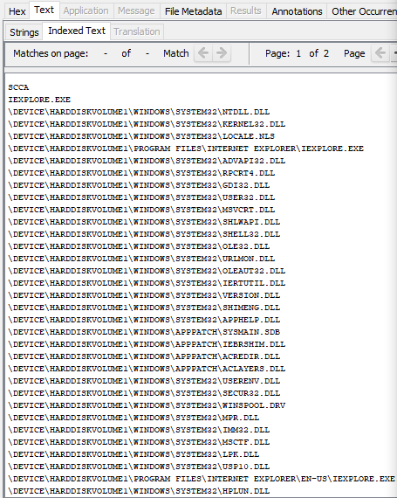
Prefetch
Eric Zimmerman’s PECmd.exe will provide run count and last run dates.
Though Autopsy AND PECmd will show files touched by the executable.

Slide 32
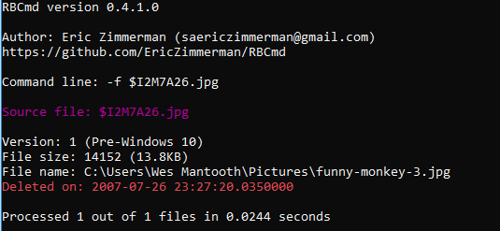
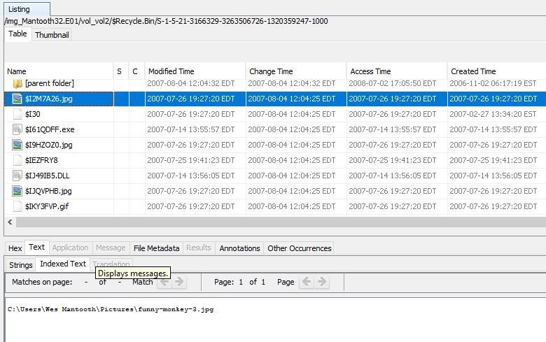
Recycle Bin
Eric Zimmerman’s RBCmd.exe will provide date deleted and original path.
Though Autopsy will also. Note, UTC and EDT time differences!!

Slide 33
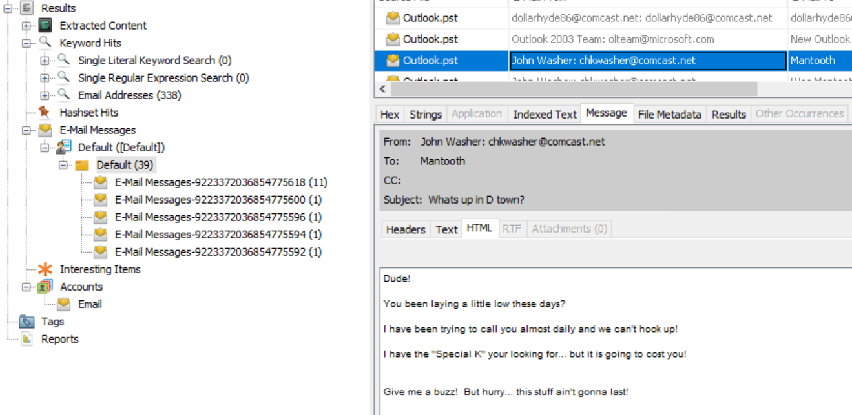
Windows Mail
Autopsy can parse .PST mail archives.

Slide 34
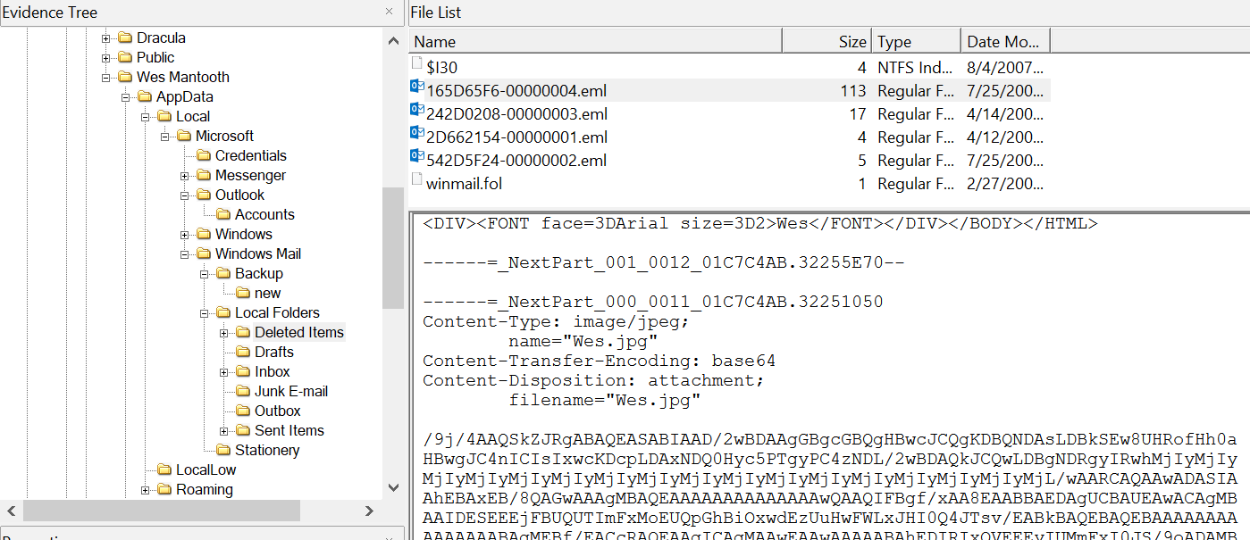
Windows Mail
Our Autopsy tool will parse PST files, or we can export the PST and import into LibreOffice, but what about .eml files in User\AppData\Microsoft\Windows Mail\ ?

Slide 35
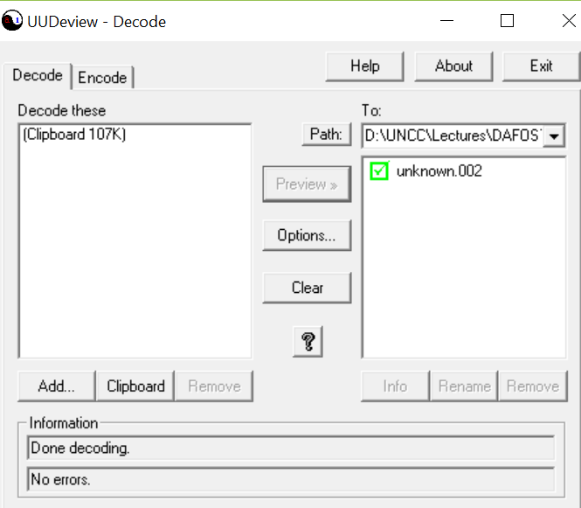
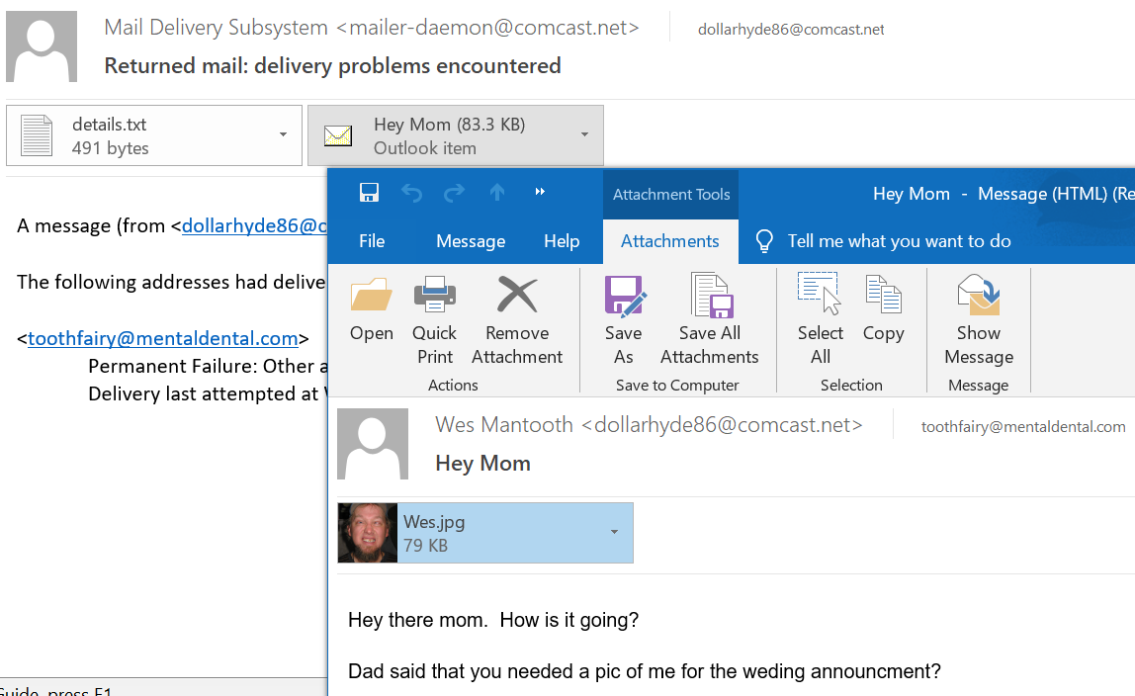
Windows Mail (Windows Vista/7)
Export the .eml and open in a mail program or use UUDeview to decode the base64 portion of the MIME email. The decoded file will need to be renamed .jpg to view in Windows.

Slide 36
Program Runs
By exporting .pf files and changing the “Advanced Options” of WinPrefetchView” we see how often certain programs have been run.

Slide 37
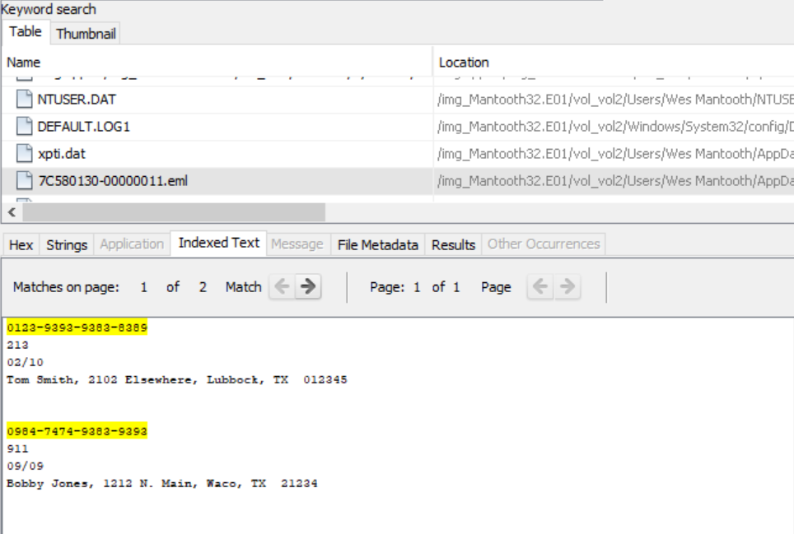
Autopsy allows Regex searches (In this case a generic search for credit cards)
[0-9]{4}[-][0-9]{4}[-][0-9]{4}[-][0-9]{4} [-][0-9]{4}
Any set of 4 numbers followed by “-”, repeat 3 times.

Slide 38
Extension Mismatch
This file purports to be a TXT, but when we look at it, its mostly garbled. Opening in HxD we see the file signature of a JPG. Changing the extension makes the file viewable again.

Slide 39
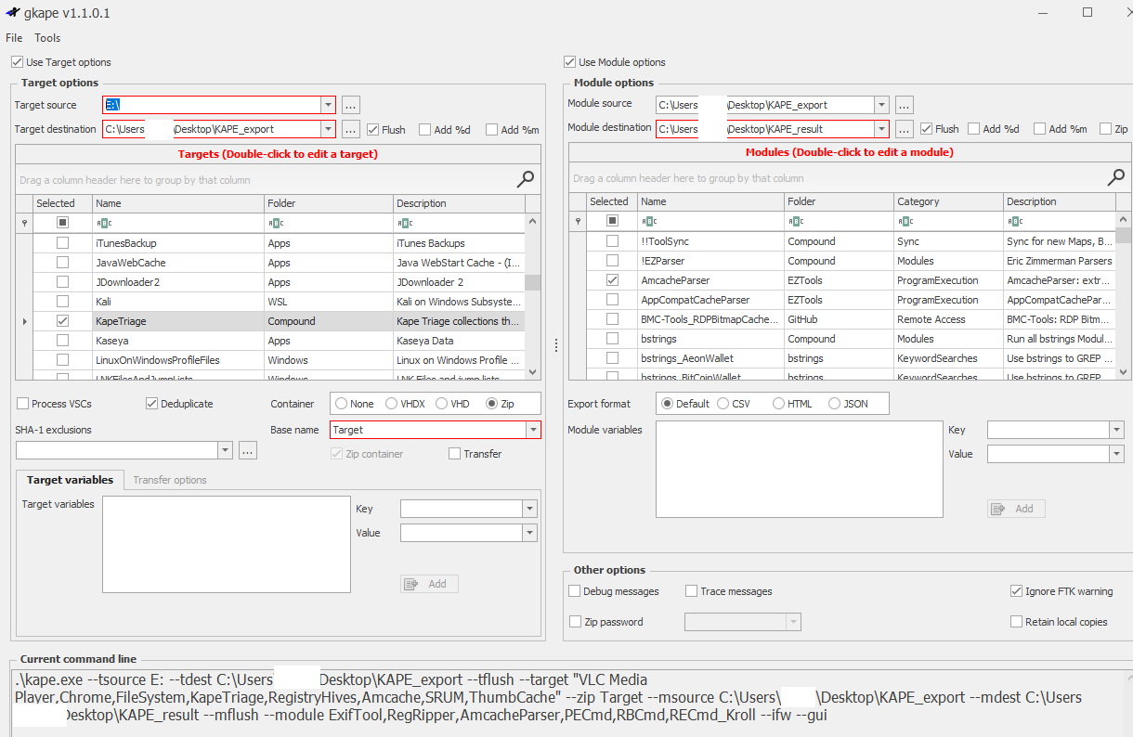
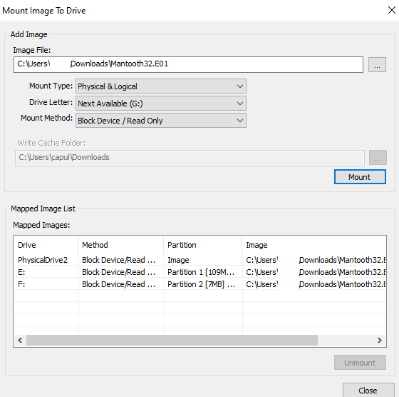
Kroll Artifact Parser Extractor (KAPE)

Slide 40
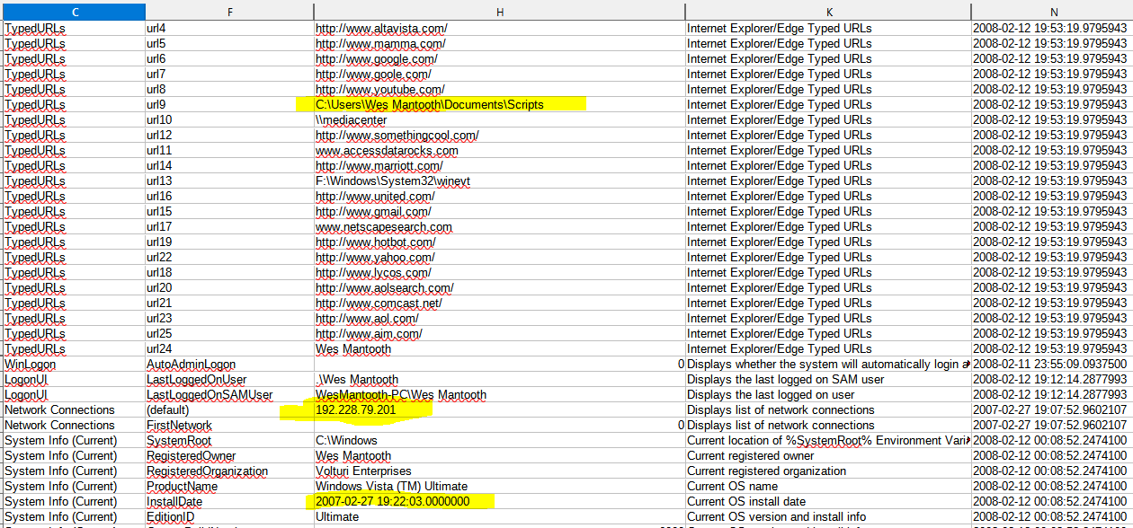

Slide 41
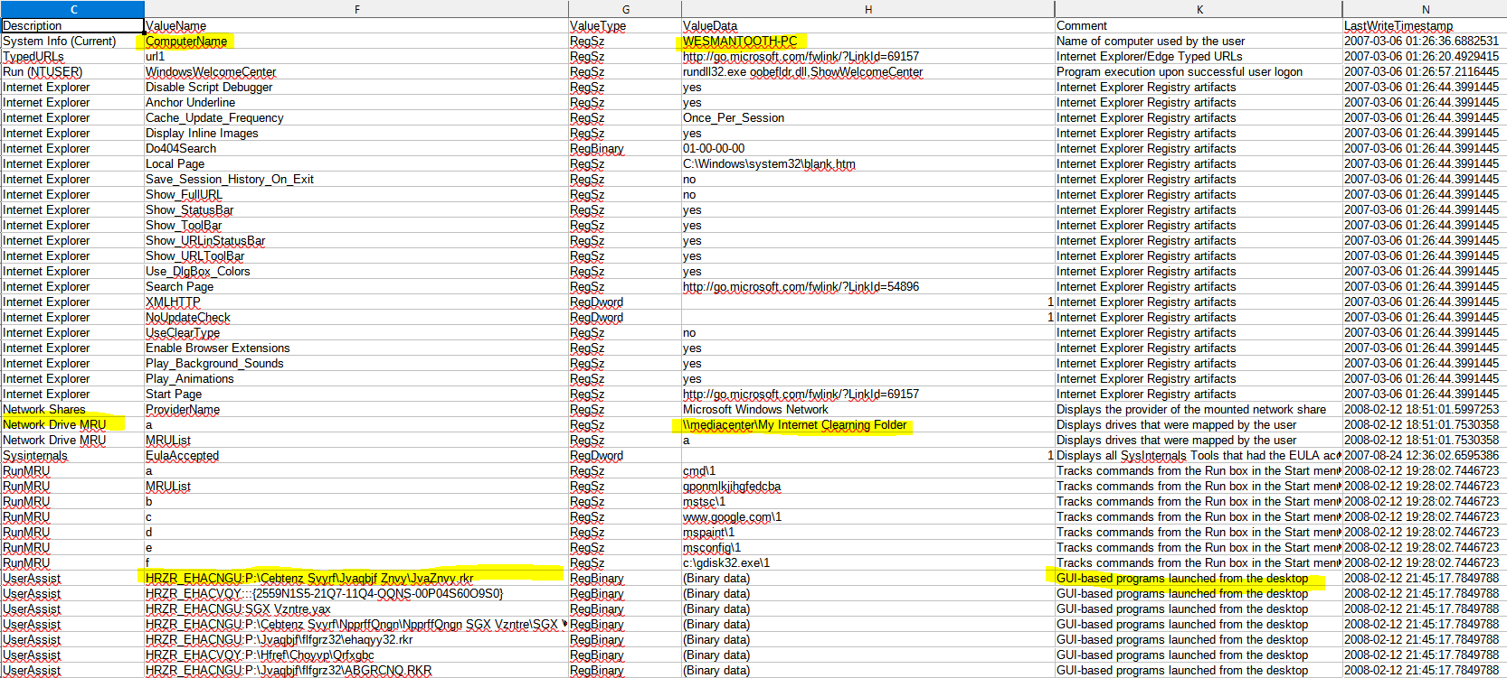

Slide 42
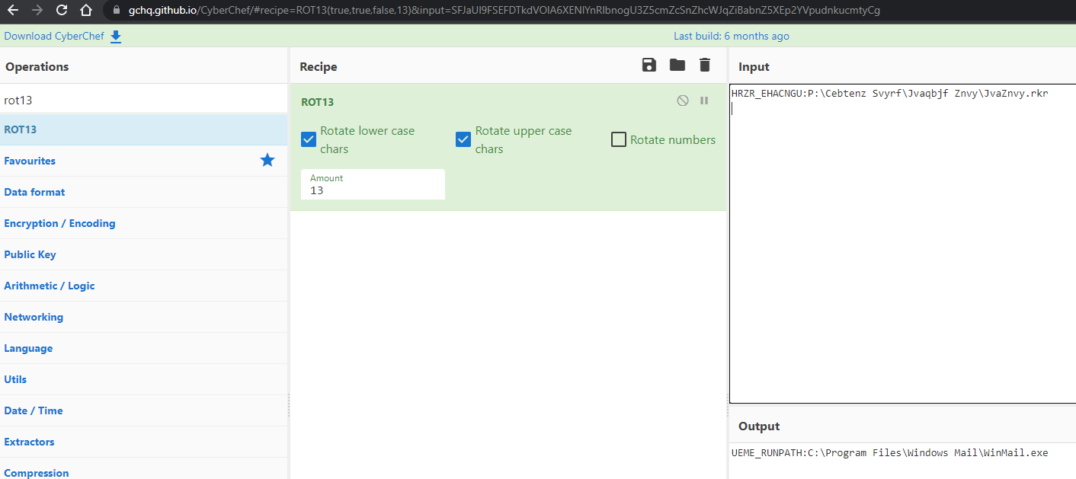

Slide 43
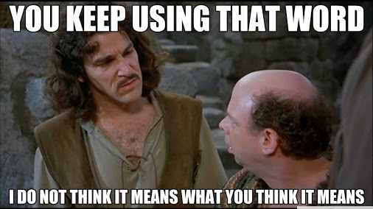
User perspective vs Reality
Files are Created, Modified and Accessed. Do those dates mean what you think they mean? Can a file be modified before it was created?
Even if they do, how many points do we consider while matching file time to actual time?
Time Zone
BIOS/UEFI Time
Network Time Server
Delayed writes
Anti-forensics

Slide 44
Key Points
All artifacts are data
Data for the user
Data for the system
Data the developer never intended to store or forgot to clean up
Some tools may not indicate there is additional data to be had.
In general, Commercial tools have the edge, but the best tool is the Examiner. Do not be complacent about results supplied to you by any software.

