Slide 1
The lives of artifacts: How we are engaged and the consequences of engagement
Patricia Turrisi College Day November 12, 2011
turrisip@uncw.edu
Associate Professor of Philosophy
Director, Graduate Liberal Studies

Slide 2
Selected Sources
Jean Baudrillard, tr., James Benedict, THE SYSTEM OF OBJECTS. Verso, London and New York, 1996.
F. T. Evans, “Two Legs, Thing Using and Talking: The Origins of the Creative Engineering Mind.” Journal AI & Society Volume 12 Issue 3, Jul. 1998, Springer-Verlag London, UK.
Sherry Turkle, ed., EVOCATIVE OBJECTS: Things We Think With. MIT Press, 2007.
Mihaly Csikszentmihalyi and Eugene Rochberg-Halton, THE MEANING OF THINGS: Domestic Symbols and the Self. Cambridge University Press, 2002

Slide 3
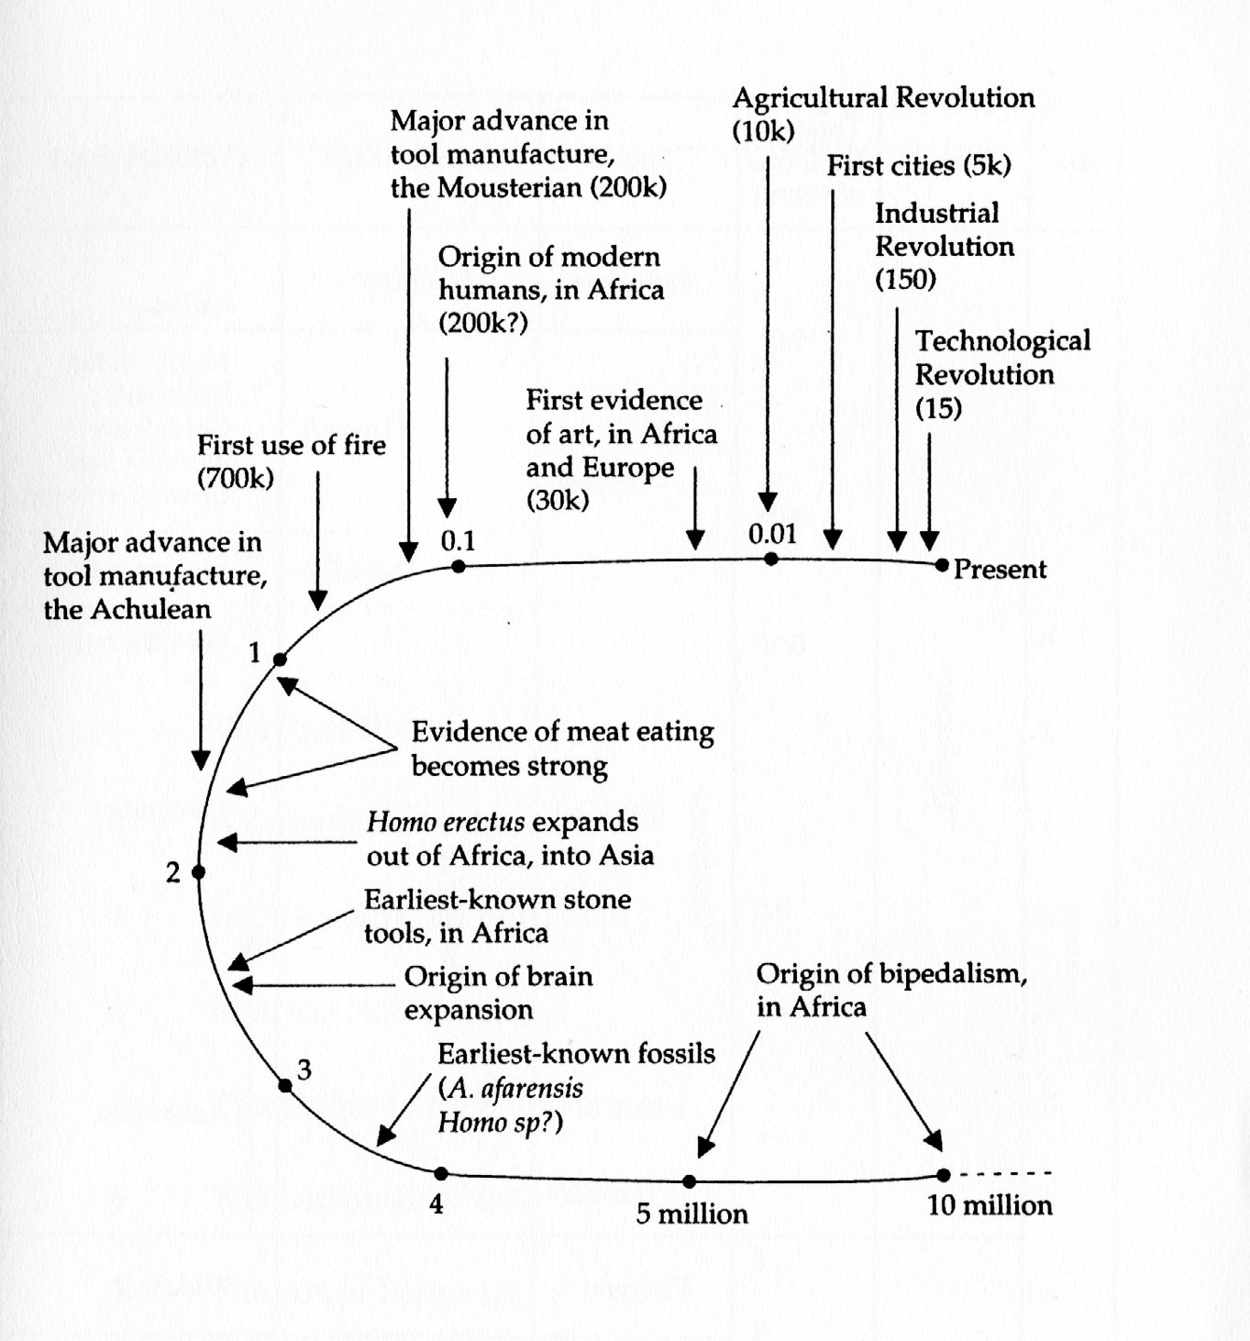
Human Progress I
Bipedalism and Upright Posture
Opposable Thumb
Big Brain
Homo faber
Then, Us
Richard Leakey, The Origin of Humankind

Slide 4
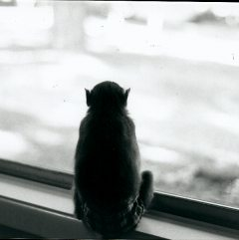
Human Progress II
Upright Posture
Big Brain/Hands at Eye Level
Object Fancy
Stone Tools/Migrations
Carnivorous Habit
Fire
Art Object Fancy
Cooking and Agriculture
Inner Life/Selves/Opposition to the External World
Industry Technology
Object Fancy
Full on engagement with artifacts and

Slide 5
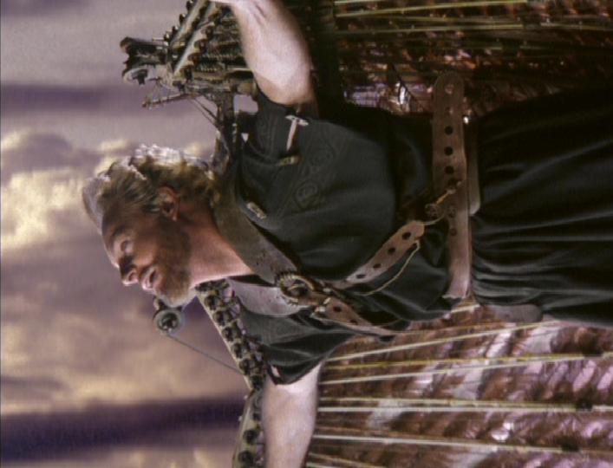
What is an artifact?

Slide 6
What is “object fancy”?
1. The desire to pick up, handle, and hold a material object, especially a consumer product of elegant design.
2. The urge to touch, own, arrange, collect, display, or talk about a manufactured human artifact.
3. The motivation for compulsive shopping.
Center for Non-Verbal Studies http://center-for-nonverbal-studies.org/

Slide 7
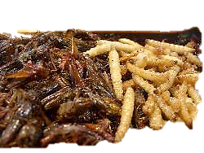
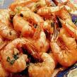

From cicadas to cheese puffs

Slide 8
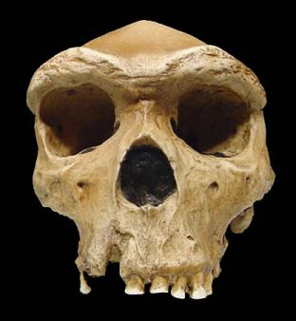
Homo habilis (2.5mya)
And others . . .
Homo Sapiens (250,000 YA)
Homo Sapiens Sapiens
Homo Faber
Homo Bricoleur/Homo Opportunus (10,000BP)
Notes:
vLower Paleolithic
Main article: Lower Paleolithic
2.5 million years ago: start of the Pleistocene epoch and the current Quaternary period; emergence of the genus Homo. Smilodon, the best known of the sabre-toothed cats, appears.
1.5 million years ago: earliest possible evidence of the controlled use of fire by Homo erectus
790,000 years ago: earliest demonstrable evidence of the controlled use of fire by Homo erectus
700,000 years ago: last reversal of the earth's magnetic field
500,000 years ago: colonisation of Eurasia by Homo erectus
300,000 years ago: Homo sapiens separated from Homo erectus. Approximate age of Canis lupus. Middle Stone Age begins in Africa.
[edit] Middle Paleolithic
Main article: Middle Paleolithic
250,000 years ago: appearance of Homo neanderthalensis
200,000 years ago: appearance of Homo sapiens in Africa
150,000 years ago: time of mitochondrial Eve
125,000 years ago: peak of the Eemian Stage interglacial
100,000 years ago: earliest estimate for the domestication of dogs
90,000 years ago: time of Y-chromosomal Adam
c. 75,000 years ago: Toba Volcano supereruption.^{[1]}
60,000 years ago: out of Africa migration of modern humans; approximate age of Haplogroup N (mtDNA), Haplogroup C (mtDNA) and Haplogroup A (mtDNA)
50,000 years ago: Modern humans spread from Africa to the Near East; age of Haplogroup B (mtDNA)^{[2]} In the next millennia, these human group's descendants move on to southern India, the Malay islands, Australia, Japan, China, Siberia, Alaska, and the northwestern coast of North America.^{[2]} Later Stone Age begins in Africa.
[edit] Upper Paleolithic
Main article: Upper Paleolithic
40,000 years ago: Cro-Magnon colonisation of Europe
35 000 years ago: oldest known figurative art (Venus of Hohle Fels), age of the Aurignacian culture
c. 32,000 years ago: Aurignacian culture begins in Europe.
31,000 years ago: oldest known cave paintings
30,000 years ago: approximate age of Haplogroup X (mtDNA) and Haplogroup I (mtDNA). A herd of reindeer is slaughtered and butchered by humans in the Vezere Valley in what is today France.^{[3]}
29,000 years ago: extinction of Homo neanderthalensis.
c. 28,500 years ago: New Guinea is populated by colonists from Asia or Australia.^{[4]}
c. 28,000-20,000 years ago: Gravettian period in Europe. Harpoons, needles, and saws invented.
c. 26,000 years ago: Women around the world use fibers to make baby-carriers, clothes, bags, baskets, and nets.
25,000 years ago: first colonisation of North America. A hamlet consisting of huts built of rocks and of mammoth bones is founded in what is now Dolni Vestonice in Moravia in the Czech Republic. This is the oldest human permanent settlement that has yet been found by archaeologists.^{[5]}
22,000 years ago: the oldest known tally stick (the Ishango Bone)
[edit] Mesolithic
Main article: Mesolithic
c. 20,000 years ago: Chatelperronian culture in France.^{[6]} Kebara culture in the Levant.
c. 16,000 years ago: Wisent sculpted in clay deep inside the cave now known as Le Tuc d'Audoubert in the French Pyrenees near what is now the border of Spain.^{[7]}
c. 14,800 years ago: The Humid Period begins in North Africa. The region that would later become the Sahara is wet and fertile, and the Aquifers are full.^{[8]}
12,000 years ago (10,000 BC): Land ice leaves Denmark and southern Sweden; start of the current Holocene epoch.
11,000 years ago (9000 BC): Emergence of Jericho, which is now one of the oldest continuously inhabited cities in the world.
10,000 years ago (8000 BC): The Quaternary extinction event. Many of the ice age megafauna go extinct, including the megatherium, woolly rhinoceros, Irish elk, cave bear, cave lion, and the last of the sabre-toothed cats. The mammoth goes extinct in Eurasia and North America, but is preserved in small island populations until ~1650 BC.
[edit] Neolithic
Main articles: Neolithic and Neolithic revolution
9,000-10,000 years ago (7-8000 BC): In northern Mesopotamia, now northern Iraq, cultivation of barley and wheat begins. At first they are used for beer, gruel, and soup, eventually for bread.^{[9]} In early agriculture at this time, the Planting stick is used, but it is replaced by a primitive Plow in subsequent centuries.^{[10]} Around this time, a round stone tower, now preserved to about 8.5 meters high and 8.5 meters in diameter is built in Jericho.^{[11]}
9,500 years ago (7500 BC): Çatal Höyük urban settlement founded in Anatolia
9,000 years ago (7000 BC): Jiahu culture began in China
7,500 years ago (5500 BC): Copper smelting in evidence in Pločnik and other locations.
7,000 years ago (5000 BC): late Neolithic civilizations, invention of the wheel and spread of proto-writing.
6,000 years ago (4000 BC): Civilizations develop in the Mesopotamia/Fertile crescent region (around the location of modern day Iraq).
For later events, see Timeline of ancient history.

Slide 9

Adaptations follow successful use (rather than precede them.)
Upright posture
Lucy’s stats:
Where found: Hadar site, Ethiopia, 1974
Pedigree: Hominidae (all species originating after the human/African ape ancestral split, leading to and including all species of Homo)
Evidence of Bipedalism: Femur is angled relative to knee joint surfaces, which allows bipeds to balance on one leg at a time during locomotion. Prominent patellar lip keeps patella (knee cap) from dislocating due to this angle. Large condyles adapted to handling the added weight that results from shifting from four limbs to two. Vertebrae show evidence of the spinal curvatures necessitated by a permanent upright stance.

Slide 10

Conditions required
Hands (opposable thumb power grip handedness)
Upright posture, eyes forward
Binocular three-dimensional vision
Ability to rotate, reverse, inverse objects mentally
Time and space travel in the abstract: ability to make inferences about entities, relationships, principles not immediately present to direct experience

Slide 11
The thing-using mind.
Before tools, there was

Slide 12
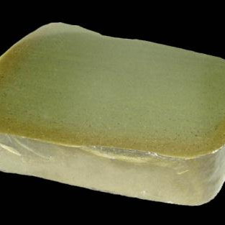
Liths: raw materials from which tools are made
Tenerean African Neolithic Period
When an artifact is made of a type of lithic that is not available in the region where it was found or created, we can make some interesting deductions such as the tool maker might have traveled a great distance to acquire the lithic to make the artifact, the artifact might have been made by another tool maker and traded to the final owner of the tool or the lithic itself, might have been traded to the final owner who then in turn, made the tool.
This is a thick cross-sectional slice of a
natural large nodule of green jasper.

Slide 13

we are the technology that evolved.

Slide 14
Characterizing our unique “specialization”
Strictly speaking, our specialization is not physical.
Nor is it fixed.
We are an entrepreneurial species who re-purposes opportunistically.
We are constructed to seize, grasp, handle, examine, carry, gather, collect, sort, categorize, store for another time, manipulate and enjoy . . . OBJECTS.

Slide 15
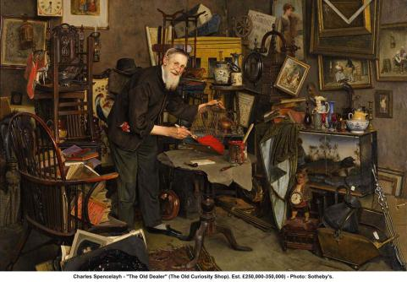
Human beings and their artifacts

Slide 16
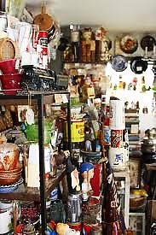

Slide 17
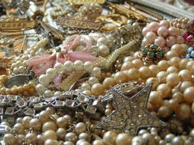

Slide 18
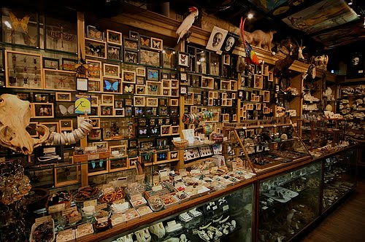

Slide 19
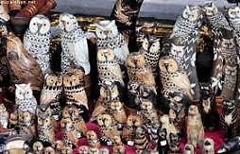

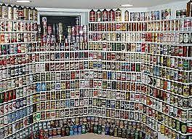
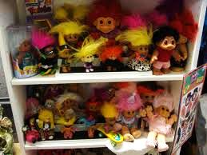
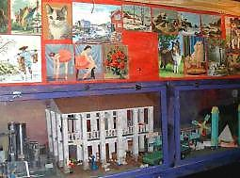
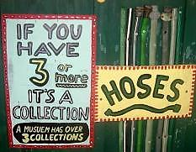




Slide 20
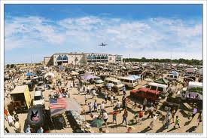

Slide 21
Ecclesiastes 8
Qoheleth, son of David: I amassed silver and gold, the treasures of kings and provinces, aquired singers men and women, and every human luxury, chest upon chest of it. So I grew great, greater than anyone in Jerusalem before me, nor did my wisdom leave me. I denied my eyes nothing that they desired, refused my heart no pleasure, for I found all my hard work a pleasure. Such was the return for all my efforts. I then reflected on all that my hands had achieved and all the effort I had put into its achieving. What futility it all was. What chasing after the wind! There is nothing to be gained under the sun.

Slide 22
Luke 12:13-16
Watch and be on your guard against avarice of any kind, for life does not consist in possessions even when someone has more
than he needs.
A farmer decided to tear down his barn and build a larger one to hold all his crops.
And I will say to my soul, “My soul, you have plenty of good things laid by for many years to come. Take things easy, eat, drink and have a good time.” But God said to him, “Fool, this very night, the demand will be made for your soul, and this hoard of yours, whose will it be then? So it is when someone stores up treasure for himself instead of becoming rich in the sight of God”

Slide 23
Matthew 6:19-20
Do not store treasures up for yourselves on earth, where moth and woodworm destroy them, and thieves can break in and steal.
But store up treasures for yourselves in heaven, where neither moth nor woodworm destroys them, and thieves cannot break in and steal.
For wherever your treasure is, there will your heart be too.

Slide 24
Plato on Tyrants
http://classics.mit.edu/Plato/republic.10.ix.html
Then, in general, those kinds of things which are in the service of the body have less of truth and essence than those which are in the service of the soul?

Slide 25
And if there be a pleasure in being filled with that which is according to nature, that which is more really filled with more real being will more really and truly enjoy true pleasure; whereas that which participates in less real being will be less truly and surely satisfied, and will participate in an illusory and less real pleasure?
Those then who know not wisdom and virtue, and are always busy with gluttony and sensuality, go down and up again as far as the mean; and in this region they move at random throughout life, but they never pass into the true upper world; thither they neither look, nor do they ever find their way, neither are they truly filled with true being, nor do they taste of pure and abiding pleasure. Like cattle, with their eyes always looking down and their heads stooping to the earth, that is, to the dining-table, they fatten and feed and breed, and, in their excessive love of these delights, they kick and butt at one another with horns and hoofs which are made of iron; and they kill one another by reason of their insatiable lust. For they fill themselves with that which is not substantial, and the part of themselves which they fill is also unsubstantial and incontinent.

Slide 26
And why are mean employments and manual arts a reproach? Only because they imply a natural weakness of the higher principle; the individual is unable to control the creatures within him, but has to court them, and his great study is how to flatter them.

Slide 27
discourse on the Nature of Inequality 1754
Jean-Jacques Rousseau
But even if nature really affected, in the distribution of her gifts, that partiality which is imputed to her, what advantage would the greatest of her favourites derive from it, to the detriment of others, in a state that admits of hardly any kind of relation between them? I hear it constantly repeated that, in such a state, the strong would oppress the weak; but what is here meant by oppression? Some, it is said, would violently domineer over others, who would groan under a servile submission to their caprices. This indeed is exactly what I observe to be the case among us; but I do not see how it can be inferred of men in a state of nature, who could not easily be brought to conceive what we mean by dominion and servitude. One man, it is true, might seize the fruits which another had gathered, the game he had killed, or the cave he had chosen for shelter; but how would he ever be able to exact obedience, and what ties of dependence could there be among men without possessions?

Slide 28
Rene Descartes, meditations on first philosophy
But it may be said, perhaps, that, although the senses occasionally mislead us respecting minute objects, and such as are so far removed from us as to be beyond the reach of close observation, there are yet many other of their informations (presentations) of the truth of which it is manifestly impossible to doubt; as for example, that I am in this place, seated by the fire, clothed in a winter dressing gown, that I hold in my hands this piece of paper, with other intimations of the same nature. But how could I deny that I possess these hands and this body, and withal escape being classed with persons in a state of insanity, whose brains are so disordered and clouded by dark bilious vapors as to cause them pertinaciously to assert that they are monarchs when they are in the greatest poverty; or clothed [in gold] and purple when destitute of any covering; or that their head is made of clay, their body of glass, or that they are gourds? I should certainly be not less insane than they, were I to regulate my procedure according to examples so extravagant.

Slide 29
Contemporary Conventional wisdom
“Greatness is not found in possessions, power, position, or prestige. It is discovered in goodness, humility, service, and character.”
William Arthur Ward (1921–1994), author of Fountains of Faith, is one of America's most quoted writers of inspirational maxims.
More than 100 articles, poems and meditations written by Ward have been published in such magazines as Reader's Digest, This Week, The Upper Room, Together, The Christian Advocate, The Adult Student, The Adult Teacher, The Christian Home, The Phi Delta Kappan, Science of Mind, The Methodist Layman, Sunshine, and Ideals.
His column Pertinent Proverbs has been featured in the Fort Worth Star-Telegram and in numerous service club publications throughout the United States and abroad. He is one of the most frequently quoted writers in the pages of Quote, the international weekly digest for public speakers.
“Four steps to achievement: Plan purposefully. Prepare prayerfully. Proceed positively. Pursue persistently.”

Slide 30
The fortunes of Object fancy in the First World
“Wise Warnings”
Against Possessions, the external world
Virtues of minimalism, de-cluttering
“Crude Acquisition”
Of useful natural objects and artifacts
Rise of crafts, arts, the passion for retail, hoarding

Slide 31
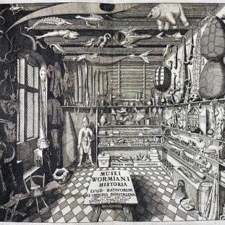
Consequences of engagement with artifacts

