Slide 1
Medicine and Religion: Convergence and Divergence
Patricia Turrisi, Ph.D.
Associate Professor of Philosophy

Slide 2
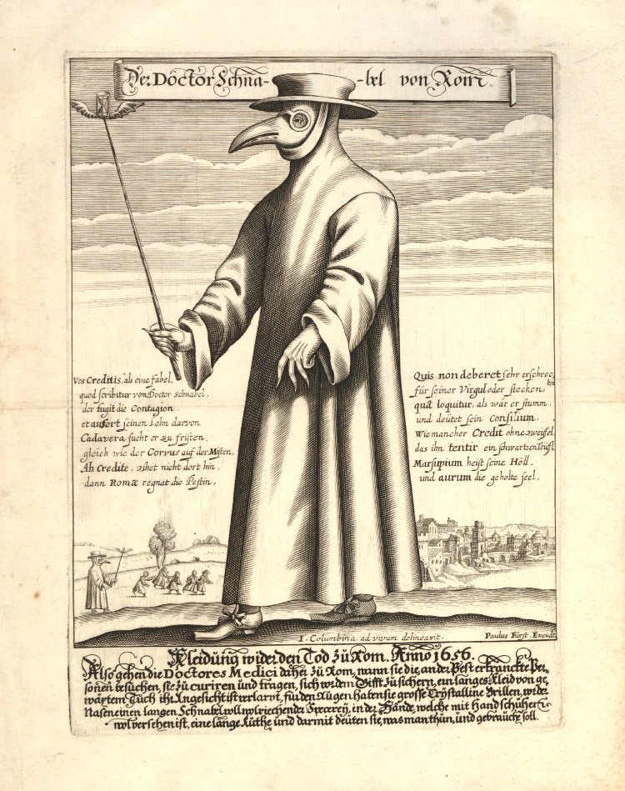
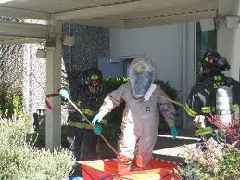
The Hazmat Suit Over the Ages
Notes:
A plague doctor would have worn a beak doctor costume in his role as a specialized doctor. He was known then as a "Beak Doctor".^{[1]} The protective suit consisted of a heavy fabric overcoat that was waxed, a mask of glassed eye openings and a cone shaped like a beak to hold scented substances.^{[9]} Some of the scented materials were amber, balm-mint leaves, camphor, cloves, laudanum, myrrh, rose petals, and storax.^{[5]} A wooden cane pointer was used to help examine the patient without touching.^{[10]}
Historian O'Donnell says that a medieval plague doctor was also referred to as the chirurgeon (Middle English "cirurgien", from Old French, from Latin chīrurgia, as referring to surgery). He says the chirurgeon wore a long black oilcloth robe that had a hood.^{[11]} It was intended as a protection suit against the contagious plague. This costume had openings for the eyes that were made of glass. It also had a hollow long beak for the nose, which was filled with camphor, garlic, mint, or a sponge of vinegar. This was all to protect the doctor from miasmatic bad air.^{[12]}

Slide 3
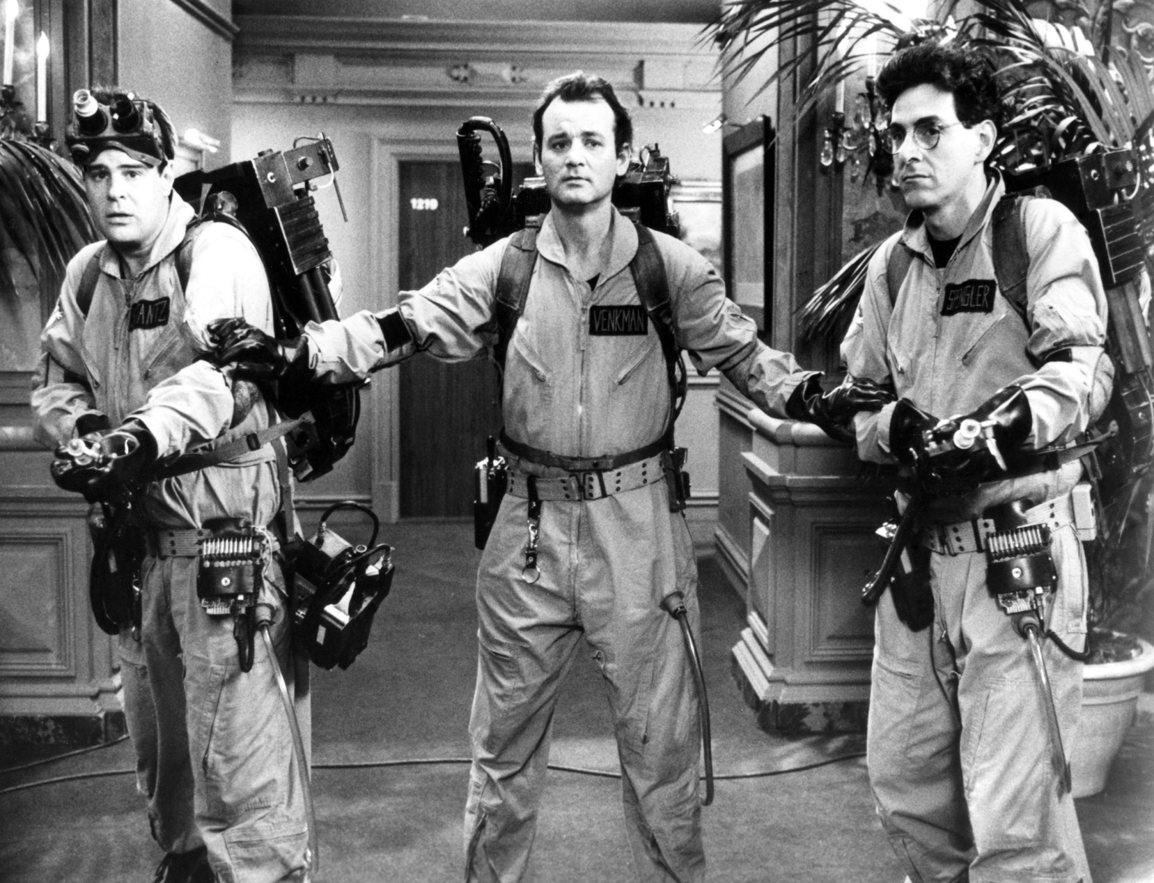

Slide 4
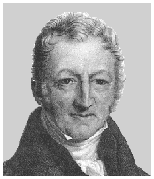
The Borders of Medicine and Religion
"The power of population is so superior to the power of the earth to produce subsistence for man, that premature death must in some shape or other visit the human race. The vices of mankind are active and able ministers of depopulation. They are the precursors in the great army of destruction, and often finish the dreadful work themselves. But should they fail in this war of extermination, sickly seasons, epidemics, pestilence, and plague advance in terrific array, and sweep off their thousands and tens of thousands. Should success be still incomplete, gigantic inevitable famine stalks in the rear, and with one mighty blow levels the population with the food of the world".
—Malthus T.R. 1798. An essay on the principle of population. Chapter VII, p61
Thomas Malthus
Anglican country curate at Okewood near Albury in Surrey
Notes:
an Anglican country curate at Okewood near Albury in Surrey.

Slide 5
Adherence to Health Therapies
In 2003, The Adherence to Long-term Therapies Project, a global initiative launched in 2001 by the Noncommunicable Diseases and Mental Health Cluster of the World Health Organization reported that
Poor adherence to treatment of chronic diseases is a worldwide problem of striking magnitude
  Adherence to long-term therapy for chronic illnesses in developed countries averages 50%. In developing countries, the rates are even lower. It is undeniable that many patients experience difficulty in following treatment recommendations.
  http://www.who.int/chp/knowledge/publications/adherence_full_report.pdf

Slide 6
A specific finding:
Since
  The impact of poor adherence grows as the burden of chronic disease grows worldwide
  The consequences of poor adherence to long-term therapies are poor health outcomes and increased health care costs
  Improving adherence also enhances patients’ safety
  Adherence is an important modifier of health system effectiveness
“Increasing the effectiveness of adherence interventions may have a far greater impact on the health of the population than any improvement in specific medical treatments”
Health systems must evolve to meet new challenges

Slide 7
Health systems must evolve to meet new challenges.
The first of these challenges:
Patients need to be supported, not blamed
Despite evidence to the contrary, there continues to be a tendency to focus on patient-related factors as the causes of problems with adherence, to the relative neglect of provider and health system-related determinants. These latter factors, which make up the health care environment in which patients receive care, have a major effect on adherence.

Slide 8
The practice of attaching moral judgments to persons who suffer from disease or do not practice adherence to medical advice or treatment has deep roots.
Notes:
The miasmatic theory of disease held that diseases such as cholera, chlamydia or the Black Death were caused by a miasma (ancient Greek: "pollution"), a noxious form of "bad air". This concept has been supplanted by the germ theory of disease.
Miasma was considered to be a poisonous vapor or mist filled with particles from decomposed matter (miasmata) that caused illnesses. It was identifiable by its foul smell.
In the first century AD, the Roman architectural writer Vitruvius described the potential effects of miasma (Latin nebula) from fetid swamplands when siting a city:
For when the morning breezes blow toward the town at sunrise, if they bring with them mist from marshes and, mingled with the mist, the poisonous breath of creatures of the marshes to be wafted into the bodies of the inhabitants, they will make the site unhealthy.^{[1]}
The miasmatic theory of disease remained popular in the Middle Ages and a sense of effluvia contributed to Robert Boyle's Suspicions about the Hidden Realities of the Air. In the 1850s, miasma was used to explain the spread of cholera in London and in Paris, partly justifying Haussmann's latter renovation of the French capital. The disease was said to be preventable by cleansing and scouring of the body and items. Dr. William Farr, the assistant commissioner for the 1851 London census, was an important supporter of the miasma theory. He believed that cholera was transmitted by air, and that there was a deadly concentration of miasmata near the River Thames' banks. The wide acceptance of miasma theory during the cholera outbreaks overshadowed the partially correct theory brought forth by John Snow that cholera was spread through water. This slowed the response to the major outbreaks in the Soho district of London and other areas. Another proponent of the miasmatic theory was Crimean War nurse Florence Nightingale (1820–1910),^{[2][3][4]} who became famous for her work in making hospitals sanitary and fresh-smelling.
Contents
[hide]
1 Sanitary reforms
2 Cholera
3 See also
4 References
5 External links
[edit] Sanitary reforms
The theory of miasma disease made sense to the English sanitary reformers of the mid-nineteenth century. Miasma explained why cholera and other diseases were epidemic in places where the water was undrained and very foul-smelling. The theory led to improvements in the sanitation systems, which coincidentally led to decreased episodes of cholera, thus helping to support the theory.
Even though the miasmatic theory has been disproven by the discovery of viruses and bacteria, it helped make the connection between poor sanitation and disease. This caused public health reforms and encouraged cleanliness, even though some doctors still did not wash their hands between patients. They believed that the miasmata were only airborne, and would not be stuck on the doctors' hands.
The miasmatic theory was consistent with the observations that disease was associated with poor sanitation (and hence foul odours) and that sanitary improvements reduced disease, but not with the observations of microbiology that led to the germ theory of disease.
[edit] Cholera
So far as cholera is concerned, the miasmatic theory was disproved by John Snow following an epidemic in Soho, central London in 1854.^{[5]} Because of the miasmatic theory's predominance among Italian scientists, the 1854 discovery by Filippo Pacini of the bacillus that caused the disease was completely ignored, and the bacteria had to be rediscovered thirty years later by Robert Koch.
A remnant of this theory is the name of malaria, from Italian mala aria ("bad air").

Slide 9
The Nature of the Beast
The notion of nature as hostile to human interests is as old as the Bible.
The association of wilderness with original sin and the wages of sin is Biblical.
The use of nature as a weapon against humanity is Biblical.
Notes:
This article is about the actual air at night. For the song by Teddy Geiger, see Underage Thinking.
Prior to the late nineteenth century, night air was considered dangerous in most western cultures. Based on “zymotic” theory, people believed vapors called “miasma”(miasmata, plural) rose from the soil and spread diseases. Miasmas came from rotting vegetation and foul water—especially in swamps and urban ghettos.
Many people and especially the weak or infirm avoided breathing night air by going indoors and keeping windows and doors shut.
In addition to ideas associated with zymotic theory, there was also a general fear that cold or cool air spread disease.
The fear of night air gradually disappeared as understanding about disease increased as well as with improvements in home heating and ventilation.
Particularly important was the understanding that the agent spreading malaria was the mosquitoes (active at night) rather than miasmas.
[edit]

Slide 10
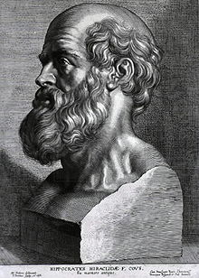
Hippocrates’ Humors

Slide 11
Passions and Tempers
We are born with a certain temperament that is made up of a mixture of humors – the body’s krasis -- its constitution or complexion.
Each person’s ideal is that their humors are balanced according to their inborn temperament.
Each person has their own optimal balance.
The proportions between the humors change continuously.
When your body is thrown off-balance, it is in a state of dyskrasia, and you become ill.

Slide 12
Activities, habits and individual acts
Excess
Deficiency
When you engage in behaviors that increase the proportion of a humor beyond what your temperament can accommodate, you develop an excess.
Neglect of one or more humors, or excess by another results in the overall disproportion of the humors.

Slide 13
The Humors
When choler is predominant, one has a choleric temperament:
  element: fire
  qualities: hot and dry
  color: yellow
  taste: bitter
  season: summer
  time of day: midday
  body organ: spleen
  period of life: youth
  signs: Aries, Leo, Sagittarius
  planet: Mars
Choler (yellow bile)
Melancholy (black bile)
Blood
Phlegm

Slide 14
An excess of choler
In a balanced person, the predominance of choler ensures a reactive and quick-tempered character. A choleric is typically able to make decisions well and fast, and prefers action over contemplation. But a surplus of choler can become "burned" and eventually turn into melancholy (melan=black, choler=bile, in Greek). Meanwhile, the choleric will become acrid and negative; reactivity might be directed at the wrong objects. This sort of choleric will get angry easily, and maybe have episodes of uncontrolled and potentially dangerous rage.

Slide 15
Melancholy
predominant in those endowed with a melancholic temperament
element: earth
qualities: cold and dry
color: black
taste: sour
season: autumn
time of day: afternoon
body organ: liver
period of life: maturity
signs: Taurus, Virgo, Capricorn
planet: Saturn

Slide 16
A Melancholy Disposition
Melancholics used to be identified by their pale, sallow looks, their lack of appetite and tendency to withdraw from society.
If you have a high proportion of black bile, you may be too withdrawn and indulge too much in self-doubt. You may be prone to obsession and anxiety, to fretting over small matters, to seeing the glass half-empty and using your sense of the vanity of all things to justify your inability to engage in life, work or love.

Slide 17
Blood
Blood is the "best" of all the humours. The sanguine person is typically balanced, equanimous, patient, thoughtful, active in a measured way, able to judge people and situations well, and to contain his or her own shifts of moods, as well as those of others. The presence of blood will diminish the power exerted by other humours that may be present in high doses. An excess of blood, however, may go along with a general insensitivity and indifference to the fate of others. A little melancholy might be just what is needed in such cases.

Slide 18
Defective Blood
If the presence of blood is defective, then you might suffer from ailments caused by the excess of one or more of the three other humors. On the other hand, if neither of those is particularly predominant, you might be perfectly balanced.

Slide 19
Phlegm
No one wants to be diagnosed as phlegmatic -, since it is associated with slowness, sleepiness, runny noses and lack of drive of any sort.
A particularly high dose of it might signify that you are a little slow, lacking in nerve and reactivity, and prone to exhaustion or even narcolepsy. You might tend to catch colds easily, and to have a low libido.
Notes:
Timothy Shay (T.S.) Arthur (June 6, 1809 – March 6, 1885) was a popular nineteenth-century American author. He is most famous for his temperance novel Ten Nights in a Bar-Room and What I Saw There (1854), which helped demonize alcohol in the eyes of the American public.
1854 was also the year Arthur published Ten Nights in a Bar-Room. The story of a small-town miller (perhaps based on Arthur’s father) who gives up his trade to open a tavern, the novel’s narrator is an infrequent visitor who over the course of several years traces the physical and moral decline of the proprietor, his family, and the town’s citizenry due to alcohol. The novel sold well, but insinuated itself in the public consciousness largely on the basis of a very popular stage version that appeared soon after the book. The play remained in continuous production well into the twentieth century when at least two movie versions were made.

Slide 20
A well regulated life and the avoidance of excess of any sort usually ensures a humorally balanced organism - and vice-versa.

Slide 21
Finding balance
Eating the right food at the right time of day in the right season, exposure to the right colors, engaging in appropriate activities, and due diligence paid to the elements and qualities of the humor you wish to manage will help you to keep your temperament and your constitution aligned.

Slide 22
The 4 Humours on BBC
http://www.bbc.co.uk/programmes/b008h5dz
http://www.bbc.co.uk/iplayer/console/b008h5dz/In_Our_Time_The_Four_Humours
Notes:
Links
For key sources (and relevant commentary) for the history of evidence based medicine:
http://www.jameslindlibrary.org/
For the text of John Snow on Cholera (1855):
http://www.ph.ucla.edu/EPI/snow/snowbook.html
For an electronic library of medical history texts:
http://www.bium.univ-paris5.fr/histmed/medica.htm
For early modern anatomy illustrations:
http://www.nlm.nih.gov/exhibition/historicalanatomies/
For illustrations relating to the history of medicine:
http://www.nlm.nih.gov/hmd/collections/photos/
and
http://medphoto.wellcome.ac.uk/
Guides to medical history on the internet:
http://www.medhist.ac.uk/
and
http://www.mic.ki.se/HistGen.html
and
Jeremy Norman's historyofscience.com:
http://www.historyofscience.com/
To purchase copies of Bad Medicine: Doctors Doing Harm Since Hippocrates: http://www.oup.co.uk/isbn/0-19-280355-7
Alternatively, visit www.bookfinder.com to find the best price, new or secondhand.
David Wootton's page at the University of York (includes list of other publications):
http://www.york.ac.uk/depts/hist/staff/wootton.shtml

Slide 23
The pervasive influence of humor theory
“a balanced diet”
temperature (!) and hydration regulation (“heat and moisture”)
“seasonal activities”
The iniquity of binges and the joy of purgatives
The condemnation of excess (drinking to excess, addiction, overindulgence, lack of self-control, “overdoing it”
Deficiencies of all sorts (vitamin deficiency, attention deficit disorder, defective hearing, vision, heart valves, bone density, brains, memory, etc.)

Slide 24
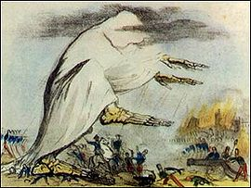
Our own natures are in need of management but we live in nature, which is ultimately unmanageable.
One must practice self-control in order to achieve moderation, but Tyche (Fortuna) will decide in the end. Luck is as important as good care and in a contest, will triumph over human efforts.

Slide 25
Inherit the Wind (and the miasma)
The miasmatic theory of disease held that diseases such as cholera, Chlamydia or the Black Death were caused by a miasma ("pollution"), a noxious form of "bad air".
Miasma was considered to be a poisonous vapor or mist filled with particles from decomposed matter (miasmatic) that caused illnesses. It was identifiable by its foul smell.
In the first century AD, the Roman architectural writer Vitruvius described the potential effects of miasma (nebula) from fetid swamplands:
For when the morning breezes blow toward the town at sunrise, if they bring with them mist from marshes and, mingled with the mist, the poisonous breath of creatures of the marshes to be wafted into the bodies of the inhabitants, they will make the site unhealthy.

Slide 26
The Stink of Death
Adam and Eve are condemned to exit the garden of Eden where they would also experience death, but not until Adam labored for his daily breath by the sweat of his brow and Eve suffered the pain of childbirth.
The effluvia given off by soil and decaying life, as well as by the excrement of living human beings (including their breath, sweat and gases), was considered, well into the last century to be associated with “uncleanness” of moral infection.

Slide 27
Immunologists have hypothesized that the upturn in cases of childhood and adult asthma as well as a number of immunodeficiency diseases can be traced to the lack of ventilation in modern residences and places of business as well as to the ubiquitous use of antibiotics and antibacterial substances by individuals regardless of socioeconomic class.

Slide 28
The problem of "night air"
Through a major portion of the twentieth century, controversies raged over whether outdoor air, especially at night, was safe to breathe.
Profound changes in how people viewed nature, disease and health allowed both skeptics and believers to have their day.
While the miasmatic theory gave way to the germ theory, the threat of mosquitoes allowed the triumph of the “bad air” theorists.
Agoraphobia and has a basis in beliefs about the perils of night air and air in general, the moral threats associated with nature itself and beliefs about the moral depravity of the world beyond the home.
Notes:
TRAVELING THROUGH New Jersey in September 1776, John Adams and Benjamin Franklin stopped for the night at an inn so full that they were forced to share a cramped, single room with only one window. "The Window was open," Adams recalled in his autobiography, "and I, who was an invalid and afraid of the Air in the night (blowing upon me), shut it close. Oh! says Franklin dont shut the Window. We shall be suffocated. I answered I was afraid of the Evening Air. Dr. Franklin replied, the Air within this Chamber will soon be, and indeed is now worse than that without Doors: come! open the Window and come to bed, and I will convince you: I believe you are not acquainted with my Theory of Colds." Adams did as he was told, while his learned bed-mate "began an harrangue, upon Air and cold and Respiration and Perspiration, with which I was so much amused that I soon fell asleep and left him and his Philosophy together."¹ 1 Franklin's lecture washed over the slumbering Adams like a cool New Jersey breeze, but in the long run such opinions would prove harder to ignore. For the next century and a half, numerous scientists, doctors, architects and household advice writers would admonish Americans about their fear of night air. The common practice of closing the windows at night, they warned, was far less healthy than breathing fresh air from outdoors. Yet Americans proved to be at least as skeptical or inattentive as John Adams; until the twentieth century they still were being scolded for their superstitions.

Slide 29
Ten Days in a Barroom
Timothy Shay (T.S.) Arthur (June 6, 1809 – March 6, 1885) was a popular nineteenth-century American author. He is most famous for his temperance novel Ten Nights in a Bar-Room and What I Saw There (1854), which helped demonize alcohol in the eyes of the American public.
The story of a small-town miller who gives up his trade to open a tavern, the novel’s narrator is an infrequent visitor who over the course of several years traces the physical and moral decline of the proprietor, his family, and the town’s citizenry due to alcohol. The novel sold well, and the play remained in continuous production well into the twentieth century when at least two movie versions were made.

Slide 30
The Temperance Movement
Led by Christian churches
At its height through the 19th century
Drinking as sin/temperance as a moral virtue
Medicine the ally/enemy of the temperance movement

Slide 31
Ritual in Medicine
When a practice persists over time and is carried out in a rigidly assigned social structure despite its impracticality or senselessness, there is a deeper cultural foundation that is keeping it alive.
  The social hierarchy among health professionals
    Hospitals, Specialists, Doctors, PA’s, Nurses and others
  The social hierarchy in which the patient is the petitioner
    The cost of medical care
    Medical costumes and comportment
  Public health versus private practice

Slide 32
Areas of tension between medicine and religion:
Sexually Transmitted Diseases
Stem cell research and therapies
genetic testing and genetic therapy
Cloning and bio-enhancement
Obstetrics, Abortion, Birth Control
Mental Health: taking the alleviation of suffering seriously
Nutrition, Diet and Associated Disease
Overall, are patients being supported not blamed?

Slide 33
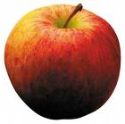
Thank you for your attention!

