Slide 1

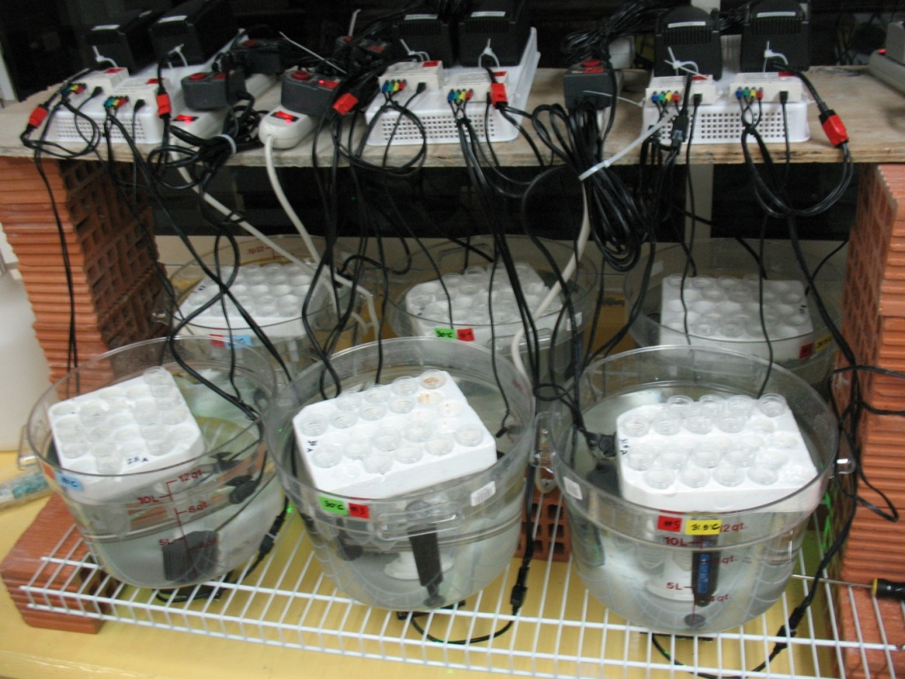
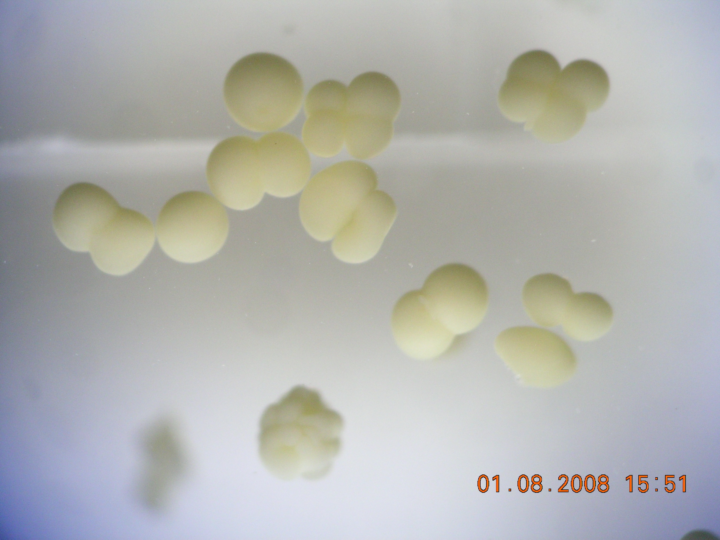
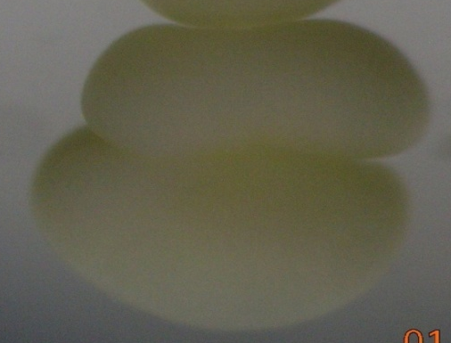
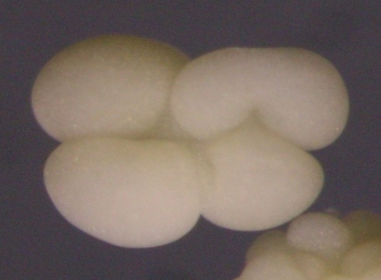
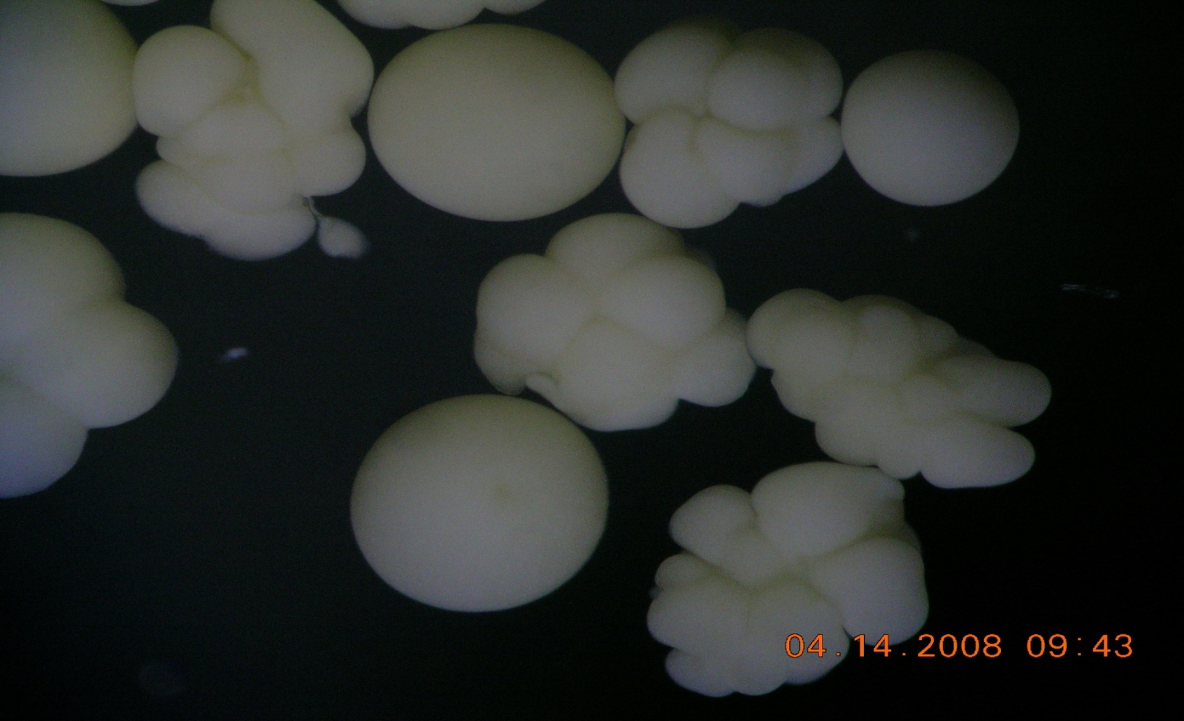
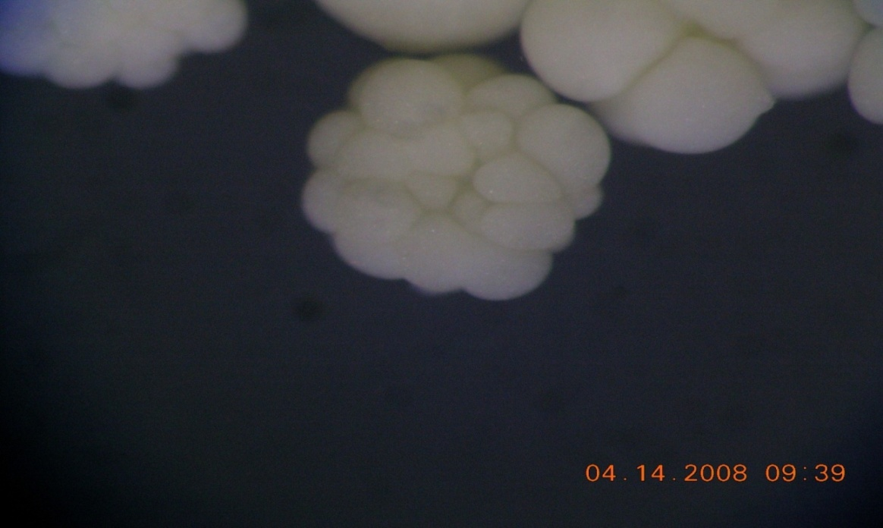
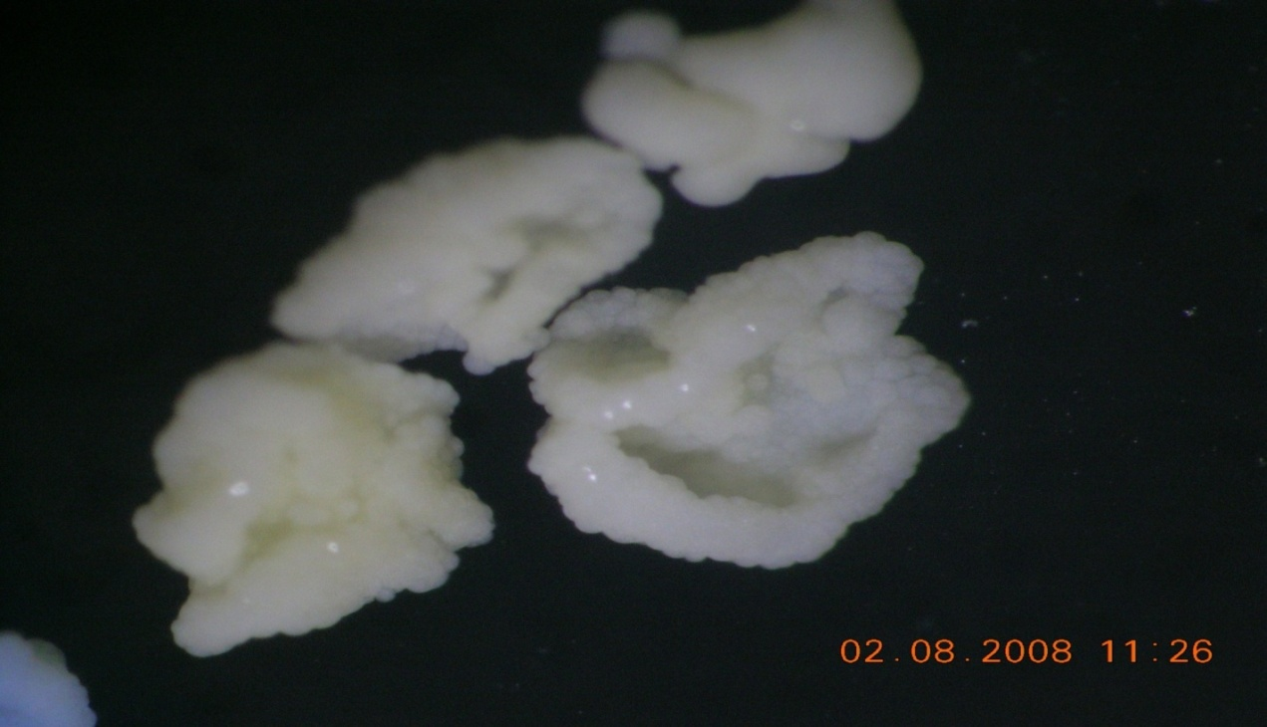
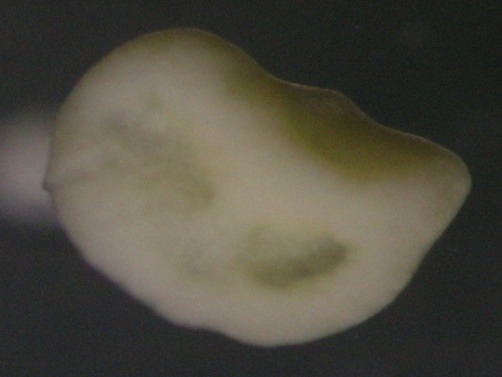
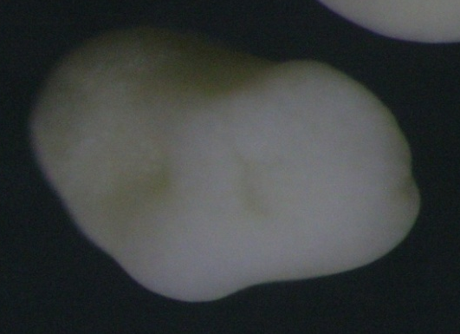
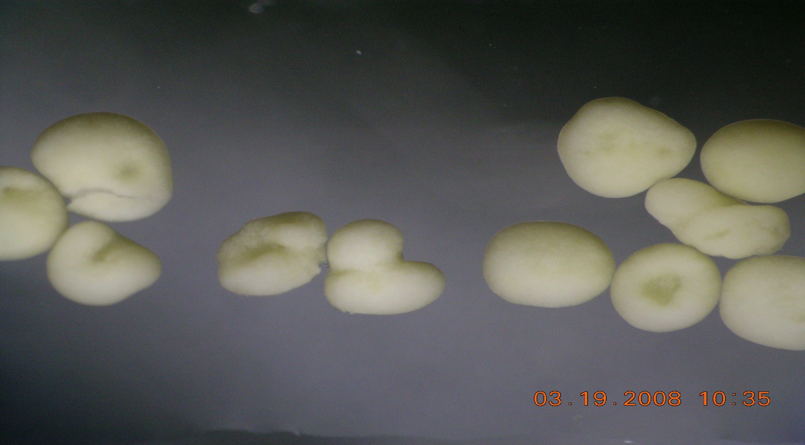
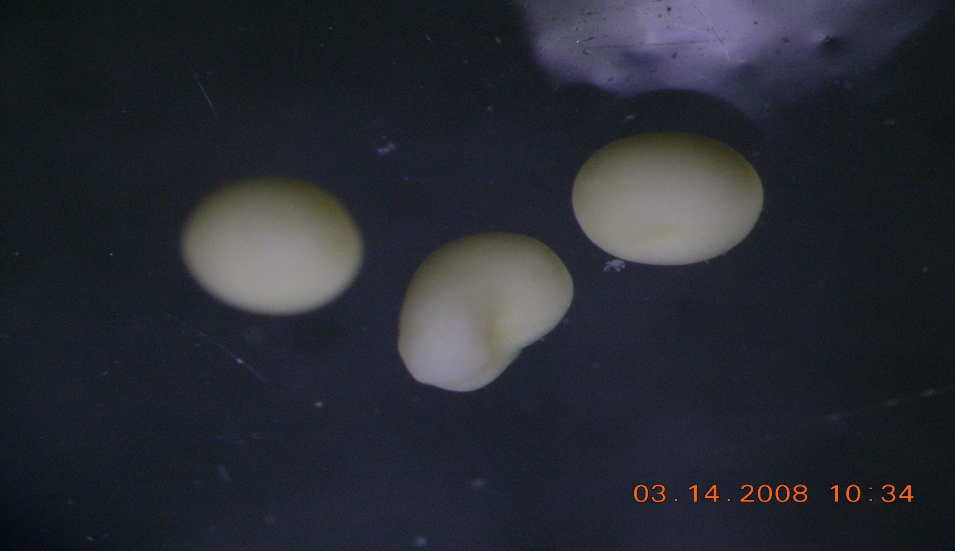
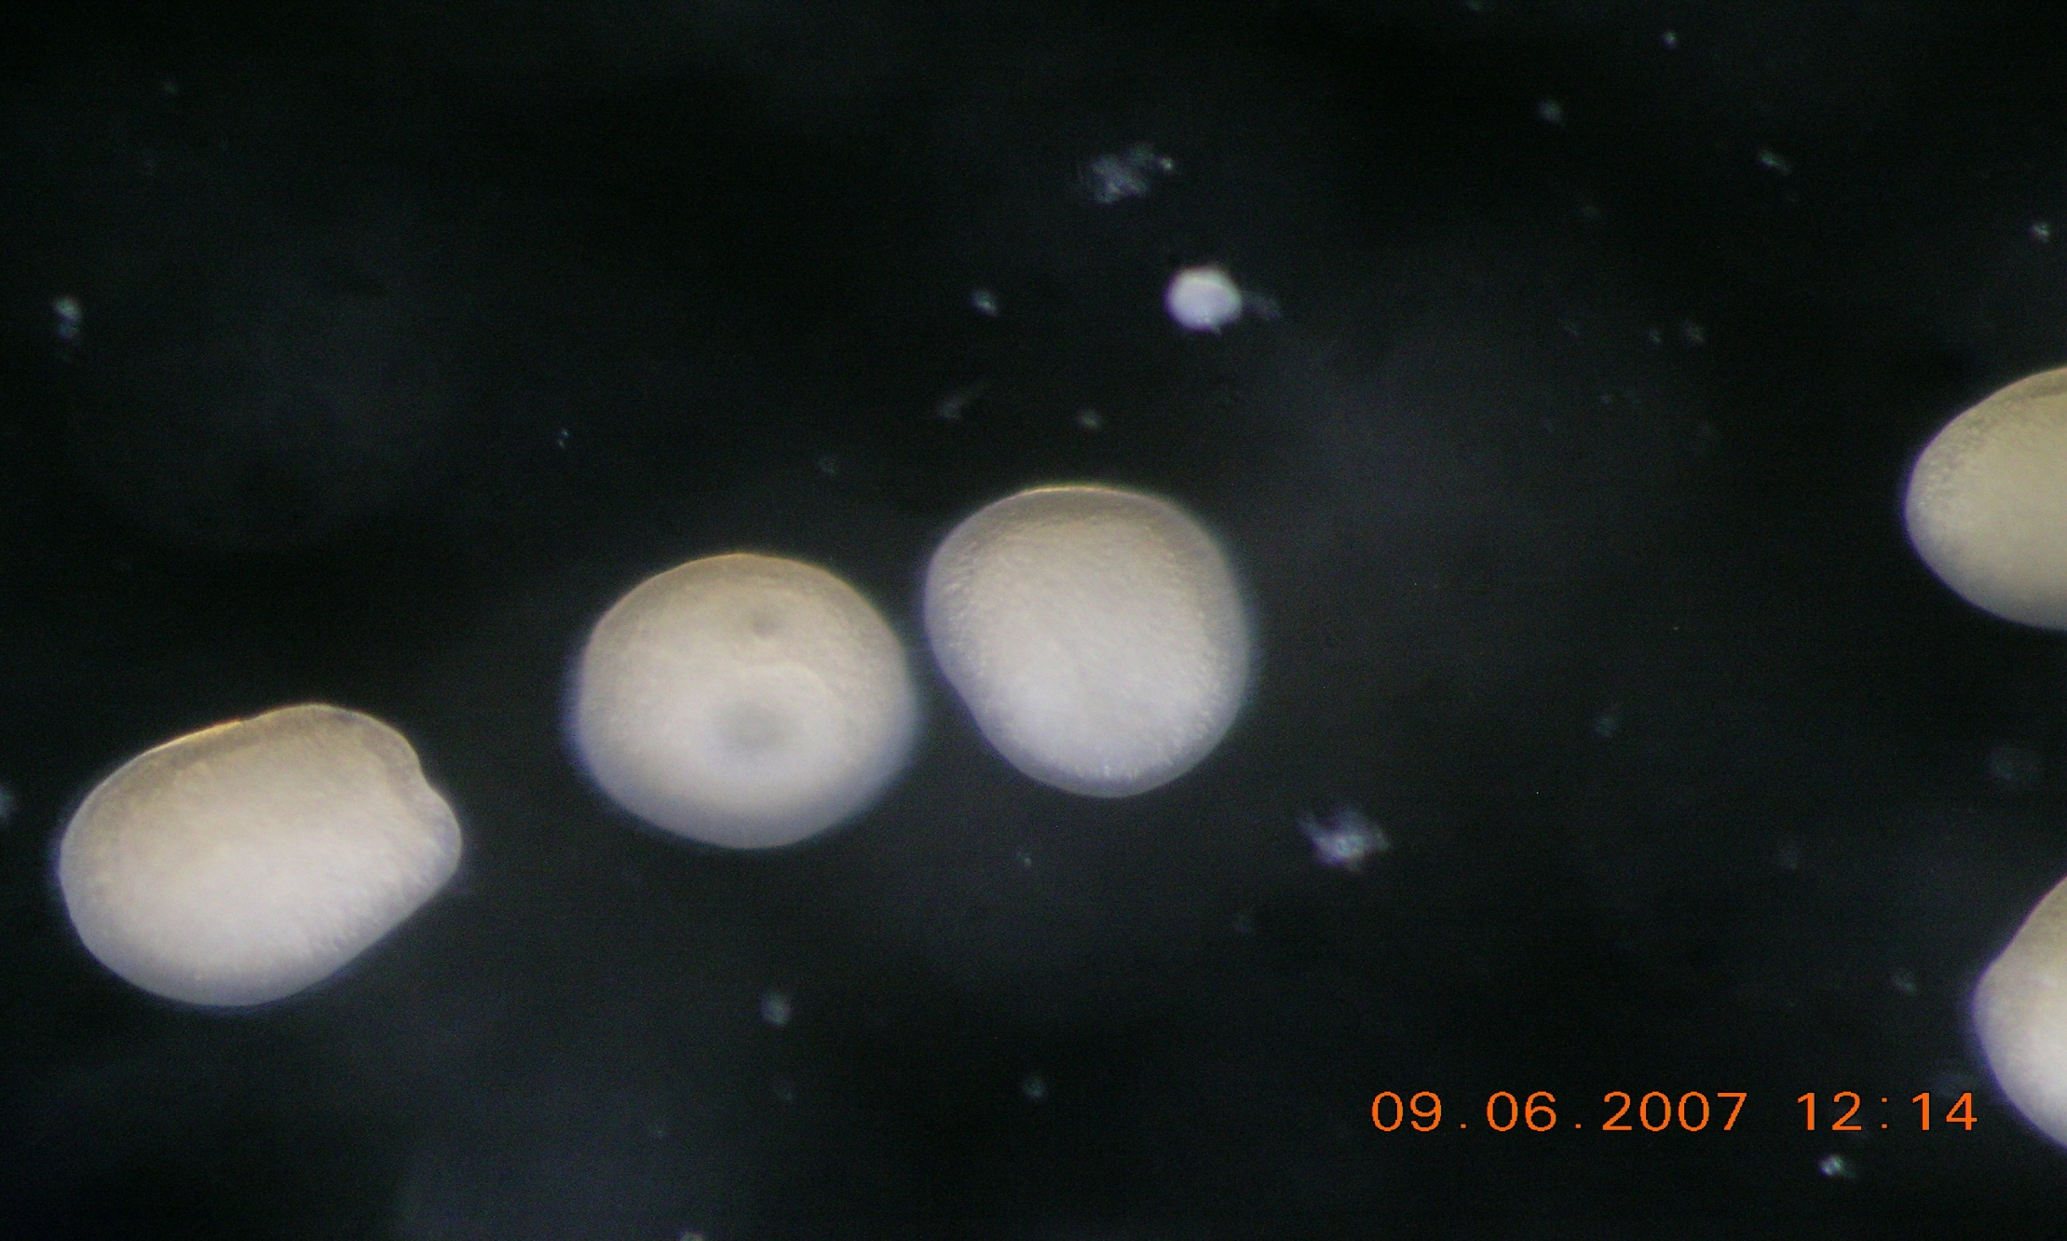
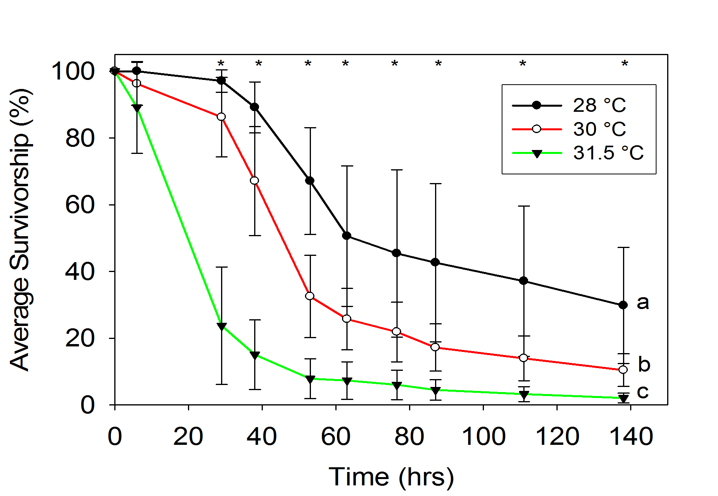
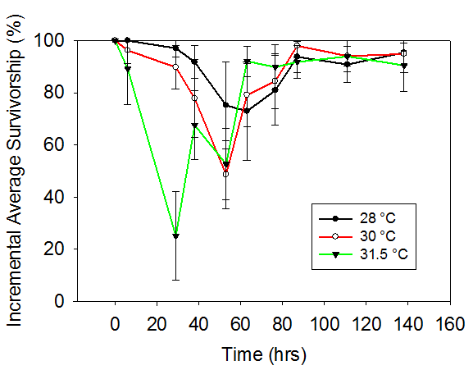
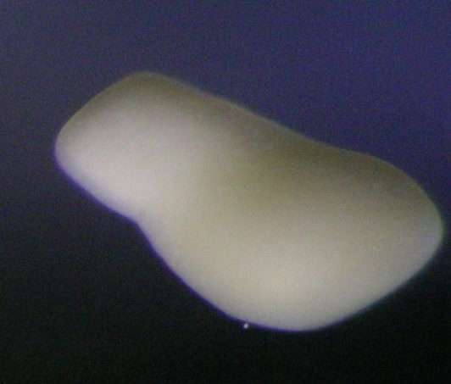

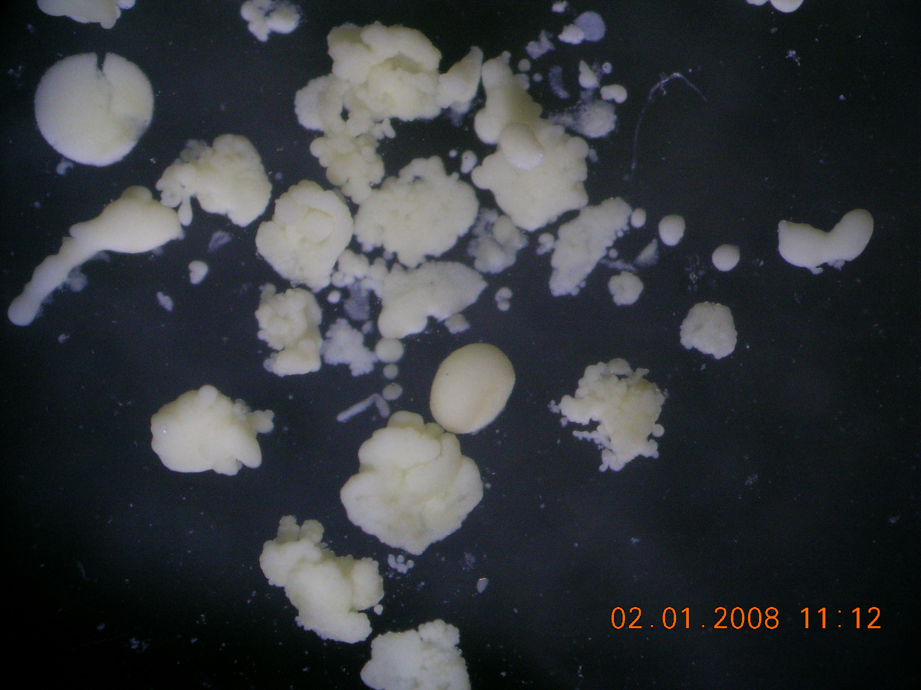
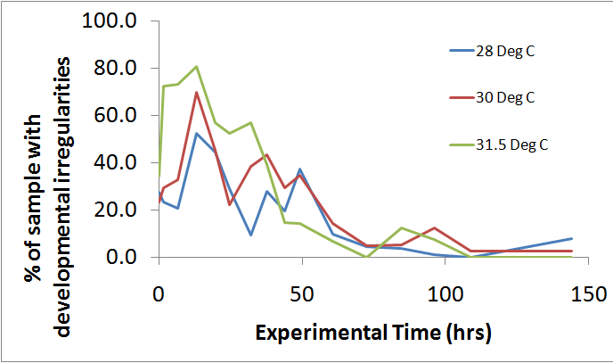
The Effects of Elevated Sea Surface Temperatures on Acropora palmata
Larval Survival and Development
Carly J. Randall, Andrew M. Miller and Alina M. Szmant, Center for Marine Science, University of North Carolina Wilmington
25-1137
Abstract
High temperature anomalies associated with global warming have been shown to be responsible for a reduction in live coral cover on reefs. Prolonged episodes of warmer seawater temperatures are known to cause adult corals to undergo bleaching, become more susceptible to disease, and exhibit reduced reproductive success. However, the effect of elevated temperatures on early life-stages of corals remains poorly studied. If elevated temperatures reduce survival and/or affect the development of coral larvae, the recovery of coral populations will be impeded. Temperature effects on the survivorship and development of larvae of the broadcast spawning coral Acropora palmata were studied in a laboratory setting. Larvae maintained at two elevated temperatures (30 and 31.5 ºC) exhibited reduced survivorship as compared to those maintained within the normal annual temperature range (28 ºC). Over 140 hours, larvae maintained at 28 ºC exhibited a cumulative average survivorship of 28.9 % whereas larvae maintained at 31.5 ºC exhibited a significantly reduced survivorship of only 2.0 %. Intermediate survivorship of 10.9 % was observed at 30 ºC. Additionally, larvae maintained at elevated temperatures exhibited a faster rate of development with increased developmental abnormalities at higher temperatures. These results demonstrate that larval development of Acropora palmata can be seriously affected during summers with elevated seawater temperatures.
Materials and Methods
TABLE 1.
Photo credits: C. Randall and A. Miller
I. LARVAL SURVIVORSHIP
+ A. palmata spawn was collected during a September 2007 spawning event in Puerto Morelos, Mexico.
+ Following fertilization for approximately 1 hour, at an ambient temperature of 29 °C, embryos were transferred to one of three temperature treatments 28 °C (control), 30 °C and 31.5 °C (elevated) and maintained in 12 L culture bins.
+ After approximately 6 hours, 36 replicate groups of 20 larvae were counted into 50 mL centrifuge tubes. 6 tubes were haphazardly assigned to each of 2 culture bins per temperature.
+ Every 12 – 14 hours for the next 6 days
the number of surviving larvae were counted.
 | DEVELOPMENTAL STAGE | DESCRIPTION OF STAGE
1 | Egg: | unfertilized ovum or fertilized embryo before first cleavage.
2 | First cleavage: | fertilized embryo that is undergoing first cleavage.
3 | Second cleavage: | fertilized embryo that is undergoing second cleavage.
4 | 4 to 8 Celled Embryo: | embryo with 4-8 cells.
5 | 8 to 16 Celled Embryo: | embryo with 8-16 cells.
6 | +16-celled embryo: | round embryo that contains more than 16 visible cells.
7 | “Pre-prawn Chip:” | flattened embryo; blastomeres distinguishable under dissecting microscope.
8 | “Prawn Chip:” | flattened embryo; individual cells are no longer distinguishable under a dissecting microscope.
9 | Blastulating phase: | prawn chips developing into blastulae.
10 | Gastrulating phase: | smooth, round embryos with an invagination.
11 | Gastrula: | embryos that appear round, smooth and pale yellow in color (fixed samples).
12 | Early Planula (larva): | oval shaped larva with a clear oral pore.
13 | Planula: | elongated larva with a larger, more developed oral pore with a widened aboral end.
14 | Pre-settlement Planula: | development of tentacle buds around oral end.
15 | Small Irregular: | irregular cell masses; smaller than 500 μm
16 | Large Irregular: | irregular cell masses; larger than 500 μm
1
2
3
Figure 1. Temperature exposure systems consisting of 12 L polycarbonate bins equipped with a chiller, heater, water pump and temperature logger. Sample tubes of larvae were suspended in the water baths.
4
5
6
7
8
9
Results
I. LARVAL SURVIVORSHIP
10
11
12
Statement of the Problem
A. palmata is an important reef building Caribbean coral that reproduces via broadcast spawning.
Live cover of A. palmata has severely decreased on many Caribbean reefs due to diseases (particularly yellow band disease), bleaching due to elevated temperatures, hurricane damage, and anthropogenic activity over the last several decades.
Recruitment to adult populations by larvae is necessary to rebuild these decimated Caribbean reefs.
Due to the changing climate, summer seawater temperatures have been rising and can exceed 31 °C in the summer, 2-3 °C above historical upper summer temperatures.
A. palmata reproduces annually during August and September and their larvae spend over one week in the plankton, during the annual temperature maximum.
Therefore, larvae of this species can be exposed to elevated temperatures during development. If larval survivorship is negatively affected by elevated temperatures, the supply of larvae, important to reef recovery, will be reduced.
13
14
15
Figure 2. Photomicrographs of the developmental stages of Acropora palmata observed in the temperature exposure experiment.
Figure 3. Average survivorship of A. palmata larvae exposed to three temperatures over six days (n=12). Error bars = standard deviation. Letters denote statistically significant differences among temperatures . * denotes time points in which temperature differences were significant (p<0.05, 2-way repeated measure ANOVA).
Figure 4. Average survivorship during each time interval of A. palmata larvae exposed to one of three temperatures (i.e. the survivorship of larvae from one time point to the next; n=12). Error bars = standard deviation.
Notice a dramatic increase in mortality experienced by the 31.5 degree larvae 20-40 hours earlier than those at the lower temperatures.
16
Results
30 °C
31.5 °C
28 °C
II. LARVAL DEVELOPMENT
Developmental Stages
Materials and Methods
LARVAL DEVELOPMENT
+ Additional larvae were cultured at the test temperatures and sampled periodically for examining development.
+ Every few hours during the first 24 hours following fertilization, larvae were collected and fixed in 2.5% glutaraldehyde in a 0.05 M sodium cacodylate buffer.
+ Two to three samples were collected over the subsequent 5 days and fixed as described above.
+ Samples were examined with a dissecting scope to quantify the developmental time series.
+ Embryos and larvae were assigned to one of 16 stages based on morphology (including two categories for irregular growth), and were defined as described in Table 1. Figure 2 includes photo micrographs of each stage.
Figure 6. The percentage of abnormalities in Acropora palmata embryos and larvae raised at one of three temperatures during development. Sample size ranged from 10 to 198 larvae depending on the temperature and time.
Research Questions
1. How do elevated temperatures affect the survivorship of embryos and larvae of A. palmata?
2. How will elevated temperatures affect the rate of development of larvae and embryos in A. palmata?
Do elevated temperatures cause developmental abnormalities?
Figure 5. The proportion of Acropora palmata embryos and larvae at each developmental stage quantified in samples collected during a 6 day exposure to one of three temperatures. Each group of three bars corresponds to samples from three temperatures at each sampling time (28, 30 and 31.5 °C from left to right). Sample size ranged from 10 to 198 larvae depending on the temperature and time.
Results and Conclusions
Survivorship at 30 °C and 31.5 °C was significantly lower than at 28 °C, and survivorship at 31.5 °C was significantly lower than at 30 °C.
Compared to a survivorship of 28.9% at 28 °C, only 10.9% and 2.0% survived at 30 °C and 31.5 °C , respectively.
Mortality rates varied over the developmental timecourse; there was a dramatic decrease in survivorship that occurred during the time of gastrulation (Figure 4)
At the 2 elevated temperatures, mortality associated with gastrulation occurred earlier in the time-course (Figures 3 and 4).
Larvae from the elevated temperatures experienced a greater rate of development than larvae at the control temperature and differences were noted as early as 13 hours into development (Figure 5).
At the elevated temperatures, a larger percent of embryos and larvae developed irregularly than at the control temperature (Figure 6).
In Conclusion, A. palmata larvae are sensitive to and negatively affected by elevated temperatures within the range being observed during anomously warm summers in recent years (e.g. 2005).
Gastrulation appears to be a highly sensitive developmental step that results in greater mortality than other developmental phases. The mortality that normally occurs during this stage of development is exacerbated by elevated temperatures.
We predict that Acropora palmata larval supply will be affected if predicted temperature rises of 1.8 to 4 °C by 2100 take place.
Acknowledgements
Funding was provided by UNCW Academic Affairs and NSF Biocomplexity grant OCE- 0603790 to M. Medina, A. Szmant and M. Coffroth. We thank R. Iglesias-Prieto, M. Medina, M. Coffroth, P. Erwin, P. Medina-Rosas and C. Voolstra for their help in the field.

