Slide 1
Nonfiction Picture Books You Say? Our Resources Will Show You the Way
Logan McKnight
Jeanne Swafford
University of North Carolina – Wilmington
Presentation at the North Carolina Reading Association Annual Conference
March 12, 2013

Slide 2
Overview
Locating quality nonfiction titles and keeping up with new publications
Notable nonfiction authors
Classroom connections using multiple texts

Slide 3
How do you locate nonfiction texts?

Slide 4
Nonfiction Awards
Orbis Pictus Award for Outstanding Nonfiction for Children
http://www.ncte.org/library/NCTEFiles/About/Awards/OP2010-Present.pdf
2. Notable Social Studies Trade Books for Young People (historical fiction, biography, nonfiction)
http://www.socialstudies.org/system/files/files/notable2011.pdf
3. Outstanding Science Trade Books for Young People (may not be nonfiction but portrays science concepts in engaging ways) http://www.nsta.org/publications/ostb/ostb2013.aspx

Slide 5
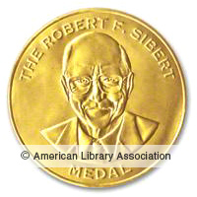
3. Sibert Informational Book Award
http://www.ala.org/alsc/awardsgrants/bookmedia/sibertmedal/sibertpast/sibertmedalpast
4. Boston-Globe Horn Book Award
http://archive.hbook.com/bghb/current.asp
5. Cook Prize (for outstanding STEM bks)
http://www.bnkst.edu/center-childrens-literature/cook-prize/

Slide 6
7. Children’s Book Guild Nonfiction Award (to authors) http://www.childrensbookguild.org/nonfiction-award/past-winners
8. Publisher’s Weekly Best Books – Children’s Nonfiction
http://www.publishersweekly.com/pw/best-books/2011/childrens-nonfiction#list
9 . School Library Journal Best Books – Nonfiction
http://www.schoollibraryjournal.com/slj/articlereview/892886-451/best_books_2011_nonfiction.html.csp
10. Flora Stieglitz Straus (nonfiction that inspires children) http://bankstreet.edu/center-childrens-literature/childrens-book-committee/awards/
AND MORE!

Slide 7
Authors | Science
Steve Jenkins Robyn Paige | Writing model: interesting organization, design, word choice. K-5
Sy Montgomery | Scientists in the Field series. 3rd - up
Sandra Markle | Inside Outside series. 2nd – 5th
Nic Bishop | Close-up photos. K – 5th
Seymour Simon | Photography. Descriptive writing. 2nd – 8th
Gail Gibbons | Also social studies. K – 3rd.
Stephen Swinburne | Protecting animals. 3rd – 6th Also simple concept books (e.g., colors, shadows). PK-2

Slide 8
Authors | Biography
Andrea Davis Pinkney | African Americans, K - 5
Kadir Nelson | African Americans, K - 9
Doreen Rappaport | Also African American history and historical fiction, 2nd - 8
Robert Burleigh | Also nonfiction , 1st – 5th
Kathleen Krull | Lives of . . ., Giants of Science series. 3rd – 8th
Phillip Hoose | Also nonfiction conservation, 4th - up
Russell Freedman | Also nonfiction history, 5th - up

Slide 9
Authors | Biography
Patricia McKissack Fredrick McKissack | African American experience. K - up (Also other genres)
Barbara Kerley | Also Photo Inspirations series. K – 5th
Susan Campbell Bartoletti | Also nonfiction history & other genres. 5th - up
Candace Fleming | Also other genres, 4th – 7th
Jan Greenberg, Sandra Jordan | Many artist biographies, K – 8th

Slide 10
Authors | Latino experience
Pat Mora | Various genres, including nonfiction
Jonah Winter Jeanette Winter | Latino, African American biographies, other nonfiction representing various cultures & topics. K– 5th
Carmen Lomas Garza | Various genres, including nonfiction

Slide 11
What we know:
We need to teach children how to read nonfiction texts with varying text structures, visual representations of information (maps, charts, photographs), non-linear texts.
Students need to question the authenticity of texts (critical reading).
Students need to be engaged.

Slide 12
Students need choices.
Learning engagements must be relevant to students’ lives.
Students engage in multiple forms of literacy outside of school.
Individuals need to use multiple digital and print texts to learn.

Slide 13
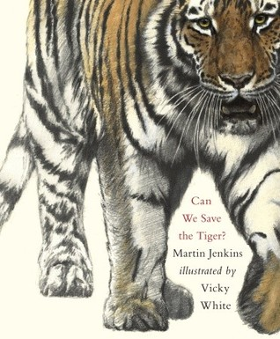
Endangered Species Text Set

Slide 14
Questions
Why are there endangered species? How does this happen?
How do we know a species is endangered?
What species are endangered?
What would it feel like to be a threatened or endangered species?
Where are endangered species located?
What can we do to help protect and conserve endangered species?

Slide 15
Questions
How would a historian look at conservation/endangered species?
How would an artist view endangered species? How do you represent something you’ve never seen?
How would a mathematician view endangered species? What questions would they ask? What problems would they solve?
What songs/sounds do we hear that we might not if the species went extinct?
How are ecosystems affected when a species is endangered or goes extinct? How do endangered and/or extinct species affect us?
What local issues/stories are there involving endangered species and/or conservation?

Slide 16
Resource Highlights
Can We Save the Tiger?
Design a Habitat for the Black-Footed Ferret
Interactive Map
The Price of Progress
Through Endangered Eyes

Slide 17
Can We Save the Tiger?

Slide 18
Design a Habitat
http://www.arkive.org/education/games/design-a-habitat

Slide 19
Design a Habitat continued
Information about why/how the species became endangered.

Slide 20
Design a Habitat continued
Students use information learned to problem solve and create a suitable habitat for the ferrets.

Slide 22
Map of Endangered Species
http://www.escapefoundation.org/about-escape-foundation/a-world-of-endangered-species/

Slide 23
The Price of Progress
http://www.cbsnews.com/stories/2007/04/22/sunday/main2714532.shtml

Slide 24
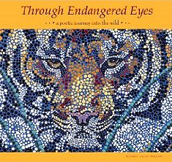
Through Endangered Eyes: a poetic journey into the wild

Slide 25
So what?
The variety of resources in a text set makes for a well rounded study of the topic.
Offers multiple perspectives and causes students to ask questions and think critically
This type of thinking allows students to synthesize
Concepts come together, create new understandings and deepen understandings of the topic

