Slide 1
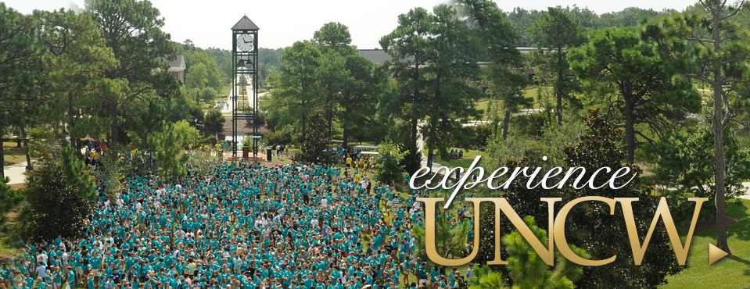
Welcome to the Coolest Place in Town!!!!!!

Slide 2
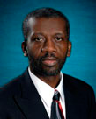
Dr. Devon Simmonds Computer Science Department
Department of Computer Science

Slide 3
Welcome, Motivation & Academic Expectations

Slide 4
My Story

Slide 5
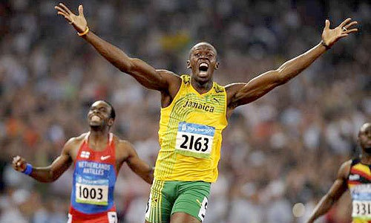
My Story

Slide 6
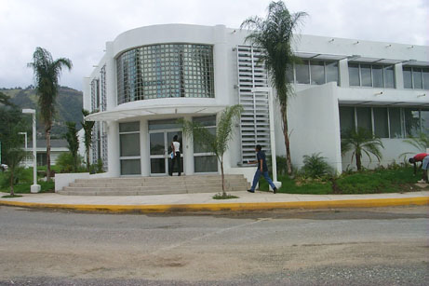
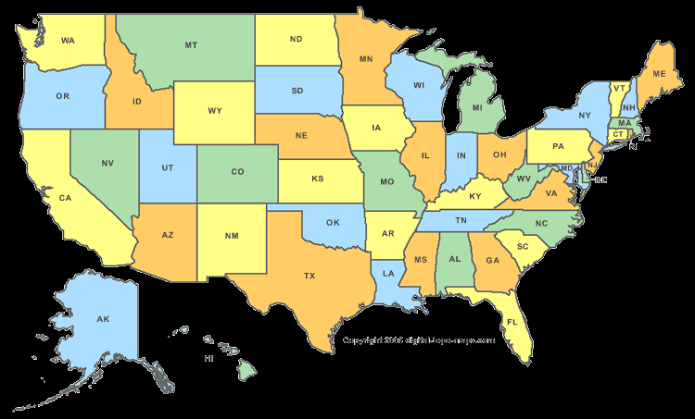
My Story
United States
Ph.D. Colorado State University
University of Technology, Jamaica

Slide 7
Welcome, Motivation & Academic Expectations
Getting to know you

Slide 8
Welcome, Motivation & Academic Expectations
What are your goals and aspirations?

Slide 9
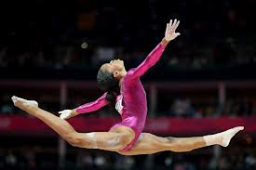
Welcome, Motivation & Academic Expectations
A global village

Slide 10
Welcome, Motivation & Academic Expectations
“We have found that there are some aspects of college life that relates to success in class that our freshmen were not anticipating. We developed this program with a group of faculty members from UNCW so you would know what to expect” – from UNCW.

Slide 11
Welcome, Motivation & Academic Expectations
All of UNCW, students, faculty and staff have all worked hard to get here.
You were chosen from an excellent pool of new students via a rigorous selection process.
Make the most of your time here.

Slide 12
Welcome, Motivation & Academic Expectations
University Statement of Academic Expectations for Students
In choosing UNCW,
You have become part of our community of scholars.
We recognize that the this learning experience is challenging and requires hard work.
It also requires a commitment to make time available to do that hard work.

Slide 13
Welcome, Motivation & Academic Expectations
University Statement of Academic Expectations for Students
In choosing UNCW,
The university expects you to make academics your highest priority by dedicating your time and energy to training your mind and acquiring knowledge.
Academic success in critical thinking and problem solving prepares you for the changes and challenges you will encounter in the future.
Our faculty and academic support resources are readily available as partners in this effort, but the primary responsibility for learning is yours.

Slide 14
Welcome, Motivation & Academic Expectations
Academic Priority & Standards
Academics must be your #1 priority over all other activities (work, involvement, etc.).
Go beyond the minimum and excel.
College is more difficult than you think. It requires time and effort outside the classroom. Manage your time well.
Learning is your primary responsibility. The faculty and academic support resources are your partners in your learning but it is still your responsibility.

Slide 15
Welcome, Motivation & Academic Expectations
Academic Priority & Standards
Learning is an active process and your active engagement is critical.
Do you know what the standards of your professors are? (talk about the importance of the syllabus)
Students should appreciate learning for its own sake and should enjoy engaging in the learning process, but not expect to be “entertained”.
Learning is a life-long process.
Critical thinking is a life skill.

Slide 16
Welcome, Motivation & Academic Expectations
Strategies for Academic Success
Those who are successful in class stay in touch with the professor and study.
Utilize academic resources (writing center, tutoring & learning center, math lab, supplemental instruction, library resource staff, help desk).
Students who succeed have learned how to manage their time and put academics as their first priority.

Slide 17
Welcome, Motivation & Academic Expectations
Strategies for Academic Success
Students who succeed read the text books.
Student who are successful know their professors expectations by understanding the syllabus.
Students who are successful in college have adjusted their study skills to reflect what is necessary in college.

Slide 18
Welcome, Motivation & Academic Expectations
Strategies for Academic Success
Look beyond the short term of how to succeed in this class and look at the future. (You may need an internship or a reference from your faculty member so get to know them. The person sitting next to you in class may be your business partner in the future.)
Choose your friends that support your goals not detract from them.

Slide 19
Welcome, Motivation & Academic Expectations
Classroom Etiquette & Expectations
We expect students to be civil & respect their professors and classmates.
Be on time to class. If you are going to miss class tell the professor but be aware this does not excuse your absence.
Cell phones, pagers, etc. are not appropriate in the class room. Turn them off and put them away.

Slide 20
Welcome, Motivation & Academic Expectations
Classroom Etiquette & Expectations
Side conversations are distracting to others. Don’t do it.
The classroom should have an environment of professional courtesy.
Intellectual discourse involves challenging ideas in a civil and respectful manner.
Respect the learning of others.

Slide 21
Welcome, Motivation & Academic Expectations
Academic Honesty
UNCW Honor Code
Plagiarism
Acknowledging the work of others (cheating vs. collaboration)

Slide 22
Q
u
e
s
t
i
o
n
s
?

