Slide 1
The Historical Context of the Rosenwald Schools
Donyell L. Roseboro, Ph. D.
University of North Carolina Wilmington
November 13, 2009

Slide 2
Three Questions
    Why educate Black people?
    How should we educate Black people?
    What should Black people be able to do once they are educated?

Slide 3
Education v. Schooling
Abraham Flener in 1927 said, “Education is an intellectual and spiritual process. It has to do with opening the windows of the human mind and the human soul” (cited in Tozer, Violas, & Senese, 1998, p. 3).

Slide 4
Schooling
“The totality of experiences that occur within the institution called school, not all of which are educational” (Tozer, 1998, p. 3).

Slide 5
Why educate Black people?
Family
Christian Missionaries (Moravians, Quakers, and American Missionary Association--AMA)
Anti-slavery reformers of the 1830s and beyond
  David Walker
  William Lloyd Garrison

Slide 6
David Walker’s Appeal (1829)
I must observe to my brethren that at the close of the first Revolution in this country, with Great Britain, there were but thirteen States in the Union, now there are twenty-four, most of which are slave-holding States, and the whites are dragging us around in chains and in handcuffs, to their new States and Territories to work their mines and farms, to enrich them and their children-and millions of them believing firmly that we being a little darker than they, were made by our Creator to be an inheritance to them and their children for ever-the same as a parcel of brutes.

Slide 7
William Lloyd Garrison (1830)
“Now how is it with the slave?” His answer… He knows not what is going on beyond his own narrow boundaries. He can neither read nor write. The letters of the alphabet are caballistical to his eyes. A thick darkness broods over his soul. Even the "glorious gospel of the blessed God," which brings life and immortality to perishing man, is as a sealed book to his understanding.”
Notes:
From the term Kaballah which means secret or mysterious

Slide 8
So why educate Black people?
It depends on one’s perspective…
    To make them more docile workers (using particular verses of the Bible)
    To help enslaved people see beyond their own narrow boundaries (Garrison)
    To rise up and resist slavery (Walker), to demonstrate your humanity, to fight for racial uplift, to lead your people (Perry, 2003)

Slide 9
How Should we Educate Black People?
Morrill Land Grant Acts (1862, 1890)
Freedmen’s Bureau Schools (1862-1972)
  Freedmen's Bureau Schools

Slide 10
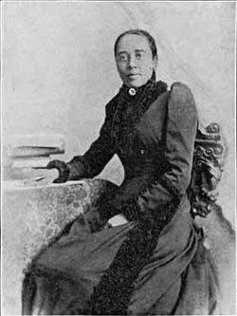
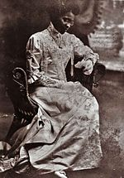
Notable Black Educators
Ana Julia Cooper
Charlotte Hawkins
Brown

Slide 11
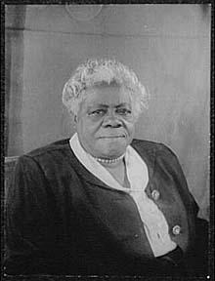
Notable Black Educators
Mary McLeod Bethune
After the slave was freed, every effort has persisted to maintain ‘white supremacy’ and wall the Negro
in from every opportunity to challenge this concocted ‘supremacy’” (Bethune, 1944, “Certain Unalienable Rights”).

Slide 12
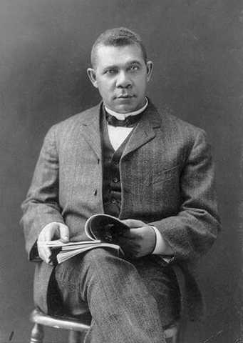
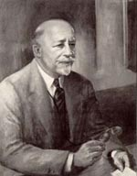
Notable Black Educators
Booker T. Washington
W. E. B. Du Bois

Slide 13
What should Black People be able to do once they are educated?
  Get a job
  Understand themselves as free and thinking people who could participate in civic life
  Fight for racial uplift
  Lead their people

Slide 14
Where are Rosenwald Schools in this Context?
  When Julius Rosenwald and his family created the Rosenwald fund to educate African Americans, there was already a healthy debate in the U.S. about what should be the goals and purposes of education for Black Americans.
  The schools built were based on architectural designs and work of professors (and students) at Tuskegee Institute
  Du Bois even appreciated the work of Julius Rosenwald

Slide 15
African American Education Post Rosenwald Era
1954 Brown v. Board of Education: Question of tangible v. intangible resources (Buildings & Money v. curriculum & reputation)
Re-segregation of public schools (have they ever really been integrated?)—will we (Black people) be forever troubled by the question, “What did segregated Black schools provide that desegregated schools did not or cannot?”

Slide 16
Henry Louis Gates, Jr.
“Education in a democratic society (or one that aspires to that ideal) has particular burdens placed upon it” (1992, p. 328).

Slide 17
References
Freedman’s Bureau (n. d.). Retrieved on November 12, 2009 from http://www.archives.gov/research/african-americans/freedmens-bureau/
Garrison, W. L. (1830). Abolition and slavery. Retrieved on November 12, 2009 from http://www.digitalhistory.uh.edu/documents/documents_p2.cfm?doc=73
Gates, H. L., Jr. (1992). The transforming of the American mind. Social Education 56(6), 328-331.
Notable Kentucky African Americans Database (2009). Henry Boyd. Retrieved on November 12, 2009 from http://www.uky.edu/Libraries/NKAA/subject.php?sub_id=113
Perry, T., (2003). Freedom for literacy and literacy for freedom: The African American philosophy of education. In T. Perry, C. Steele, & A. Hilliard, III. Young Gifted and Black: Promoting high achievement among African-American students (pp. 11-51). Boston: Beacon Press.
Tozer, S., Violas, P.C., & Senese, G. (1998). School and society (3rd edition). Boston: McGraw-Hill.
Wadelington, C. W. & Knapp, R. (1999). Charlotte Hawkins Brown and Palmer Institute: What one young African American woman could do. Chapel Hill: The University of North Carolina Press.
Walker, D. (1829). The Appeal. Retrieved on November 12, 2009 from http://www.pbs.org/wgbh/aia/part4/4h2931t.html
Washington, B. T. (1895). Booker T. Washington delivers the 1895 Atlanta compromise speech. Retrieved on November 13, 2009 from http://historymatters.gmu.edu/d/39/

