Slide 1
Gender & Family
“That institution in society that arranges for: (1) Regulation of Sexual Relations; (2) Household Composition; (3) Child-Rearing”

Slide 2
Sex vs. Gender
Sex (a biological fact)
The biological characteristics that differentiate women and men (XX or XY Chromosome)
Gender (a cultural & social-psychological fact)
The socially constructed patterning of masculinity and femininity, and of relations between women and men
Notes:
Can any one tell me the difference between sex and gender?
Do you think we are born liking pink and blue?

Slide 3
“Doing Gender”: Gender Socialization
Doing Gender:
(West and Zimmerman, 1987) the ongoing process through which people create gender for themselves and others by acting and appearing the way we “should” as men and women.
Gender as a social construction
Symbolic interaction

Slide 4
Women and Men
Notes:
How do we know these are men and women?

Slide 5
Women and Men

Slide 6
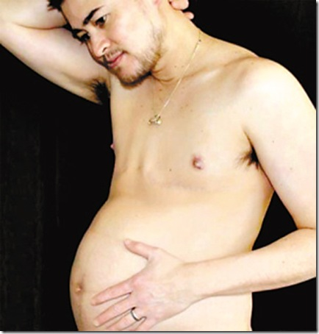
Women and Men?

Slide 7
Socialization: The Importance of Peers and Others in Society
Cultural & cognitive categorization into one group or the other
Gender expectations for women and for men
Sanctions for not behaving the way a man or woman is supposed to behave
Notes:
What you think, how you perceive these people are is more important than who they actually are, what their gender is.
If you don’t know someones gender, it is awkward and you don’t know how to act, even if the interaction (buying groceries) has no gender significance at all.
You can go to any party and see that men and women act differently among other people of the same gender vs. opposite gender

Slide 8
Family
Regulation of Sexual Relations
Culture
Changes in Gender Roles
Divorce

Slide 9
Family & Divorce Regulation of Sexual Relations
Crude Divorce Rate = No. of divorces/100 (or 1000) married persons
1920: 13.4
!960: 23.1
1990: 51.1
BUT: How the 50% rate is calculated
Annual marriage rate per 1,000/Annual divorce rate per 1,000
2003:
7.5 marriages per 1,000
3.8 divorces per 1,000 (NCHS, 2005)

Slide 10
Family & Divorce Regulation of Sexual Relations
Better method of calculation
How many people who have ever married subsequently divorced?
Highest rate = ca. 41%
Factors Predicting Success & Failure
Education
Divorce rates lowest for college graduates
1/3 to ¼ the rate of non-graduates
Age
Nearly ½ under age 18
40% under age 20
24% over age 25
Religion
Born-again Christians same as general population (ca. 1/3)

Slide 11
Family & Divorce Factors Predicting Success & Failure
Region
Highest rates
South & Midwest
“Red” states higher than “blue” states
from Smart Marriages Listserv , Jan. 4, 2005
Cohabitation
Couples cohabiting before marriage
Significantly higher risk of divorce than couples not cohabiting before marriage

Slide 12
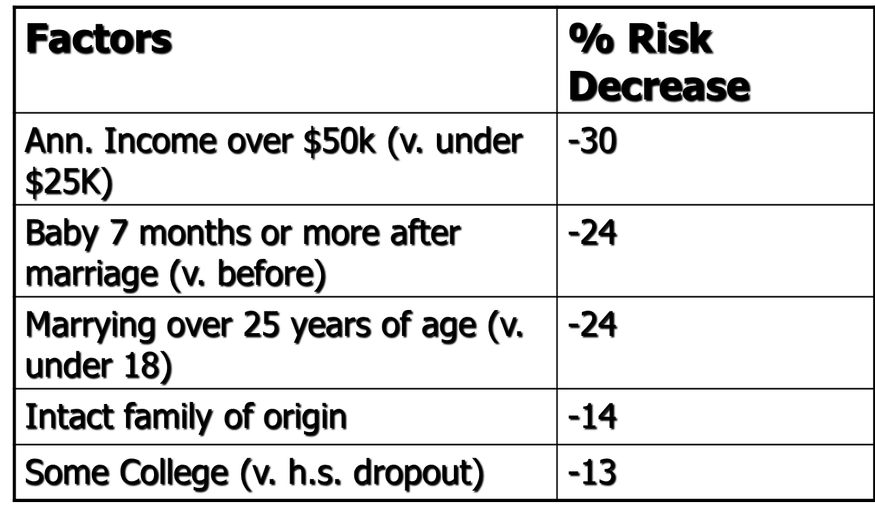
Family & Divorce Factors Affecting Success & Failure

Slide 13
Household Composition “Who Lives With Whom?”
Divorce (obvious effect)
Changing Household Forms
Living together has increased > six-fold
Often short term
Higher divorce rate
Staying single:
2000: 27.2 million people, 26% of all households (in 1950, 9.3%)
Vs. 22% married couples & their kids
21% married couples living alone

Slide 14
Household Composition “Who Lives With Whom?”
Changing Household Forms
Waiting Longer (Older married households)
Median Age at First Marriage
 | Male | Female
1950 | 22.8 | 20.8
2003 | 27.1 | 25.3

Slide 15
Household Composition “Who Lives With Whom?”
Single Parent Households
2000: ca. 13.5 million single parents had custody of 21.7 million children under 21 years of age
% of population made up by married couples with children decreased from 40% in 1970 to 24% in 2000
Single parent households increased from 9% in 1990 to 16% of all households by 2000.
Of all custodial parents, 85% were mothers
Variation by race/ethnicity

Slide 16
Household Composition “Who Lives With Whom?”
Children in single-parent households by race/ ethnicity, 2006 (American Community Survey & Annie E. Casey Foundation, 2006)
White | 23%
Black | 65%
American Indian | 49%
Asian | 23%
Hispanic | 36%

Slide 17
Household Composition & Child-Rearing: Lineality & Locality
Unusual Society
Patterns of lineality & locality
Patrilineal
Trace blood & property lines along father’s side
Matrilineal
Trace blood & property lines along mother’s side

Slide 18
Household Composition & Child-Rearing: Lineality & Locality
Matrilocal
Children live with mother
Patrilocal
Children live with father
Locality & lineality have separated
Divorce
$ goes with dad
Kids go with mom

Slide 19
Family: Functional Changes & the State
Matrilocal & Patrilineal Society
→ Bureaucratization of the family
To meet child rearing function of family
due to household composition changes
Child-rearing
State has stepped in
Welfare
AFDC (until 1997)
TANF (since July 1, 1997)

