Slide 1
Chapter 3
Elementary Number Theory and Methods of Proof

Slide 2
3.1
Direct Proof and Counterexample 1
Integers

Slide 3
Mathematical Proof
A mathematical proof is a carefully reasoned argument to convince a skeptical listener. (pg 125)
Example:
How would you prove if 5x + 3 = 33 then, x = 6?
5x + 3 – 3 = 33 – 3
5x = 30
5x / 5 = 30 / 5
x = 6

Slide 4
Properties
Equality Property
A = A
A = B then B = A
A = B and B = C then A = C
Integers closed under addition, subtraction, multiplication.
integer + integer = integer
integer – integer = integer
integer * integer = integer

Slide 5
Even & Odd Integers
Definition
an integer n is even if, and only if, n equals twice some integer.
n is even ⇔ ∃an integer k such that n =2k
an integer n is odd if, and only if, n equals twice some integer + 1.
n is even ⇔∃an integer k such that n = 2k + 1

Slide 6
Example
Is 0 even?
Yes, 0 = 2 * 0
Is -301 odd?
Yes, 2(-151) + 1
Is 6a²b even, if a and b are integers?
Yes, 2(3a²b) (integers closed on multiplication)
If a and b are integers, is 10a + 8b + 1 odd?
Yes, 2(5a + 4b) + 1, where s = 5a + 4b, then 2s + 1
hence, odd because the definition of odd integers.

Slide 7
Prime and Composite
Definition of Prime
n is prime ⇔ ∀positive integers r and s, if n = r*s then r=1 or s=1. n>1
Definition of Composite
n is composite ⇔ ∃positive integers r and s such that n = r * s and r ≠ 1 or s ≠1.

Slide 8
Example
Is 1 prime?
No, for definition n > 1.
Is it true that every integer greater than 1 is either prime or composite?
Yes, for any integer n > 1 the definitions are negations of each other.
Write the first 6 prime numbers.
2, 3, 5, 7, 11, 13
Write the first 6 composite numbers.
4, 6, 8, 9, 10, 12

Slide 9
Constructive Proofs of Existence
Existential Statement Truth
∃x ∈D such that Q(x)
Q(x) is true for at least one x in D.
Constructive proof demonstrates the existence by providing a method for creating the object under proof, Q(x).

Slide 10
Example
Constructive proofs of existence
Prove: There is an integer n that can be written in two ways as a sum of two prime numbers.
(Note for ∃proof you need only one example of truth.)
Can you find an example of n that makes the statement true?
Solution: Let n 10. Then 3 + 7 = 5 + 5 (true)
Suppose that r and s are integers. Prove: ∃an integer k such that 22r + 18s = 2k.
Solution: Let k = 11r + 9s. Then 2k = 2(11r + 9s) by distributive law 2k = 22r + 18s.

Slide 11
Nonconstructive Proof of Existence
Nonconstructive proof involves showing that the existence of a value of x that makes Q(x) true is guaranteed by an axiom or a prior proof or that there is no such x leads to a contradiction.

Slide 12
Disproving Universal by Counterexample
Universal
∀x in D, if P(x) then Q(x)
must be true for all x
Counterexample
∃x in D such that P(x) and ~Q(x)
must find a x that makes P(x) true and Q(x) false
Disproof by Counterexample
To disprove a statement of the form “∀x in D, if P(x) then Q(x),” find a value of x in D for which P(x) is true and Q(x) is false.
Such an x is called a counterexample.

Slide 13
Example
Disprove
∀real numbers a and b, if a² = b² then a = b
P is a² = b² , Q is a = b
find a case where P is true and Q is false will disprove the universal statement.
a = 1 and b = -1, P is true and Q is false, hence disproved

Slide 14
Proving Universal Statements
Universal: ∀x in D, if P(x) then Q(x)
Proof by exhaustion can be used if D is finite and small. This proof requires you to test every x in D.
Proof by exhaustion can be applied to P(x) too. When there are only a finite set of elements that satisfy P(x) then exhaustion can be employed.

Slide 15
Example
Method of exhaustion for a finite P(x)
∀n ∈ Z, if n is even and 4≤n≤30, then n can be written as a sum of two prime numbers
P(n) ∈ (4, 6, 8, 10, 12, … , 28, 30)
Q – a sum of two prime numbers
Solution
4 = 2+2 6=3+3 8=3+5 10=5+5 12=5+7
14=3+11 16=3+13 18=5+13 20=7+13 …

Slide 16
Proving Universal Statements
Method of Generalizing from the Generic Particular
To show that every element of a domain satisfies a certain property, suppose x is a particular but arbitrarily chosen element of the domain, and show that x satisfies the property.

Slide 17
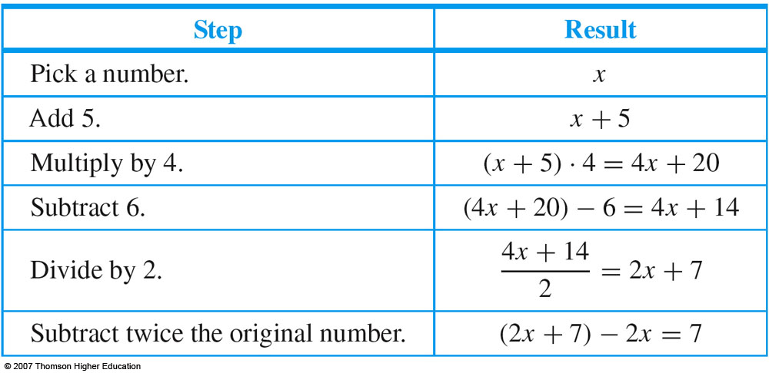
Example
Math Trick:
Pick a number, add 5, multiply by 4, subtract 6, divide by 2 and subtract twice the original number.
result = 7
Notes:
x is the particular because it represents a single quantity
x is also the arbitrarily chosen or generic because it can represent any number.

Slide 18
Proving Universal Statements
Method of Direct Proof
application of generalizing from the generic particular with the conditional, if P(x) then Q(x).
∀x in D, if P(x) then Q(x), you suppose x is a particular but arbitrarily chosen element of D that satisfies P(x), and then you show that x satisfies Q(x).
Suppose x∈D and P(x)
Show that conclusion, Q(x), is true

Slide 19
Example
Prove that the sum of any two even integers is even.
(formal) ∀integers m and n, if m and n are even then m+n is even.
Starting point: Suppose m and n are particular but arbitrarily chosen integers that are even.
To Show: m + n is even
m = 2r for some integer r, n = 2s for some integer s
m + n = 2r + 2s
2(r + s) = 2 k , where k is (r+s)
by definition 2(r+s)=2k is even
hence, m + n is even (QED)
Theorem 3.1.1 “ the sum of any two integers is even”

Slide 20
Writing Proofs of Universal Statements
Copy the statement of the theorem to be proved.
Clearly mark beginning of proof with Proof.
Make your proof self contained.
identify each variable and initialize variables
Write your proof in complete sentences.
use of shorthand is allowed, e.g. Then m+n = 2r+2s
Give a reason for each assertion.
by hypothesis, by definition of, by theorem
Use words to make logic arguments clear.
Therefore, It follows, Hence, Then, Thus, etc.

Slide 21
Getting Proofs Started
Write the first sentence of a proof “starting point” and the last sentence of a proof “conclusion to be shown”.
Example: Every complete, bipartite graph is connected
(formal) ∀graphs G, if G is complete and bipartite, then G is connected.
Starting Point: Suppose G is a graph such that G is complete and bipartite.
Conclusion to be shown: G is connected
The proof will have the first and last sentences:
First: Suppose G is a graph such that G is complete and bipartite.
Last: Therefore G is connected.

Slide 22
Disproving an Existential Statement
Negation of existential is universal statement, so to prove an existential false you must prove its (negation) universal true.

Slide 23
Example
There is a positive integer n such that n² + 3n + 2 is prime.
(negation) For all positive integers n, n² + 3n + 2 is not prime.
Proof
Suppose n is any positive integer.
We can factor n² + 3n + 2 to obtain n² + 3n + 2 = (n+1) (n+2).
We know that n+1 and n+2 are integers (b/c they are sums of integers) and n+1 > 1 and n+2 > 1.
Thus n² + 3n + 2 is a product of two integers greater than 1, and so n² + 3n + 2 is not prime (by definition of primes).

