Slide 1

The Big Picture
An Overview of the Research Methods We Will Encounter

Slide 2
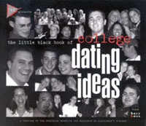
So . . . What’s your major?
Briefly answer the following questions:
  Do seniors date differently than freshmen?
  Why or why not?
  How would you study the phenomenon to see if your conclusions are supported?

Slide 3

Making Sense of . . .
Existing Information
Secondary Research
  Efficient
  Vocabulary
  Methods
Library Workshop
UNCW has its very own library!

Slide 4
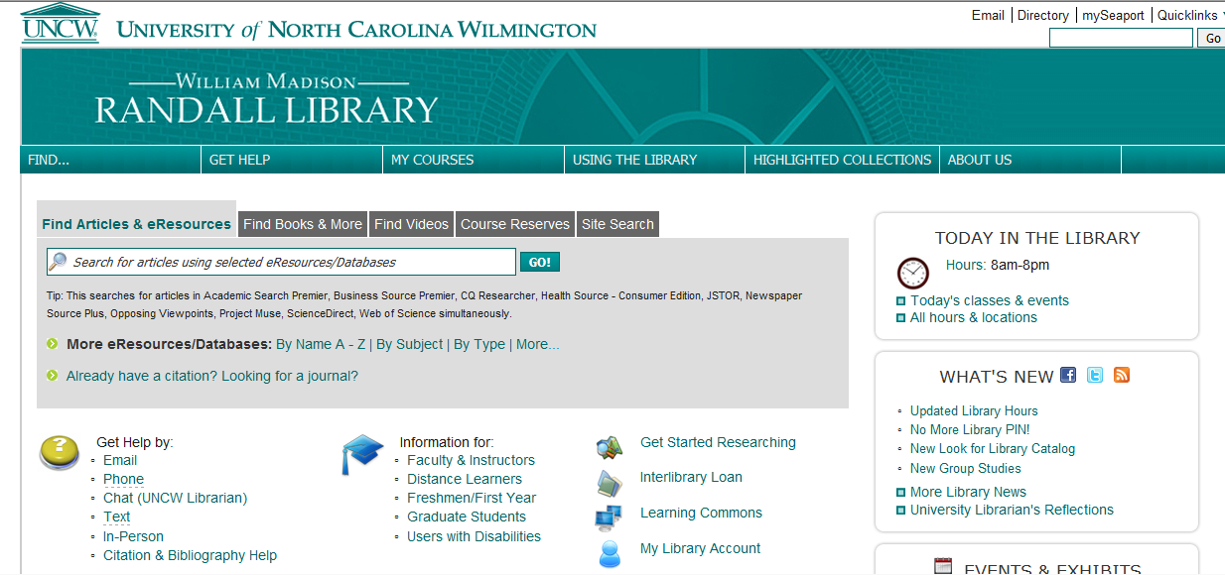
Application
What kinds of existing information would we look at to begin to answer our research question?
  Vocabulary?
    Scholarly
    Slang/Common
  Current trends?
  Historical data?

Slide 5

Making Sense of . . .
Subjective Experience
Qualitative research
  Emphasis on Description
  “Local reality,” vocabulary, rules and processes
Research Project One

Slide 6

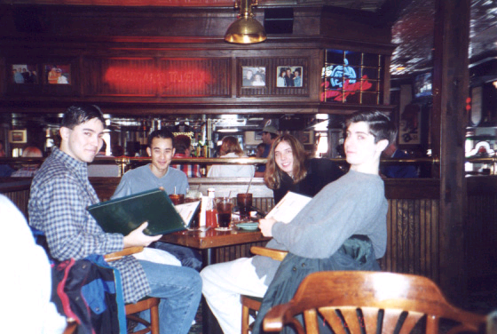
Interpretive Research Uses Qualitative Methods
In-Depth Interviews
Focus Groups
Observational studies
Case Studies
How might we use interpretive research to explore differences in senior and freshmen dating practices at UNCW?

Slide 7



Making Sense of . . .
Messages and Artifacts
There are two broad approaches to making sense of “texts”
  Rhetorical Analysis
  Content Analysis

Slide 8
Rhetorical Analysis
Typically focus is on evaluation and judgment
Typically uses rhetorical theories as its tools
COM 301

Slide 9
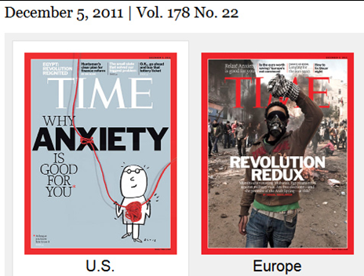
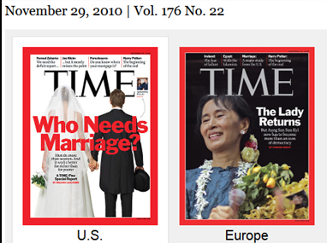
Content Analysis
Focuses on quantitative description of large sample of texts
  Uses numbers and coding to identify patterns
  Uses concepts and logic of social sciences
Application Activity

Slide 10

Application
How might we examine some existing messages about dating?

Slide 11

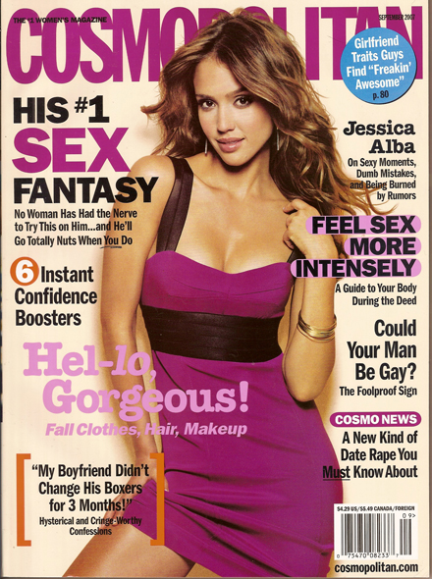
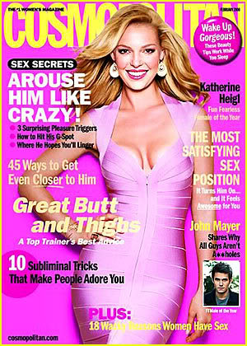
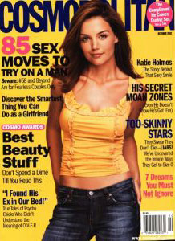
Notes:
Evelyn Millis Duvall Ph.D written in 1958.

Slide 12
Making Sense of. . .
Measurable Responses
Quantitative research research focuses on observable and measurable aspects of the phenomenon under study

Slide 13
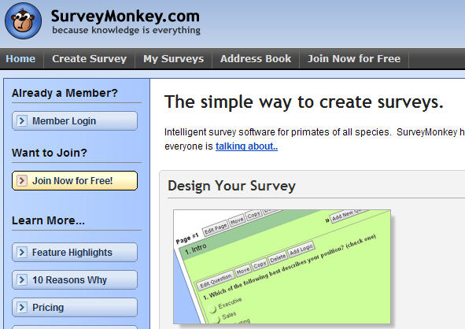
Empirical Research Uses Quantitative Methods
Content Analysis
Surveys
Experiments
Content Analysis activity
Research Project Two

Slide 14

Application
How might we use surveys or experiments to explore differences in senior and freshmen dating practices at UNCW?

Slide 15

Why do we have so many methods!?!?
The KEY to all of this is:
Appropriateness:
Does your method
match your research
question?

Slide 16
Before you FREAK OUT! . . .
This was an overview, we will go through this again!
Your writing assignments will focus on using just one of these primary methods at a time
I am at peace with COM 200 . . .
and my mullet

