Slide 1
Quantitative Research Report
On the vast majority of topics in the social and behavioral sciences, there are at least minor disagreements about the interpretation of the available data, and often there are major disagreements. Hence, you may soon find yourself acting like a juror, deliberating about which researchers seem to have the most cohesive and logical arguments, which ones have the strongest evidence and so on.
Jose L. Galvan Writing Literature Reviews (2nd ed.).

Slide 2
Reminder: Read the COM Bulletin
News
Scholarship information
And More!
Read the bulletin you should and smart you will become . . . .

Slide 3
Discuss with 1 or 2 others and put these in their logical order—write the numbers in the order they should go.
Literature review
Introduction
Results
Method
Discussion
Conclusion
Example: 632145

Slide 4
The correct order is:
214356

Slide 5
Order of Basic Sections of Quantitative Report
Introduction
Literature review
Method
Results
Discussion
Conclusion

Slide 6
Critical Thinking Activity
Introduction
Literature review
Method
Results
Discussion
Conclusion
Report?
Inference?
Judgment?
Can you write a one sentence summary of the primary explicit or implicit argument each section makes
Sections of Report
Statements & Arguments

Slide 7
Example
References
REPORT
ARGUMENT: that the authors have been careful and thorough in their secondary research of high quality sources and attributed those sources accurately.

Slide 8
Sections
Introduction
Literature review
Method
Results
Discussion
Conclusion
Report?
Inference?
Judgment?
One sentence summary of the primary explicit or implicit argument each section makes
Report Sections
Statements & Arguments

Slide 9
Reports are organized in a logical progression
Introduction
Literature review
Method
Results
Discussion
Conclusion
Formal reports are organized to answer a fairly logical set of questions a critical reader would ask in the most likely order they would be asked. Anticipating and answering the questions of the reader is a good way to plan your message.
Report Sections

Slide 10
Issues in Writing
Presentation affects how reports are perceived.
Please discuss chapter guidelines and grading rubric EARLY and often. Supplemental text has an EXCELLENT checklist!
Oh, and . . .

Slide 11
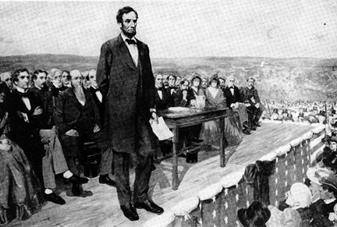
Reminder: Five Canons Matter
Invention
Arrangement
Style
Memory
Delivery
“You cannot escape the responsibility of tomorrow by evading it today.” Abe Lincoln

Slide 12
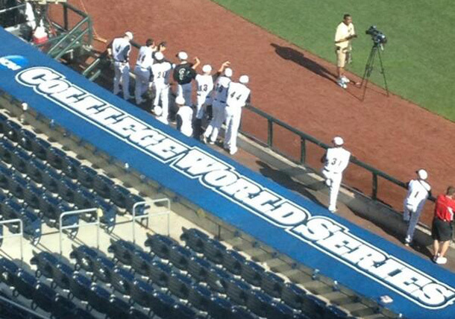
Proofread . . .

