Slide 1
Key Lecture Slides on Qualitative Research
I generally don’t post slides but because of adverse weather we had some choppiness and some compression to catch up so I’ve posted some key slides to help with RP 1 and exam preperation.

Slide 2
Part One: Overall Design of Qualitative Research
The first set of slides summarize the overall design of a qualitative project. In RP 1 you will use interview so you won’t need to worry about choosing a method. You also only have a sample of one group member so you won’t worry about sample. BUT, you must understand these issues for the exam and future classes and life beyond UNCW.

Slide 3
The Research Process
Preparation
Engagement
Reflection
Expression
This is true for each method we cover

Slide 4
Preparation: Research Focus
Communication issue or topic
Compelling sub-focus
It may change in light of further research
It may change in light of actual interview
Consult literature
To help narrow and sharpen focus
To help generate specific interview questions
To help with eventual analysis of data gathered

Slide 5
Preparation: Determine Sample
We’ll talk about this in more detail for Research Project Two when you actually must plan your sample.
For now, know that most qualitative designs have some form of non-random sampling
1
Who?
2
How Many?
3
How Chosen?

Slide 6
Preparation: Design Instrument
Design of the interview guide and other data collection instruments is next session.
Key: successful interview requires BOTH:
design and
“being in the moment” of the interview itself.

Slide 7
Summary So Far . . .
You make it sound so
logical!
Preparation
Conception and clarification of research focus/questions
Secondary Research
Design of study
Sampling
Question guide with questions derived from secondary research!
“Only after you’ve prepared are you ready to engage participants directly.”

Slide 8
Engagement: Gaining Access
Harder than it seems
Initial contact
Negotiating levels of access, etc.
Gatekeepers and Sponsors
Key: develop trust and rapport

Slide 9
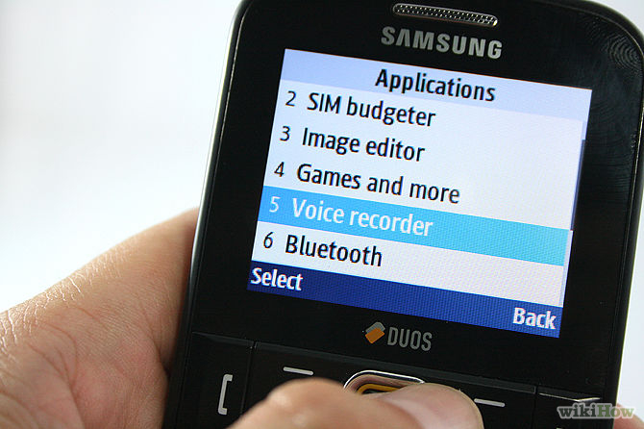
Engagement: Collecting Data
Observe (Look!)
Information is a “difference that makes a difference”
Ask Questions(Listen!)
Planned
Unplanned, follow ups
Take notes as you go
Descriptive notes
Analytical notes and connections to consider
Key questions to consider
Record the interview only if agreed to by all parties!

Slide 10
Expression
We will read chapter 14 soon along with suggested readings in recommended text to help here.
For now focus on looking CLOSELY at assignment description for Research Project One and be sure you understand it.
Learn from the journal articles you read as well!

Slide 11
Creating a Good Interview Guide
All research starts with good questions. Good overall questions that focus a project are key but so are specific interview questions you ask your participants. This next group of slides summarizes our class session discussion.

Slide 12
Asking Good Interpretive Questions
At its best, the qualitative interview is an event in which one person (the interviewer) encourages others to freely articulate their interests and experiences. Its ability to travel deeply and broadly into subjective realities has made the interview a preeminent method in communication and nearly all qualitative research.
Lindlof and Taylor: Qualitative Communication
Research Methods (2nd ed.)

Slide 13
Ask Questions
Ask relevant biographical questions to contextualize information
Some questions should allow respondent to tell his or her own story
Open questions are better than closed questions
Prepare and use an interview guide to assist in this process

Slide 14
Treadwell’s Types
Descriptive: asking participant to describe a phenomenon.
“Tell me about your ‘ideal event’ and some examples of past events that have nailed it and come up short?”
So you want to be an event planner?

Slide 15
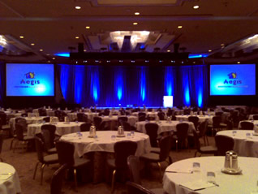
Treadwell’s Types
Structural: explain relationships among different terms.
“What, for you, is the relationship between the choice of venue and the theme of the conference?”

Slide 16
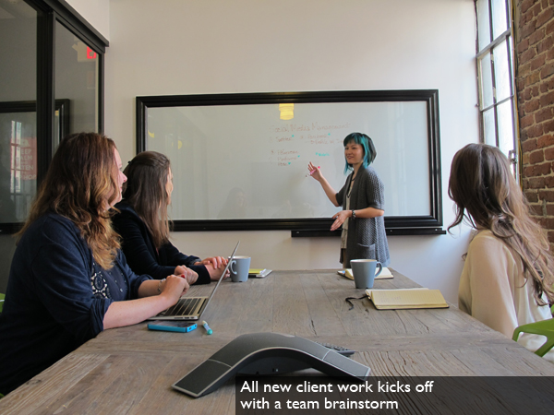
Treadwell’s Types
Contrast: Explain the difference between two or more things or concepts.
“You seem to make a distinction between ‘goals’ and ‘purpose.’ Can you clarify the difference for me?”

Slide 17
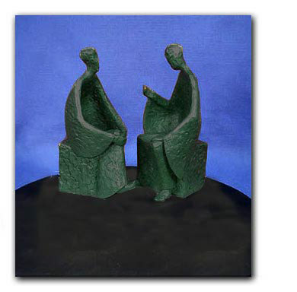
Interview Questions: Thematic
Experience/Behavior
What would I see you doing?
Opinion/Value
What do you think should have happened?
Feelings
How did that make you feel?
What’s the difference?

Slide 18
Interview Questions: Thematic
Local Knowledge
How do you know when someone is trying to steal?
Sensory Questions
How does the smell impact your communication?
Background
So, how long have you been in a rock band . . . .

Slide 19
Question Matrix
Type of Question | Past | Present | Future
Knowledge | ? | ? | ?
Value | ? | ? | ?
Etc. | ? | ? | ?

Slide 20
Interview Questions: Chronological
Opening Questions
Ice breakers, easy to answer
Introductory Questions
Address topic, set context
Transition Questions
Move into key questions, threatening issues
Key Questions
2-5 questions at the “heart” of the study
Ending Questions
Summary, perception check and “Is there anything else you would like to add?”

Slide 21
So, here’s your tool box
Type/Purpose:
Description
Structure/relationship
Contrast
Themes
Experience/Behavior
Values
Feelings
Sense
Chronological
Intro
Key
Conclusion
Don’t forget!
Rules
Roles
Routines
Rituals
Circular questioning

Slide 22
So, let’s make sure we’ve got this
For RP 1 you’ll want to talk enough to clarify a research topic and communication focus.
Do secondary research on that topic and further narrow focus around communication issue(s).
Create interview guide based on that effort.
Conduct at least one interview with group member using guide and circular questioning/follow up questions
Write up the experience using the outline provided on my site in a way that is compelling and adheres to basics of APA citation style.

