Slide 1
Today’s Session
Research as Argument
Some group time
But First . . .

Slide 2
Group 3X5 Cards
I will be constructing the rotation schedule based on the group cards you have filled out.
If there have been changes correct them TODAY.
Check email for schedule. It will be on the website too.

Slide 3
Group Resource

Slide 4
Learn to Save the Right Stuff
I am currently taking COM400. After reading the syllabus for the course I began frantically looking through old documents in hopes of finding pieces that would be suitable for my portfolio.
Tonight I stumbled across my Forte results. To be completely honest, I had never paid any attention to the results either time that I took the test. Looking back on them now I am learning so much about my strengths and weaknesses. I just wanted to let you know how beneficial that test was for me and how appreciative I am that you required us to take it. Please continue to stress the importance of the test to your students- I never realized how eye opening it would be in determining where I can apply my skills in the future!

Slide 5
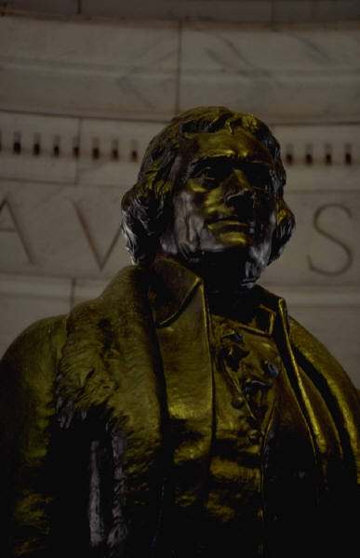
Research As Argument
“Reason and free inquiry are the only effectual agents against error.”
---Thomas Jefferson

Slide 6
Parts of an Argument
Claim
Assertion
Data
Evidence or support
Warrant
Reason(s) data and claim can be linked
“Olsen has a pretty strict attendance policy.”
“How do you know?”
“It’s in the syllabus.”
“So . . “
“So? So the syllabus tells us what the professor is going to do and expect.”
“Overachiever . . .”
“Loser . . . Wanna eat?”
“Yeah.”

Slide 7
Warrants seem trickiest
There are different types of warrants
Warrants based on authority
Warrants based on key values
Warrants based on basic logic such as cause-effect
Warrants based on theories and concepts

Slide 8
Warrants seem trickiest
Warrants may also “take the form of rules, principles, or conventions particular to certain fields” (Warnick, 1998).
Often not explicitly stated! We can often identify warrant only after claim and evidence have been made clear.

Slide 9
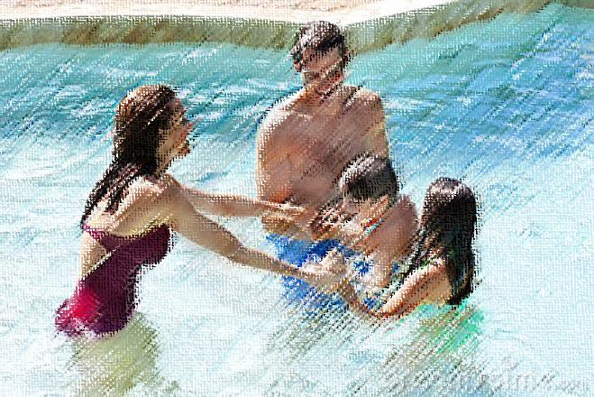
What Type of Warrant?
Claim: Americans should cut back on work to spend more time with their families.
Support: Americans spend more hours than they used to on the job. Parents depend more and more on outside caregivers.
Warrant: Family time is more important than work time.

Slide 10
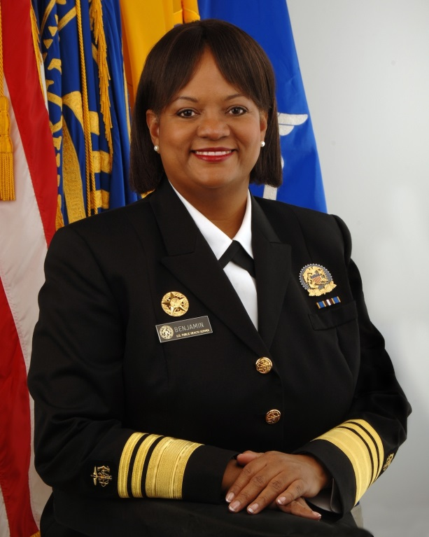
What Type of Warrant?
Claim: Cigarettes are dangerous to one's health.
Data: The Surgeon General has issued warnings about the damage smoking does to adult lungs and heart, and to developing babies.
Warrant: The surgeon general is reliable as a medical authority.
Surgeon General: Regina Benjamin

Slide 11
Which is the example of better writing for a possible term paper?
Example A: “This paper examines several definitions of interpersonal communication and compares and contrasts them on key aspects.”
Example B: “After comparing and contrasting the major definitions of interpersonal communication I argue that Woods (1998) offers the most useful definition for improving interpersonal communication.”

Slide 12
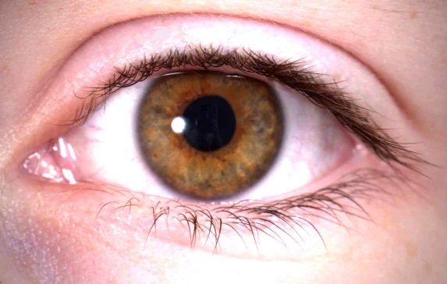
Three Types of Statements
Report: verifiable through investigation
Inference: based on facts but goes beyond what is currently known to what is probable or reasonable
Judgment: describes the world in ways that express evaluation based on certain criteria

Slide 13
Application
Meet someone new, say “hey, what’s your major?”
Identify a movie or TV show that your group has seen.
Write an example of each type of statement concerning that movie.
Report Inference Judgment

Slide 14
Example

Slide 15
Application to Courses and Life
Most term papers, especially in COM will be stronger if approached as arguments
Explicit CLAIM
Quality EVIDENCE (data)
Clear REASONS (warrant) that draw from theories, concepts, experts.
Your life should be full of good questions and arguments for your answers to those question.
Employers are looking for critical thinkers.

Slide 16
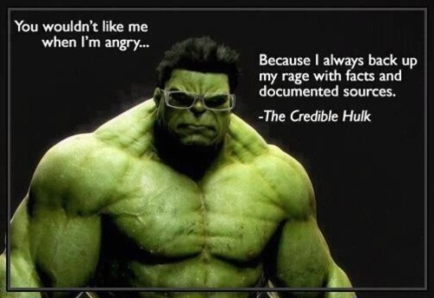

Slide 17
For example
According to ONET online there are 11 key skills for PR practitioners. Here are top five:
Active listening
Intellectual curiosity
Ability to coordinate strategies to situations
Critical thinking
Judgment and decision making

Slide 18
Homework
Read DT 11 and complete worksheet
Work on IRB
Look ahead to RP 1 since that is how we’ll apply DT 11
Figure out which CBT each of your group members are doing: each member does a different one!
Set the right culture and set of expectations for your group!

