Slide 1
Research Project Two Part Two: The Method Section and other components
The purpose of this presentation is to offer a more detailed explanation of the assignment than I offer in class.

Slide 2
Some Ground Rules
Don’t just print these slides out indiscriminately—print to DISC if you must print them.
Go through this as a teaching module—stop, when prompted, to discuss or write with your group when possible.
Don’t assume that following these tips guarantees an “A.”
Save trees please

Slide 3
Some Guiding Metaphors
Experienced cooks can look at a recipe and tell if the dish will taste good. Experienced architects and builders can look at a blueprint and tell if a building will be sound.
This Research Project is a recipe or a blue print for a quantitative study. I will be able to tell if it is methodologically sound. You should be able to too!

Slide 4
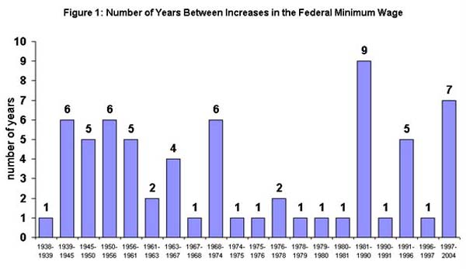
What am I Looking For
Critical Thinking: Is it clear from your Research Project that you understand the goals, limits and challenges of quantitative research (sampling, measurement, etc.).
Vocabulary: Can you express you ideas using the appropriate course vocabulary.

Slide 5
Review . . .
Research Project Two will have five basic sections and an appendix:
Introduction that establishes context for and significance of your general RQ/problem. (heading or sub-headings here)
Review of Literature that must include subheadings that demonstrate strategic organization
Purpose of Study paragraph that provides a more specific research question now that we are educated by the review
Method section that describes the methodology you would use to answer the RQ (more on this is in the other tutorial)
References in strict adherence to APA style
Appendix A: Your data collection instruments such as questionnaires or pretest/posttest.

Slide 6
@ this point . . ..
I assume you’ve gone through the first tutorial on the literature review and that it makes sense
This tutorial takes you through the remaining sections of the proposal:
Method
Conclusion
References
Appendices

Slide 7
An Example of an RQ
RQ: Is regular playing of occultic-themed video games associated with greater belief in the supernatural?
What is likely approach?
Content Analysis
Survey
Pre/Quasi or Experimental Study?
Really guess before advancing slide . . .

Slide 8
My Answer
Most likely approach is a pre/quasi experimental study
Post test only of pre-existing groups because you’ve got a group already playing the games and a group that doesn’t.
You can only post test because they already play.
If you said survey you were not far off, but quasi experiment is better because of our focus on cause and effect.

Slide 9
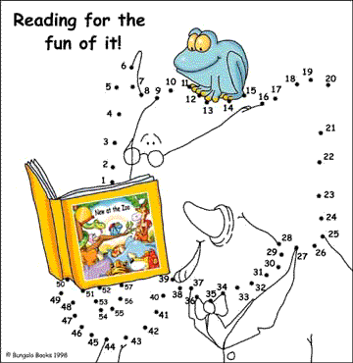
Did you notice . . .
Notice that in that answer I demonstrate awareness of limitations (pre-existing groups, etc.) and use specific vocabulary from our texts in labeling the approach. This is what I’m looking for from you as you think through sampling and measurement issues related to your study.
COM 200
Connecting the dots is a big part of COM 200

Slide 10
Method
Begin the method section by stating the method and offering a brief justification of the appropriateness of this method for addressing the RQ
Cite source(s) to justify the choice. At a minimum our textbook would work. Even better is if other studies you come across call for a particular method.

Slide 11
Step by Step: Sample
You will be needing a sample of people.
Address such issues as
How many
How chosen
Any need for sub-sampling or stratifying the sample?
At the end of this section your reader should have a good mental picture of who you are sampling and how you are selecting them.
“Sweetie, I want us to participate in a study on how older couples argue, OK?”
“NO!, There! See, we argued!”
“Sweetie, it’s for science!”
“Fine, but I’m not missing the game!”

Slide 12
Step by Step: Instrument
You need to create an entire data collection questionnaire for Appendix A (more later)
You are strongly encouraged to use or adapt one or more existing instrument rather than develop most of your instrument yourself. In either case you would describe the instrument with several key examples of questions in the body.
If you borrow from existing instruments cite them as you describe your own data collection tool.
You are allowed to use more than existing questionnaire (or portions of it) in your study.
You will almost certainly use more than one type of scale in your study.

Slide 13
For Example
If I’m doing that video game study mentioned earlier I might argue that we would use a combination of Guttman and Likert type items.
I might also mention that we borrowed an “Attitudes toward the occult” scale from a previous study in a psychology journal and cite the study.
I would offer an illustrative example of items in the essay. In my discussion in the body of the essay I would refer the reader to Appendix A for more detail.
Appendix A would have my entire questionnaire formatted exactly as I would hand it to participants (you are not limited to APA format).

Slide 14
Step By Step: Data Analysis
The next subheading within the Method section is Data Analysis.
Here is the core issue: Do you understand what statistics you need to make sense of your data once you collect it?
You will need to understand a few things about your data to pick the right statistics and talk about them correctly.

Slide 15
Picking the Right Statistic
What level of measurement are we using for the independent and dependent variables?
If you are measuring a variable at the nominal or ordinal level your statistical choices are very limited.
Many times you will be measuring the independent variable at the nominal level and the dependent variable at the interval level.
I have some links to statistics sources on this site that can help you choose. Our optional text is also very helpful here.

Slide 16
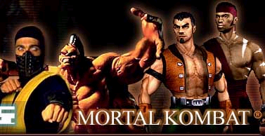
For Example
In my study I have the IV (play/exposure) measured at the nominal level: no play, some play, lots of play and the DV (attitudes toward the occult) measured at the interval level using Guttman and Likert scales

Slide 17
Picking the Right Statistic
The second issue is: What do we want to know?
Description
Difference
Correlation

Slide 18
OK, I was a bit tricky
Remember EVERY study will focus at some point on description. You must summarize your data for your self and for your reader.
Which descriptive statistics do you need to use to make sense of the data collected in this study?

Slide 19
Beyond Description . . .
My research question deals primarily with difference: are the attitudes and beliefs of players different than those of non-players.
So we know we’re measuring the DV at the interval level
We know we are testing for significant difference between two groups
What procedure should we use? Try to figure it out before advancing to the next slide!

Slide 20
Which Statistic?
Significant difference using interval level DV?
Chi Square
T-Test
ANOVA
Pearsons
Really guess before advancing slide

Slide 21
Which Statistic?
Significant difference using interval level variable?
Chi Square
T-Test
ANOVA
Pearsons

Slide 22
Another Match Game
Picking the right statistic is a lot like citing sources in APA. You have to figure what type of source it is and then match it to the APA guide.
In picking the right statistic you must know the level of measurement for each variable and what you want to know. Then match that scenario to the appropriate statistic. Try THIS SITE.

Slide 23
Conclusion
Conclusion should address one or more of the following
Limitations of your study
Likely results
Follow up question to pursue after this study
You must also address what you learned about social science by doing this project and use course vocabulary when doing so!

Slide 24
Some Hints
Tie future questions back to literature review.
Tie follow up studies to limitations of your own study
Limit discussion of “what we learned” to genuine insights and not generic filler
Use course vocabulary correctly
Just kidding, they can be good or bad, like most anything else . . .

Slide 25
Final Thoughts
Make sure APA is perfect at this point.
Be sure tone of Research Project is formal, efficient writing that is similar to what you encountered in the journals.
Have fun and be proud of your final product. If you’re not proud, revise it until you are.

