Slide 1
Doing Research Project Two: Part One: Introduction and Literature Review
This tutorial supplements the assignment description offered elsewhere on this site.

Slide 2
Some Ground Rules
Don’t just print these slides out indiscriminately—save to your thumb drive or similar.
Go through this as a teaching module—stop, when prompted, to discuss or write with your group when possible.
Don’t assume that following these tips guarantees an “A.”
Save trees, please

Slide 3
The Big Picture: How should we organize Research Project Two?
Research Project Two will have six basic sections and an appendix:
Introduction that establishes context for and significance of your general RQ/problem. (heading or sub-headings here)
Review of Literature that must include subheadings that demonstrate strategic organization
Purpose of Study paragraph that provides a more specific research question now that we are educated by the review
Method section that describes the methodology you would use to answer the RQ (more on this is in the other tutorial)
Conclusion that includes group reflections
References in strict adherence to APA style
Appendix A: Your data collection instruments such as questionnaires or pretest/posttest.

Slide 4
This Tutorial
Wow, this tutorial is fascinating already—I can’t wait to write the Research Project One with my group!
This tutorial focuses on the first three sections of the Research Project
Introduction
Review of Literature
Purpose of Study
But before you do any of that you’ve got to have a pretty good sense of your topic and problem.

Slide 5
The Introduction
The introduction should do many of the things you’ve learned to do in other introductions
Gain the attention and involvement of your reader
Clarify your purpose for the document
Offer a general sense of the topic and research problem being addressed
Give a clear sense of what is coming
You should cite one or two sources here rather than offering unsubstantiated opinions or generic fluff like “video games are everywhere”
By the end of the introduction we should know enough about the topic/problem that the literature review makes sense
You will want to revise your introduction LAST once you’ve written the rest of your document.

Slide 6
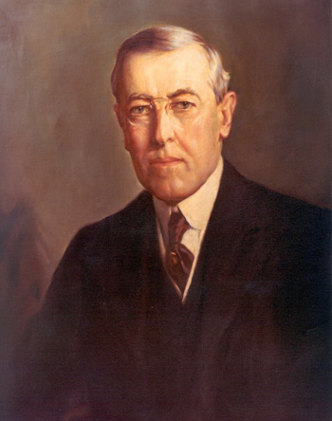
Why do we do a lit. review?
President Woodrow Wilson once said “I use not only all the brains I have, but all I can borrow.” Successful people get that way by learning from others as well as from their own experience.
A literature review is the section of the paper that summarizes what we know because of other research on this topic.
“I wish I could have taken Dr. Olsen’s class.” ~ W. W.

Slide 7
Why do we do a lit. review (part II)
The literature review section of Research Project two provides an opportunity for you to demonstrate that you can 1) find quality sources, 2) report on them accurately and efficiently, infer from them soundly and form judgments.
The result of that is you show your reader two things: 1) you understand the issues, 2) what the gap in our knowledge is that your study addresses.

Slide 8
What’s your problem?
Remember that you need a basic research problem. You are not answering the RQ or solving the problem by doing the literature review. The review is clarifying what we do know and what we don’t yet know about your problem or RQ.
For our purposes at least one of the variables in your problem must be a communication variable—that’s one reason why you take COM 105 before COM 200.
“I don’t know what I don’t know yet. I haven’t researched it!”

Slide 9
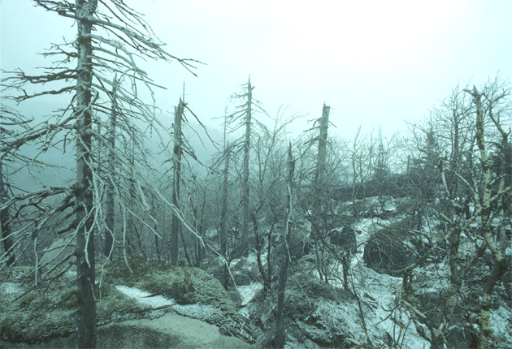
Example: Acid Rain
Let’s say you’re interested in acid rain. How can that incorporate a communication variable?
Write down two possibilities before hitting the next slide.
Really, go ahead and do it.

Slide 10
Example Acid Rain
Here are some possibilities—how do they compare with yours?
What are the major themes in media coverage of acid rain?
What are the persuasive communication strategies used by environmental groups to shape public and political opinion on acid rain?

Slide 11
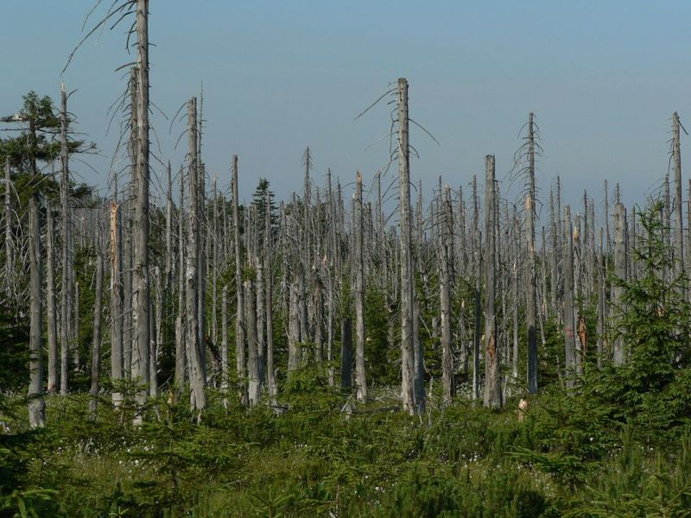
Quick Review
Which of the methods below would be the most appropriate method for answering the questions I proposed?
Survey
Experiment
In-depth interview
Content Analysis

Slide 12
Quick Review: Answer
Which of the methods below would be the most appropriate method for answering the questions I proposed in the last slide?
Survey
Experiment
In-depth interview
Content Analysis
But remember: you must choose a problem that is best addressed with a survey or experiment (since we’ve already explored content analysis)

Slide 13
Let’s move on . . .
I’m assuming you have a preliminary problem at this point that has a fairly narrow focus and at least one communication variable. Now what?
Systematic secondary research—hit the library!
Hi, remember me . . .

Slide 14
Research Reminders
Keep close track of your searches and search terms.
What databases
What search terms and commands
You may need to share your search process with your reader in the first paragraph of your review, especially if your search does not yield many quality sources.
I see it! But don’t touch my screen! #*!@!

Slide 15
What if we don’t find much?
Talk to a librarian and be as specific as possible about what you’ve tried, etc.
Be broader in your search. Don’t just search “women in PR” search “sex differences at work,” etc.
If you still don’t have much, your first paragraph of the review should discuss your process and make it clear that despite being rigorous in your search, little literature was found on your topic. Your ethos is at stake! The next slide offers an example.

Slide 16
My friend from ODU, Dr. Jim Basler, wrote this introduction to establish the lack of communication research on his topic of interest. Keep in mind the article is about 10 years old so databses, etc. change: focus on his logic.
Since 1985 there has been a renewed interest in prayer research as evidence by the 742 works in print related to prayer found in an electronic data base called FIRSTSEARCH and a comprehensive review of the empirical research on prayer through the 1995 (Francis & Evans, 1995). However, less than 15 of these works since 1985 were empirical and none of the works cited were published in communication journals. Since FIRSTSEARCH may not index all some communication journals, a second computer search was performed using an index of communication journals called COMMINDEX. [He then goes on to give the limited results found there as well and the search terms used.]

Slide 17
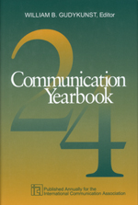
Let’s PREPARE to write this thing
So, you’ve done the searches, talked with the librarians, talked with each other, kept track of searches. Now you have a digital folder of downloaded articles and stack of articles and books Now what?
Take down COMPLETE bibliographic information
Summarize sources and pull out key quotes
Determine the best organizational strategy for presenting your sources. Chronological? Topical? Problem-Solution? Some combination? Knowing your pattern will help with transitions and sub-headings
You did look for books too, right?)

Slide 18
What are we writing for?
The literature review should address the following issues:
What do we already know about your topic or research question?
How does your RQ relate to what we already know and add to our knowledge?
What specific method or instruments are most appropriate for answering your RQ?
Let’s take each of these themes separately.

Slide 19
1) What do we already know?
In answering this question you might address such issues as
Accepted definitions of key terms/variables
Major findings of previous research
Themes
Trends
Controversies
Calls for additional research

Slide 20
2) How does your RQ relate to what we already know?
Even the literature review makes an argument that there is a gap in what we know and the study being reported on or proposed addresses this gap.
How would your study address the “gap?”
What did you borrow from previous studies?
Definitions?
Instruments?
Methodology?
Remember, even experts borrow from other experts. For novices it is a mandatory practice.

Slide 21
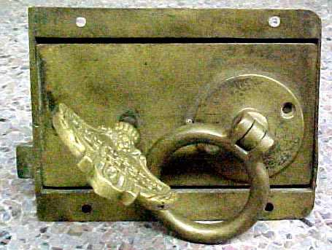
3) What method and instrument(s) are you using?
Notice the above question implies an argument about the appropriateness of your proposed method. There are two issues here.
Appropriateness as compared with the existing literature
Appropriateness given the research question you’ve asked in your study
Make sure the key fits the lock you’re trying to open.

Slide 22
Appropriateness
Does your method match your RQ?
Use your sources or our methods textbook to justify your choice. Find expert that says your method is the right one for your type of RQ
This article supports our choice of survey method. My group is going to LOVE me even MORE!

Slide 23
Organizing the review
The first paragraph of the review will likely do the following
Provide sense of the literature: is there a lot or a little, is it generally in agreement or is there controversy, etc.
Provide sense of what your review does: exemplary or exhaustive, specific focus
Provide explicit discussion of organization (preview of major sections)
Step by Step to a good research paper.

Slide 24
Organizational hints
Generally definitions are established early on and then major findings and finally any calls for future directions of research.
Make sure that your review reads like an essay and not a listing of sources. This is where inferences become important as do good transitions.

Slide 25
Bad Example
Smith (1998) found that respect for authority among his sample of college students declined after the imposition of campus censorship.
Rivenbark (1992) argued that regulation of campus newspaper content by the administration is a necessary obligation given the education goals of the university and the use of state tax dollars to fund many newspapers.
Notice in this example there is no clear relationship between the two sources.

Slide 26
Better Example
Rivenbark (1992) argued that regulation of campus newspaper content by the administration is a necessary obligation given the education goals of the university and the use of state tax dollars to fund many newspapers. However, Smith (1998) found that respect for authority among his sample of college students declined after the imposition of campus censorship. Such a finding may actually undermine the education mission of the university.
Notice in this example offers a clearer sense of contrast between the two sources and establishes the controversiality of the issues thus justifying further study.

Slide 27
So far so good
You’ve got an insightful title that clearly integrates your variables and research question.
You’ve got a compelling introduction that establishes the context and importance of your problem
You’ve got a well-organized review that offers definitions, key findings, and a gap in our knowledge.
It’s time for the final paragraph!

Slide 28
The final paragraph
The final paragraph of review should summarize the argument you’ve made in the review.
Summarize the trends that lead to the gap your study addresses.
Minimal if any use of sources here
Transition to the next section of the proposal.
Next Section!?!
You mean there’s MORE?!?!

Slide 29
Purpose of Study
This is a short section just after the literature review. Some articles will set it apart in a separate section, others will make it the last section of the review. I require that you set it apart.
This should clarify your variables by providing CLEAR research questions, sub-questions and hypotheses if necessary.
This section should provide and end with a clear transition to the Method section which explains how these questions will be answered (see tutorial part two for details).
See, research methods is a lot like golf . . . only less frustrating

Slide 30
Format of Purpose of Study
Transitional sentence or two from literature review and then offer research questions and hypothesis (if you have some based on literature review)
RQ 1: Will students who discuss tutorials as a group do better on Research Project than students who do not discuss tutorials?
H1: Students who report 15 minutes or more of active discussion of tutorials will demonstrate higher scores in final Research Project grades than students who report minimal or inactive discussion of tutorial.

Slide 31
Some APA Reminders
Make limited use of direct quotes focus on paraphrasing with sources cited.
Use first person when logical “we used the following search terms . . .” but avoid “we thought this was a good article”
Keep review in past tense, but be logical about tense in other areas of review: “Peterson (1997) argued . . .” but you can say “Peterson (1997) seems to offer the most widely applied definition of argumentativeness and is the one adopted in this study.”

Slide 32
Final thoughts
This is a challenging assignment. Even experienced researches will find this task challenging when taking on an unfamiliar topic.
Write early enough to step back a while before revision.
Make good use of the Writing Empirical Reports text!!!!
Get others in group or Writing Center to read it carefully.

