Slide 1
Doing Research Project One:
The In-Depth Interview
The purpose of this presentation is to offer a more detailed explanation of the assignment than I offer in class.

Slide 2

Some Ground Rules
Don’t just print these slides out indiscriminately—print to FILE if you must print them.
Go through this as a teaching module—stop, when prompted, to discuss or write with your group when possible.
Don’t assume that following these tips guarantees an “A.”

Slide 3

Reminder!
Research Project One does not need to have anything to do with the “topic” that you formed groups around last week. That is if you were in the PR section this does not need to address PR. The only Research Project that focuses on your topic is Research Project Two.
Research Project One
Research Project Two

Slide 4
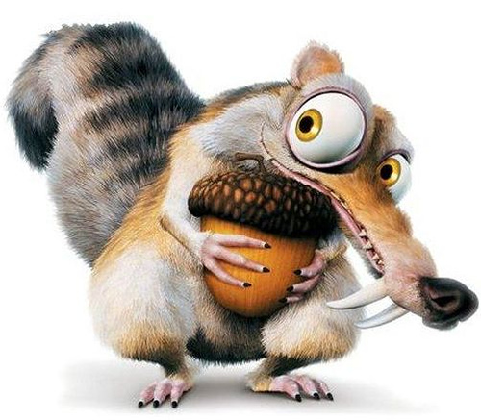
Research Project One:
In a Nutshell
Carry out in in-depth interview according to the standards and guidelines offered in class and our text.
Write up a report based on that interview that highlights key findings about interview focus and offers some discussion of what was learned about the interpretive research process more generally.

Slide 5
Basic Requirements of Research Project One
Body of write up should be about four pages (double spaced) and include sub-headings (see APA guide)
You should also have a complete title page, appendix and references on separate pages
You should integrate at least five sources beyond our textbook into your Research Project
It must be stapled

Slide 6

What Does He Want?!?!?
A worthwhile communication issue.
Well-designed questions.
Insightful write-up of results
Thoughtful reflection on the process—what did you learn about research?
Integration of secondary research.
Correct APA style.

Slide 7
A Worthwhile
Communication Issue
Biographical information is important, but NOT the goal of the interview. It is not about “Tina” but about a communication issue Tina deals with.
It will help if you pretend that Tina is just one of several folks you will interview to learn about the issue (one of your sample).

Slide 8
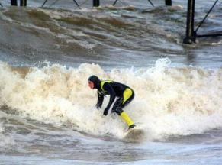
A Worthwhile
Communication Issue
How would you improve the following purpose statement?
  “We interviewed Jeff about what he likes most about surfing.”
Write down your revision before looking at the next slide.

Slide 9
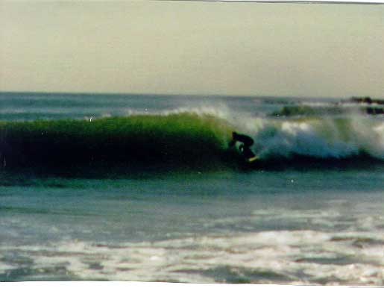
A Worthwhile
Communication Issue
Here is one way I would improve it:
  “We interviewed Jeff to better understand the unique communication rules and vocabulary of the Wilmington surf culture”
Did your revision offer similar improvements?

Slide 10
A Worthwhile
Communication Issue
At this point you should brainstorm about a communication issue you might focus on within the topic you have chosen to interview your team member on.
Tie the purpose of the interview to course concepts such as:
  Rules, roles, rituals, routines
  Meanings, metaphors, etc.

Slide 11
Well-Designed Questions
Why are we doing this Research Project? To learn the skill of interviewing. Much of that skill lies in preparation. This preparation includes:
  understanding and commitment to the philosophy of interpretive approach.
  informed effort to construct well-designed questions.
  informed effort to conduct an interview well.

Slide 12
Well-Designed Questions for Communication Research
Poor Design
Why did your parents get divorced?
Do you use special vocabulary at work?
Better Design
How did your parents explain their decision to you?
What are some unique words or phrases that are often said at work?

Slide 13
Well-Designed Questions
Additional Design Hints
  Theory informs practice. You should be able to tell me (if asked over lunch) what course material or secondary research informed every question you created.
  Make sure that it is clear how your secondary research informs your question design (more on that later).
  Pursue elaboration about specific vocabulary and examples from your interviewee with your follow up questions.

Slide 14

Well-Designed Questions
Take some time to create or revise your questions so that they clearly integrate the standards discussed in class (and are similar to the better- designed examples in the earlier slide).
Really, go ahead, I’ll wait. . . .

Slide 15

Insightful Write-up of Results
The write-up should clearly address the following issues, and should address them in the order presented here:
  introduction
  key results/findings
  brief reflection by interviewee
  reflection and analysis of your process (what did the group learn about interpretive research)
  References
  Appendix with list of questions
  Attached signed grading rubric
Let’s look at each issue

Slide 16
Insightful Write-up of Results
The introduction should efficiently address the following:
  Your topic and its significance to the reader (context)
  The specific purpose of your essay
It should be a short paragraph or two and should also provide basic biographical information on your interviewee.

Slide 17
Insightful Write-up of Results
Results are the bulk of the essay and should focus on Insights gained about the phenomena under investigation
You can also talk a little about key observations on metacommunication (which give insight into specific issues raised in the interview) such as:
    Voice, gestures, posture
    Animated or guarded responses, etc.
These issue should not become your focus but can provide illustrations of your deeper findings. Do not get side tracked into psycho analysis. If you want to explore “motives,” ask!

Slide 18
Some Common
Questions
  Can we use first person? YES, that is consistent with interpretive approach.
  How should we refer to the interviewee? By their first name. When referring to a group of folks interviewed you would say “participants.”
  Do we need to have subheadings? YES, that is key to demonstrating competence in APA. Do not put a subheading for the “introduction”—this is the assumed way one starts an essay.
  When do we use sources? THROUGHOUT the essay! Tie interview data with sources, tie importance with sources, tie reflections to our textbook, etc.

Slide 19

Thoughtful Reflections on Process
While the bulk of the essay will focus on results, two key areas of reflection are also required:
  Reactions of the interviewee
  Reflections on the process
Many groups forget to do good reflection. Maybe this unusual image will help your group remember

Slide 20
Thoughtful Reflection on Process
Reactions of interviewee
  This may be a full paragraph or two if the interviewee has significant insights to share, but don’t fake it or put in a bunch of filler: think then write.
  It should be first person but somewhat formal and integrate course vocabulary—connect with our text!
  Some questions to consider include:
    How at ease were you/were you made to feel?
    What was easier or harder than you expected?
    How did this experience help your understanding of the research process from the perspective of the interviewee?

Slide 21

Thoughtful Reflection on Process
Reflection on Process as a Group
  A KEY aspect of this Research Project is your ability as a team to connect your interview process experience with course content. Here are some questions to consider:
    What concepts from the readings and lecture did you see happen? What “came alive.”
    In light of your first interview, what would you do differently in future interviews (try to connect this with course concepts?
    What did you learn related to basic themes and goals of this course?

Slide 22
Appendix A
Appendix A should list the questions you planned to ask and the sources that informed them as needed. Follow up questions such as “can you give me an example” need not be included.
Here is an example:
  Knowledge: How do surfers communicate displeasure or correct an overly selfish surfer that cuts people off a lot? (Becker, 1996, p. 34)
This example shows the type of question being asked, a question, and the source that gave rise to the question. The complete source will of course be listed in APA style in the references.

Slide 23
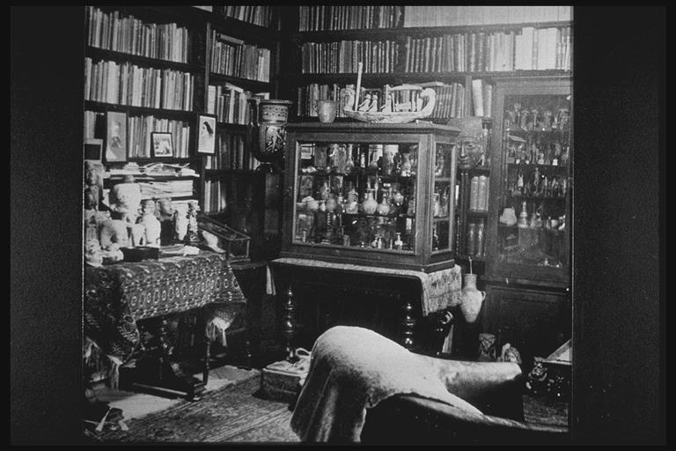
References
Each sources that is actually cited in your essay should be listed in your references in strict adherence to APA style.
Interior of Sigmund Freud’s study

Slide 24

Integration of Secondary Research
There are three likely questions about this requirement:
  What types of sources should we look for?
  How should we use them?
  What counts as a source?

Slide 25

Integration of Secondary Research
What sources might we look for?
  Sources about the phenomenon under investigation. For instance studies on twin communication.
  Sources on the process of in-depth interviews, such as other research methods texts or relevant journal articles. For example, there are entire books on in-depth interviewing and the Journal of Contemporary Ethnography is accessible through EBSCOHost

Slide 26
Integration of Secondary Research
Sources on the phenomena under investigation might be used:
  to help establish significance of the problem in your introduction
  to link the interviewee’s responses back to findings by other researchers for the reader
  to identify specific questions you will ask
Using sources to help you design effective questions is probably the most important use of the sources for this Research Project. But attempt to use sources for all three of the purposes outlined above.

Slide 27
Integration of Secondary Research
Use of sources on the process of in-depth interviewing:
  to briefly support the inclusion of a particular question or interview strategy.
  to briefly support or explain your reported reflections on the interview process.

Slide 28
Integration of Secondary Research
What counts as a source?
  Do they have to be academic sources? No, you must have at least two academic source (journal, academic book or edited volume), others can be popular sources, though I certainly would reward the integration of journals and other academic sources where appropriate.
  Does our textbook count as a source? Cite it if you specifically refer to it, but no, it does not count toward your minimum number of sources. You must have at least FIVE sources in addition to our textbook.

Slide 29

Correct APA Style
APA is the most common style guide for formal writing in the social sciences. Sorry, you have to learn it.
That said, keep the guide handy and follow it EXACTLY.
Your teams should demonstrate correct use of sub-headings.
Your team should demonstrate correct citations and references.
I expect error free writing that has been looked at by each team member (and maybe the writing center if you have the time and inclination).

Slide 30

Final Thoughts
Do quality work, but have fun doing it. This has been a “breakthrough” assignment for many students.
Work as a group! Research, brainstorm for questions, do MORE than your share!
The goal is to be able to take on the role of ethnographic researcher and “write up” research results.
I look forward to reading your first Research Projects!
Meet over pizza when you’re done, not to get things done.

