Slide 1
The Big Picture I: Ethics, Core Skills, Group Skills
To enjoy the things we ought and to hate the things we ought has the greatest bearing on excellence of character.
~ Aristotle (384 BC - 322 BC),
Nichomachean Ethics

Slide 2
Today’s session
Research ethics highlights
IRB assignment explained
COM Department Core skills
What’s next
But first . . .

Slide 3
Some Reminders
Purchase textbook(s) and clicker ASAP
Consider joining a club related to your major and/or professional interests

Slide 4
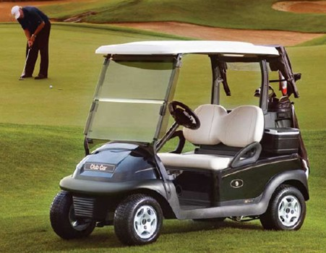
Some reading to get you stoked!
Dr. O,
I am currently down in Augusta, GA working a summer internship with Club Car (also enrolled through UNCW to get credits). During my time here I have been assigned a wide variety of tasks however my most recent was one that so closely resembled your COM 200 class it made me feel as if I was sitting in Randall working on your class. I am having to compile information about different products that we offer, and with that information create surveys that will be sent out to our dealers and distributors. I am then having to figure out how to send out these surveys based on location. Without having prior knowledge of coding and data collection I would have been totally lost. I have to admit, it is nice being about to turn what I learned through my studies to a successful day at work...thanks!
Regards,
Matt
COM Graduate

Slide 5
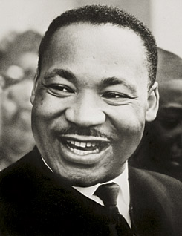
Ethics Essentials
The time is always right to do what is right.
— Martin Luther King, Jr., civil-rights leader, minister (1929-1968)

Slide 6
For Discussion
Would you . . .
Show participants offensive materials?
Deliberately deceive participants?
Record people’s behavior without them being aware of it?
Why?
Why Not?

Slide 7
Key Points of Ethics Codes
Do no harm.
Informed consent.
Voluntary participation.
Participants can leave at any time.
Debriefing after the study.
Anonymity or confidentiality.
Crediting other researchers.
Full reporting.

Slide 8
Keys to ethical research
Preserve the identity, dignity and self-worth of those you research.
Confidentiality and anonymity
Respect their time
Provide debrief

Slide 9
Keys to ethical research
Cite your sources—respect intellectual property. Get in the personal habit of GIVING CREDIT!

Slide 10
Keys to ethical research
Be able to publicly justify every choice you make.
Or you will be privately fired . . . .

Slide 11
Application Exercise
You’ll take some online training to become IRB certified to work with human subjects when conducting research.
Put on resume & COM 400 Portfolio
Several COM professors have been asking for this in order to better prepare you for assignments in their classes
Details are on my page under “Assignment Tutorials”
Due date is in schedule but can be complete anytime.

Slide 12
About ethics in COM 200
The conditions of COM 200 may provide temptation to cheat. . . . .
Let’s rehearse some responses we might use if someone asks
You to take their clicker to class for them and click in on a quiz
Seek out old exams or probes to study or copy answers from

Slide 13
Responses
Based on rules
Based on situation and outcomes
Based on identity
That’s Not Who I Am

Slide 14
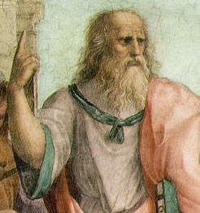
Core Skills
For my part, I have undertaken the task of molding the ideal orator, and as my first desire is that he should be a good man, I will return to those who have sounder opinions on the subject. . . . The definition which best suits its real character is that which makes rhetoric the science of speaking well. For this definition includes all the virtues of oratory and the character of the orator as well, since no man can speak well who is not good himself.
Quintilian,
Institutio Oratoria, 95,
translated by H. E. Butler

Slide 15
Core Skills
The world needs good people.
Become the person you wish you could meet.
Core Skills is a partial list to provide focus.
If you doubt its worth, show this list to your parents or your employers and get their reactions . . .
Use the challenges of this course to help forge your character not just your skills.
Use the group work in the course to grow as a person and assess how you’re doing.
Pressure Reveals

Slide 16
Coreskills
Confidence
Intellectual Curiosity
Responsibility
Feeling able to do what you set out to do, mentally, emotionally, and physically.
Valuing and participating in experiences that comprise “the life of the mind”
Taking control of the processes necessary to achieve what you set out to accomplish. This involves the coordination of motivation, initiative, and perseverance

Slide 17
Coreskills
Collaboration
Critical Thinking
Problem Solving
Working well with others to accomplish a high quality outcome of a completed task, service, product or performance.
Using sound reasoning, criteria, theories and definitions to explore specific questions or issues of concern.
Coordinating all that you know and can do to bring about satisfactory outcomes.

Slide 18
Coreskills
Civility
Praxis
Showing regard for the dignity of other people and the importance of social expectations.
Able to do what the theory or concept tells you to do with skill and self-awareness.

Slide 19
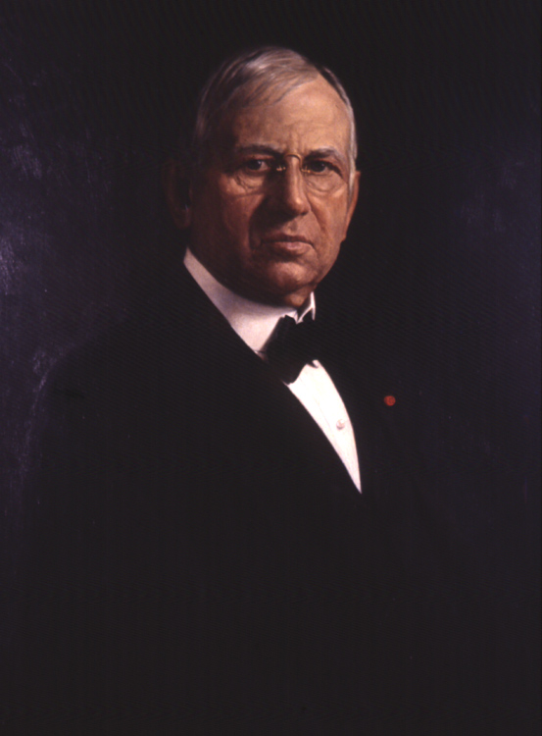
It’s not just an academic thing . . .
Courtesy is the one coin you can never have too much of or be stingy with."
--John Wanamaker, member, Advertising Hall of Fame

Slide 20
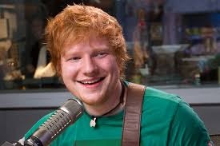
It’s not just an academic thing . . .
“It’s the time of being polite,” he says. “Radio stations aren’t going to play you if you show up late. You have to be respectful and do your job.”
Ed Sheeran

Slide 21
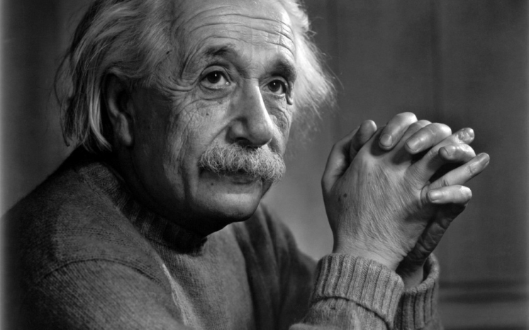
It’s not just a humanities thing . . .
Most people say that it is the intellect which makes a great scientist. They are wrong: It is character."
-- Albert Einstein,
I wish I could have been in COM 200

Slide 22
Convocation, COM 105—200 Connection
The UNCW Honor Pledge
"As a student at The University of North Carolina Wilmington, I am committed to honesty and truthfulness in academic inquiry and in the pursuit of knowledge. I pledge to uphold and promote the UNCW Student Academic Honor Code."
Ethics was part of convocation and the first lecture in BOTH gateway classes. . . .
Have we made ourselves clear?

Slide 23
Next Time
Read DT chapter 2 for next session.
Do chapter worksheet from my site
Practice quiz based on worksheet
If you did not register clicker on the COM 200 Blackboard site, do so ASAP!
In two sessions we will break into groups: don’t be absent! Review page 28 of our student manual to prepare!!.
Look at specialty areas and 400-level classes of interest

