Slide 1
Path-Goal Theory
Chapter 7

Slide 2
Overview
Path-Goal Theory Perspective
Conditions of Leadership Motivation
Leader Behaviors & Subordinate Characteristics
Task Characteristics
How Does the PGT Approach Work?

Slide 3
Path-Goal Theory (House, 1971) Description
Definition
Path-goal theory centers on how leaders motivate subordinates to accomplish designated goals
Emphasizes the relationship between
  the leader’s style
  the characteristics of the subordinates
  the work setting

Slide 4
Path-Goal Theory (House, 1971) Description
Perspective
Goal - To enhance employee performance and satisfaction by focusing on employee motivation
Motivational Principles (based on Expectancy Theory) - Subordinates will be motivated if they believe:
  they are capable of performing their work
  that their efforts will result in a certain outcome
  that the payoffs for doing their work are worthwhile

Slide 5
Challenge to Leader
Use a Leadership Style that best meets subordinates’ motivational needs
  choose behaviors that complement or supplement what is missing in the work setting
  enhance goal attainment by providing information or rewards
  provide subordinates with the elements they need to reach their goals

Slide 6
Conditions of Leadership Motivation
Leadership generates motivation when:
It increases the number and kinds of payoffs subordinates receive from their work
Makes the path to the goal clear and easy to travel through with coaching and direction
Removes obstacles and roadblocks to attaining the goal
Makes the work itself more personally satisfying

Slide 7
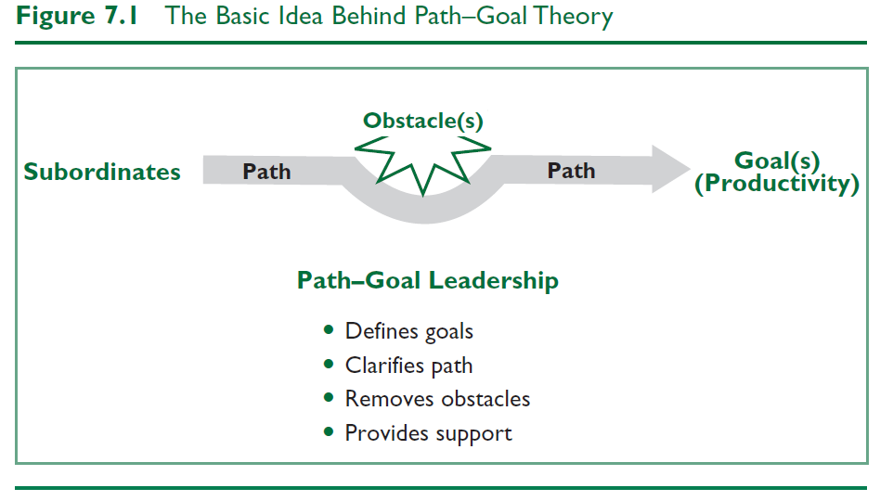

Slide 8
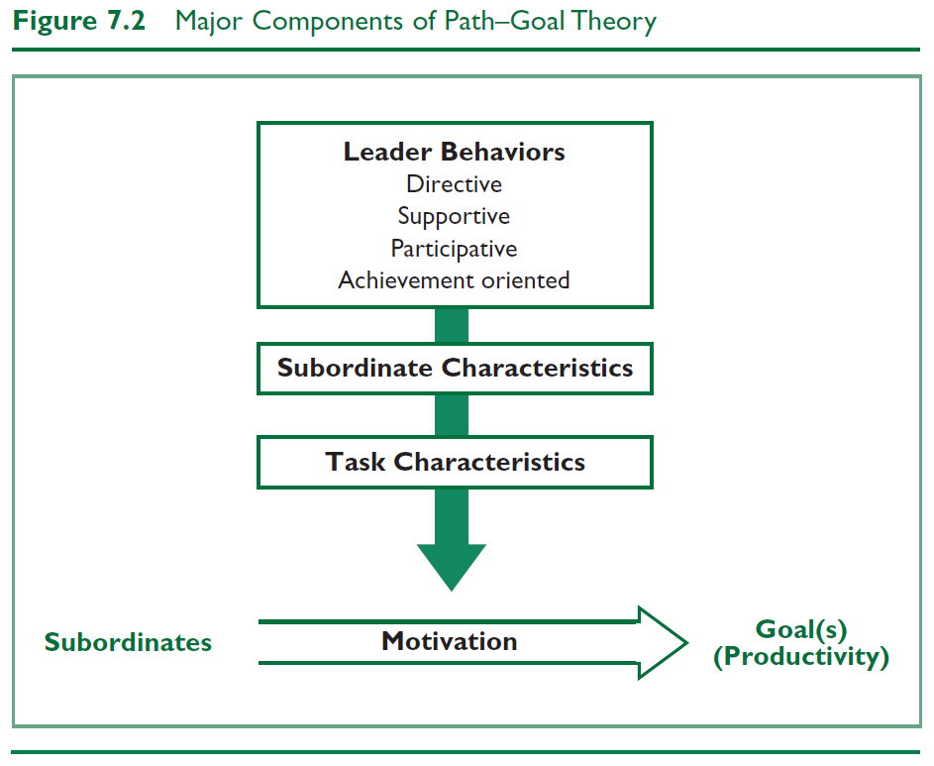

Slide 9
Leader Behaviors
Directive Leadership
Leader who gives subordinates task instruction including:
  What is expected of them
  How task is to be done
  Timeline for task completion
  Clear standards of performance
  Clear rules & regulations

Slide 10
Leader Behaviors
Supportive Leadership
Leader who is friendly and approachable:
  Attending to well-being & human needs of subordinates
  Using supportive behavior to make work environment pleasant
  Treating subordinates as equals & giving them respect for their status

Slide 11
Leader Behaviors
Participative Leadership
Leader who invites subordinates to share in the decision-making:
  Consults with subordinates
  Seeks their ideas & opinions
  Integrates their input into group/organizational decisions

Slide 12
Leader Behaviors
Achievement-Oriented Leadership
Leader who challenges subordinates to perform work at the highest level possible:
  Establishes a high standard of excellence for subordinates
  Seeks continuous improvement
  Demonstrates a high degree of confidence in subordinates’ ability to establish & achieve challenging goals

Slide 13
Subordinate Characteristics
Strong need for affiliation
  Friendly and concerned leadership is a source of satisfaction
  Supportive Leadership
Preference for Structure
  Dogmatic & authoritarian
    Leadership provides psychological structure, task clarity, & greater sense of certainty in work setting
  Directive Leadership

Slide 14
Subordinate Characteristics
Desire for Control
  Internal locus of control
    Leadership that allows subordinates to feel in charge of their work & makes them an integral part of the decision-making process
    Participative Leadership
  External locus of control
    Leadership that parallels subordinates feelings that outside forces control their circumstances
    Directive Leadership

Slide 15
Subordinate Characteristics
Perception of their own ability – specific task
  As perception of ability and competence goes up, need for highly directive leadership goes down
  Directive leadership may become redundant, possibly excessively controlling

Slide 16
Task Characteristics
Components
Design of subordinates’ task
  Organization’s formal authority system
  Primary work group of subordinates

Slide 17
Task Characteristics
Task Situations Requiring Leader Involvement
Unclear and ambiguous - Leader needs to provide structure
Highly repetitive - Leader needs to provide support to maintain subordinate motivation
Weak formal authority - If formal authority system is weak, the leader needs to assist subordinates by making rules and work requirements clear
Nonsupportive/weak group norms - Leader needs to help build cohesiveness and role responsibility

Slide 18
Task Characteristics
Obstacles
Anything in the work setting that gets in the way of subordinates
  They create excessive uncertainties, frustrations, or threats for subordinates
Leader’s responsibility is to help subordinates by –
  Removing the obstacles
  Helping subordinates around them
Assisting with obstacles will increase
  Subordinates’ expectations to complete the task
  Their sense of job satisfaction

Slide 19
How Does the Path-Goal Theory Approach Work?
Focus of Path-Goal Theory
Strengths
Criticisms
Application

Slide 20
How Does Path-Goal Theory Work?
The leader’s job is to help subordinates reach their goals by directing, guiding, and coaching them along the way
Leaders must evaluate task and subordinate characteristics and adapt leadership style to these
The theory suggests which style is most appropriate for specific characteristics

Slide 21
Path-Goal Theory Approach
Focus
Overall Scope
Path-goal theory is a complex but also pragmatic approach
Leaders should choose a leadership style that best fits the needs of subordinates and their work
Path-goal theory provides a set of assumptions about how different leadership styles will interact with subordinate characteristics and the work situation to affect employee motivation

Slide 22
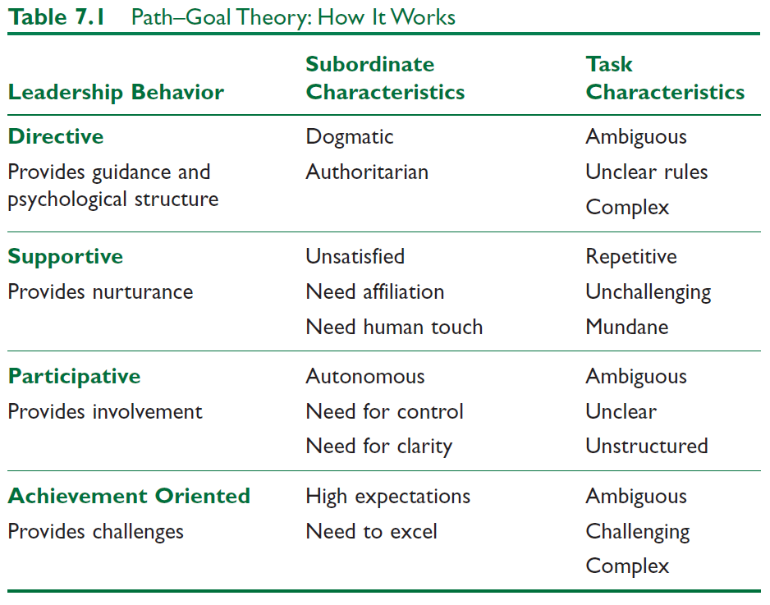
Path-Goal Theory Matrix

Slide 23
Strengths
Useful theoretical framework. Path-goal theory is a useful theoretical framework for understanding how various leadership behaviors affect the satisfaction of subordinates and their work performance.
Integrates motivation. Path-goal theory attempts to integrate the motivation principles of expectancy theory into a theory of leadership.
Practical model. Path-goal theory provides a practical model that underscores and highlights the important ways leaders help subordinates.

Slide 24
Criticisms
Interpreting the meaning of the theory can be confusing because it is so complex and incorporates so many different aspects of leadership; consequently, it is difficult to implement.
Empirical research studies have demonstrated only partial support for path-goal theory.
It fails to adequately explain the relationship between leadership behavior and worker motivation.
The path-goal theory approach treats leadership as a one-way event in which the leader affects the subordinate.

Slide 25
Application
PGT offers valuable insights that can be applied in ongoing settings to improve one’s leadership.
Informs leaders about when to be directive, supportive, participative, or achievement oriented.
The principles of PGT can be employed by leaders at all organizational levels and for all types of tasks.

