Slide 1
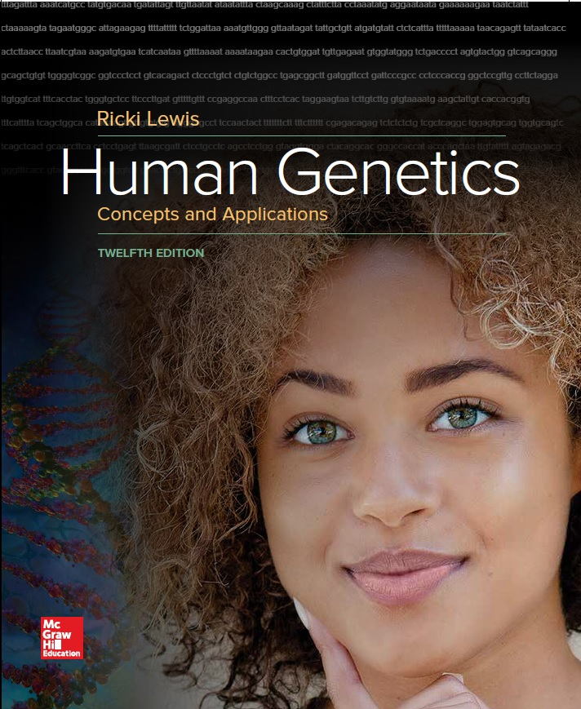
Human Genetics Concepts and Applications
Twelfth Edition
Chapter 22
Genomics
© McGraw-Hill Education. All rights reserved. Authorized only for instructor use in the classroom. No reproduction or further distribution permitted without the prior written consent of McGraw-Hill Education.

Slide 2
Learning Outcomes (1 of 2)
Explain how linkage studies, positional cloning experiments, and gene mapping led to the idea to sequence human genomes.
Distinguish between the two approaches used to sequence the first human genome.
Define reference genome.
Explain why genome sequencing requires multiple copies of a genome.

Slide 3
Learning Outcomes (2 of 2)
Identify limitations of exome and genome sequencing.
Discuss the types of information that the first sequenced human genomes provided.
Discuss practical aspects of implementing exome and genome sequencing in health care.

Slide 4
Sequencing Genomes of the Deceased
The Genomic Postmortem Research Project of the Marshfield Clinic Foundation in Wisconsin is sequencing the genomes of 300 deceased individuals and comparing the information to data in electronic medical records.
The purpose of this project is to use the information gained from this undertaking to assist clinicians in preventing, detecting, and treating specific diseases.
It would help to better identify specific genes involved in certain forms of cancer and genes that may affect human responses to certain medications, such as antidepressants, cancer drugs, painkillers, and others.

Slide 5
From Genetics To Genomics
Genetics is a young science, genomics is younger still
Term genome was coined in 1920, to refer to a complete set of chromosomes and its genes
Now it refers to all the DNA in a haploid set of chromosomes
Term genomics was coined in 1986
Indicates the study of genomes

Slide 6
Linkage Studies
Genetic maps have increased in detail and resolution
Cytogenetic map: Distinguishes DNA sequences that are at least 5,000 kilobases apart
Linkage map: Distinguishes genes hundreds of kilobases apart
Physical map: Distinguishes genes tens of kilobases apart
Sequence map: Depicts the order of bases

Slide 7
Figure 22.1
Different Levels of Genetic Maps are Like Zooming up the Magnification on a Geographical Map

Slide 8
Positional Cloning
Gene-by-gene approach that matches single genes to specific diseases
Begins with a phenotype, and gradually identifies a causative gene, localizing it to a part of a chromosome
Yielded discoveries of genes that cause diseases as Duchenne muscular dystrophy, cystic fibrosis and Huntington disease

Slide 9
The Human Genome Project
Idea to sequence the human genome emerged in the 1980s with several goals
Officially started in 1990
$3 billion, 15-year project
Under the direction of the DOE and NIH
Draft of the human genome in 2001
Finished sequence in 2003
Represents the work of thousands of researchers in an international collaboration

Slide 10
Human Genome Project (ELSI)
Recognizing the impact of the human genome project on public policy
3% of the government-sponsored budget was set aside for Ethical, Legal, and Social Issues
Prevents misuse of information and genotypic discrimination

Slide 11
Key Inventions
Expressed Sequence Tag (EST) technology
Enables researches to find protein-encoding genes
cDNAs that are expressed in a particular cell type
DNA microarrays
Display short DNA molecules
Important in sequencing and assessing gene expression

Slide 12
Sequencing the Human Genome (1 of 2)
Researchers cut several genomes-worth of DNA into overlapping pieces of about 40 Kilobases
Followed by randomly cutting into small fragments and sequencing
Computer algorithms were used to search for overlaps
By overlapping the pieces, the software derives the overall DNA sequence

Slide 13
Sequencing the Human Genome (2 of 2)
The U.S. government-funded international consortium used a clone-by-clone approach
Aligned pieces one chromosome at a time
Celera Genomics, a private company, used a whole genome shotgun approach
Shattered the entire genome; then rebuilt it

Slide 14
Deriving a DNA Sequence

Slide 15
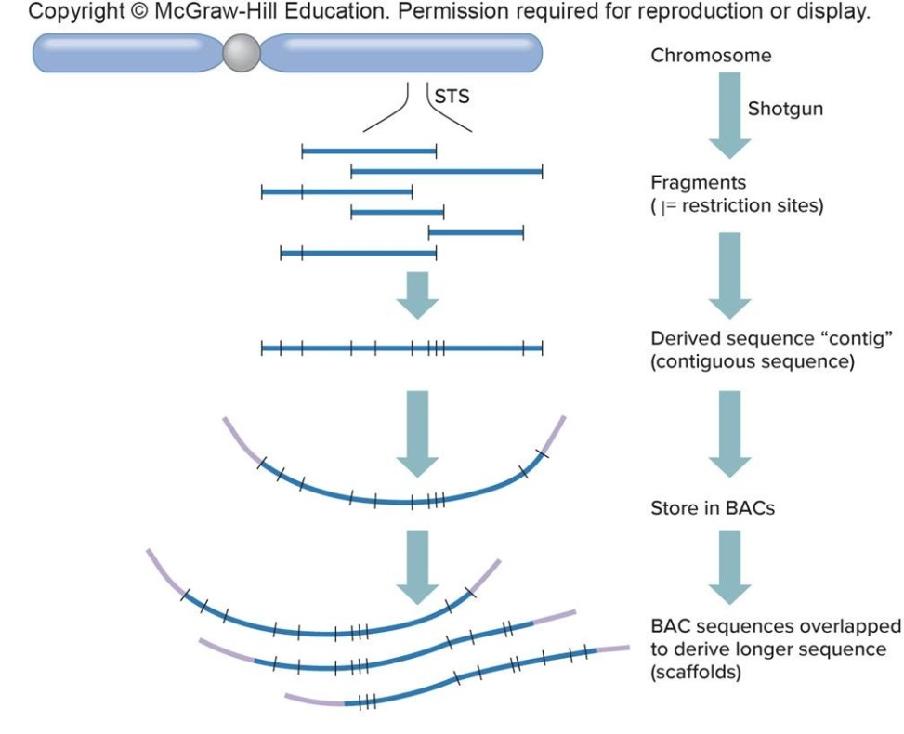
Figure 22.3 (a) Two Routes to Sequencing the Human Genome
International Human Genome Mapping Consortium “BAC by BAC” (BAC= bacterial artificial chromosome)

Slide 16
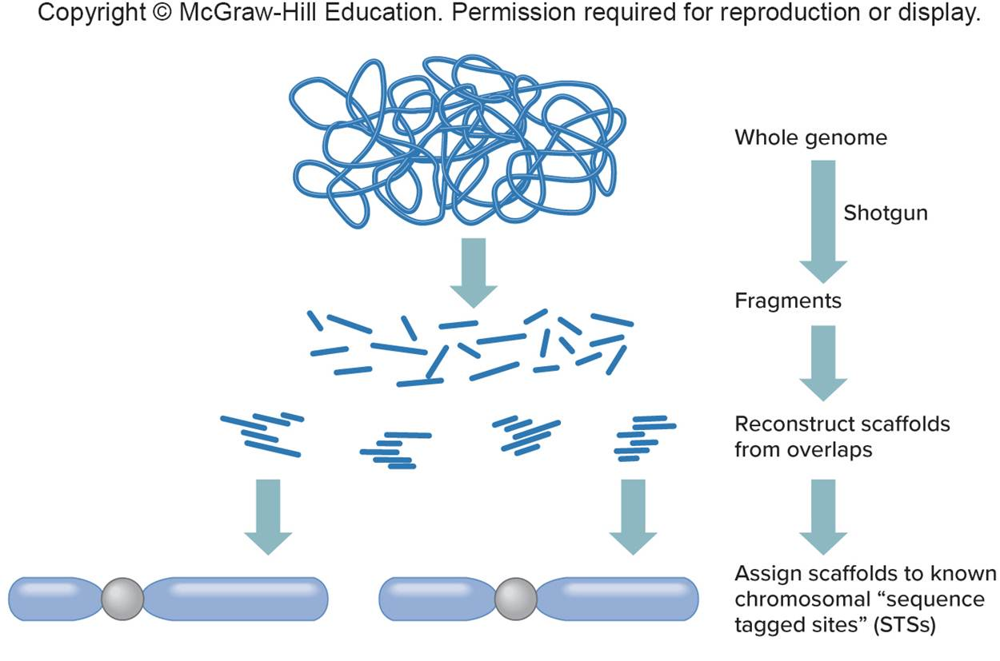
Figure 22.3 (b) Celera “Shotgun” Approach
Celera Genomics “shotgun” approach

Slide 17
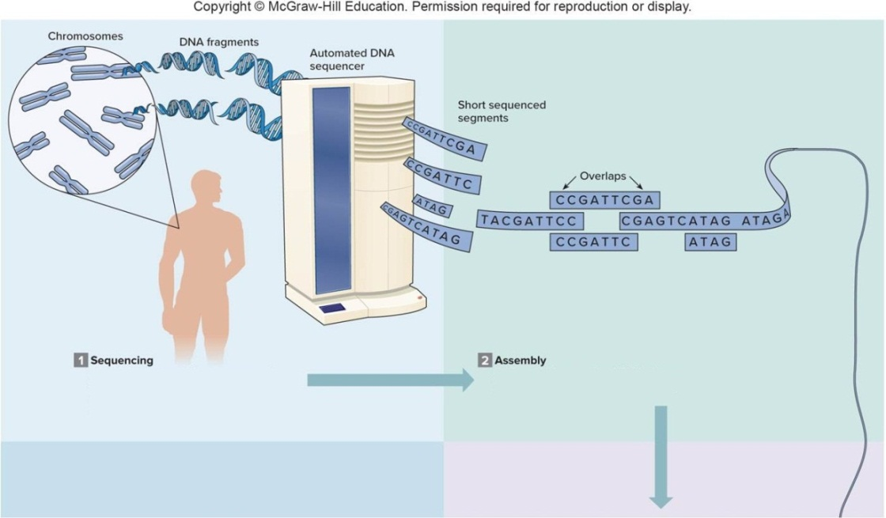
Sequencing Genomes (1 of 2)
Sequencing
DNA “shotgunned” into many small fragments, using restriction enzymes. DNA sequencer devices sequence small fragments.
Assembly
Software aligns ends of DNA pieces by recognizing sequence overlaps.

Slide 18
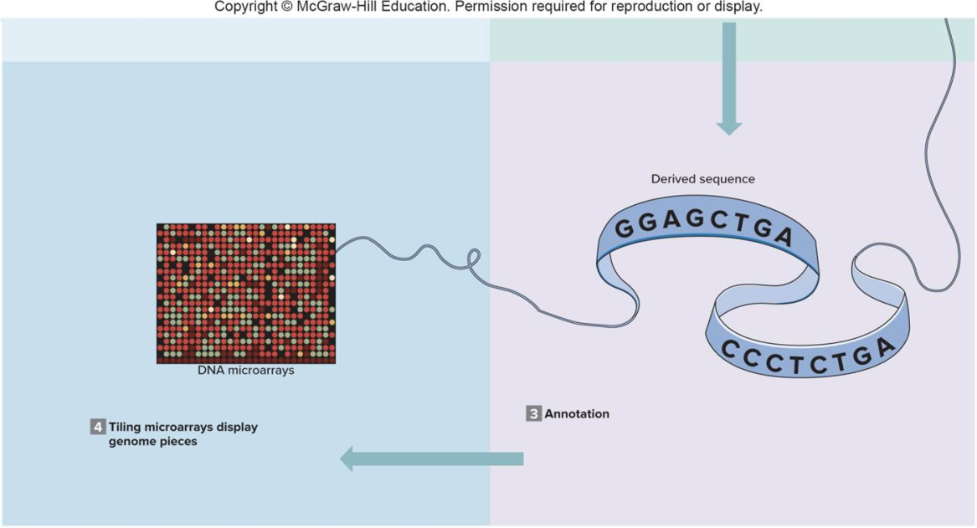
Sequencing Genomes (2 of 2)
Figure 22.4
Annotation
Software searches for clues to locations of protein-encoding genes. Databases from other species’ genomes searched for similarities to identify gene functions

Slide 19
Technology Timeline (1 of 3)
Evolution Of Genome Projects And Related Technologies
1997 | Two methods of DNA sequencing invented. The Sanger method persists for detailed sequencing of individual genes.
1985-1988 | Idea to sequence human genome suggested at several scientific meetings.
1988 | Congress authorizes the Department of Energy and the National Institutes of Health to fund the Human Genome Project
1989 | Researchers at Standford and Duke universities invent DNA microarrays
1990 | Human Genome Project officially begins. Part of International Consortium with the United Kingdom, Canada, Japan, France, Germany, and China.
1991 | Expressed sequence tag (EST) technology identifies protein-encoding DNA sequences.
1992 | First DNA microarrays available
1993 | Need to automate DNA sequencing recognized.
1994 | U.S. and French researchers publish preliminary map of 6,000 genetic markers, one every 1 million bases along the chromosomes.
1995 | Emphasis shifts from gene mapping to sequencing. First genome sequenced: Hemophilus influenzae
Notes:
Copyright © McGraw-Hill Education. Permission required for reproduction or display.

Slide 20
Technology Timeline (2 of 3)
1996 | Resolution to make all data public and updated daily at GenBank website. First eukaryote genome sequenced—yeast.
1998 | International consortium releases preliminary map of pieces covering 98 percent of human genome. Millions of sequences in GenBank. Instructions for creating DNA microarrays posted on Internet. First multicellular organism's genome sequenced—roundworm.
1999 | Rate of filing of new sequences in GenBank triples. International consortium and two private companies race to complete sequencing. First human chromosome sequenced-22.
2000 | Completion of first draft human genome sequence announced. Microarray technology flourishes. First plant and fungal genomes sequenced.
2001 | Two versions of draft human genome sequence published.
2003 | Finished human genome sequence announced to coincide with 50th anniversary of discovery of DNA structure.
 | Human exome sequence available on DNA microarrays. HapMap project identifies linkage patterns.
2004 | Final version of human genome sequence published.
2005 | Annotation of human genome sequence continues. Number of species with sequenced genomes soars.
 | High-throughput, next-generation DNA sequencing introduced.

Slide 21
Technology Timeline (3 of 3)
2007 | Detailed analysis of 1 percent of the human genome (ENCODE project) reveals that most of it is transcribed. First individual human genome sequenced. Human Micro biome Project begins.
2008 | First genome synthesized—Mycoplasma genitalium.
2010 | Several human genomes sequenced. First synthetic genome supports a bacterial cell. By now, 4,000 bacterial and viral and 250 eukaryotic species' genomes have been sequenced.
2012 | 1000 Genomes Project completes cataloging of human genetic diversity.
2014 | Tens of thousands of human genomes and hundreds of thousands of human exomes sequenced.
2015 | Precision Medicine Initiative announced, to include human genome sequence information.
2017 | Health care providers learn how to incorporate DNA sequence—based screens and tests into their medical practices.
2020 | 5 million or more people will have had their genomes sequenced.
2025 | 100 million to 2 billion people will have had their genomes sequenced.

Slide 22
Comparative Genomics (1 of 2)
Hundreds of species have had their genomes sequenced
First, viruses and bacteria
Then, our closest relatives (rats and chimps), and our favorites (cats and dogs)
Genomes of species that represent evolutionary crossroads have been the most informative

Slide 23
Comparative Genomics (2 of 2)
By comparing genomes, scientists infer evolutionary relationships from DNA sequences that are conserved and presumably selected over time
Expected to have vital functions
One way of displaying short sequence similarities is the pictogram

Slide 24
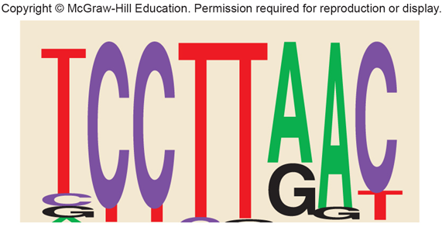
Pictogram
Not highly conserved
Highly conserved

Slide 25
Annotation
Description and significance of a particular gene variant
Includes
Normal function of the gene
Mode of inheritance
Genotype
Frequency of a variant in a particular population

Slide 26
Comparative Genomics May Help Us Answer Important Questions
Minimal set of genes for life
Distinctions between three domains of life
Simplest organism with a nucleus
Basic blueprint of an animal
Birds to mammals
Chimps to humans

Slide 27
Analysis of the Human Genome
After sequencing genomes became possible, attention turned to
Refining the process
Cataloguing human variation
Discovering gene functions
Information used in medical tests and treatments must be validated for clinical utility

Slide 28
Cost and Speed
Cost of sequencing decreased and speed increased due to annotation of genes with information such as:
Gene function
Mode of inheritance and frequencies of variants
Genotypes

Slide 29
Limitations of Exome and Genome Sequencing
Will not detect
Copy number variants
Mitochondrial DNA
Uniparental disomy
Gene-gene and gene-environment interactions

Slide 30
Personal Genome Sequencing
Comparing the genomes of healthy people to those with certain diseases will reveal how gene combinations affect health
Permits recognition of controllable environmental factors
Sequencing personal genomes is under way
Information can be used in several ways
Can detect
Disease-associated recessive alleles
Gene variants that contribute to risk of having or developing a trait or illness
Predict drug responses

Slide 31
Table 22.3 A Gallery of Genomes (1 of 2)
Gender | Findings
XY | Hypertrophic cardiomyopathy (enlarged heart), dominant mutation of "uncertain pathogenicity"
 | Peroxisome disease similar to adrenoleukodystrophy, asymptomatic carrier
 | Age-related macular degeneration (ARMD; visual loss), mutation likely pathogenic"
 | Hypertension, homozygous recessive for common mutation that increases risk by 8%
 | Increased plasma triglycerides due to ApoA5 mutation, not associated with increased risk of coronary artery disease
XX | Biotinidase deficiency, asymptomatic carrier
 | Adenosine deaminase deficiency, asymptomatic carrier
 | Stiff arteries, lifetime risk of heart attack increased 0.5-3% above population risk of 15%
 | Nephropathy (kidney disease) mutation, risk increased <0.1%
 | Hypertension, increased risk associated with variant in noncoding DNA
XY | Baldness (confirmed with use of mirror)
 | Ichthyosis vulgaris. Heterozygous for filaggrin mutation, has 30-50% risk of atopic dermatitis (eczema), which individual already has
 | Polydactyly mutation, but known in only one family
 | Age-related macular degeneration mutation, "likely pathogenic"
Notes:
Copyright © McGraw-Hill Education. Permission required for reproduction or display.

Slide 32
Table 22.3 A Gallery of Genomes (2 of 2)
Gender | Findings
XX | Esophageal cancer, dominant mutation increases risk fourfold
 | Crohn's disease, mutation in NOD2 gene “likely pathogenic"
 | Down syndrome risk to offspring 0.4% due to mutation in MTRR gene (age is more important risk factor)
 | Hypertension, 4% increase in risk due to SNPs in noncoding region of angiotensin II gene
XY | Galactosemia deficiency, asymptomatic carrier
 | Intellectual disability, dominant variant in CDH gene, "not statistically significant" increase in risk
 | Lumbar disc disease risk increased from 4% in general population to 11%; individual already has it

Slide 33
Dilemmas in Knowing a Genome
There are a number of medical ethical dilemmas in having information on a patient’s genome.
How much genome information should be shared with the patient?
Does a patient have an ethical obligation to share genome results with relatives who may also be at elevated risk of developing an illness?
Should a parent sequence a newborn or child’s genome?

Slide 34
Bioethics – Should We Create Genomes?
Researchers introduced the first synthetic genome in 2010. So, the technology is available.
Some ethical and academic questions are:
Are scientists creating life?
Is enough already known to be able to use this synthetic technology to create cells to improve life?
How might this ability be misused?

Slide 35
End of Presentation

