Slide 1
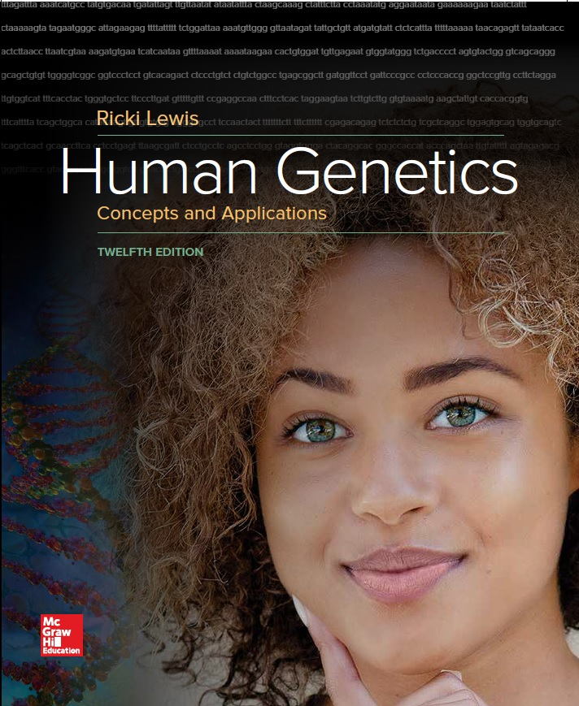
Human Genetics Concepts and Applications
Twelfth Edition
Chapter 21
Reproductive Technologies
© McGraw-Hill Education. All rights reserved. Authorized only for instructor use in the classroom. No reproduction or further distribution permitted without the prior written consent of McGraw-Hill Education.

Slide 2
Learning Outcomes (1 of 2)
Explain how a child can be conceived to provide tissue for an older sibling.
Define assisted reproductive technology (ART).
Distinguish infertility from subfertility.
Describe causes of infertility in the male.
Describe causes of infertility in the female.
List infertility tests.
Describe ARTs that donate sperm, uterus, or oocyte.
List the steps of in vitro fertilization.

Slide 3
Learning Outcomes (2 of 2)
Explain how preimplantation genetic diagnosis enables people to select embryos conceived in vitro that have normal chromosomes and do not have certain mutations.
Explain how testing a polar body can reveal information about a genotype of a fertilized ovum.
Discuss uses for extra embryos resulting from ARTs.

Slide 4
Savior Siblings and More (1 of 2)
Innovative ways to conceive offspring:
Couple in search of an oocyte donor advertises for an attractive, athletic woman.
Cancer patient stores her oocytes before therapy; becomes a mother two years later.
A paralyzed man has sperm removed and injected into his partner’s oocyte.
Lisa and Jack Nash sought to have a child for a different reason.
They needed a savior sibling to save their daughter Molly’s life, who was suffering from Fanconi anemia.

Slide 5
Savior Siblings and More (2 of 2)
An umbilical cord stem cell transplant could save the life of Molly.
The use of preimplantation genetic diagnosis proved effective in assisting Molly to overcome her condition.
Using Assisted Reproductive Technology, the Nash’s conceived a son, Adam, who was free of this genetic condition and could supply his sister with the necessary cord blood.

Slide 6
Assisted Reproductive Technologies
ARTs are methods that replace the source of a male or female gamete, aid fertilization, or provide a uterus
Developed to treat infertility but are becoming part of genetic screening
The U.S. Government does not regulate ARTs
However, the British Government does

Slide 7
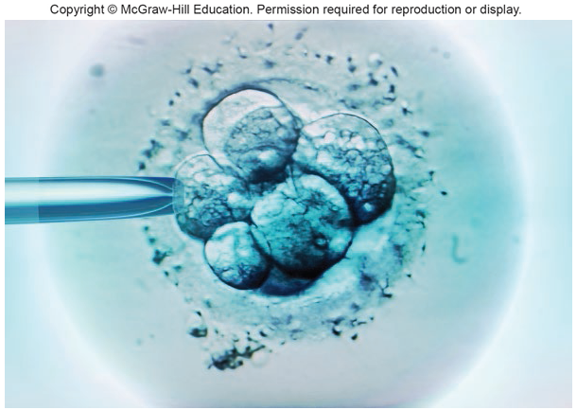
Preimplantation Genetic Diagnosis
A process in which cells are selected from an early embryo and tested for inherited diseases prevalent in a family
Figure 21.1: Savior siblings
© Science Photo Library/Alamy Stock Photo

Slide 8
Infertility and Subfertility
Infertility is the inability to conceive a child after a year of frequent intercourse without contraceptives
Subfertility distinguishes couples who can conceive, but require longer time than usual
Affect one in six couples
A physical cause can be identified in 90% of cases: 30% in males, 60% in females

Slide 9
Male Infertility (1 of 4)
Easier to detect, but often harder to treat than female infertility
4 in 100 men are infertile
Most cases of male infertility are genetic
Causes of infertility include:
Azoospermia
Low sperm count (oligospermia)
A malfunctioning immune system
A varicose vein in the scrotum
Structural sperm defects

Slide 10
Male Infertility (2 of 4)
Most cases of male infertility are genetic.
Due to small deletions of Y chromosome that remove genes important for spermatogenesis
Mutations in genes for androgen receptors or protein fertility hormones, or that regulate sperm development
In cases of low sperm count, sperm can be stored frozen, then pooled.

Slide 11
Male Infertility (3 of 4)
Sperm’s inability to move may be due to hormone imbalance
Abnormal shapes may reflect impaired apoptosis that removes such sperm
Genetic package of an immobile or abnormally shaped sperm can be injected into an oocyte to fertilize

Slide 12
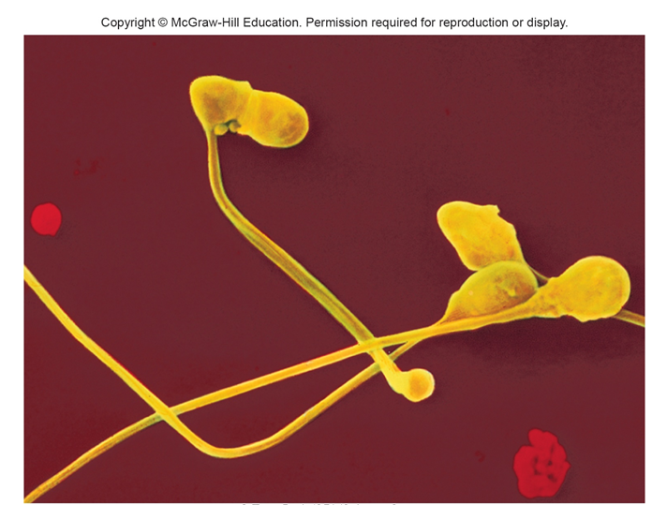
Male Infertility (4 of 4)
© Tony Brain/SPL/Science Source

Slide 13
Female Infertility (1 of 5)
Abnormalities in any part of the female reproductive system can cause infertility.
Many women with subfertility or infertility have irregular menstrual cycles.
This makes it difficult to pinpoint when conception is most likely.
Tracking ovulation cycles aid in determination of the most likely days for conception.

Slide 14
Female Infertility (2 of 5)
Hormonal imbalance that underlies irregular ovulation could be caused by:
Tumor in the ovary or in the pituitary gland
Underactive thyroid gland
Use of steroid-based drugs
Fertility drugs stimulate ovulation but may induce release of multiple oocytes

Slide 15
Female Infertility (3 of 5)
Woman whose ovaries are inactive or absent can use a donor oocyte for pregnancy
Signs of reduced ovarian reserve are:
An ovary with too few follicles
Elevated levels of follicle-stimulating hormone on the third day of the menstrual cycle
Blocked fallopian tubes can result in ectopic pregnancy (tubal pregnancy)

Slide 16
Female Infertility (4 of 5)
Excess tissue growth in uterine lining may make it inhospitable for an embryo.
Fibroids: Benign tumors
Endometriosis: Buildup of uterine lining
Secretions in the vagina and cervix may be hostile to sperm.
Infertility may also result if the oocyte fails to release sperm-attracting chemicals.

Slide 17
Female Infertility (5 of 5)
Early pregnancy loss due to an abnormal chromosome number is more common in older females.
Losing very early embryos may appear to be infertility.
Bleeding resembles a heavy menstrual flow.

Slide 18
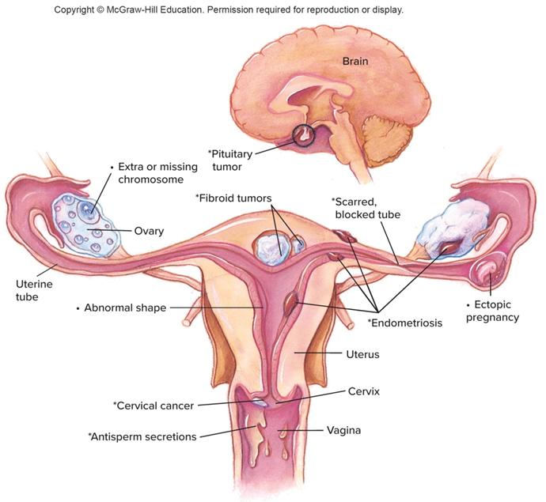
Sites of Reproductive Problems in the Female
Key
Infertility
Spontaneous abortion

Slide 19
Infertility Tests
The man is checked first, because it is easier, less costly and less painful to obtain sperm than oocytes.
Sperms are checked for number (sperm count) motility and morphology (shape).
A gynecologist can then check the female to see if reproductive organs are present and functioning.
Psychological factors may also be at play.

Slide 20
Assisted Reproductive Technologies (ARTs) (1 of 2)
Many people with fertility problems use alternative ways to conceive.
Several of the ARTs were developed in nonhuman animals.
In the U.S., about 1% of the 4 million births each year are from ARTs.

Slide 21
Assisted Reproductive Technologies (ARTs) (2 of 2)
Examples:
Intrauterine insemination (IUI)
Surrogate motherhood
In vitro fertilization (IVF)
Gamete intrafallopian transfer (GIFT)
Zygote intrafallopian transfer (ZIFT)
Oocyte banking and donation
Preimplantation genetic diagnosis (PGD)
Sequential polar body analysis

Slide 22
Landmarks in Reproductive Technology (1 of 3)
Technology Timeline
 | In Nonhuman Animals | In Humans
1782 | Intrauterine insemination(IUI) in dogs
1790 |  | Pregnancy reported from IUI
1890s | Birth from embryo transplantation in rabbits | IUI by donor
1949 | Cryoprotectant enables safe freezing of animal sperm
1951 | First calf born after embryo transplantation
1952 | Live calf born after insemination with frozen sperm
1953 |  | First reported pregnancy after insemination with frozen sperm
1959 | Live rabbit offspring produced from IVF
1972 | Live offspring from frozen mouse embryos
1976 | Intracytoplasmic sperm injection (ICSI) in hamsters | First reported commercial surrogate motherhood arrangement in the United States
1978 | Transplantation of ovaries between cows | Baby born after IVF in United Kingdom
Notes:
Copyright © McGraw-Hill Education. Permission required for reproduction or display.

Slide 23
Landmarks in Reproductive Technology (2 of 3)
 | In Nonhuman Animals | In Humans
1980 |  | Baby born after IVF in Australia
1981 | Calf born after IVF | Baby born after IVF in United States
1982 | Sexing of embryos in rabbits
 | Cattle embryos split to produce genetically identical twins
1983 |  | Embryo transfer after uterine lavage
1984 |  | Baby born in Australia from frozen and thawed embryo
1985 |  | Baby born after gamete intrafallopian transfer (GIFT)
 |  | First reported gestational-only surrogacy arrangement in the United States
1986 |  | Baby born in the United States from frozen and thawed embryo
1989 |  | First preimplantation genetic diagnosis (PGD)
1992 |  | First pregnancies from ICSI

Slide 24
Landmarks in Reproductive Technology (3 of 3)
 | In Nonhuman Animals | In Humans
1995 | Sheep cloned from embryo cell nuclei | 62-year-old woman gives birth from fertilized donated oocyte
1996 | Sheep cloned from adult cell nucleus
1998 | Mice cloned from adult cell nuclei | Baby born 7 years after his twin
1999 | Cattle cloned from adult cell nuclei
2000 | Pigs cloned from adult cell nuclei
2001 |  | First savior sibling born to treat sister for genetic disease
 |  | Human preimplantation embryo cloned, survives to 6 cells
2003 |  | 3,000-plus PGDs performed to date
2004 | Woman pays $50,000 to have her cat cloned | First birth from a woman who had ovarian tissue preserved and implanted on an ovary, after cancer treatment
2005 | Dog cloned
2011 |  | First children born free of single-gene disease following sequential polar body analysis
2013 |  | First woman conceives from stored ovarian tissue

Slide 25
Intrauterine Insemination
Donated sperm is placed in a woman’s cervix or uterus.
Success rate is 5–15%.
1790: First reported pregnancy from artificial insemination.
1953: Methods for freezing and storing sperm were developed.
Sperm catalogs list personal characteristics.

Slide 26
Surrogate Motherhood
In surrogate motherhood, a woman carries a pregnancy to term for another woman who cannot conceive and/or carry the pregnancy.
Custody rights are given up at birth.
Complex legal and emotional issues must be considered.
A surrogate mother may or may not have contributed an oocyte.

Slide 27
In vitro Fertilization (IVF) (1 of 3)
For in vitro fertilization, a sperm fertilizes an oocyte in a culture dish.
Embryos are transferred to the oocyte donor’s uterus (or a surrogate’s uterus) for implantation.
1978: First IVF child born (Louise Joy Brown).
4 million IVF children have been born till date.
A woman can undergo IVF if her ovaries and uterus work but her uterine tubes are blocked
Oocytes from an ovary are removed through laparoscopy and transferred to a culture dish

Slide 28
In vitro Fertilization (2 of 3)
Intracytoplasmic sperm injection (ICSI):
Sperm that cannot enter the oocyte is microinjected into the female cell
ICSI is more effective than IVF alone
Allows conception in cases of low sperm count, or many abnormal sperm
And in cases where male has spinal cord injuries and cannot ejaculate
Blastocyst is transferred to the uterus.
Women is pregnant when the level of human chorionic gonadotropin hormone rises in her blood.

Slide 29
In vitro Fertilization (3 of 3)
Several embryos were implanted to increase the success rate of IVF in the past.
Led to multiple births
Guidelines now suggest transferring only one embryo
Embryos resulting from IVF can be frozen for later use.

Slide 30
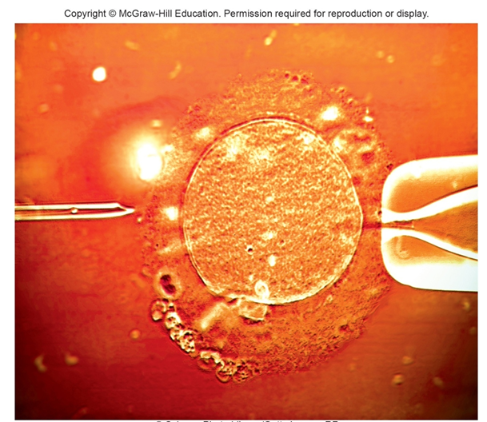
Intracytoplasmic Sperm Injection
© Science Photo Library/Getty Images RF

Slide 31
Gamete Intrafallopian Transfer (GIFT)
GIFT is a method in which the largest oocytes from a woman and sperm from her partner are placed together in her uterine (fallopian) tube
Fertilization occurs in the woman’s body
Allows conception in cases of fallopian tube blockage
22% success rate

Slide 32
Zygote Intrafallopian Transfer (ZIFT)
IVF ovum is introduced into the uterine tube and allowed to move to the uterus for implantation
Also about 22% successful
GIFT and ZIFT are done much less frequently than IVF
They often will not work for women with scarred uterine tubes

Slide 33
Oocyte Banking and Donation (1 of 2)
Oocytes, like sperm, can be stored frozen
Women can store their own oocytes to have children later or prior to undergoing chemotherapy
Oocytes are frozen in liquid nitrogen
Difficulties exist as oocytes pause in meiosis II until fertilization occurs
Only 3% successful
New technique can freeze strips of ovarian tissue.
Women can obtain oocytes from donors.

Slide 34
Oocyte Banking and Donation (2 of 2)
Embryo adoption is a variation on oocyte donation.
A woman with malfunctioning ovaries and a healthy uterus carries an embryo.
Results when her partner’s sperm is used in intrauterine insemination of a woman who produces healthy oocytes
Cytoplasmic donation
Older women have their oocytes injected with cytoplasm from the oocytes of younger women to rejuvenate the cells
Oocyte donation technology has lagged behind sperm banks
Oocytes are harder to obtain than sperm

Slide 35
Preimplantation Genetic Diagnosis (PGD) (1 of 3)
This PGD technique allows detection of genetic and chromosomal abnormalities prior to implantation
Preimplantation—Embryo is tested at a stage prior to when it would implant in the uterus
About 29% success rate
One cell or blastomere of an 8-celled embryo can be removed for testing
The remaining cells will complete normal development
Accuracy in detecting a mutation or abnormal chromosome is about 97 percent
Errors happen when a somatic mutation affects the sampled blastomere and not the rest of the embryo

Slide 36
Preimplantation Genetic Diagnosis (PGD) (2 of 3)
1989: First children who had PGD
Used to select females who could not inherit X-linked conditions from mothers
1992: First child born following PGD to screen for cystic fibrosis allele present in her family
Used to screen early embryos derived from IVF for normal chromosome number before implanting
Increases the chances of successful live births
Using the technology for gender selection is considered as a misuse

Slide 37
Preimplantation Genetic Diagnosis (PGD) (3 of 3)

Slide 38
Table 21.1 Some Assisted Reproductive Technologies
TECHNOLOGY | PROCEDURES
GIFT | Deposits collected oocytes and sperm in uterine tube.
IVF | Mixes sperm and oocytes in a dish. Chemicals simulate intrauterine environment to encourage fertilization.
IUI | Places or injects washed sperm into the cervix or uterus.
ICSI | Injects immature or rare sperm into oocyte, before IVF.
Oocyte freezing | Oocytes retrieved and frozen in liquid nitrogen.
PGD | Analyzes chromosomes and gene variants in early embryos, in vitro. Selected embryos are implanted in the uterus and child will be free of tested-for conditions.
Sequential polar body analysis | Genetic testing of polar body attached to just-fertilized ovum enables inference that fertilized ovum is free of a family's mutation.
Surrogate mother | Woman carries a pregnancy for another.
ZIFT | Places IVF ovum in uterine tube
Notes:
Copyright © McGraw-Hill Education. Permission required for reproduction or display.

Slide 39
Sequential Polar Body Analysis
Provides genetic information earlier in development
Infers absence of a mutation in a fertilized ovum by checking a second polar body
Approach is based on Mendel’s first law, gene segregation
Technology is still in experimental stage
Followed up with PGD to test predictions to ensure that IVF embryos transferred are free of the family’s mutation

Slide 40
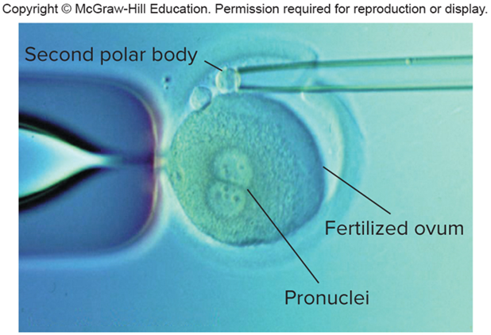
Sequential Polar Body Analysis
Courtesy of Dr. Anver Kuliev

Slide 41
Extra Embryos (1 of 2)
Sometimes ARTs leave “extra” oocytes, fertilized ova, or very early embryos.
Table 21.2 Fates of Frozen Embryos
Store indefinitely
Store and destroy after a set time
Donate for embryonic system cell derivation and research
Thaw later for use by biological parents
Thaw later for use by other parents
Discard
Notes:
Copyright © McGraw-Hill Education. Permission required for reproduction or display.

Slide 42
Extra Embryos (2 of 2)
Enable researchers to study aspects of early human development that cannot be investigated in other ways
Using fertilized ova or embryos designated for discard in research is controversial
Without regulations on privately funded research, ethically questionable experiments can happen

Slide 43
Assisted Reproductive Disasters
ARTs introduce ownership and parentage issues.
Another controversy is that human genome information is providing more traits to track and perhaps control in coming generations.
So, who will decide which traits are worth living with, and which are not?

Slide 44
Table 21.3 Assisted Reproductive Disasters (1 of 3)
A physician used his own sperm to perform intrauterine insemination on 15 patients, telling them that he had used sperm from anonymous donors.
A plane crash killed the wealthy parents of two early embryos stored at -320°F (-195°C) in a hospital. Adult children of the couple were asked to share their estate with two 8-celled siblings-to-be.
Several couples planning to marry discovered that they were half-siblings. Their mothers had been inseminated with sperm from the same donor.
Notes:
Copyright © McGraw-Hill Education. Permission required for reproduction or display.

Slide 45
Table 21.3 Assisted Reproductive Disasters (2 of 3)
Two Rhode Island couples sued a fertility clinic for misplacing several embryos.
Several couples sued a fertility clinic for implanting their oocytes or embryos in other women without donor consent. One woman requested partial custody of the resulting children if her oocytes were taken, and full custody if her embryos were used, even though the children were of school age and she had never met them.

Slide 46
Table 21.3 Assisted Reproductive Disasters (3 of 3)
A man sued his ex-wife for possession of their frozen fertilized ova. He won, and donated them for research. She had wanted to be pregnant.
The night before in vitro fertilized embryos were to be implanted in a 40-year-old woman's uterus after she and her husband had spent 4 years trying to conceive, the man changed his mind and wanted the embryos destroyed.

Slide 47
End of Presentation

