Slide 1
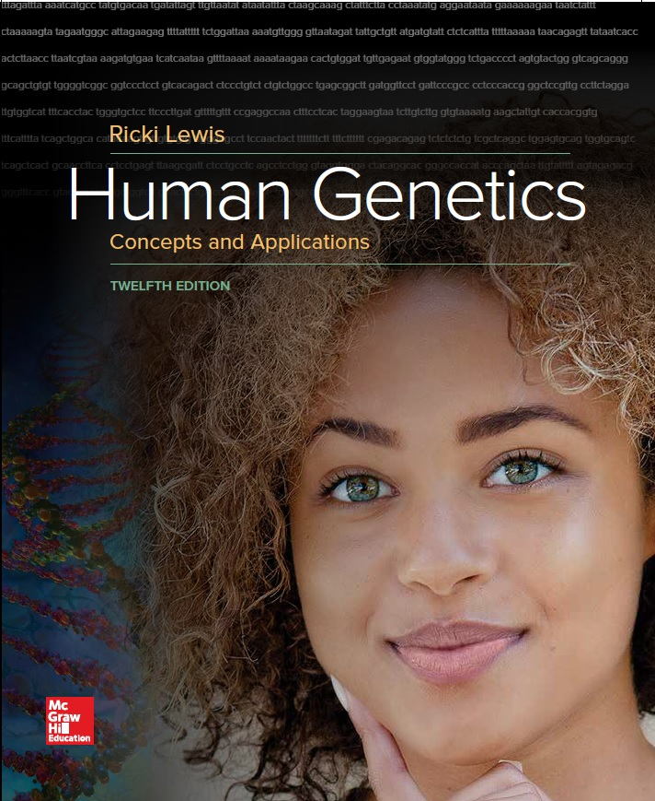
Human Genetics Concepts and Applications
Twelfth Edition
Chapter 20
Genetic Testing and Treatment
© McGraw-Hill Education. All rights reserved. Authorized only for instructor use in the classroom. No reproduction or further distribution permitted without the prior written consent of McGraw-Hill Education.

Slide 2
Learning Outcomes (1 of 2)
Describe the services that a genetic counselor provides.
Describe types of genetic tests that are done at different stages of human prenatal development and life.
Discuss the benefits and limitations of direct-to-consumer genetic testing.
Explain how pharmacogenetics and pharmacogenomics personalize drug treatments.

Slide 3
Learning Outcomes (2 of 2)
Describe three approaches to correcting inborn errors of metabolism.
Discuss how gene therapy adds a functional gene to correct or counter symptoms of a single-gene disease.
Explain how CRISPER-Cas9 genome editing may be used to help diagnose and develop treatments for single-gene diseases.

Slide 4
Gene Therapy to Genome Editing
Gene therapy using genome editing is becoming a valuable medical treatment tool.
One example of this therapy is for the treatment of mucopolysaccharidosis type III, more commonly known as Sanfilippo syndrome type A.

Slide 5
Genetic Counseling
Addresses medical, psychological, sociological, and ethical issues.
Genetic counselor is a health care professional with a master’s degree who helps patients and their families navigate the confusing path of genetic testing.
Genetic counseling began in pediatrics, and prenatal care, and has become specialized.
The field has even infiltrated public policy as genetic testing has become widespread.

Slide 6
Genetic Counselors (1 of 2)
The U.S. only has about 3000
Provide information to individuals, couples expecting children, and families about:
Modes of inheritance
Disease risks and symptoms
Available tests and treatments
Interpret direct-to-consumer genetic tests and assist other health care professionals with genetic information in their practices

Slide 7
Genetic Counselors (2 of 2)
When genetic counseling began, it was “nondirective”
The practitioner did not offer an opinion or suggest a course of action, but presented options
A more recent definition of the role of the genetic counselor is “shared deliberation and decision making between the counselor and client.”

Slide 8
The Genetic Counseling Process (1 of 2)
Reasons to seek genetic counseling:
Family history of abnormal chromosomes
Elevated risk of single-gene disease
Family history of multifactorial disease
Family history of cancer
Genetic counseling sections
Family history
Pedigree construction
Information provided on specific diseases, modes of inheritance, tests to identify at-risk family members
Testing arranged, discussion of results and treatments
Links to support groups, appropriate services, clinical trials
Follow-up contact
Notes:
Copyright © McGraw-Hill Education. Permission required for reproduction or display.

Slide 9
The Genetic Counseling Process (2 of 2)

Slide 10
Genetic Testing
Genetic tests are administered at all stages of human existence, and for a variety of reasons.
Identifying mutations can help in diagnosis and choosing treatments.
As the pace of exome and genome sequencing accelerates, and such testing becomes widely available.

Slide 11
Table 20.1 Genetic Testing (1 of 4)
PRENATAL
Test | Description | Chapter
Sperm selection | Enriches for X- or Y-bearing sperm, then intrauterine insemination or in vitro fertilization | 6,21
Preimplantation genetic diagnosing and sequencing | Sequences genes, exomes, and genomes and examines chromosomes of 1 cell of 8-celled embryo conceived in vitro; remaining embryo develops for a few days and is then implanted in the uterus | 21
Chorionic villus sampling | Tests DNA and chromosomes of chorionic villus cell | 13
Rescue karyotyping | Detects small deletions and duplications in archived cells from past unexplained pregnancy losses | 13
Noninvasive prenatal diagnosis | Tests cell-free fetal (placental) DNA | 13
Maternal serum markers | Measure levels of biomarkers in pregnant woman's blood | 13
Amniocentesis | Tests DNA and chromosomes of amniocytes | 13
Notes:
Copyright © McGraw-Hill Education. Permission required for reproduction or display.

Slide 12
Table 20.1 Genetic Testing (2 of 4)
NEWBORNS
Test | Description | Chapter
Screening | Screen metabolites and DNA in heelstick blood sample for 50-plus actionable conditions | 20
Genome sequencing | Sequence genomes of many newborns to assess clinical value | 20
CHILDREN
Test | Description | Chapter
Chromosomal microarray analysis | Detects small deletions, duplications, and other copy number variants associated with certain phenotypes | 8
Exome sequencing | Diagnoses unrecognized syndromes or atypical cases; family comparisons distinguish de novo from inherited mutations in children | 1,4,8

Slide 13
Table 20.1 Genetic Testing (3 of 4)
ADULTS
Test | Description | Chapter
Dor Yeshorim program | Preconception carrier tests for genetic diseases more prevalent among people of Jewish ancestry | 15
Sickle cell disease | Tests athletes to identify carriers at risk for symptoms | 11,12
Comprehensive carrier testing | Preconception carrier tests for many single-gene diseases | 20
Population carrier screen | Tests for heterozygotes for diseases more prevalent in certain population groups | 15
Ancestry testing | Y chromosome and mitochondria! DNA sequences identify paternal and maternal lineages; these and autosomal markers identify distant cousins | 16
Forensics testing | Copy numbers of short tandem repeats (STRs) in crime scene or disaster evidence | 14

Slide 14
Table 20.1 Genetic Testing (4 of 4)
Test | Description | Chapter
Military | Identify remains; risk for depression, PTSD; rapid infection diagnosis | 1
Susceptibility | BRCA cancers, Alzheimer disease | 5,18
Pharmacogenetics | Drug efficacy, adverse effects, and dose | 20
Genome-wide association studies | Identify genes contributing small degrees to a phenotype | 7
Paternity | Half of a child's genome comes from the father | 14
Centenarians | Identify gene variants that extremely old people share | 3
POSTHUMOUS
Test | Description | Chapter
Disease diagnosis | Identify mutations in cells of deceased individuals | 2,22
History | Identify remains | 5,14
Human origins | Compare genomes of modern and archaic humans | 16

Slide 15
Newborn Screening (1 of 3)
Usually tests for inborn errors of metabolism
Are not genetic tests, but instead they use tandem mass spectrometry to identify unusual metabolites or chemical imbalances that indicate a certain disease
The field of newborn screening began in 1961 with the Guthrie test for phenylketonuria (PKU).
It detects phenylalanine, which builds up in affected individuals.

Slide 16
Newborn Screening (2 of 3)
In 1963, a specialized diet became available.
The diet is difficult to follow, but does prevent mental retardation.
After diet’s success, genetic tests expanded.
Some states perform DNA tests on newborns as well as biochemical tests.

Slide 17
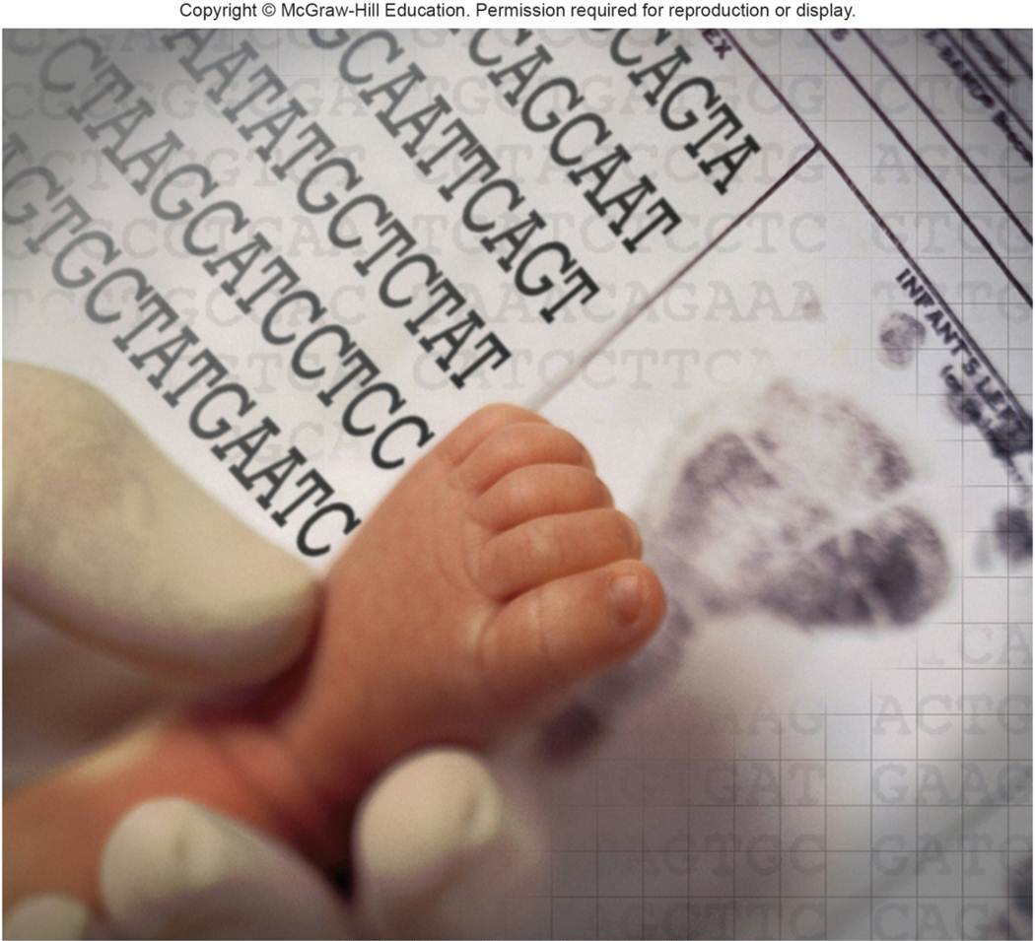
Newborn Screening (3 of 3)
© National Human Genome Research Institute

Slide 18
Genetic Testing of Children
Chromosomal microarray (CMA) test detects very small deletions and duplications that are associated with:
Autism
Developmental delay
Intellectual disability
Behavioral problems
Other phenotypes

Slide 19
Genetic Testing of Adults
Like children, adults take single-gene tests as part of diagnostic workups based on symptoms or other test results.
Faster DNA sequencing has lowered the cost of carrier tests to the point that it may be more economical to test everyone for many diseases with one blood sample per person.

Slide 20
Direct-To-Consumer Genetic Testing (DTC) (1 of 2)
Companies market DNA-based tests for traits, susceptibilities, and genetic diseases to the general public.
The Clinical Laboratory Improvement Amendments (CLIA) control genetic testing.
DTC tests presented as information, not diagnoses, may not be regulated.
Unawareness of incomplete penetrance is one complication of DTC genetic testing.

Slide 21
Direct-To-Consumer Genetic Testing (DTC) (2 of 2)
Three Direct-to-consumer tests that provide information, but not a diagnosis are:
Tests for inborn athletic ability
Nutrigenetic testing
Pharmacogenetic and pharmacogenomic tests

Slide 22
Tests for Inborn Athletic Ability
Several dozen companies worldwide offer DTC genetic tests for athletic ability.
The genes tested for are related to fitness and athletic ability.
Two genes of particular interest are the angiotensin-1-converting enzyme gene and the ACTN3 (alpha-actinin 3) gene.

Slide 23
Table 20.2 Genes Associated With Athletic Characteristics (1 of 2)
Gene abbreviation | Encoded protein | Protein Function
ADRBR | Beta-2 adrenergic receptor | Regulates blood glucose level, vasodilation, fat utilization
APOA2 | Apolipoprotein A2 | Weight gain with high saturated fat diet
COL1A1 | Type 1 collagen alpha-1 | Increased need for hydration, decreased response to endurance activity
COL5A1 | Type 5 collagen alpha-1 | Susceptibility to tendon injury
FABP2 | Fatty acid binding protein 2 | Increases fatty acid uptake in small intestine, increasing blood levels of triglycerides, LDL, and total cholesterol and lowering HDL
GDF5 | Growth differentiation factor 5 | Increases risk of tendon disease and osteoarthritis
Notes:
Copyright © McGraw-Hill Education. Permission required for reproduction or display.

Slide 24
Table 20.2 Genes Associated With Athletic Characteristics (2 of 2)
Gene abbreviation | Encoded protein | Protein Function
GST | Glutathione S transferase | Detoxification, antioxidant activity, decreased free radicals
IL6 | Interleukin-6 | Immune response and inflammation in injury repair
PPAR | Peroxisome proliferator-activated receptor gamma | Fat storage and glucose metabolism
TRHR | Thyrotropin-releasing hormone receptor | Controls metabolic rate
VDR | Vitamin D receptor | Degree of muscle growth and bone density increase with strength training
VEGF | Vascular endothelial growth factor | Increased blood vessel extensions with exercise

Slide 25
Nutrigenetics Testing
Some DTC testing company websites offer genetic tests along with questionnaires about diet, exercise, and lifestyle habits.
The company then sends a “nutrigenetics” profile with dietary suggestions and pitches to purchase supplements.
However, many of these companies provide inaccurate information.
Some suggestions are even dangerous.

Slide 26
Matching Patient to Drug
A pharmacogenetic test detects a variant of a single gene that affects drug metabolism.
A pharmacogenomic test detects variants of multiple genes or gene expression patterns that affect drug metabolism.

Slide 27
Table 20.3 Pharmacogenetics
Gene abbreviation | Encoded protein | Genotype | Phenotype
CYP2D6 | Cytochrome P450 | 2D6 | Poor metabolizer; increased sensitivity to certain beta blocker heart drugs
HTR2A | Serotonin receptor | G allele | Strong response to SSRI drugs to treat depression and anxiety
OPRM1 | Opioid receptor | A118G (asp to asn) | Requires higher doses of opiates for pain relief
SLCO1B1 | Solute carrier organic anion transporter | T/C (val/ala) | 4.5-fold increased risk of muscle pain from statin drugs
 |  | C/C (ala/ala) | 17-fold increased risk of muscle pain from statin drugs
VKORC1 | Vitamin K epoxide reductase complex subunit 1 | 1639G>A | Increased sensitivity to warfarin (a blood thinner)
Notes:
Copyright © McGraw-Hill Education. Permission required for reproduction or display.

Slide 28
Treating Genetic Disease
Treatments have evolved through stages:
Removing an affected body part
Replacing an affected body part or biochemical with material from a donor
Delivering pure, human proteins derived from recombinant DNA technology to compensate for the effects of a mutation
Refolding correctly a misfolded protein
Gene therapy, to replace mutant alleles

Slide 29
Treating the Phenotype
Lysosomal storage diseases are a subclass of inborn errors of metabolism.
Treatments are based on understanding metabolic pathways.
If any enzyme is deficient or its activity blocked, the substrate builds up and the product is deficient.
There are three general approaches for counteracting these diseases.

Slide 30
Counteracting a Metabolic Abnormality

Slide 31
Table 20.4 Lysosomal Storage Disease Treatments
Treatment | Mechanism
Enzyme replacement therapy | Recombinant human enzyme infused to compensate for deficient or absent enzyme
Substrate reduction therapy | Oral drug that reduces level of substrate so enzyme can function more effectively
Pharmacological chaperone therapy | Oral drug that bind to patient's misfolded protein, restoring function
Notes:
Copyright © McGraw-Hill Education. Permission required for reproduction or display.

Slide 32
Gene Therapy
Delivers working copies of genes to specific cell types or body parts, typically aboard modified viruses
The first efforts focused on inherited disorders with a known mechanism, even though the conditions are rare
Targeting more common illnesses, such as heart disease and cancers
Germline gene therapy:
Gamete or zygote alteration; heritable; not done in humans; creates transgenic organisms
Somatic gene therapy:
Corrects only the cells that a disease affects; not heritable

Slide 33
Invasiveness of Gene Therapy
Ex vivo gene therapy is applied to cells outside of body that are then returned.
In vivo gene therapy is applied directly to an interior body part.
The most invasive

Slide 34
Gene Therapy Invasiveness

Slide 35
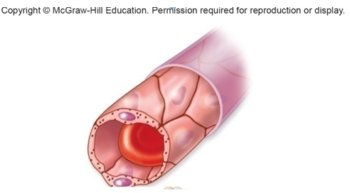
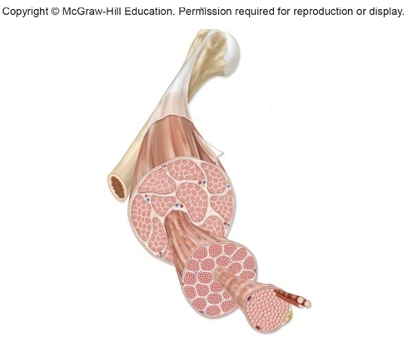
Some Sites of Gene Therapy (1 of 2)
Endothelium
The tile-like endothelium that forms capillaries can be genetically altered to secrete proteins into the circulation
Muscle
Immature muscle cells (myoblasts) given healthy dystro-phin genes may treat muscular dystrophy
Notes:
Copyright © McGraw-Hill Education. Permission required for reproduction or display.

Slide 36
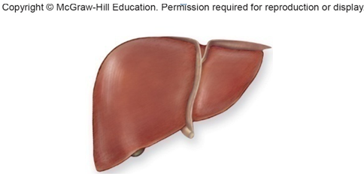
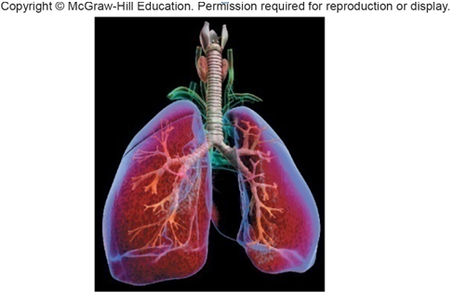
Some Sites of Gene Therapy (2 of 2)
Liver
To treat certain inborn errors of metabolism, only 5 percent of the liver’s 10 trillion cells need to be genetically altered.
Lungs
Gene therapy can reach damaged lungs through an aerosol spray. Enough cells would have to be reached to treat hereditary emphysema(alpha-1-antitrypsin deficiency) or cystic fibrosis

Slide 37
Somatic Gene Therapy Targets
Endothelium—Can secrete needed proteins directly into bloodstream
Muscle—Accessible, comprises ½ body mass and has a good blood supply
Liver—Many functions and can regenerate
Lungs—Are easily accessed with aerosol spray

Slide 38
Gene Therapy: ADA, Adenosine Deaminase Deficiency
Severe combined immune deficiency (SCID) can be caused by ADA deficiency.
Toxins destroy T cells, thereby causing susceptibility to infections and cancer.
Replacement of ADA in individuals genetically deficient was attempted.

Slide 39
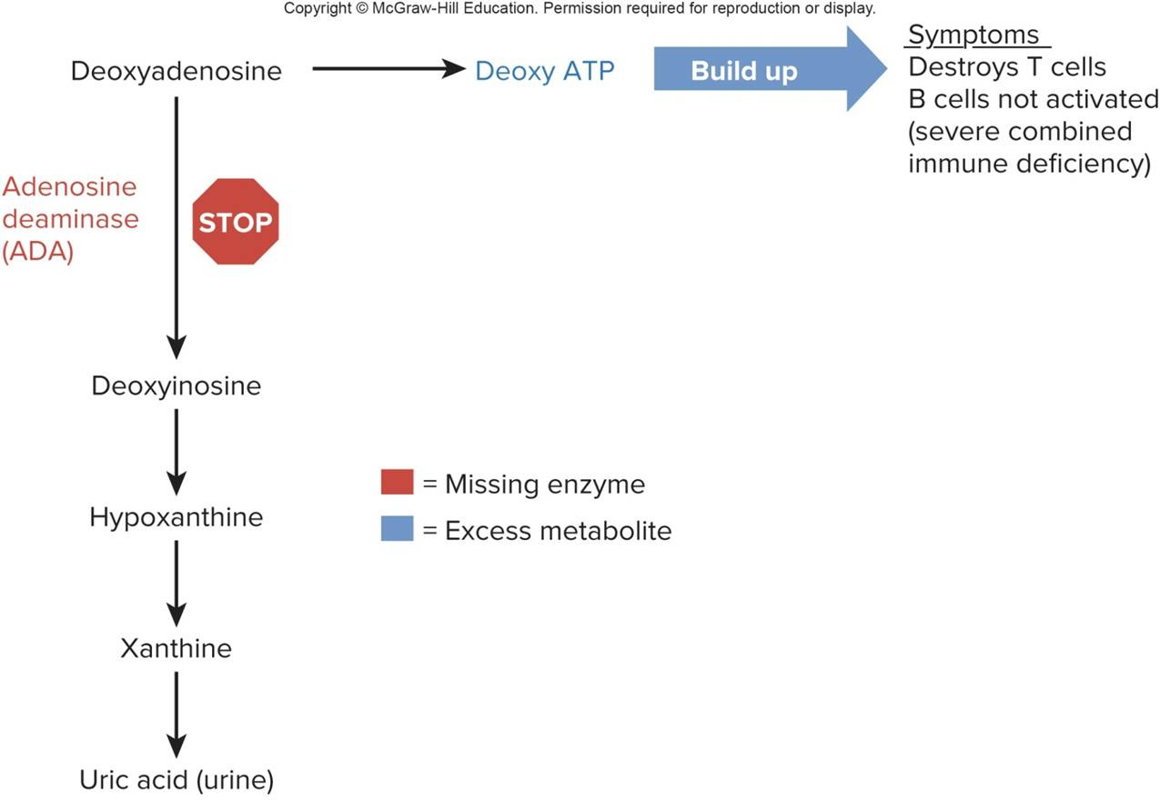
Adenosine Deaminase Deficiency
© Anna powers

Slide 40
Diagnosis and Treatment with CRISPR-Cas9 (1 of 2)
The CRISPR-Cas9 gene editing tool may one day replace gene therapy because it is more precise.
CRISPR-Cas9 not only delivers a gene to a specific part of the genome, it can also replace a gene, remove a gene, or add a gene.
It can act at multiple precise sites in the genome.
CRISPR-Cas9 has had much success in animal models in the evaluation of genetic basis for thoracic aortic aneurysm and dissection.

Slide 41
Diagnosis and Treatment with CRISPR-Cas9 (2 of 2)
Sickle cell disease is also a candidate condition for the CRISPR-Cas9 therapy.
Cancer treatment also is being studied using this therapy.

Slide 42
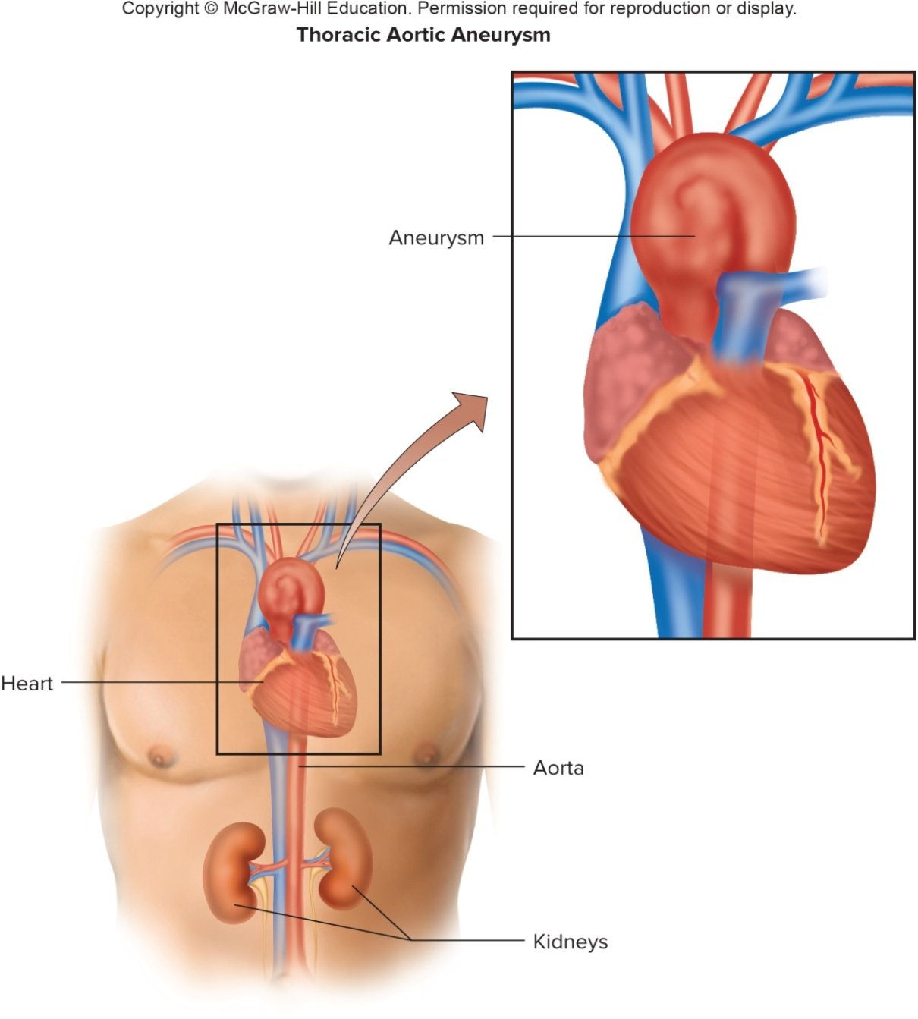
Diagnosis and Treatment of CRISPR-Cas9

Slide 43
End of Presentation

