Slide 1
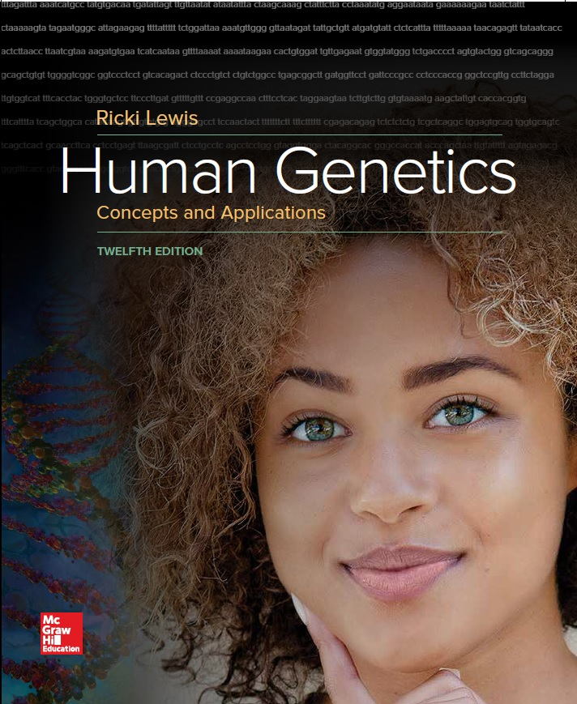
Human Genetics Concepts and Applications
Twelfth Edition
Chapter 18
Cancer Genetics and Genomics
© McGraw-Hill Education. All rights reserved. Authorized only for instructor use in the classroom. No reproduction or further distribution permitted without the prior written consent of McGraw-Hill Education.

Slide 2
Learning Outcomes (1 of 2)
List the characteristics of a cancerous tumor.
Explain how loss of cell cycle control causes cancer.
Explain how most cancers are not inherited, but are genetic.
Describe cancer cells.
Explain how cancers can arise from stem cells.
Distinguish between driver and passenger mutations in cancer.
Discuss how mutations in several genes drive cancer.

Slide 3
Learning Outcomes (2 of 2)
Describe what can happen to chromosomes in cancer cells.
Explain how mutations in oncogenes and tumor suppressor genes cause or increase susceptibility to cancer.
Discuss environmental factors that increase risk of or cause cancer.
Explain how cancer diagnosis and treatment have become more specific and increasingly based on genetics and genomics.

Slide 4
Introduction (1 of 3)
Cancer is an abnormal growth that invades and spreads.
One in three people develop cancer.
Derangement of cell cycle is caused by inherited cancer susceptibility genes, or, from an environmental exposure.
Researchers have sequenced the genomes of tumors to understand genetic changes that cause and accompany a cancer.

Slide 5
Introduction (2 of 3)
Cellular pathways affected by cancer causing gene mutations
Cell fate—Differentiation
Cell survival—Oxygen availability and preventing apoptosis
Genome maintenance—Abilities to survive in the presence of reactive oxygen species and toxins
Specialized cells must follow a schedule of mitosis.
If a cell escapes normal control over its division rate, it forms a growth called a tumor.

Slide 6
Introduction (3 of 3)
A tumor is benign if it does not spread or “invade” surrounding tissue.
A tumor is cancerous or malignant if it infiltrates nearby tissues.
Metastasis
The tumor spreads to other parts of the body via the blood or lymph vessels
Makes a cancer lethal, and is difficult to detect
Carcinogens are substances that cause cancer
Most are mutagens (damage DNA)

Slide 7
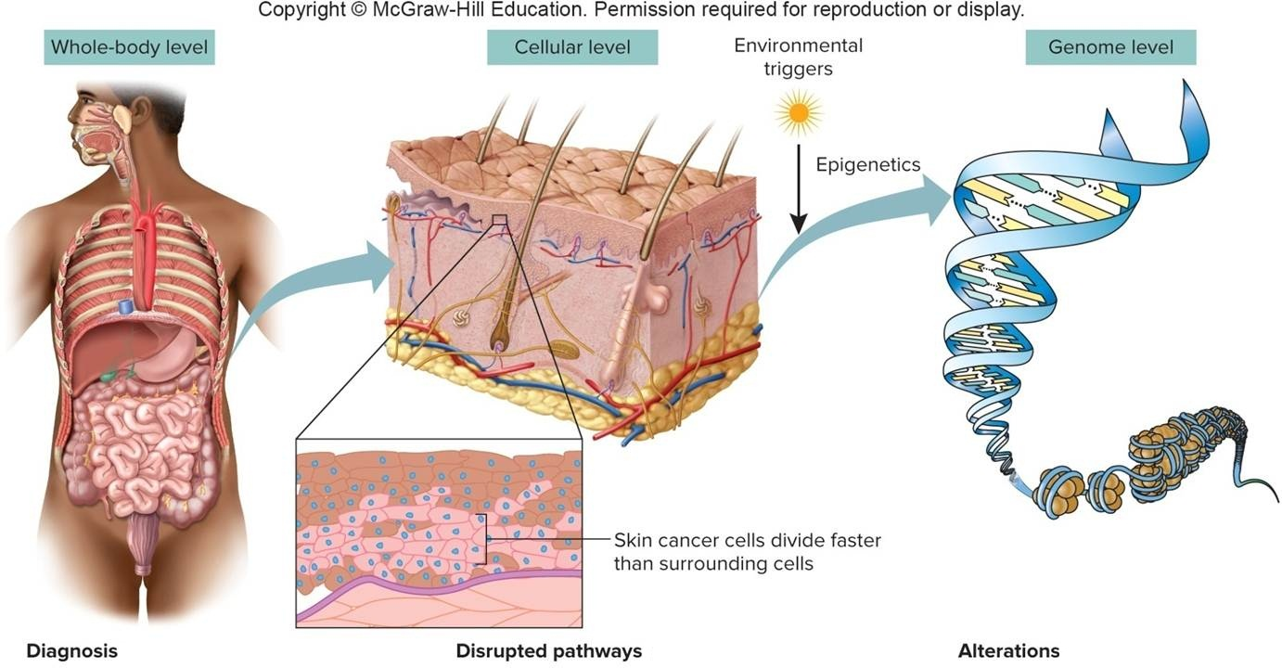
Levels of Cancer (1 of 3)

Slide 8
Levels of Cancer (2 of 3)
Diagnosis
Symptoms
Tests
Biomarkers
Imaging
Mutation detection
Disrupted pathways
Cell fate
Cell survival
Genome maintenance

Slide 9
Levels of Cancer (3 of 3)
Alterations
Point mutations
Copy number variants
Chromosome rearrangements
Aneuploidy
Changes in gene expression

Slide 10
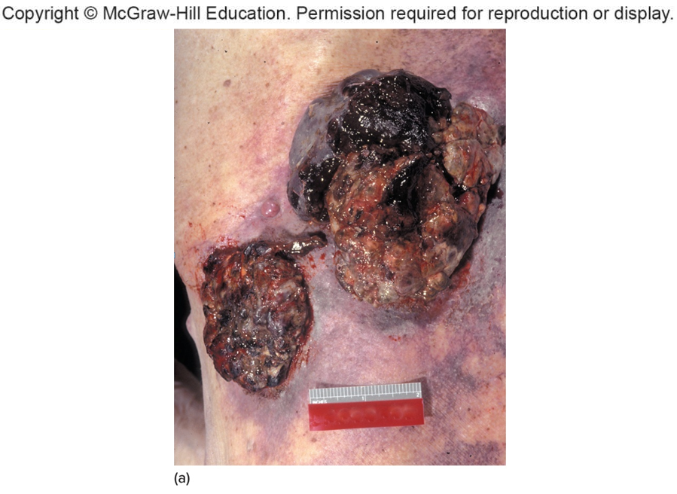
Cancer Cells Stand Out (1 of 2)
a: © McGraw-Hill Higher Education

Slide 11
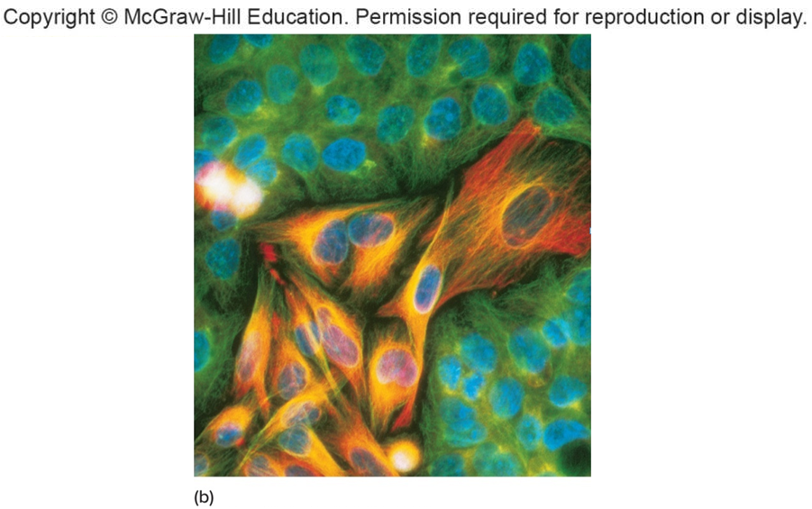
Cancer Cells Stand Out (2 of 2)
b: © Nancy Kedersha/Science Source

Slide 12
Cancer-Causing Genes
Oncogenes
More than 100
Cause cancer if inappropriately activated
Tumor suppressor genes
More than 30
Deletion or inactivation causes cancer
Function—Cell cycle control/checkpoints
Mismatch mutations in DNA repair genes
Allow other mutations to persist

Slide 13
Loss of Cell Cycle Control (1 of 2)
Many types of cancer result from faulty checkpoints
Timing, rate, and number of cell divisions depend on:
Protein growth factors
Signaling molecules from outside the cell
Transcription factors within

Slide 14
Loss of Cell Cycle Control (2 of 2)
Checkpoints control the cell cycle.
A mutation in a gene that halts or slows the cell cycle can lift the constraint, leading to inappropriate mitosis.
Failure to pause in order to repair DNA can allow a mutation in an oncogene or tumor suppressor gene to persist.

Slide 15
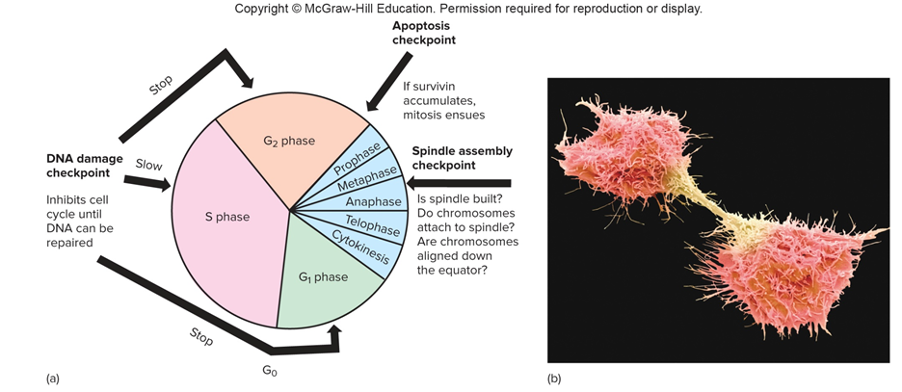
Cell Cycle Control
b: © Steve Gschmeissner/SPL/Getty Images

Slide 16
Cancer Sends a Cell Down a Pathway of Unrestricted Cell Division

Slide 17
Telomeres and Telomerase
Loss of control of telomere length may also contribute to cancer.
Telomeres or chromosome tips, protect chromosomes from breaking.
Gametes keep telomeres long using telomerase.
Normal, specialized cells have telomerase turned off, limits cell division.
Cancer cells turns telomerase back on.
Telomeres extend, and releases the brake on rapid cell division.

Slide 18
Inherited vs. Sporadic Cancer (1 of 2)
Cancer is genetic, and not usually inherited
Germline mutations
Cancer susceptibility passed on to offspring
Mutation is present in every cell of the individual
Cancer develops when second somatic mutation occurs
Rare, tend to strike earlier in life than sporadic cancers

Slide 19
Inherited vs. Sporadic Cancer (2 of 2)
Somatic mutations
Occur sporadically in non-sex cells
Result from a single dominant mutation or two recessive mutations in the same gene
Cancer susceptibility not passed on to offspring

Slide 20
Germline versus Sporadic Cancer

Slide 21
Origin of Cancer
Cancer begins at the genetic and cellular levels.
If not halted, cancer spreads through tissues to take over organs and organ systems.

Slide 22
Characteristics of Cancer Cells (1 of 2)
Looks different from a normal cell
Cell surface has different types and/or number of antigen
Contain heritable mutations
Transplantable
Dedifferentiated: Less specialized than normal cell types
Unusual cell growth

Slide 23
Characteristics of Cancer Cells (2 of 2)
Lack contact inhibition
Invasive: Squeeze into any space available
Metastasize: Move to new location in body
Induce angiogenesis: Formation of new capillary extensions
Secrete hormones that encourage their own growth
Aneuploid—Miss or have extra chromosomes

Slide 24
Table 18.1 Characteristics of Cancer Cells
Oilier, less adherent
Loss of cell cycle control
Heritable
Transplantable
Dedifferentiated
Lack contact inhibition
Induce local blood vessel formation (angiogenesis)
Invasive
Increased mutation rate
Can spread (metastasize)
Notes:
Copyright © McGraw-Hill Education. Permission required for reproduction or display.

Slide 25
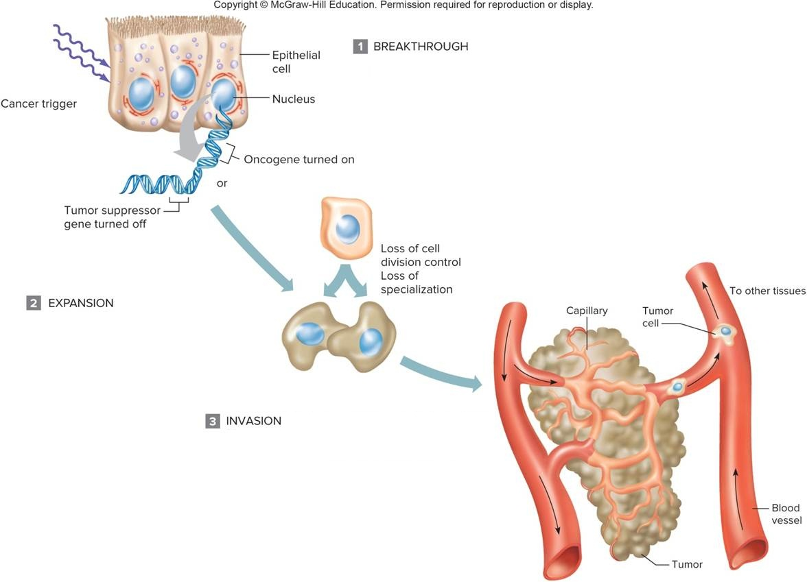
Steps in the Development of Cancer (1 of 2)

Slide 26
Steps in the Development of Cancer (2 of 2)
Breakthrough: First driver mutation Cancer begins in a single cell when an oncogene is turned on or a tumor suppressor gene is turned off, lifting controls on cell division
Cancer Trigger: Inherited mutation or environmental insult that causes mutation
Expansion: Second driver mutation Cancer cells divide more frequently and can survive in an environment with scarce nutrients, oxygen, and growth factors
Invasion: Further mutations in multiple pathways The cancerous tumor grows and spreads locally and then attracts blood vessels and enters the bloodstream

Slide 27
Origins of Cancer Cells (1 of 2)
Cancer can begin at the cellular level in at least four ways:
Activation of stem cells that produce cancer cells
Dedifferentiation
Increase in proportion of a tissue that consists of stem cells or progenitor cells
Faulty tissue repair

Slide 28
Origins of Cancer Cells (2 of 2)
A cancer cell may descend from:
A stem cell that yields slightly differentiated daughter cells that retain the capacity to self-renew
A specialized cell that loses some of its features and can divide
Cancer stem cells produce both cancer cells and abnormal specialized cells
Found in brain, blood, and epithelium cancers

Slide 29
Cancer Stem Cells

Slide 30
Cancer by Loss of Specialization
Specialized cells lose some of their distinguishing features as mutations occur when they divide.
Cells may begin to express “stemness” genes that override signals to remain specialized.

Slide 31
Dedifferentiation Reverses Specialization
Adapted from "Neurobiology: At the root of brain cancer," Michael F. Clarke, Nature 432:281-282. Macmillan Publishers Ltd, November 18, 2004

Slide 32
Cancers from Shifting Balance of Cell Types in a Tissue (1 of 2)
Loss of balance at the tissue level can occur in favor of cells that can divide continually or frequently.
When a mutation shifts the balance to create more stem and progenitor cells, the extra cells pile up, and a tumor forms.

Slide 33
Cancers from Shifting Balance of Cell Types in a Tissue (2 of 2)

Slide 34
Uncontrolled Tissue Repair May Cause Cancer

Slide 35
Driver and Passenger Mutations
Driver mutation provides the selective growth advantage to a cell that defines the cancerous state
Oncogenes or tumor suppressor genes which can be generated from abnormal chromosomes
Passenger mutation occurs in a cancer cell
Does not cause or propel the cancer’s growth or spread
Occurs in cancerous and noncancerous cells

Slide 36
Driver Mutations
Cumulative effect
“Gatekeeper” enables a normal epithelial to divide slightly faster than others
Clone of faster-dividing cells gradually accumulates
Second mutation boosts the division rate
Driver mutations can be identified by:
Comparing mutations in tumor cells from people at different stages of the same cancer
Studying cancer cells of patients who respond to a drug and then relapse

Slide 37
Evolution of a Cancer (1 of 2)

Slide 38
Evolution of a Cancer (2 of 2)

Slide 39
Oncogenes
Proto-oncogenes are genes that promote cell division
Expression at the wrong time of development or place in the body leads them to function as oncogenes
Activation is associated with:
Point mutation
Chromosomal translocation
Inversion
Activation causes a gain-of-function

Slide 40
Oncogenes: Overexpression of a Normal Function (1 of 4)
Viruses integrated next to a proto-oncogene can cause rapid transcription when the virus is transcribed.
Increased production of oncogene encoded protein switches on genes that promote mitosis, triggers changes.
Proto-oncogene may be activated when it is moved next to an actively transcribed gene.
Gland synthesizes the hormone, oncogene is expressed.

Slide 41
Oncogenes: Overexpression of a Normal Function (2 of 4)
Examples: Cervical cancer and anal cancer following HPV infection, and Burkitt lymphoma
Translocation or inversion places a proto-oncogene next to an antibody gene

Slide 42
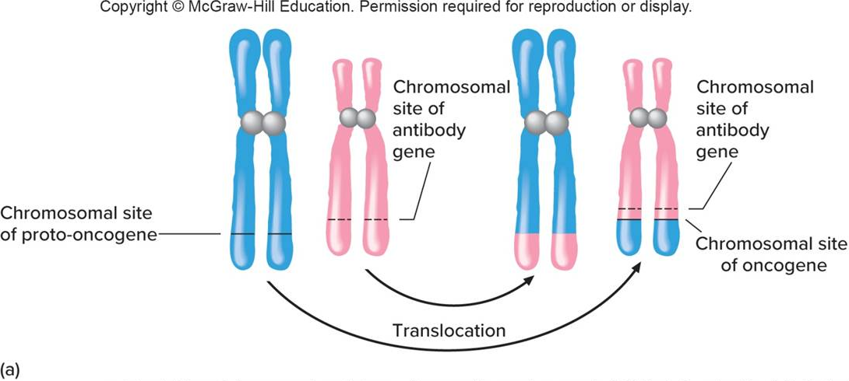
Oncogenes: Overexpression of a Normal Function (3 of 4)
a: Adapted from "Tissue repair and stem cell renewal in carcinogenesis," Philip A. Beachy, Sunil S. Karhadkar, and David M. Berman, Nature 432:324-331. Macmillan Publishers Ltd, 2004

Slide 43
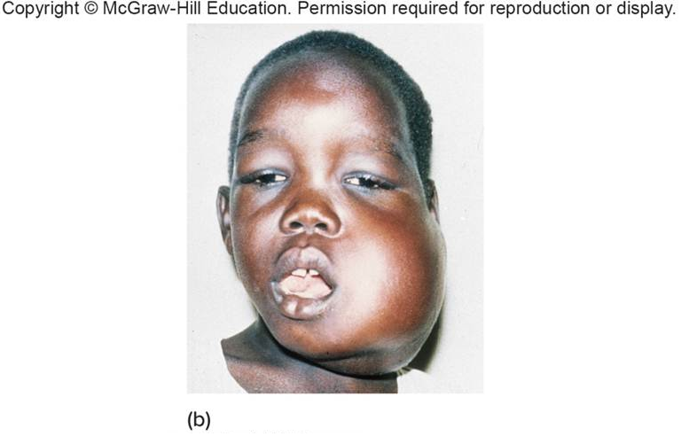
Oncogenes: Overexpression of a Normal Function (4 of 4)
b: Source: Centers for Disease Control and Prevention

Slide 44
Fusion Proteins
Oncogenes are activated when a proto-oncogene moves next to another gene.
The gene pair is transcribed together.
The double gene product is a fusion protein.
It activates or lifts control of cell division.

Slide 45
Chronic Myelogenous Leukemia (CML)
Most patients have a translocated Philadelphia chromosome (tip of 9 on 22).
Abl (chromosome 9) and bcr (chromosome 22) genes produce a fusion protein.
BCR-ABL oncoprotein is a tyrosine kinase that excessively stimulates cell division.
Understanding cellular changes allowed development of new drug, Gleevec, for treatment.

Slide 46
HER2
Product of an oncogene
Excessive levels in approximately 25% of breast cancer patients
Receptors of epidermal growth factor
Tyrosine kinase receptors send too many signals to divide
Monoclonal antibody drug, Herceptin, binds to receptors, blocking signal to divide

Slide 47
Tumor Suppressor Genes
Cancer can be caused by loss or silencing of a tumor suppressor gene
Inhibits expression of genes involved in all of the activities that turn a cell cancerous
Example—Wilm’s tumor
Gene that halts mitosis in the rapidly developing kidney tubules in the fetus is absent

Slide 48
Retinoblastoma (RB) (1 of 3)
A rare childhood eye tumor
Inherited retinoblastoma requires two point mutations or deletions
Germline and somatic
In sporadic cases, two somatic mutations occur, one on each copy of chromosome 13

Slide 49
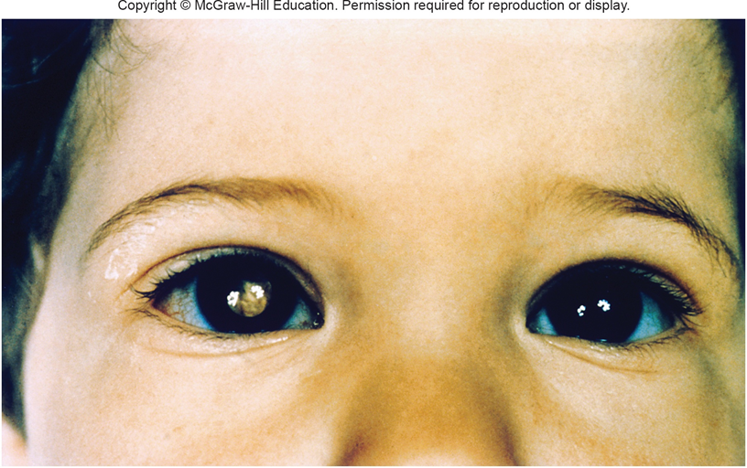
Retinoblastoma (RB) (2 of 3)
© Science Source

Slide 50
Retinoblastoma (RB) (3 of 3)
Study of RB was the origin of the “two-hit” hypothesis of cancer causation.
Two mutations or deletions are required.
One in each copy of the RB gene
The RB protein binds transcription factors so that they cannot activate genes that carry out mitosis.
Normally halts the cell cycle at G₁

Slide 51
p53
Determines if a cell repairs DNA replication errors or dies by apoptosis
More than 50% of human cancers involve an abnormal p53 gene
Mutations occur only in somatic cells
Li-Fraumeni syndrome
Family members have a very high risk of developing cancer

Slide 52
p53 Cancers Reflect Environmental Insults

Slide 53
Breast Cancer
Two main forms:
Familial form: A germline mutation is inherited and then a somatic mutation occurs in a breast cell
Sporadic form: Two somatic mutations affect the same cell
Mutations in many genes can cause cancer

Slide 54
BRCA
The two major breast-cancer susceptibility genes are BRCA1 and BRCA2.
BRCA1 encodes a protein that interacts with other proteins that counter DNA damage.
BRCA2 mutation increases the risk of developing colon, kidney, prostate, pancreas, gallbladder, skin, or stomach cancer.
Mutations in these genes have different incidences in different populations.

Slide 55
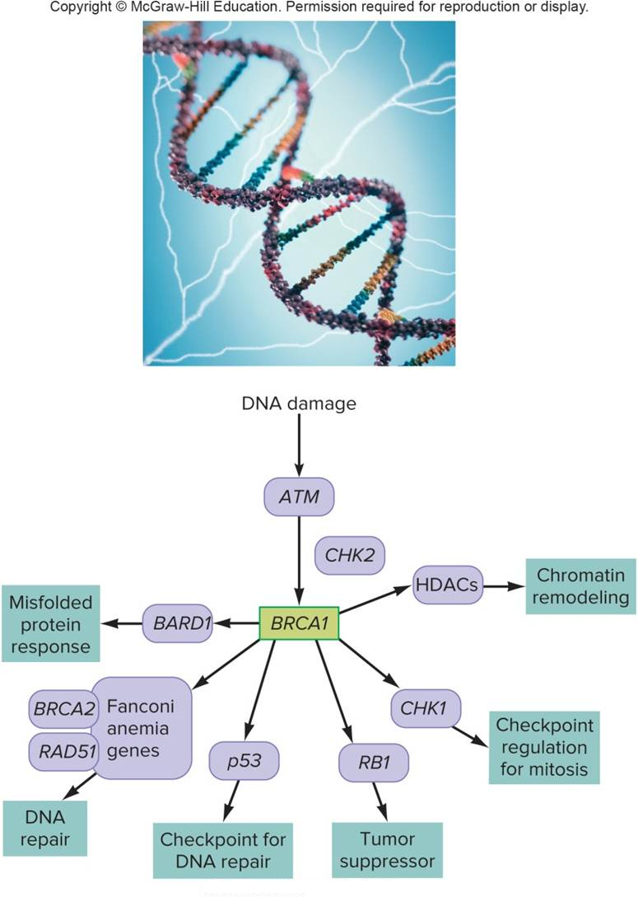
BRCA1 Controls Cellular Defense Mechanisms
© Comstock Images/Jupiter Images

Slide 56
Environmental Causes of Cancer
Environmental factors contribute to cancer by mutating or altering the expression of genes that control the cell cycle, apoptosis, and DNA repair.
Inheriting a susceptibility gene places a person farther along the road to cancer.
However, cancer can happen in somatic cells in anyone.
Interactions between genes and the environment exist.
Environmental factors contribute to cancer by mutating genes and altering gene expression.

Slide 57
Challenges of Diagnosing and Treating Cancer (1 of 3)
Oldest treatment is surgery, which removes the tumor.
Radiation and chemotherapy nonselectively destroy rapidly dividing cells.
Newer approaches are targeted based on genetic information.
Highly effective if matched to a sensitive tumor type

Slide 58
Challenges of Diagnosing and Treating Cancer (2 of 3)
Ability to sequence cancer exomes and genomes is providing a new specificity for diagnosing and treating cancer.
Cell-free tumor DNA (ctDNA) can reveal response to a treatment
Liquid biopsy—A less invasive method to monitor a cancer’s spread
Genetic information helps physicians choose appropriate drugs by stratifying patients.

Slide 59
Challenges of Diagnosing and Treating Cancer (3 of 3)
Detecting gene expression patterns can inform treatment choices.
Continuing analysis of cancer cell genomes and annotation of the human genome informs the effect of a malignant cell.

Slide 60
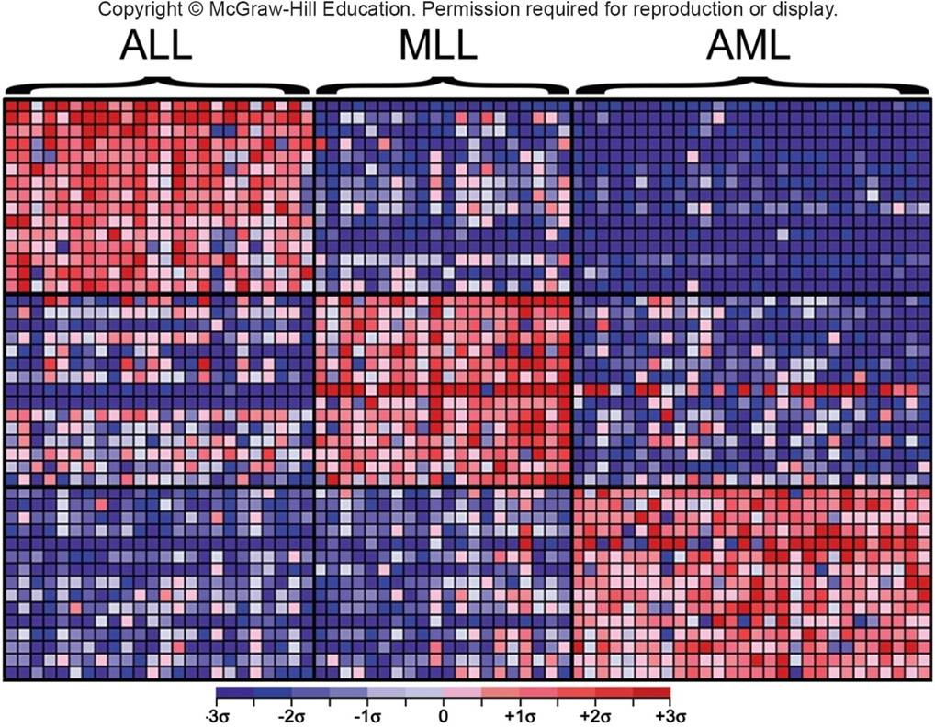
Cancer Cells That Look Alike May Be Genetically Distinct
σ=standard deviation from mean

Slide 61
Chimeric Antigen Receptors (1 of 2)
A chimeric antigen receptor, or CAR, is part T cell receptor and part antibody.
The T cell receptor part is engineered to guide the T cell to a specific target, such as cancer cells.
The antibody part then binds to the target, altering the immune system to respond and kill the cancer cells.

Slide 62
Chimeric Antigen Receptors (2 of 2)
The technology has been successfully used.
The T cells are the individuals own T cells, that have been modified.
A newer approach, termed universal chimeric antigen receptors (UCAR), uses T cells from donors.
The ability to use donated cells means that more people will be able to be treated.

Slide 63
Liquid Biopsy (1 of 2)
A liquid biopsy is the process of checking DNA pieces in the blood plasma for oncogen or tumor suppressor mutations.
The DNA detected is cell-free tumor DNA (ctDNA).
This DNA can also be checked in the urine (bladder cancer), sputum (lung cancer), and feces (colorectal cancer).

Slide 64
Liquid Biopsy (2 of 2)
The advantages are:
Asymptomatic tumors can be detected early
Better specificity than protein biomarkers
Monitor for tumor recurrence after treatment
Monitor effectiveness of tumor treatment
One disadvantage is false positive findings

Slide 65
Circulating Tumor DNA in the Human Vein

Slide 66
End of Presentation

