Slide 1
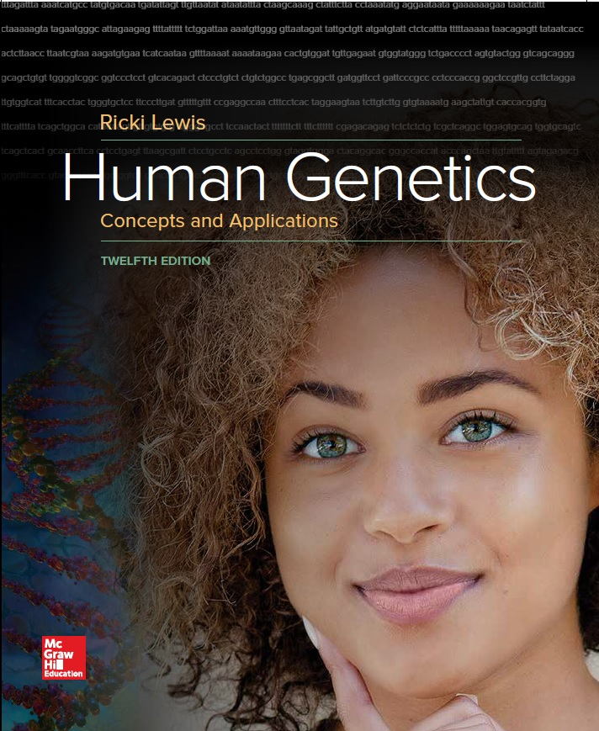
Human Genetics Concepts and Applications
Twelfth Edition
Chapter 17
Genetics of Immunity
© McGraw-Hill Education. All rights reserved. Authorized only for instructor use in the classroom. No reproduction or further distribution permitted without the prior written consent of McGraw-Hill Education.

Slide 2
Learning Outcomes (1 of 2)
List the components of the immune system.
Describe the basis of blood groups.
Explain what human leukocyte antigens are what they indicate about health.
Distinguish among physical barriers, innate immunity, and adaptive immunity.
Distinguish between the humoral and cellular immune responses.

Slide 3
Learning Outcomes (2 of 2)
Discuss conditions that result when the immune system is underactive, overactive, and misdirected.
Describe how medical technologies boost or suppress immunity to prevent or treat disease.
Explain the requirements for the body to accept an organ from another person.
Discuss how we can use knowledge of the genome sequences of pathogens.

Slide 4
Foreign versus Self (1 of 2)
Immune system protects organisms from foreign invaders.
Protection from pathogens is based upon the ability to identify foreign molecules as nonself.
Foreign may be bacteria, viruses, fungi, tumor, or transplanted cells.
Antigens: Molecules recognized by the immune system.
Usually protein fragments or carbohydrates

Slide 5
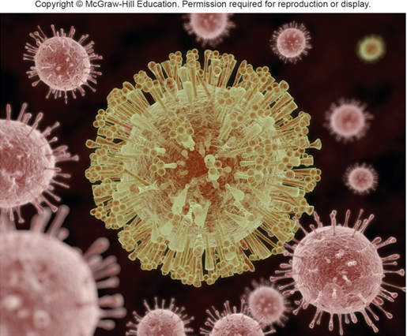
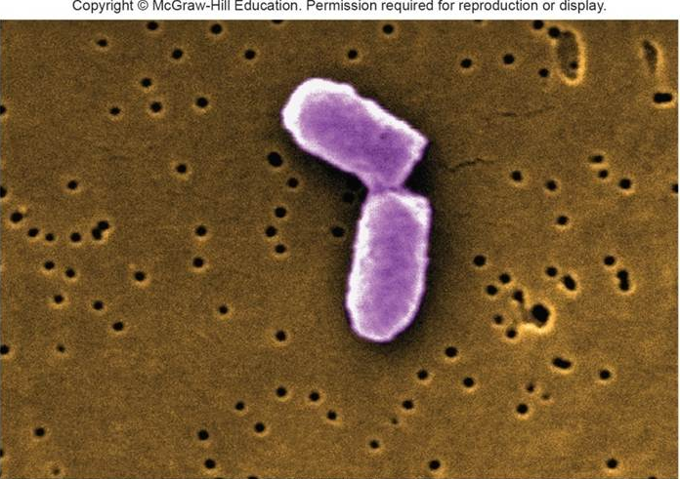
Foreign versus Self (2 of 2)
Source: CDC/Janice Haney Carr
© AuntSpray/Shutterstock

Slide 6
Genetic Control of Immunity (1 of 2)
Genes affect immunity by conferring susceptibility or resistance to infection.
Few types of single genes encode antibodies and cytokines that directly attack foreign antigens.
Genes also specify the cell surface antigens that mark the body’s cells as self.

Slide 7
Genetic Control of Immunity (2 of 2)
Understanding makes it possible to enhance or redirect the system’s ability to fight disease
Mutations can impair immunity causing:
Immune deficiencies
Auto immune disorders
Allergies
Cancer

Slide 8
Blood Groups
Antigens that dot our cell surfaces determine blood types.
We have 29 major blood types.
For more than a century, serology typed blood according to the RBC antigens.
Newer way to type blood is to identify the instructions (i.e., genes) for these antigens,
Uses a device that detects distinct DNA signatures

Slide 9
Table 17.1 Blood Groups
Blood Group | Description
MN | Codominant alleles M, N, and S determine six genotypes and phenotypes. The antigens bind two glycoproteins
Lewis | Allele Le encodes fucosyltransferase (FUT3), which adds an antigen to the sugar fucose, which the product of the H gene places on red blood cells. H gene expression is necessary for the ABO phenotype (see figure 5.3). People with LeLe or Lele have the Lewis antigen on red blood cells and in saliva. People of genotype lele do not.
Secretor | People with the Se allele secrete A, B, and H antigens into the body fluids
Notes:
Copyright © McGraw-Hill Education. Permission required for reproduction or display

Slide 10
Major Histocompatibility Complex
Found on short arm of chromosome 6
Includes about 70 genes
Code for cell protein surface features
Classified into three functional groups:
Class III genes encode plasma proteins that carry out nonspecific immune functions
Class I and II genes encode human leukocyte antigens (HLA)

Slide 11
Human Leukocyte Antigens (HLA)
Link sugars to form branched glycoproteins that extend from cell surfaces
HLA glycoproteins can recognize bacterial and viral proteins, marking them for immune system to target
Process called antigen processing
Class I are found on all cell types
Class II are found on antigen-presenting cells

Slide 12
Antigen-Presenting Cells (1 of 3)
Cells that bind antigens with HLA glycoproteins
Types:
Macrophages
T cells (or T Lymphocytes)

Slide 13
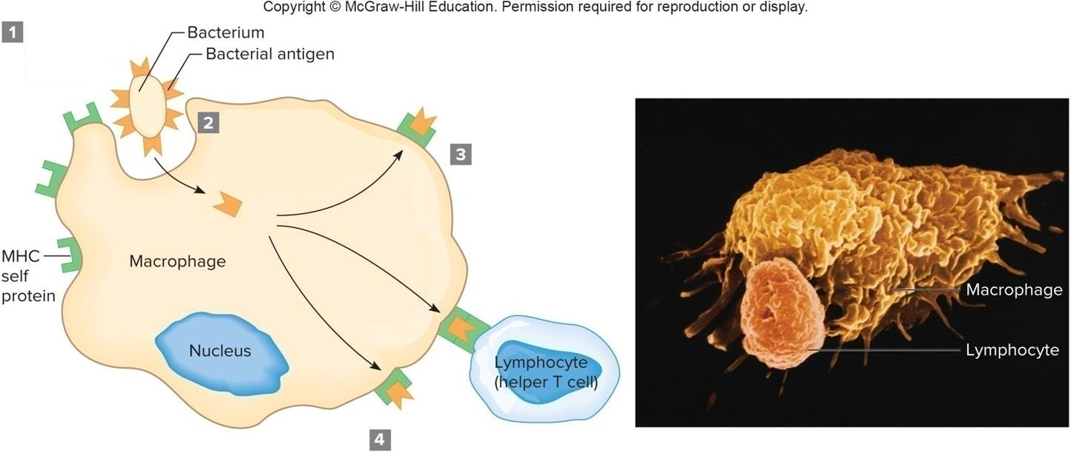
Antigen-Presenting Cells (2 of 3)

Slide 14
Antigen-Presenting Cells (3 of 3)
Phagocytosis of the microbial invader.
Antigens from the dismantled invader are attached to MHC self proteins.
MHC proteins and their attached antigens are displayed on macrophage surface.
Helper T cells recognize antigens and MHC proteins and bind to the macrophage, initiating a series of immune events.

Slide 15
HLA Diversity
Genes with multiple alleles determine an HLA type.
Genetic diversity at HLA genes is large.
One in 10,000 unrelated people will share an HLA type by chance at the six major HLA genes.
Matching at least four major HLA genes is needed for most transplants to succeed.
HLA genes account for about 50% of the genetic impact on immunity.

Slide 16
Human Immune System
Network of vessels called lymphatics and bean-shaped structures called lymph nodes
Lymph is the fluid filling the lymph ducts
Carries macrophages and B and T lymphocytes
Organs involved in production or maturation of immune cells
Spleen and thymus
Bone marrow

Slide 17
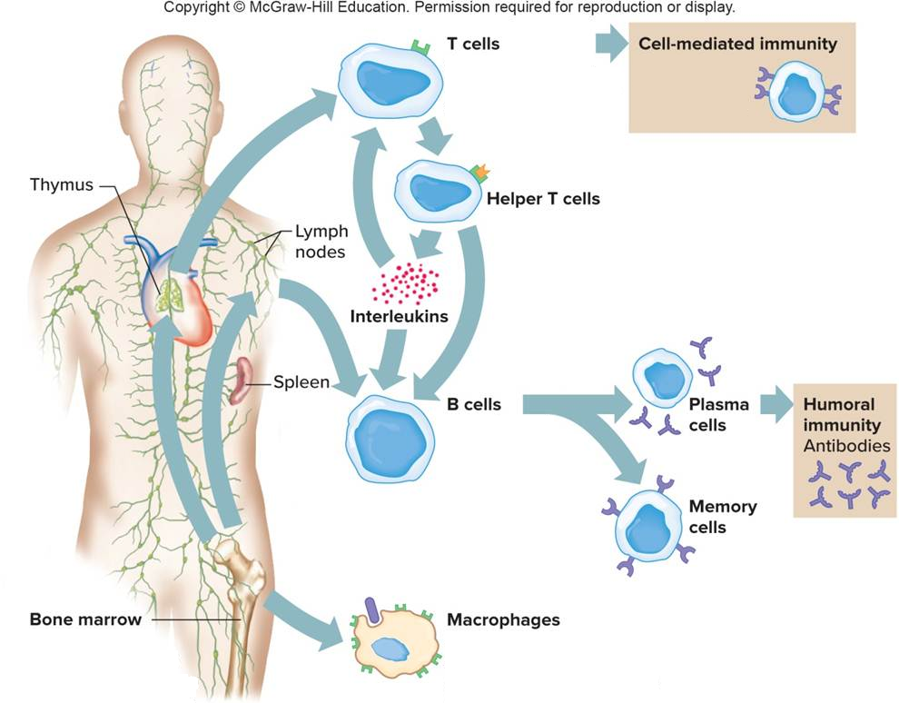
The Immune System Produces Diverse Cells (1 of 3)

Slide 18
The Immune System Produces Diverse Cells (2 of 3)
T cells mature in the thymus gland, in the small intestine, and the skin.
Cell mediated community
Cytotoxic T
Cells attack
Cells directly
B cells are released from the lymphoid tissues, such as the spleen and lymph nodes, and secrete antibodies.

Slide 19
The Immune System Produces Diverse Cells (3 of 3)
Macrophages
Engulf bacteria and stimulate helper T cells to proliferate and activate B cells.
Bone Marrow
T cells, B cells, and macrophages originate in the bone marrow and migrate in the blood.

Slide 20
Immunity
Immune response attacks pathogens, cancer cells, and transplanted cells with two lines of defense:
Innate immunity is immediate and generalized
Adaptive immunity is specific and slower
Act after various physical barriers block pathogens

Slide 21
Physical Barriers
First line of defense
Examples:
Unbroken skin
Mucous membranes and secretions
Waving cilia of the respiratory tract
Flushing effect of tears, saliva, urination, and diarrhea
All are nonspecific defenses

Slide 22
Innate Immune Response (1 of 3)
General defenses found in the body
Produces a rapid broad response if pathogen breaches physical barriers
Response time is in minutes
Central part is inflammation
Process that creates a hostile environment for pathogens
Sends in phagocytes that engulf and destroy pathogens via phagocytosis

Slide 23
Innate Immune Response (2 of 3)
Collectins: Protect against bacteria, yeasts, and some viruses
Cytokines
Interferon—Antiviral
Interleukins—Fever-inducing
Tumor necrosis factor α—Anticancer
Cytokines also play a role in adaptive immunity

Slide 24
Innate Immune Response (3 of 3)
Complement
Plasma proteins that assist or complement other defense responses
Roles of complement proteins:
Puncture bacterial cells
Dismantle viruses
Trigger histamine release to dilate blood vessels
Attract phagocytes

Slide 25
Levels of Immune Protection

Slide 26
Adaptive Immunity (1 of 2)
Requires stimulation
Response time is in days
Basic characteristics:
Diversity—Many different pathogens recognized
Specificity—Distinguishes particular molecules
Memory: Responds faster with subsequent exposure
Primary immune response: Reaction to first exposure
Secondary immune response: Reaction to exposure using “memory” of first response

Slide 27
Adaptive Immunity (2 of 2)
Types of response:
Humoral immune response—B cells produce antibodies in response to activation by T cells.
Cellular immune response—T cells produce cytokines and activate other cells.

Slide 28
Humoral Immune Response
Antigen-presenting macrophage activates a helper T cell.
Helper T cell activates a B cell with matching cell surface receptors.
B cells divide to produce plasma cells and memory cells.
Plasma cells secrete antibodies into blood that will recognize the antigen presented.
Memory cells remain dormant until second exposure when they respond faster and more effectively.

Slide 29
Production of Antibodies

Slide 30
Humoral Immune Response is Polyclonal
Different antibody proteins recognize and bind to different features of foreign cells.

Slide 31
Antibody Structure (1 of 3)
Minimally consist of four polypeptide chains:
Two long (heavy) chains
Two shorter (light) chains
Constant region of each chain is similar
Variable region of each chain is diverse
Antigen binding sites: Where antigen binds
Idiotypes: Sites in direct contact with antigen
Epitope: Portion of the antigen contacting the antibody

Slide 32
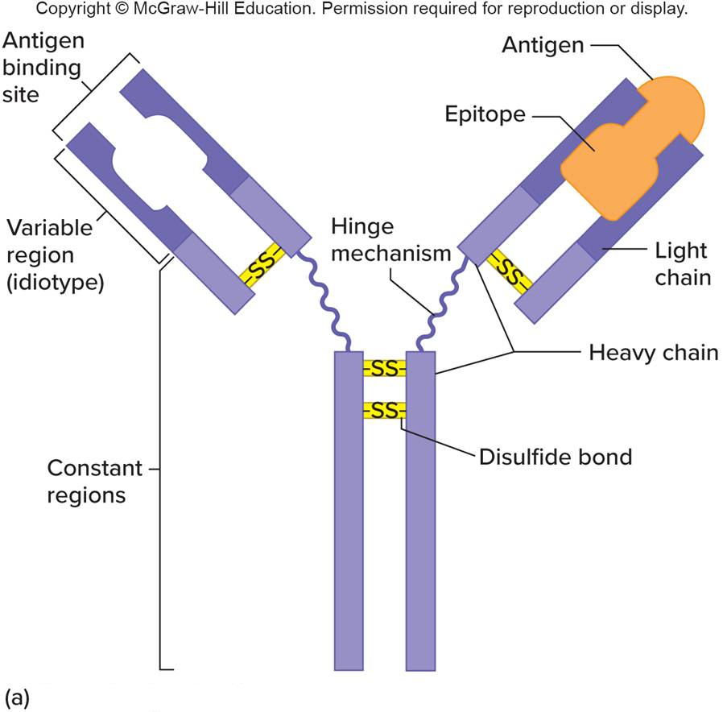
Antibody Structure (2 of 3)
An antibody unit

Slide 33
Antibody Structure (3 of 3)

Slide 34
Function of Antibodies
Bind pathogen protein or toxin and inactivates or neutralizes them
Clump pathogens making them more visible for macrophages
Activate the complement system boosting the innate immune response
Antibody response can sometimes be harmful

Slide 35
Types of Antibodies (1 of 2)
Also called immunoglobulins
Five major types distinguished by location and function
Different antibody types predominate in different stages of an infection

Slide 36
Table 17.3 Types of Antibodies (2 of 2)
Type* | Location | Functions
IgA | Milk, saliva, urine, and tears; respiratory and digestive secretions | Protects against pathogens at points of entry into body
IgD | On B cells in blood | Stimulates B cells to make other types of antibodies, particularly in infants
IgE | In secretions with IgA and in mast cells in tissues | Acts as receptor for antigens that cause mast cells to secrete allergy mediators
IgG | Blood plasma and tissue fluid; passes to fetus | Protects against bacteria, viruses, and toxins, especially in secondary immune response
IgM | Blood plasma | Fights bacteria in primary immune response; includes anti-A and anti-B antibodies of ABO blood groups
The letters A, D, E, G, and M refer to the specific conformation of heavy chains characteristic of each class of antibody.
Notes:
Copyright © McGraw-Hill Education. Permission required for reproduction or display.

Slide 37
Creation of Antibody Diversity
Genome has a limited number of antibody genes
Human body can shuffle these in many different ways to make a seemingly limitless variety of antibodies
Early development of B cells
Sections of the antibody genes are rearranged along their chromosome
Rearrangement due to enzymes cutting and pasting
Different combinations of V (Variable), D (Diversity), and J (Joining) genes creates new versions of the antibody proteins

Slide 38
Antibody Diversity

Slide 39
Cellular Immune Response Maturation of T Cells
T cells must recognize foreign antigens and not self antigens.
Thymocytes travel to the thymus and display their cell surface receptors.
Thymus lining displays self antigens.
T cells that bind these self antigens die by apoptosis.
T cells that do not bind the self antigens survive and mature.

Slide 40
Types of T Cells
Several types of T cells are distinguished by the types and patterns of receptors on their surface and by their function:
Helper T cells
Have CD4 antigens
Cytotoxic T cells
Have CD8 antigens
Regulatory T cells

Slide 41
Role of Helper T Cells
In humoral immune response
Recognize antigens presented by macrophages
Stimulate B cells to produce antibodies
In cellular immune response
Secrete cytokines
Activate cytotoxic T cell

Slide 42
Table 17.2 Types of Proteins in Innate Immunity
Protein Class | Protein | Function
Complement |  | Puncture bacteria, dismantle viruses, activate mast cells to release histamine, attract phagocytes
Collectins |  | Recognize how surfaces of bacteria, yeasts, and some viruses differ from the surfaces of human cells
Cytokines | Colony-stimulating factors | Stimulate bone marrow cells to produce lymphocytes
 | Interferons | Block viral replication, stimulate macrophages to engulf viruses, stimulate B cells to produce antibodies, attack cancer cells
 | Interleukins | Control lymphocyte differentiation and growth, cause fever that accompanies bacterial infection
 | Tumor necrosis factor | Stops tumor growth, releases growth factors, stimulates lymphocyte differentiation, dismantles bacterial toxins
Notes:
Copyright © McGraw-Hill Education. Permission required for reproduction or display.

Slide 43
Death of a Cancer Cell by a Cytotoxic T Cell

Slide 44
Table 17.4 Types of Immune System Cells
Cell Type | Function
Macrophage | Presents antigens
 | Performs phagocytosis
Dendritic cell | Presents antigens
Mast cell | Releases histamine in inflammation
 | Releases allergy mediators
B cell | Matures into antibody- producing plasma cell or into memory cell
T cell
Helper | Recognizing nonself antigens presented on macrophages
 | Stimulates B cells to produce antibodies
 | Secretes cytokines
 | Activates cytotoxic T cells
Cytotoxic | Attacks cancer cells and cells infected with viruses upon recognizing antigens
Neutrophil | Attacks bacteria
Natural killer | Attacks cancer cells and cells infected with viruses without recognizing antigens; activates other white blood cells
Suppressor | Inhibits antibody protection
Notes:
Copyright © McGraw-Hill Education. Permission required for reproduction or display.

Slide 45
Abnormal Immunity
Immune system malfunction may be inherited or acquired
May be too weak, too strong, or misdirected
Responses may be multifactorial or caused by a mutation in a single gene

Slide 46
Inherited Immune Deficiencies (1 of 2)
At least 20 types
Affect innate and adaptive immunity
Examples:
Chronic granulomatous disease: Mutation of oxidase enzyme results in neutrophils that cannot kill bacteria
Severe combined immune deficiency (SCID): Impacts both humoral and cellular immunity due to lack of mature B cells and/or T cells

Slide 47
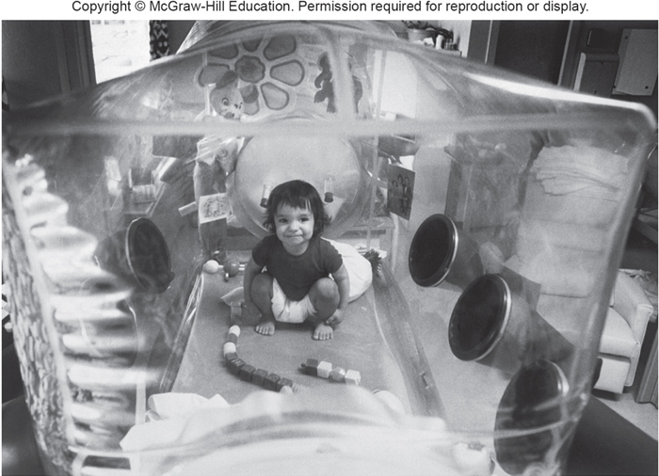
Inherited Immune Deficiencies (2 of 2)
David Vetter had an autosomal recessive form of SCID.
He was born without a thymus gland.
His T cells could not mature and activate B cells.
© Bettmann/Corbis

Slide 48
Table 17.5 Inherited Immune Deficiencies
Disease | Inheritance | Defect
Chronic granulomatous disease | ar, AD, Xlr | Abnormal neutrophilis cannot kill engulfed bacteria
Immune defect due to absence of thymus | ar | No thymus, no T cells
Neutrophil immunodeficiency syndrome | ar | Deficiency of T cells, B cells and neutrophilis
Severe combined immune deficiency (SCID)
Adenosine deaminase deficiency | ar | No T or B cells
Adenosine deaminase deficiency with sensitivity to ionizing radiation | ar | No T, B or natural killer cells
IL-2 receptor mutation | Xlr | No T, B or natural killer cells
X- linked lymphoproliferative disease | Xlr | Absence of protein that enables T cells to bind B cells
X1 | Xlr | Abnormal interleukin- 2
Note: ar = autosomal recessive; AD = autosomal dominant; Xlr = X-linked recessive.
Notes:
Copyright © McGraw-Hill Education. Permission required for reproduction or display.

Slide 49
Human Immunodeficiency Virus (HIV)
Infectious virus enters the body with direct contact of bodily fluids
Infects macrophages and helper T cells
Virus replicates and bursts out of the helper T cell, killing it
Loss of helper T cells prevents B cell activation
Infections occur because the immune system not functional
Replicates rapidly, mutates easily, and can hide

Slide 50
HIV Binds to a Helper T Cell

Slide 51
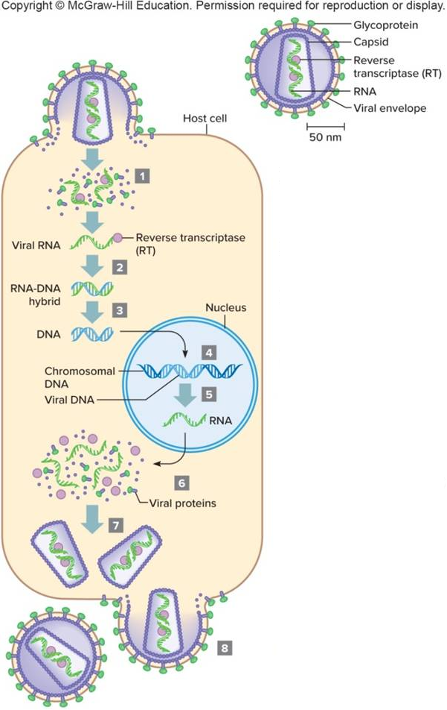
How HIV Infects (1 of 3)
Notes:
Copyright © McGraw-Hill Education. Permission required for reproduction or display.

Slide 52
How HIV Infects (2 of 3)
Virus binds receptors on plasma membrane and enters cell. Enzymes remove proteins around viral DNA.
RT catalyzes formation of DNA complementary to viral DNA.
New DNA strand serves as a template for complementary DNA strand.
Double- stranded DNA is incorporated into the host cell's genome.

Slide 53
How HIV Infects (3 of 3)
Viral genes are transcribed into mRNA
mRNA is translated into proteins in cytoplasm
Capsids surround new viral, RNA genomes
New viruses bud from host cell

Slide 54
Acquired Immune Deficiency Syndrome (AIDS)
Disease resulting from HIV infection
Immune system impact of HIV infection progresses to impair the immune function
Due to genetically diverse population of HIV in a human host, treatment requires combination of medication with different actions
Drugs inhibit different points of infection
Entry of virus into T cells
Replication of viral genetic material
Processing of viral proteins

Slide 55
Table 17.6 Anti-HIV Drugs
Drug Type | Mechanism
Reverse transcriptase inhibitor | Blocks copying of viral RNA to DNA
Protease inhibitor | Blocks shortening of certain viral proteins
Fusion inhibitor | Blocks ability of HIV to bind a cell
Entry inhibitor | Blocks ability of HIV to enter a cell
Notes:
Copyright © McGraw-Hill Education. Permission required for reproduction or display.

Slide 56
CCR5 Gene
Encodes for a receptor protein on the cell membrane (coreceptor for HIV)
Individual homozygous for a 32-base deletion of CCR5 are resistant to infection
Heterozygous individuals become infected but stay healthy for several years longer than people that do not have the mutation
Same mutation may have enabled people to survive the plague in Europe during the Middle Ages

Slide 57
Autoimmunity (1 of 2)
Immune system attacks the tissues of an individual’s own body.
Autoantibodies recognize self proteins.
About 5% of the population has an autoimmune disorder.
Signs and symptoms reflect the cell types under attack.

Slide 58
Autoimmunity (2 of 2)
Arises in several ways:
Viruses use host proteins on the viral cell surface
Proteins become the target of the immune system, which responds as if they were viral proteins
Thymocytes that recognize self antigens survive instead of self-destructing
Nonself antigen may coincidentally resemble self antigens
Skewed X inactivation

Slide 59
Table 17.7 Autoimmune Disorders
Disorder | Symptoms | Autoantibodies Against
Diabetes mellitus (type 1) | Thirst, hunger, weakness, weight loss | Pancreatic beta cells
Graves disease | Restlessness, weight loss, irritability, increased heart rate and blood pressure | Thyroid gland cells
Hemolytic anemia | Fatigue, weakness | Red blood cells
Multiple sclerosis | Weakness, poor coordination, failing vision, disturbed speech | Myelin in the white matter of the central nervous system
Myasthenia gravis | Muscle weakness | Neurotransmitter receptors on skeletal muscle cells
Rheumatic fever | Weakness, shortness of breath | Heart valve cells
Rheumatoid arthritis | Joint pain and deformity | Cells lining joints
Systematic lupus erythematosus | Red facial rash, fever, weakness, joint pain | Connective tissue
Ulcerative colitis | Lower abdominal pain | Colon cells
Notes:
Copyright © McGraw-Hill Education. Permission required for reproduction or display.

Slide 60
Rh Incompatibility
Occurs when an Rh– (no Rh antigen) mother has an Rh⁺ (has Rh antigen) child
First Rh incompatible pregnancy
Fetal cells recognized as foreign
Mother’s immune system attacks fetal cells
Produces a mild reaction, few antibodies present
Second Rh incompatible pregnancy
Large response, plentiful antibodies
Destruction of fetal blood cells, much damage

Slide 61
RhoGAM Prevents Formation of Anti-Rh Antibodies

Slide 62
Allergy (1 of 2)
Immune response to a nonthreatening foreign substance called an allergen
Size of allergens may determine type of allergic response
Larger (e.g., grass pollen) produces hay fever
Smaller (e.g., cat dander, dust mites) trigger asthma
Asthma is a chronic disease
Contraction of the airways, inflammation and mucus production block air flow

Slide 63
Allergy (2 of 2)

Slide 64
Allergic Response
Humoral and cellular immunity are involved.
IgE antibodies are made and bind mast cells.
Mast cells release allergy mediators like histamine and heparin that cause inflammation, runny eyes and nose, rashes and asthma.
Allergens activate a class of helper T cells that release cytokines.
Severe allergic reaction throughout the body is called anaphylatic shock.

Slide 65
Mutation in the Filaggrin Gene Sets the Stage for Allergy

Slide 66
Vaccination (1 of 2)
Vaccine uses antigens from a pathogen to invoke immunity before an individual has been exposed to the pathogen.
Antigens are chosen to be harmless alone.
Ability to respond rapidly to subsequent exposure prevents infection to a degree that would cause disease.
Vaccine technology dates back to 11th century China.
Edward Jenner used cowpox as a vaccine for smallpox.

Slide 67
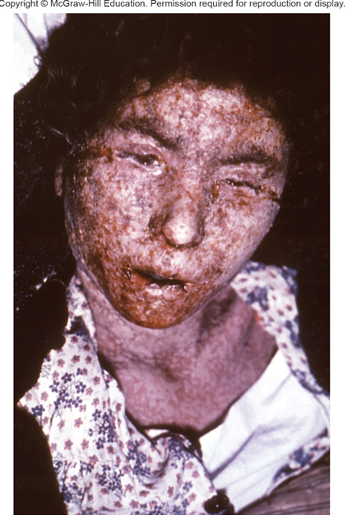
Vaccination (2 of 2)
Smallpox has not naturally infected a human since 1977.
Vaccinations are now unnecessary.
CDC/Carl Flint, Armed Forces Institute of Pathology

Slide 68
New Methods
Vaccines are mostly injections
New delivery methods include nasal sprays and genetically modified fruits and vegetables
Foreign antigens stimulate phagocytes to present antigens to nearby T cells
T cells stimulate B cells to make IgA antibodies
Coat the small intestine and protect against food-borne pathogens

Slide 69
Immunotherapy
Medical treatment used to amplify or redirect the immune response
Monoclonal antibodies (MAb)
Useful for detecting and targeting one particular antigen
In 1975, British researchers devised a technology which mass-produces a single B cell
Thus, preserving its specificity and amplifying its antibody type

Slide 70
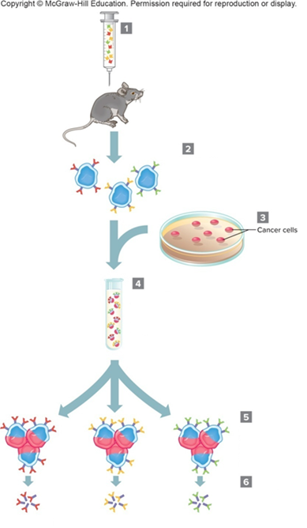
Monoclonal Antibody Technology (1 of 2)
Source: COG Cad Flint; Armed Forces Institute of Pathology
Notes:
Copyright © McGraw-Hill Education. Permission required for reproduction or display.

Slide 71
Monoclonal Antibody Technology (2 of 2)
Antigens are injected into mouse.
B cells with antibodies are extracted from mouse spleen
Cancer cells
Cancer cells are fused with spleen cells so that newly formed cells (hybridomas) live longer.
Hybridomas are separated and cloned to produce large populations
Monoclonal antibodies are produced.

Slide 72
Uses of Monoclonal Antibodies
Basic research and disease diagnosis
Home pregnancy test strips
Contain anti-hCG monoclonal antibody
If hCG is present in the urine it binds and changes the color of the test strip
Herceptin
Monoclonal antibody–based drug
Blocks receptors on breast cancer cells
Prevents reception of cell-division signal

Slide 73
Cytokines Boost Cellular Immunity
Cytokines are used to treat a variety of conditions
Examples:
Interferon—Cancer and multiple sclerosis
Interleukin-2—Kidney cancer recurrence
Colony stimulating factor—Boosts WBC levels in individuals with AIDS

Slide 74
Transplantation (1 of 2)
Organs are moved from one individual to another.
Hearts, kidneys, livers, lungs, corneas, pancreases, skin, and bone marrow are routinely transplanted.
Thousands of transplants are performed annually and recipients gain years of life.
Successful transplants lie in genetics.
Types of transplantation are defined by the relationship between the donor and recipient.
Autograft: From one person to self
Isograft: From identical twin
Allograft: Members of same species
Xenograft: From another species

Slide 75
Transplantation (2 of 2)

Slide 76
Graft Rejection
Immune system reacts to grafted tissue recognized as foreign by trying to destroy it
Hyperacute rejection reaction
Severe form of graft reaction in which the blood supply to the graft tissue is cut off
Graft versus host disease
Occurs in bone marrow transplants
Immune cells of the grafted bone marrow recognize host body as foreign and attack it

Slide 77
Genomic View of Immunity
Sequencing genomes of pathogens
Helps us understand how they infect, and aid in development of treatments
Crowd diseases
Spread rapidly through unexposed populations
Examples: Smallpox, measles, pertussis, typhus, influenza, and SARS
Bioweapons
Bacteria and viruses have been used throughout history as weapons
In their natural state or genetically-manipulated

Slide 78
End of Presentation

