Slide 1
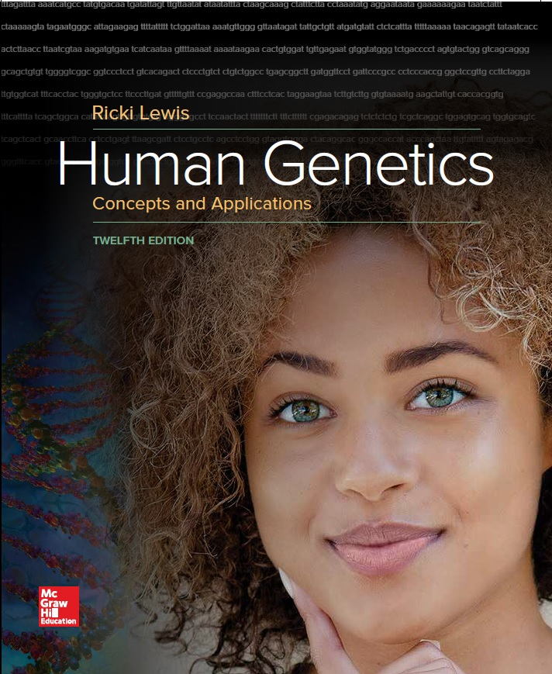
Human Genetics Concepts and Applications
Twelfth Edition
Chapter 14
Constant Allele Frequencies and DNA Forensics
© McGraw-Hill Education. All rights reserved. Authorized only for instructor use in the classroom. No reproduction or further distribution permitted without the prior written consent of McGraw-Hill Education.

Slide 2
Learning Outcomes (1 of 2)
State the unit of information of genetics at the population level.
Define gene pool.
List the five processes that cause microevolutionary change.
State the consequence of macroevolutionary change.
State the genotypes represented in each part of the Hardy-Weinberg equation.

Slide 3
Learning Outcomes (2 of 2)
Explain the conditions necessary for Hardy-Weinberg equilibrium.
Explain how the Hardy-Weinberg equilibrium uses population incidence statistics to predict the probability of a particular phenotype.
Explain how parts of the genome that are in Hardy-Weinberg equilibrium can be used to identify individuals.

Slide 4
Introduction
Population: Interbreeding group of the same species in a given geographical area
Gene pool: Collection of all alleles in the members of the population
Population genetics: Study of the genetics of a population and how the alleles vary with time
Gene Flow: Movement of alleles between populations when people migrate and mate

Slide 5
Allele Frequencies
Count both chromosomes of each individual
Allele frequencies affect the genotype frequencies
Frequency of the two homozygotes and the heterozygote in the population

Slide 6
Phenotype Frequencies
Frequency of a trait varies in different populations.
Table 14.1 Frequency of PKU in Various Populations
Population | Frequency of PKU
Chinese | 1/16,000
Irish, Scottish, Yemenite Jews | 1/5,000
Japanese | 1/119,000
Swedes | 1/30,000
Turks | 1/2,600
U.S. Caucasians | 1/10,000
Notes:
Copyright © McGraw-Hill Education. Permission required for reproduction or display.

Slide 7
Microevolution
Small genetic changes due to changing allelic frequencies in populations
Factors that change genotypic frequencies:
Nonrandom mating
Migration
Genetic drift
Mutation
Natural selection

Slide 8
Macroevolution
Formation of new species
Occurs when enough microevolutionary changes have occurred to prevent individuals from one population to successfully produce fertile offspring

Slide 9
Hardy-Weinberg Equation (1 of 2)
Developed independently by an English mathematician and a German physician
Used algebra to explain how allele frequencies predict genotypic and phenotypic frequencies in a population of diploid, sexually-reproducing species
Disproved the assumption that dominant traits would become more common, while recessive traits would become rarer

Slide 10
Hardy-Weinberg Equation (2 of 2)
p = allele frequency of one allele
q = allele frequency of a second allele
p + q = 1
All of the allele frequencies together equals 1
All the genotype frequencies together equals 1
Frequencies for each homozygote
2pq
Frequencies for heterozygotes

Slide 11
Figure 14.2 The Hardy-Weinberg Equation in English
Notes:
Copyright © McGraw-Hill Education. Permission required for reproduction or display.

Slide 12
Figure 14.3 Source of the Hardy-Weinberg Equation

Slide 13
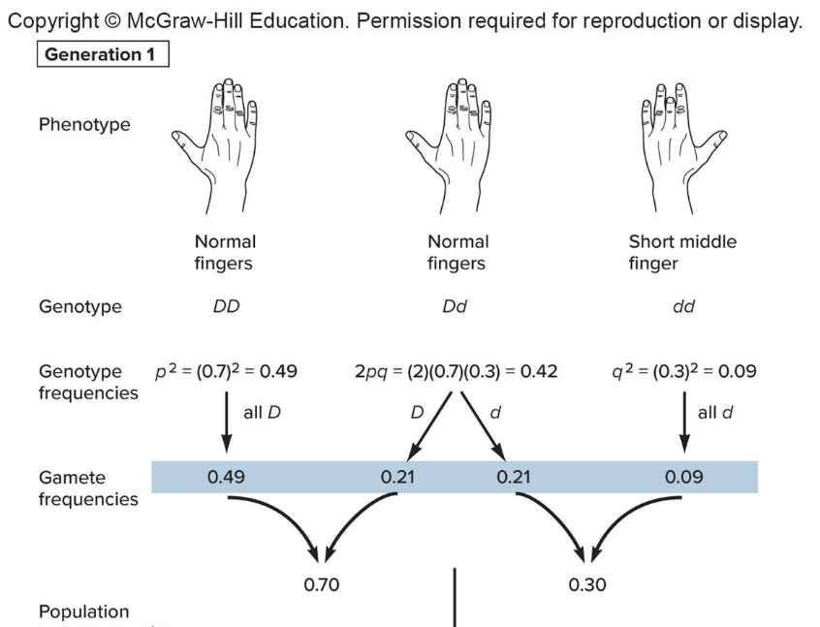
Solving a Problem (1 of 2)
Given p = frequency of D = normal length fingers = 0.70
q = frequency of d = short middle finger = 0.30

Slide 14
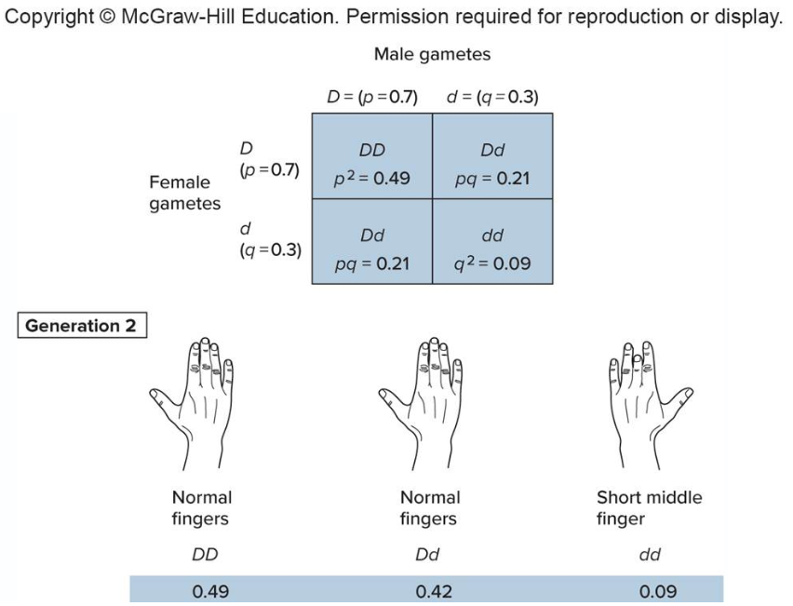
Solving a Problem (2 of 2)
Given p = frequency of D = normal length fingers = 0.70
q = frequency of d = short middle finger = 0.30

Slide 15
Hardy-Weinberg Equilibrium (1 of 2)
Table 14.2 Hardy-Weinberg Equilibrium– When Allele Frequencies Stay Constant
POSSIBLE MATINGS: Male | POSSIBLE MATINGS: Female | Proportion in Population | FREQUENCY OF OFFSPRNG GENOTYPES: DD | FREQUENCY OF OFFSPRNG GENOTYPES: Dd | FREQUENCY OF OFFSPRNG GENOTYPES: dd
0.49 DD | 0.49 DD | 0.2401 (DD × DD) | 0.2401
0.49 DD | 0.42 Dd | 0.2058 (DD × Dd) | 0.1029 | 0.1029
0.49 DD | 0.09 dd | 0.0441 (DD × dd) |  | 0.0441
0.42 Dd | 0.49 DD | 0.2058 (Dd × DD) | 0.1029 | 0.1029
0.42 Dd | 0.42 Dd | 0.1764 (Dd × Dd) | 0.0441 | 0.0882 | 0.0441
0.42 Dd | 0.09 dd | 0.0378 (Dd × dd) |  | 0.0189 | 0.0189
0.09 dd | 0.42 DD | 0.0441 (dd × DD) |  | 0.0441
0.09 dd | 0.42 Dd | 0.0378 (dd × Dd) |  | 0.0189 | 0.0189
0.09 dd | 0.09 dd | 0.0081 (dd × dd) |  |  | 0.0081
 |  | Resulting offspring frequencies: | 0.49 | 0.42 | 0.09
 |  |  | DD | Dd | dd
Notes:
Copyright © McGraw-Hill Education. Permission required for reproduction or display.

Slide 16
Hardy-Weinberg Equilibrium (2 of 2)
Allele and genotypic frequencies do not change from one generation to the next.
Gene is in Hardy-Weinberg equilibrium.
Rare for protein-encoding genes that affect the phenotype
Applies to portions of the genome that do not affect phenotype
Includes repeated DNA segments
Not subject to natural selection

Slide 17
Applying the Hardy-Weinberg Equation
Used to determine carrier probability
For autosomal recessive diseases, the homozygous recessive class is used to determine the frequency of alleles in a population
Phenotype indicates its genotype

Slide 18
Calculating the Carrier Frequency: Autosomal Recessive (1 of 3)
Cystic Fibrosis
incidence (autosomal recessive class) = 1/2,000 = 0.0005
Notes:
Copyright © McGraw-Hill Education. Permission required for reproduction or display.

Slide 19
Calculating the Carrier Frequency: Autosomal Recessive (2 of 3)
Table 14.3 Carrier Frequency for Cystic Fibrosis
Population Group | Carrier Frequency
African Americans | 1 in 66
Asian Americans | 1 in 150
Caucasians of European descent | 1 in 23
Hispanic Americans | 1 in 46

Slide 20
Calculating the Carrier Frequency: Autosomal Recessive (3 of 3)
What is the probability that two unrelated Caucasians will have an affected child?
Probability that both are carriers = 1/23 × 1/23 = 1/529
Probability that their child has CF = 1/4
Probability = 1/529 × 1/4 = 1/2.116

Slide 21
Calculating the Risk with X-Linked Traits (1 of 2)
For females, the standard Hardy-Weinberg equation applies
However, in males the allele frequency is the phenotypic frequency
p + q = 1

Slide 22
Calculating the Risk with X-Linked Traits (2 of 2)
Figure 14.6
Hemophilia A
incidence= 1/10,000 male births= 0.0001

Slide 23
DNA Repeats (1 of 2)
Short repeated segments are distributed all over the genome
Repeat numbers can be considered alleles and used to classify individuals
Types:
Variable number of tandem repeats (VNTRs)
Short tandem repeats (STRs)

Slide 24
DNA Repeats (2 of 2)
Table 14.4 Characteristics of Repeats Used in DNA Profiling
Type | Repeat Length | Distribution | Example | Fragment Sizes
VNTRs (minisatellites) | 10-80 bases | Not uniform | TTCGGGTTGT | 50-1,500 bases
STRs (microsatellites) | 2-10 bases | More uniform | ACTT | 50-500 bases

Slide 25
DNA Profiling (1 of 3)
Technique that detects differences in repeat copy number
Calculates the probability that certain combinations can occur in two sources of DNA by chance
DNA evidence is more often valuable in excluding a suspect
Should be considered along with other types of evidence

Slide 26
DNA Profiling (2 of 3)
Developed in the 1980s by British geneticist Sir Alec Jeffreys
Also called DNA fingerprinting
Identifies individuals
Used in forensics, agriculture, paternity testing, and historical investigations

Slide 27
DNA Profiling (3 of 3)
Box Figure 14.1

Slide 28
Comparing DNA Repeats
Figure 14.7

Slide 29
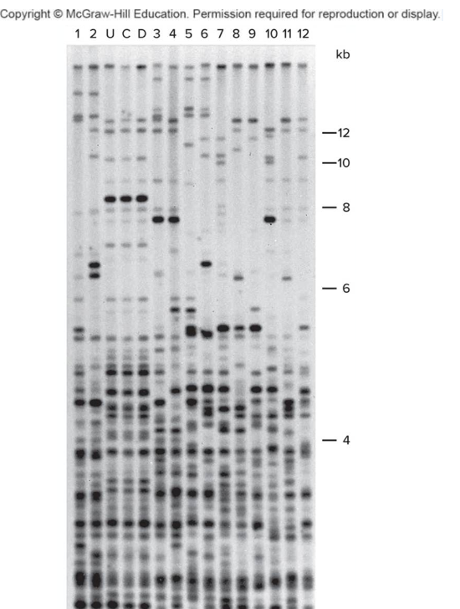
Comparing DNA Profiles
Jeffreys used his technique to demonstrate that Dolly was truly a clone of the 6-year-old ewe that donated her nucleus.
Figure 14.9
Courtesy of Esther N.Signer

Slide 30
DNA Profiling Technique
Blood sample is collected from suspect.
White blood cells release DNA.
Restriction enzymes cut DNA.
Electrophoresis aligns fragments by size.
Pattern of DNA fragments transferred to a nylon sheet.
Exposed to radioactive probes
Probes bind to DNA
Sheet placed against X-ray film
Pattern of bands constitutes DNA profile
Identify individuals

Slide 31
DNA Sources
DNA can be obtained from any cell with a nucleus.
STRs are used when DNA is scarce.
If DNA is extremely damaged, mitochondrial DNA (mtDNA) is often used.
For forensics, the FBI developed the Combined DNA Index System (CODIS).
Uses 13 STRs

Slide 32
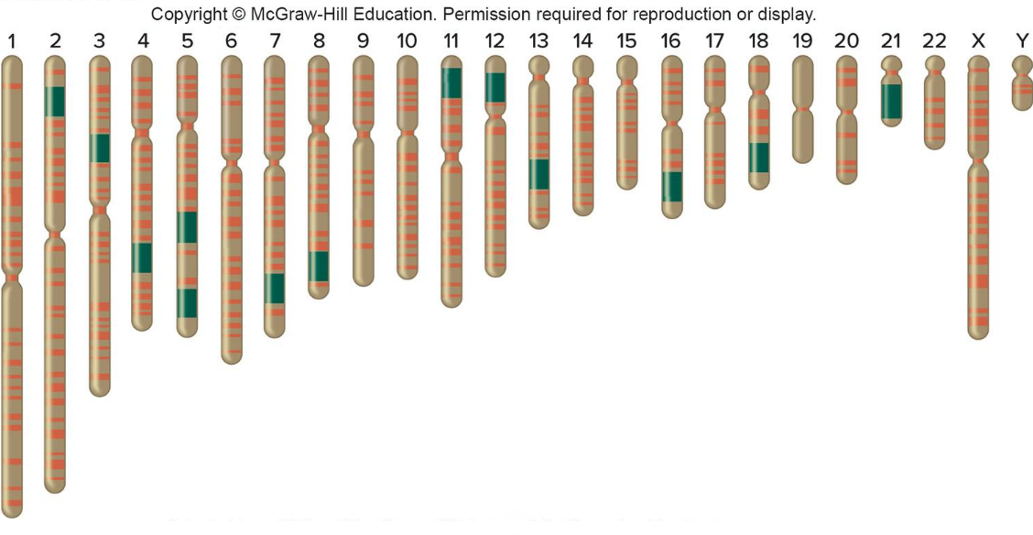
CODIS
Probability that any two individuals have same 13 markers is 1 in 250 trillion
Figure 14.10
Adapted from National Academy of Sciences. http://www.koshland-science-museum.org.

Slide 33
Population Statistics Used to Interpret DNA Profiles
Power of DNA profiling is greatly expanded by tracking repeats in different chromosomes.
Number of copies of a repeat are assigned probabilities based on their observed frequency in a population.
Product rule is then used to calculate probability of a certain repeat combination.

Slide 34
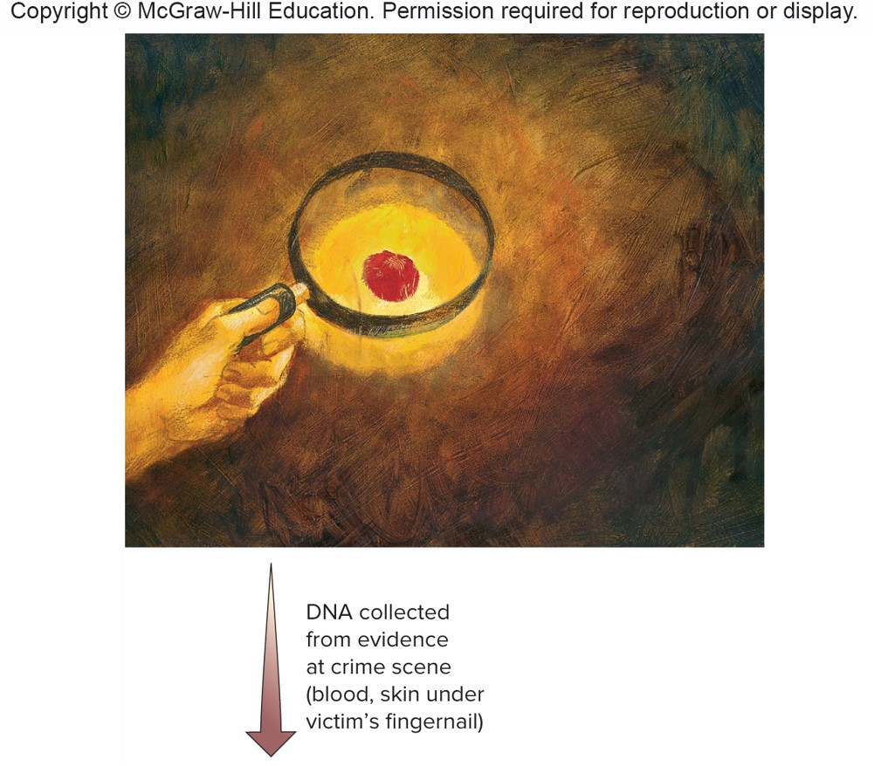
Figure 14.12 To Solve a Crime (1 of 2)
© Lisa Zador/Getty Images RF

Slide 35
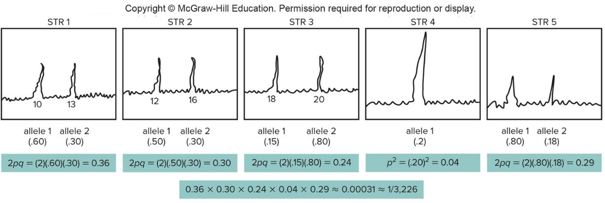
Figure 14.12 To Solve a Crime (2 of 2)
Conclusion: The probability that another person in the suspect's population group has the same pattern of these alleles is approximately 1 in 3,226.

Slide 36
Using DNA Profiling to Identify Victims
Recent examples of large-scale disasters:
World Trade Center attack (2001)
Indian Ocean Tsunami (2004)
Hurricane Katrina (2005)

Slide 37
Challenges to DNA Profiling
Table 14.5 Challenges to DNA Profiling in Mass Disasters
Climate that hastens decay
Inability to reach remains
No laboratory facilities
Number of casualties
Lack of relatives
Destruction of personal item evidence
Poor DNA quality (too fragmented, scarce, degraded)
Lack of availability of DNA probes and statistics for a population

Slide 38
Genetic Privacy
Today’s population genetics presents a powerful way to identify individuals
Our genomes can vary in more ways than there are people in the world
DNA profiling introduces privacy issues
Example: DNA dragnets

Slide 39
End of Presentation

