Slide 1
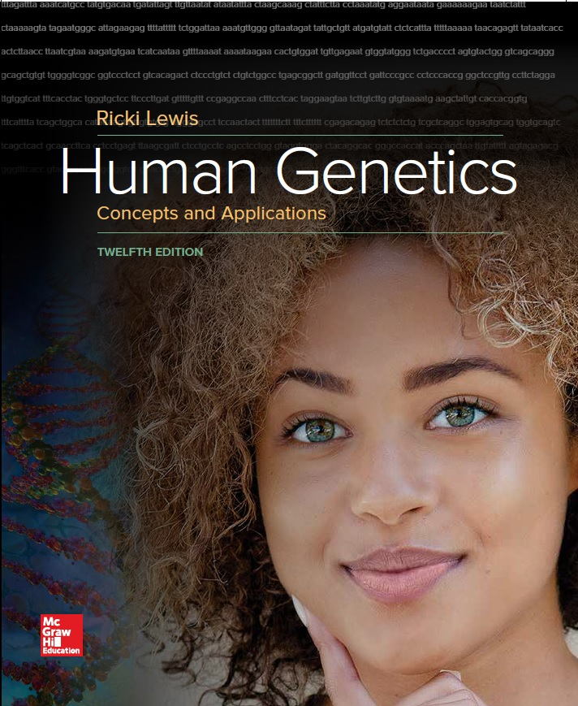
Human Genetics Concepts and Applications
Twelfth Edition
Chapter 13
Chromosomes
© McGraw-Hill Education. All rights reserved. Authorized only for instructor use in the classroom. No reproduction or further distribution permitted without the prior written consent of McGraw-Hill Education.

Slide 2
Learning Outcomes (1 of 2)
List the major parts of a chromosome.
List the types of chromosomes based on centromere position.
Describe the ways that chromosomes are obtained, prepared, detected, and depicted in detail.
Explain how atypical chromosome numbers arise.
Distinguish polyploidy from aneuploidy.
Describe specific aneuploid conditions.
Distinguish between the consequences of having balanced versus unbalanced chromosomes.

Slide 3
Learning Outcomes (2 of 2)
Describe deletions, duplications, and the two major types of translocation.
Distinguish the two types of inversions.
Describe the consequence of having an isochromosome.
Describe the consequence of having a ring chromosome.
Explain how a person could inherit both copies of a DNA sequence from one parent.
Describe how inheriting both copies of DNA from one parent can affect a person’s health.

Slide 4
Cytogenetics
Subdiscipline within genetics
Deals with chromosome variations
Excess genetic material has milder effects on health than a deficit
Large-scale chromosomal abnormalities present in all cells disrupt or halt prenatal development

Slide 5
Chromosome
Primarily consists of DNA and protein
Distinguished by size and shape
Essential parts
Telomeres
Origins of replication sites
Centromere

Slide 6
Portrait of a Chromosome (1 of 2)

Slide 7
Portrait of a Chromosome (2 of 2)
Heterochromatin is darkly staining.
Consists mostly of repetitive DNA
Euchromatin is lighter-staining.
Contains most protein-encoding genes
Telomeres are chromosome tips composed of many repeats of TTAGGG.
Shorten with each cell division

Slide 8
Centromeres
Largest constriction of the chromosome and where spindle fibers attach
Bases that form the centromere are repeats of a 171-base DNA sequence
Replicated at the end of S phase
Facilitated by centromere protein A
CENP-A is passed to next generation
Example of an epigenetic change

Slide 9
Subtelomeres (1 of 2)
Chromosome region between the centromere and telomeres
Consists of 8000 to 300,000 bases
Near telomere the repeats are similar to the telomere sequence
Contains at least 500 protein-encoding genes
About 50% are multigene families that include pseudogenes

Slide 10
Subtelomeres (2 of 2)

Slide 11
Karyotype (1 of 3)
Chromosome chart
Major clinical tool
Displays chromosomes arranged by size and structure
Humans have 24 chromosome types
Autosomes are numbered 1–22 by size
Sex chromosomes are X and Y

Slide 12
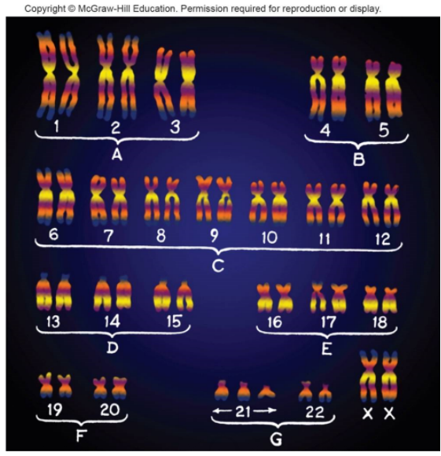
Karyotype (2 of 3)
© Biophoto Associates/Science Source. Colorization by Mary Martin

Slide 13
Karyotype (3 of 3)
Useful at several levels
Can:
Confirm a clinical diagnosis
Reveal effects of environmental toxins
Clarify evolutionary relationships

Slide 14
Centromere Positions
Telocentric—At the tip
Acrocentric—Close to center
Submetacentric—Off-center
Metacentric—At center

Slide 15
Visualizing Chromosomes
Tissue is obtained from person
Fetal tissue
Amniocentesis
Chorionic villi sampling
Fetal cell sorting
Chromosome microarray analysis
Adult tissue
White blood cells
Skin-like cells from cheek swab
Chromosomes are extracted
Then stained with a combination of dyes and DNA probes

Slide 16
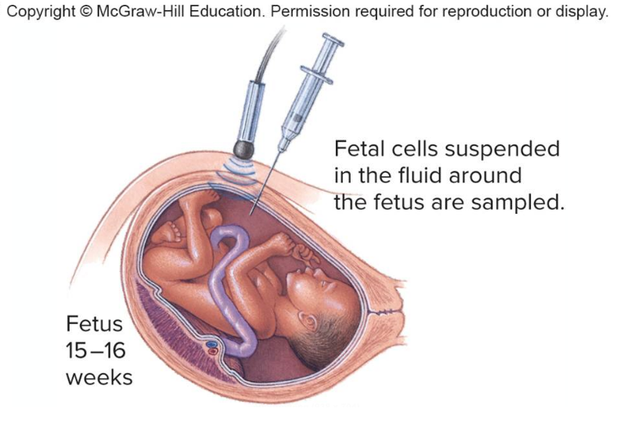
Amniocentesis (1 of 2)
Detects about 1000 of the more than 5000 known chromosomal and biochemical problems
Ultrasound is used to follow needle’s movement
Amniocentesis

Slide 17
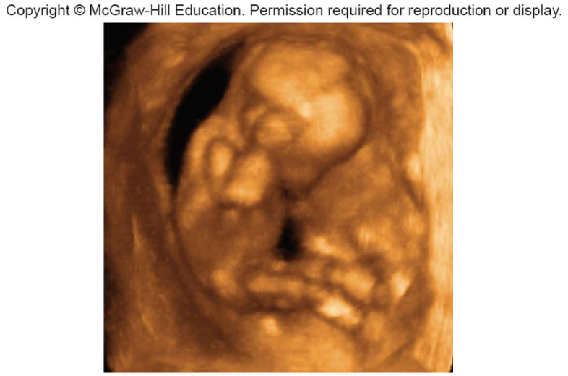
Amniocentesis (2 of 2)
Ultrasound Image
© Dr. Najeeb Layyous/Science Source

Slide 18
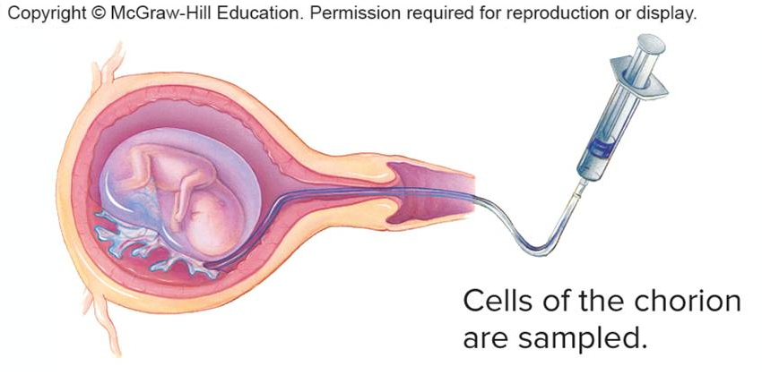
Chorionic Villus Sampling
Performed during 10–12th week of pregnancy
Provides earlier results than amniocentesis
Does not detect metabolic problems
Has greater risk of spontaneous abortion
Chorionic villus sampling

Slide 19
The Maternal Age Effect

Slide 20
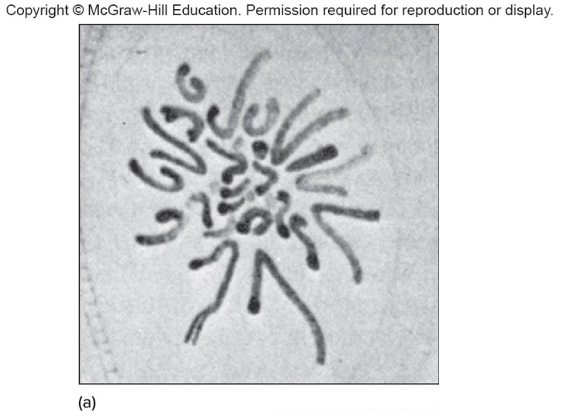
Viewing Chromosomes (1 of 2)
1882
a: Drawing by Walther Flemming, 1882

Slide 21
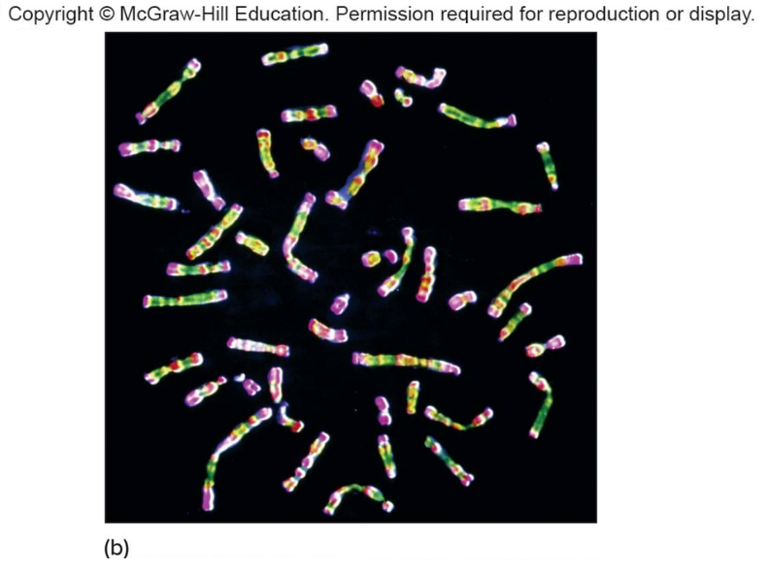
Viewing Chromosomes (2 of 2)
Now
b: © CNRI/Science Source

Slide 22
Staining Chromosomes
Dyes were used to stain chromosomes a uniform color
Were grouped into decreasing size classes, designated A though G
Improved staining techniques gave banding patterns unique to each chromosome
Researchers found that synchronizing the cell cycle of cultured cells revealed even more bands per chromosome

Slide 23
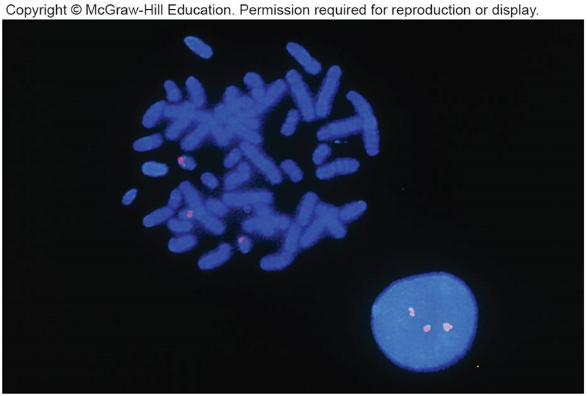
FISH
Fluorescence in situ hybridization
DNA probes labeled with fluorescing dye bind complementary DNA
Fluorescent dots correspond to three copies of chromosome 21
© James King- Holmes/Science Source

Slide 24
Table 13.1 Chromosomal Shorthand
Abbreviation | Meaning
46, XY | Normal male
46, XX | Normal female
45, X | Turner syndrome (female)
47, XXY | Klinefelter syndrome (male)
47, XYY | Jacobs syndrome (male)
46, XY, del (7q) | A male missing part of the long arm of chromosome 7
47, XX, +21 | A female with trisomy 21 Down syndrome
46, XY, t(7;9) (p21.1; q34.1) | A male with translocation between the short arm of chromosome 7 at band 21.1 and the long arm of chromosome 9 at band 34.1
48, XXYY | A male with an extra X and an extra Y chromosome
Notes:
Copyright © McGraw-Hill Education. Permission required for reproduction or display.

Slide 25
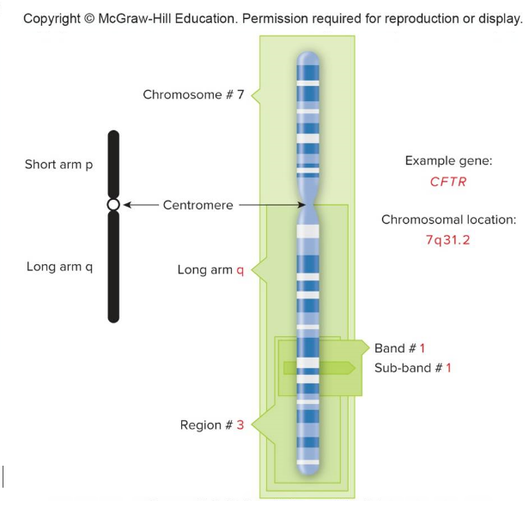
Ideogram
Schematic chromosome map
Indicates chromosome arms (p or q) and major regions delineated by banding patterns
Source: U.S. National Library of Medicine

Slide 26
Chromosome Abnormalities (1 of 2)
Karyotype may be abnormal in
Chromosome number
Chromosome structure
Abnormal chromosomes account for at least 50% of spontaneous abortions
People are being diagnosed with chromosomal abnormalities due to improved technology

Slide 27
Chromosome Abnormalities (2 of 2)
Table 13.3
Type of Abnormality | Definition
Polyploidy | Extra chromosome sets
Aneuploidy | An extra or missing chromosome
Monosomy | One chromosome absent
Trisomy | One chromosome extra
Deletion | Part of a chromosome missing
Duplication | Part of a chromosome present twice
Translocation | Two chromosomes join long arms or exchange parts
Inversion | Segment of chromosome reversed
Isochromosome | A chromosome with identical arms
Ring chromosome | A chromosome that forms a ring due to deletions in telomeres, which cause ends to adhere
Chromothripsis | One or more chromosomes shatters
Notes:
Copyright © McGraw-Hill Education. Permission required for reproduction or display.

Slide 28
Indirect Detection of Extra Chromosomes
Amniocentesis and chorionic villus sampling proved direct detection of extra chromosomes.
Maternal serum markers offer an indirect method.
These are biochemicals whose levels are in a normal range in a woman carrying a fetus with a normal number of chromosomes, but lie outside the range with fetuses that have an extra copy of a certain chromosome

Slide 29
Table 13.2 Maternal Serum Markers for Trisomy 21
Marker | Normal Function
High Level
Beta human chorionic gonadotropin (hCG) | Implantation of the embryo
Inhibin A | Lowers levels of follicle- stimulating hormone
Low Level
Estradiol (UE3) | Female hormone that binds AFP
Alpha fetoprotein (AFP) | Binds estradiol
Pregnancy- associated plasma protein (PAPP-A) | Cell division
Notes:
Copyright © McGraw-Hill Education. Permission required for reproduction or display.

Slide 30
Cell-Free DNA Testing (1 of 2)
In the maternal blood are pieces of DNA from the fetus.
Up to 20 percent of these pieces come from the placenta, and thus represent the fetal genome.
Testing DNA can detect certain fetal chromosomal abnormalities, like some of the trisomy conditions.
The test can be performed at 10 weeks into the pregnancy.

Slide 31
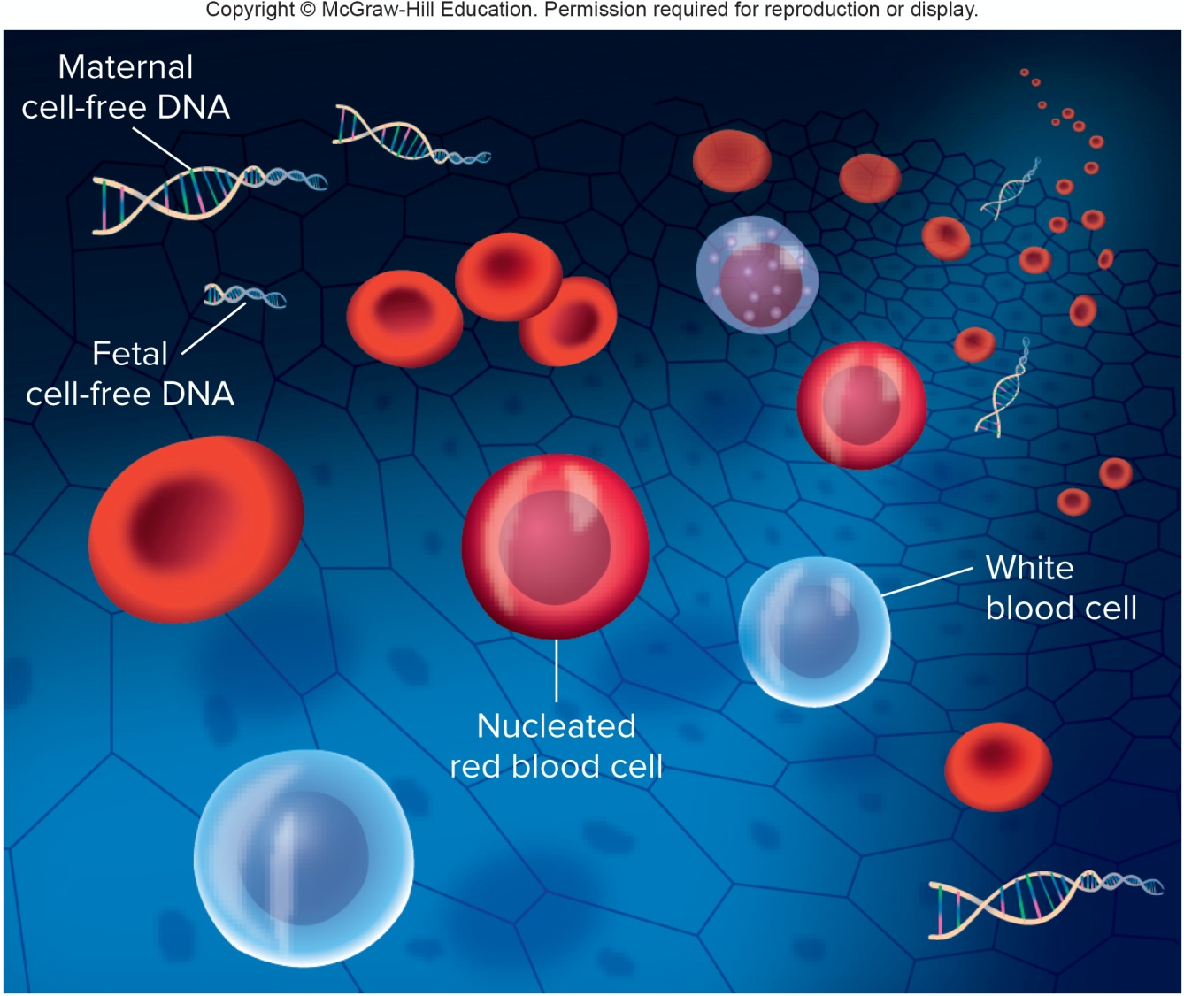
Cell-Free DNA Testing (2 of 2)

Slide 32
Polyploidy
Cell with extra chromosome sets
Triploid (3N) cells have three sets of chromosomes
Produced by:
Fertilization of one egg by two sperm
Fusion of haploid and diploid gametes
Account for 17% of all spontaneous abortions and 3% of stillbirths and newborn deaths

Slide 33
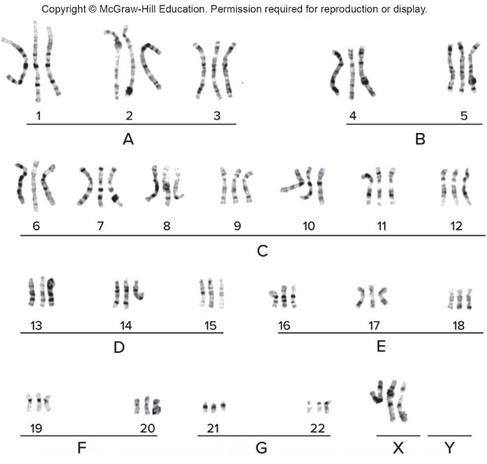
Triploidy
© CNRI/Science Source

Slide 34
Aneuploidy (1 of 2)
Normal chromosomal number is euploid.
Cells with extra or missing chromosomes are aneuploid.
Autosomal aneuploids are spontaneously aborted.
Those born are more likely to have an extra chromosome (trisomy) rather than a missing one (monosomy).

Slide 35
Aneuploidy (2 of 2)
Arises during mitosis, producing groups of somatic cells with the extra or missing chromosomes
Individual with two chromosomally-distinct cell populations is called a mosaic
Mitotic nondisjunction event that occurs early in development can have serious effects on the health of the individual

Slide 36
Nondisjunction
Meiotic error that causes aneuploidy
Produces gamete with an extra chromosome and another with one missing chromosome
Nondisjunction during meiosis I results in copies of both homologs in one gamete
Nondisjunction during meiosis II results in both sister chromatids in one gamete

Slide 37
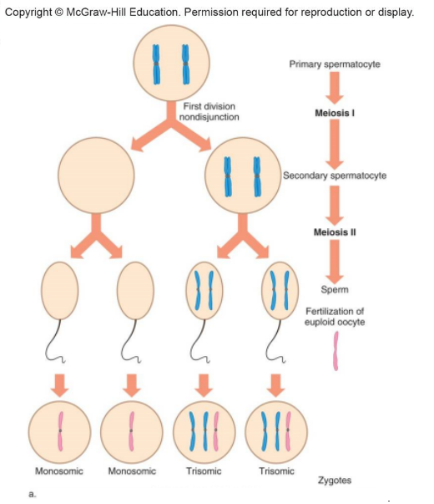
Nondisjunction at Meiosis I
Nondisjunction at meiosis I

Slide 38
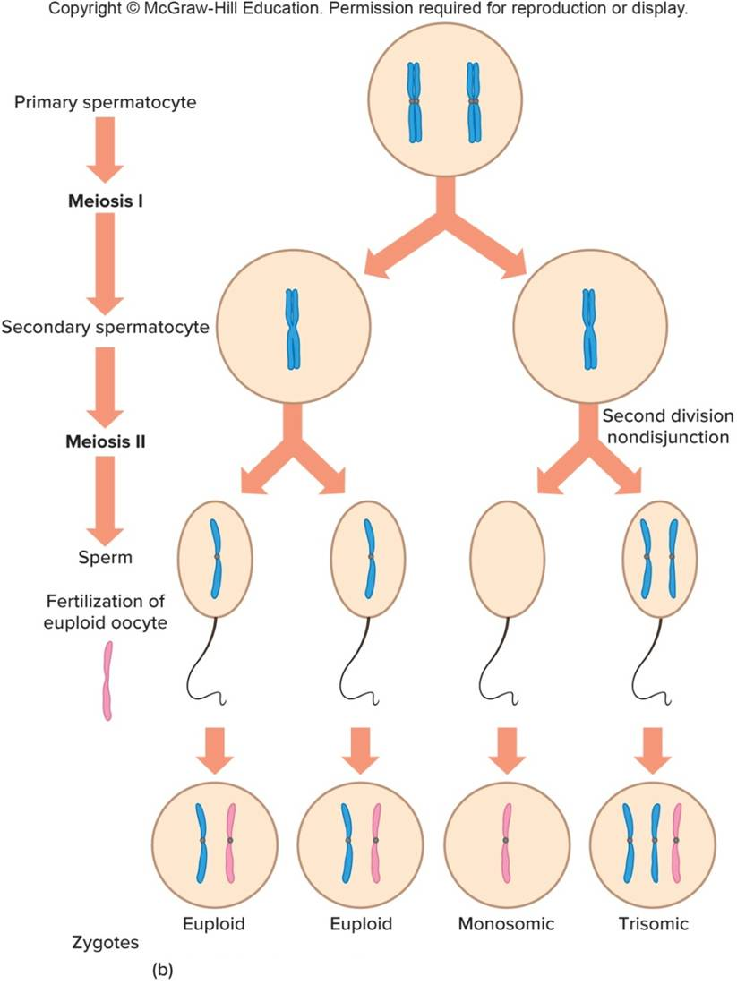
Nondisjunction at Meiosis II
Nondisjunction at meiosis II

Slide 39
Trisomies
Autosomal aneuploids cease developing as embryos or fetuses.
Frequently seen trisomies in newborns are those of chromosomes 21, 18, and 13.
Carry fewer genes than other autosomes
Table 13.4 Comparing and Contrasting Trisomies 13, 18, and 21
Type of Trisomy | Incidence at Birth | Percentage of Conceptions That Survive 1 Year After Birth
13 (Patau) | 1/12,500-1/21,700 | <5%
18 (Edwards) | 1/6,000-1/10,000 | <5%
21 (Down) | 1/800-1/826 | 85%
Notes:
Copyright © McGraw-Hill Education. Permission required for reproduction or display.

Slide 40
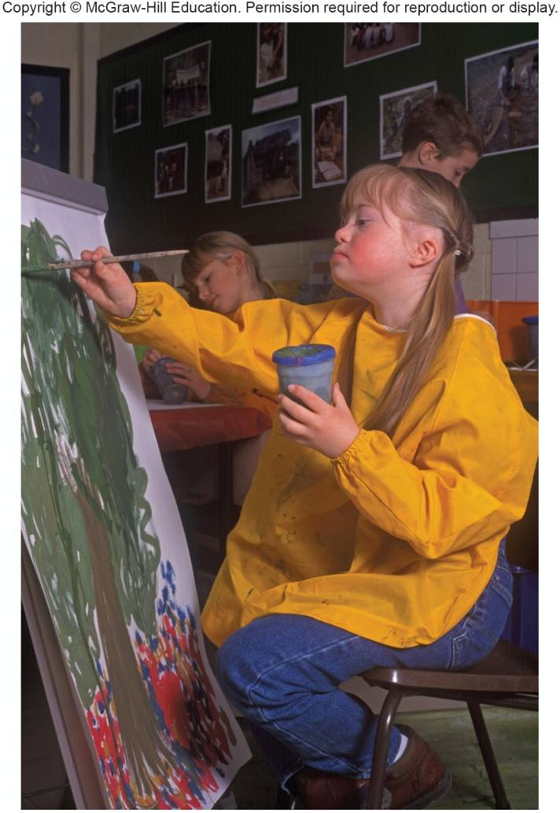
Trisomy 21
Down syndrome
Most common trisomy among newborns
Distinctive facial and physical problems
© Angela Hampton/Bubbles Photolibrary/Alamy

Slide 41
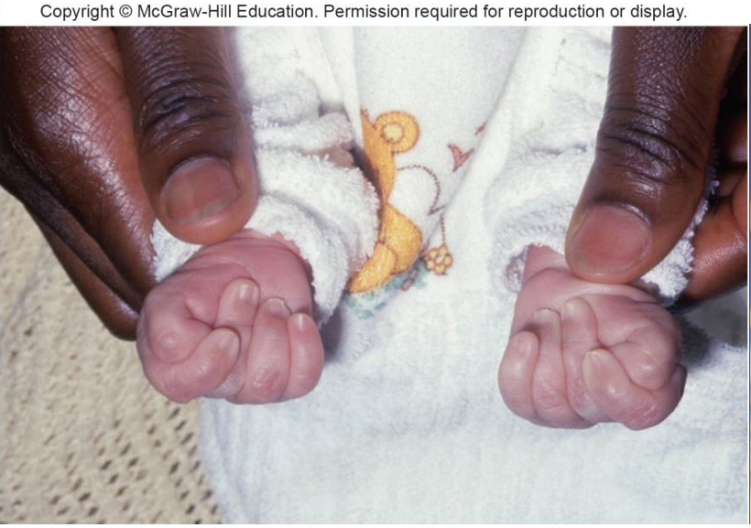
Trisomy 18
Edwards syndrome
Due to nondisjunction in meiosis II in oocyte and generally do not survive
Serious mental and physical disabilities
Distinctive feature— Oddly-clenched fists
© Wellcome Image Library/Custom Medical Stock Photo

Slide 42
Trisomy 13
Patau syndrome
Very rare and generally do not survive 6 months
Serious mental and physical disabilities
Distinctive feature—Eye fusion

Slide 43
Table 13.5 How Nondisjunction Leads to Sex Chromosome Aneuploids
Situation | Oocyte | Sperm | Consequence
Normal | X | Y | 46, XY normal male
 | X | X | 46, XX normal female
Female nondisjunction | XX | Y | 47, XXY Klinefelter syndrome
 | XX | X | 47, XXX triplo-X
 |  | Y | 45, Y nonviable
 |  | X | 45, X Turner syndrome
Male nondisjunction (meiosis I) | X |  | 45, X Turner syndrome
 | X | XY | 47, XXY Klinefelter syndrome
Male nondisjunction (meiosis II) | X | XX | 47, XXX triplo-X
 | X | YY | 47, XYY Jacobs syndrome
 | X |  | 45, X Turner syndrome
Male and female nondisjunction | XX | YY | 48, XXYY syndrome
Notes:
Copyright © McGraw-Hill Education. Permission required for reproduction or display.

Slide 44
Turner (XO) Syndrome
One in 2500 female births
99% of affected fetuses die in utero
Features:
Short stature
Webbing at back of neck
Incomplete sexual development (infertile)
Impaired hearing
Individuals who are mosaics may have children

Slide 45
Triplo-X Syndrome
One in 1000 female births
Few modest effects on phenotype include tallness, menstrual irregularities, and slight impact on intelligence
X inactivation of two X chromosomes occurs and cells have two Barr bodies
May compensate for presence of extra X

Slide 46
Klinefelter (XXY) Syndrome
One in 500 male births
Phenotypes include:
Incomplete sexual development
Rudimentary testes and prostate
Long limbs, large hands and feet
Some breast tissue development
Common cause of male infertility

Slide 47
XXYY Syndrome
Arises due to unusual oocyte and sperm
Associated with more severe behavioral problems than Klinefelter syndrome
AAD, obsessive compulsive disorder, learning disabilities
Individuals are infertile
Treated with testosterone

Slide 48
Jacobs (XYY) Syndrome
One in 1000 male births
96% are phenotypically normal
Modest phenotypes
Great height
Acne
Speech and reading disabilities
Studies suggest increase in aggressive behaviors are not supported

Slide 49
Chromosome Structural Abnormalities

Slide 50
Deletions
Missing genetic segment from a chromosome
Often not inherited
Rather they arise de novo
Larger deletions increase the likelihood that there will be an associated phenotype
Cri-du-chat (cat cry) syndrome
Deletion 5p–

Slide 51
Duplications
Presence of an extra genetic segment on a chromosome
Often not inherited
Rather they arise de novo
Effect on the phenotype is generally dependent on their size
Larger duplications tend to have an effect, while smaller ones do not

Slide 52
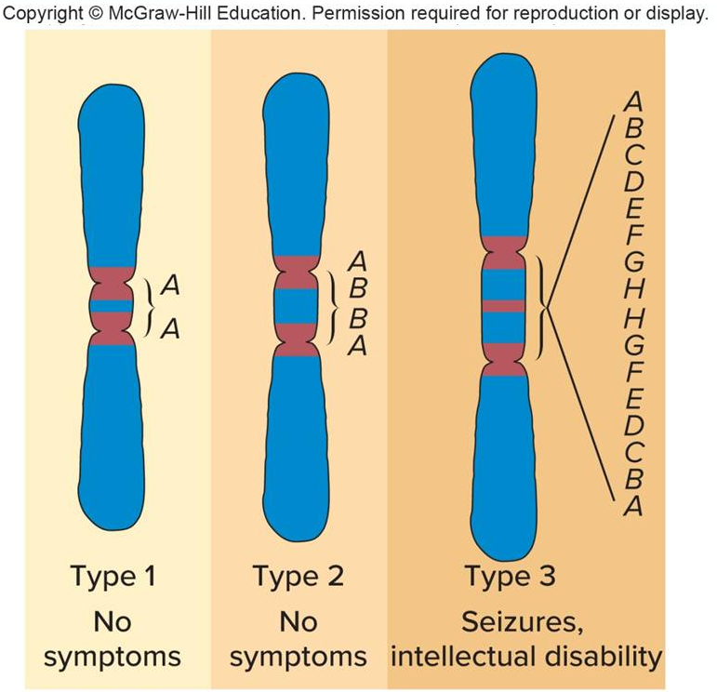
Duplications in Chromosome 15
Poor muscle tone
Epicanthal folds
Small size
Intellectual disability
Seizures
Developmental delay
Curved spine (scoliosis)
Learning disabilities
Autistic features
poor speech
hand flapping
lack of eye contact
need for routine

Slide 53
Translocations
Two nonhomologous chromosomes exchange segments
Types:
Robertsonian translocation
Reciprocal translocation

Slide 54
Robertsonian Translocations
Two nonhomologous acrocentric chromosomes break at the centromere and their long arms fuse
Short arms are often lost
Affect 1 in 1000 people
Translocation carriers have 45 chromosomes
Produce unbalanced gametes

Slide 55
Translocation Down Syndrome
5% of Down syndrome results from a Robertsonian translocation between chromosomes 21 and 14
Tends to recur in families, who also have more risk of spontaneous abortions
One of the parents is a translocation carrier
May have no symptoms
Distribution of the unusual chromosome leads to various imbalances

Slide 56
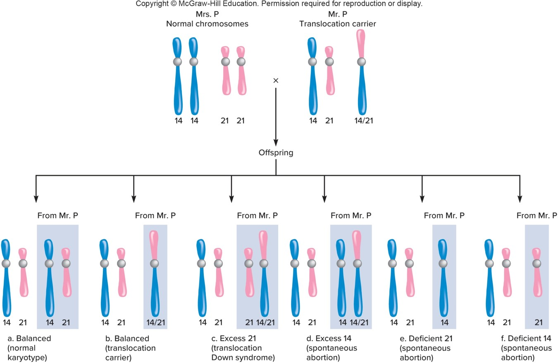
A Robertsonian Translocation

Slide 57
Reciprocal Translocations (1 of 2)
Two nonhomologous chromosomes exchange parts.
One in 500 people are carriers.
Usually healthy because they have the normal amount of genetic material.
Translocation breakpoint interrupts a gene, there may be an associated phenotype.

Slide 58
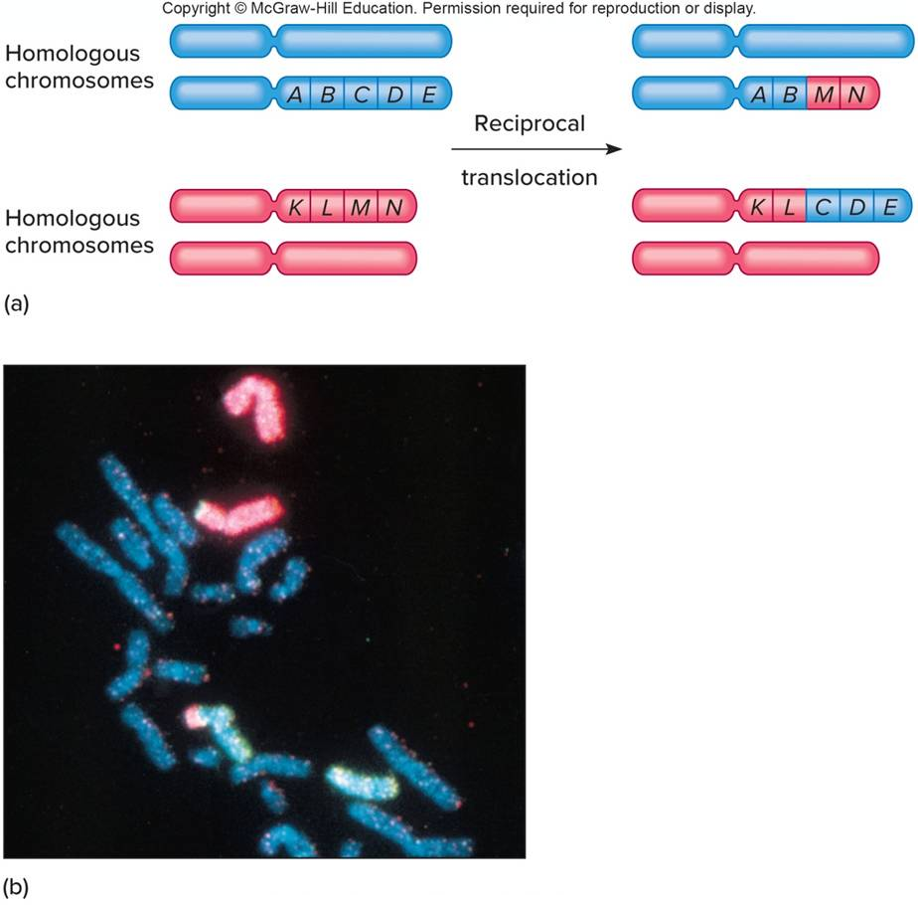
Reciprocal Translocations (2 of 2)
Courtesy of Lawrence Livermore National Laboratory

Slide 59
Inversions
Chromosome segment that is flipped in orientation
5–10% cause health problems probably due to disruption of genes at the breakpoints
Paracentric inversion—Inverted region does not include centromere
Pericentric inversion—Inverted region includes centromere
May impact meiotic segregation

Slide 60
Paracentric Inversion

Slide 61
Pericentric Inversion

Slide 62
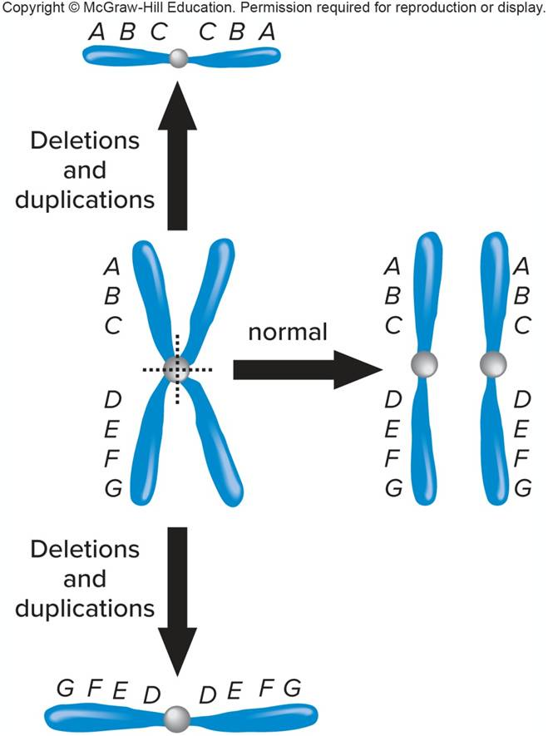
Isochromosomes
Chromosomes with identical arms
Formed when centromeres divide along the incorrect plane during meiosis

Slide 63
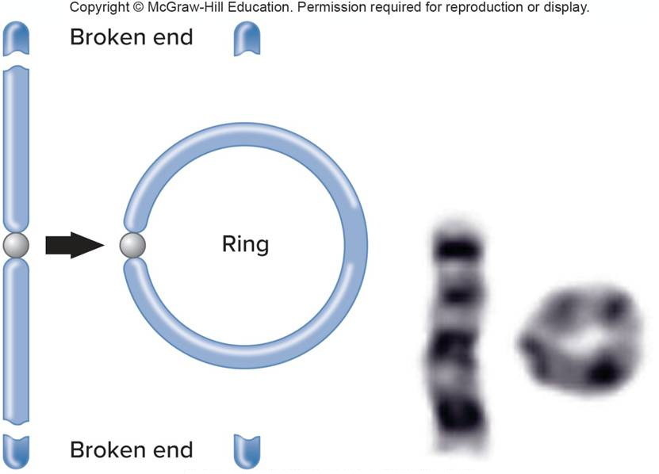
Ring Chromosomes
Occur in 1 of 25,000 conceptions
Arise when telomeres are lost and sticky chromosome ends fuse
Genes can be lost or disrupted causing symptoms
Courtesy of Ring Chromosome 20 Foundation

Slide 64
Table 13.6 Ring Chromosome Syndromes
Chromosome | Symptoms
9 | Microcephaly; triangular forehead; closely spaced, slanted, protruding eyes; arched brows; small jaw; congenital heart defects; abnormal male genitalia; intellectual disability
13 | Microcephaly, small eyes, developmental delay, underdevelopment of certain brain parts, difficulty feeding, unusual hands and feet, small or closed anus, abnormal genitals, heart defects, abnormal kidneys
14 | Microcephaly, puffy hands and feet, seizures, delayed speech and motor skills, recurrent infections, intellectual disability
20 | Microcephaly, short stature, seizures, intellectual disability
22 | Microcephaly, wide nose, large ears and eyes, floppiness (hypotonia), delayed speech and language, autistic behaviors, learning disabilities
Notes:
Copyright © McGraw-Hill Education. Permission required for reproduction or display.

Slide 65
Causes of Chromosome Aberrations
Table 13.7 Causes of Abnormal Chromosomes
Abnormalities | Causes
Numerical Abnormalities
Polyploidy | Multiple fertilization or diploid gamete leads to extra sets of chromosomes
Aneuploidy | Nondisjunction (in meiosis or mitosis) leads to lost or extra chromosomes when not all chromatid pairs separate in anaphase
Structural Abnormalities
Deletions and duplications | Translocation Crossover between a chromosome that has a pericentric inversion and its noninverted homolog
Translocation | Exchange between nonhomologous chromosomes at parts that are unstable due to symmetrical DNA sequences.
Inversion | Breakage and reunion of fragment in same chromosome, but with wrong orientation
Dicentric and acentric chromatids | Crossover between a chromosome with a paracentric inversion and its noninverted homolog
Ring chromosome | A chromosome loses telomeres and the ends fuse, forming a circle
Chromothripsis | Up to three chromosomes spontaneously shatter
Notes:
Copyright © McGraw-Hill Education. Permission required for reproduction or display.

Slide 66
Uniparental Disomy (UPD) (1 of 2)
Inheritance of two chromosomes or chromosome parts from the same parent
Requires the simultaneous occurrence of two rare events
Nondisjunction of the same chromosome in both sperm and egg
Trisomy followed by chromosome loss

Slide 67
Uniparental Disomy (UPD) (2 of 2)

Slide 68
End of Presentation

