Slide 1
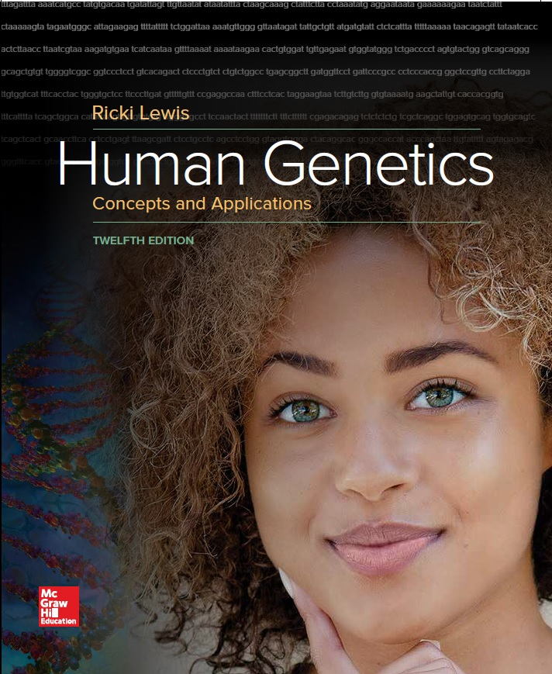
Human Genetics Concepts and Applications
Twelfth Edition
Chapter 12
Gene Mutation
© McGraw-Hill Education. All rights reserved. Authorized only for instructor use in the classroom. No reproduction or further distribution permitted without the prior written consent of McGraw-Hill Education.

Slide 2
Learning Outcomes (1 of 2)
Distinguish between mutation and mutant.
Distinguish between mutation and polymorphism.
Distinguish between germline and somatic mutations.
Describe mutations in the genes that encode beta globin and collagen.
Provide examples of how mutations in a single gene can cause more than one illness.
Explain how mutations arise spontaneously and how they may be induced.
Describe the two types of single-base mutations.

Slide 3
Learning Outcomes (2 of 2)
Explain the consequences of a splice-site mutation.
Discuss mutations that add, remove, or move DNA nucleotides.
Describe how pseudogenes and transposons can cause mutations.
Give examples of how the location of a mutation in a gene affects the phenotype.
Describe a conditional mutation.
List the types of damage that DNA repair mechanisms fix.
Describe the types of DNA repair.

Slide 4
The Nature of Gene Variants (1 of 3)
The terms mutation and polymorphism each denote a genetic change from the wild type (most common form).
A mutation is change in a DNA sequence is rare in a population and typically affects the phenotype.
A polymorphism simply means many forms. It is a change in a gene that is less rare than a mutation and more prevalent in a population.

Slide 5
The Nature of Gene Variants (2 of 3)
The sequencing of many genomes shows that a DNA base change that is a mutation in one population may be a harmless polymorphism in another, due to the effects of other genes and different environments.
The distinction between the two terms reflects gene function as well as frequency.
Because of the confusion between the terms mutation and polymorphism, the term “gene variant” is being used for both terms.

Slide 6
The Nature of Gene Variants (3 of 3)
The effect of mutations vary.
“Loss-of-function” mutations—Recessive
“Gain-of-function” mutations—Dominant
The term mutant refers to phenotype.
Usually connotes an abnormal or unusual, or even uncommon variant that is nevertheless “normal”
Mutations are important to evolution.
Our evolutionary relatedness to other species allows us to study many mutations in nonhuman species.

Slide 7
Germline and Somatic Mutation
Germline mutation
Change occurs during the DNA replication that precedes meiosis
Transmitted to the next generation of individuals
Somatic mutation
Happens during DNA replication before a mitotic cell division
Affect only cells that descend from changed cell
A person with a somatic mutation has somatic mosaicism

Slide 8
Somatic Mosaicism (1 of 3)
When somatic cells mutate in an individual, not all the cells in that individual have that mutation.
Because not all the cells are affected by the mutation, the individual has somatic mosaicism.

Slide 9
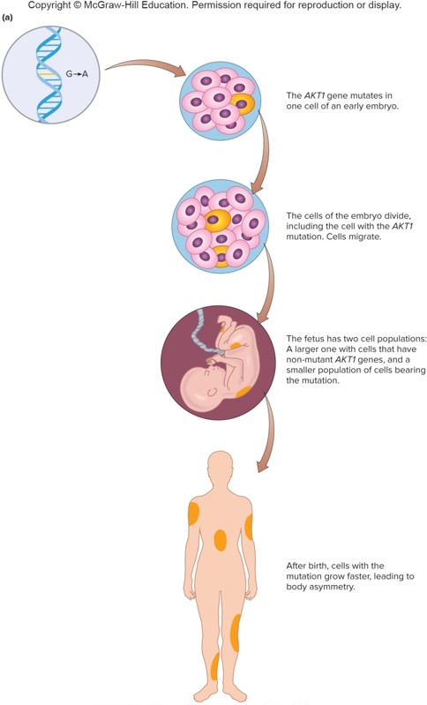
Somatic Mosaicism (2 of 3)
a: Source: The Proteus Syndrome Foundation, UK

Slide 10
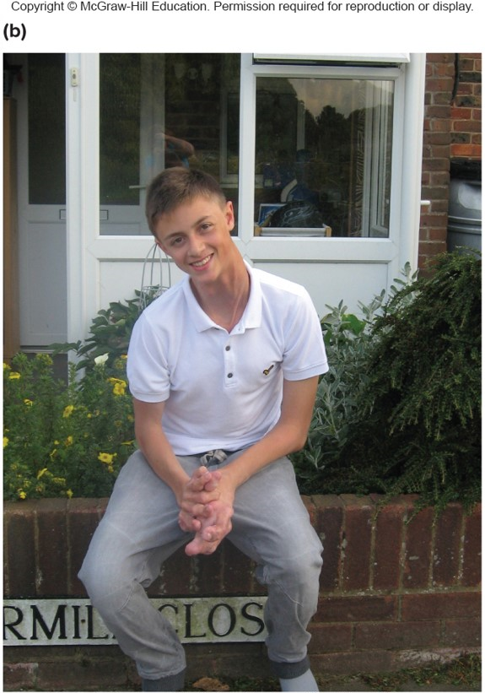
Somatic Mosaicism (3 of 3)
b: Courtesy of The Proteus Syndrome Foundation, UK

Slide 11
Mutations Alter Proteins
Identifying how a mutation causes symptoms has clinical applications
Examples of mutations that cause disease:
Beta globin gene
Collagen genes

Slide 12
Sickle Cell Anemia
Results from a single DNA base change in the β-globin gene, which replaces glutamic acid (6th position) with valine
First inherited illness linked to a molecular abnormality
Result is great pain in the blocked body parts, particularly the hands, feet, and intestines

Slide 13
Sickle Cell Disease

Slide 14
Thalassemia
Caused by another beta hemoglobin mutation
Too few beta globin chains
Excess of alpha globin prevents formation of hemoglobin molecules
Liberated iron slowly damages heart, liver, and endocrine glands
Thalassemia minor (heterozygous)
Thalassemia major (homozygous for mutation and more severe)

Slide 15
Collagen
A major component of connective tissue
Bone, cartilage, skin, ligament, tendon, and tooth dentin
More than 35 collagen genes encode more than 20 types of collagen molecules
Mutations in these genes lead to a variety of medical problems

Slide 16
Collagen Disorders
Table 12.1 Some Collagen Disorders
Disorder | Mutations (Genotype) | Signs and Symptoms (Phenotype)
Alport syndrome | Mutations in any of three genes (COL4A3, COL4A4, COL4A5) affect type IV collagen, which disrupts tissue boundaries. | Deafness and inflamed kidneys
Chondrodysplasia | Deletion, insertion, or missense mutation replaces Gly with bulky amino acids in COL2A1 type II collagen gene. | Stunted growth, deformed joints
Dystropic epidermolysis bullosa | Mutation in COL7A1 gene that encodes type VII collagen breaks down fibrils that attach epidermis to dermis. | Skin blisters upon any touch
Ehlers-Danlos syndrome | Diverse mutations in at least a dozen genes affect collagens or the molecules to which they bind. | Stretchy, easily scarred skin, lax joints
Osteoarthritis | Missense mutation in α1 collagen gene (COL1A1) substitutes Cys for Arg. | Painful joints
Osteogenesis imperfecta type I | Inactivation of α1 collagen gene (COL1A1 or COL1A2) reduces number of collagen triple helices by 50% | Easily broken bones; blue eye whites; deafness
Stickler syndrome | Nonsense mutations in type II procollagen gene (COL2A1 or COL11A1) reduce number of collagen molecules. | Joint pain, degeneration of vitreous gel and retina
Notes:
Copyright © McGraw-Hill Education. Permission required for reproduction or display.

Slide 17
Collagen Has a Precise Structure
Longer precursor, procollagen is trimmed to form collagen.
© Science Photo Library RF/Getty Images RF

Slide 18
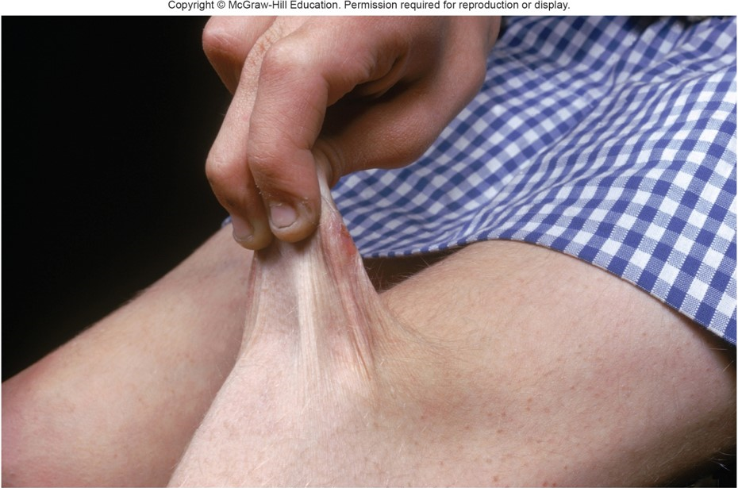
Ehlers-Danlos Syndrome
A mutation prevents procollagen chains from being cut.
Collagen molecules cannot assemble, and so skin becomes stretchy.
© Biophoto Associates/Science Source

Slide 19
Table 12.2 How Mutations Cause Disease (1 of 2)
Disease | Protein | Mutations (Genotype) | Signs and Symptoms (Phenotype)
Cystic fibrosis | Cystic fibrosis transmembrane regulator (CFTR) | Missing amino acid or other variant alters conformation of chloride channels in certain epithelial cell plasma membranes. Water enters cells, drying out secretions. | Frequent lung infection, pancreatic insufficiency
Duchenne muscular dystrophy | Dystrophin | Deletion eliminates dystrophin, which normally binds inner face of muscle cell to plasma membrane. Muscles weaken. | Gradual loss of muscle function
Familial hypercholesterolemia | LDL receptor | Deficient LDL receptors cause cholesterol to accumulate in blood. | High blood cholesterol, early heart disease
Hemophilia B | Factor IX | Absent or deficient clotting factor causes hard-to-control bleeding. | Slow or absent blood clotting
Notes:
Copyright © McGraw-Hill Education. Permission required for reproduction or display.

Slide 20
Table 12.2 How Mutations Cause Disease (2 of 2)
Disease | Protein | Mutations (Genotype) | Signs and Symptoms (Phenotype)
Huntington disease | Huntingtin | Extra bases add amino acids to the protein, which impairs certain transcription factors and proteasomes. | Uncontrollable movements, personality changes
Marfan syndrome | Fibrillin or transforming growth factor β receptor | Deficient proteins in lenses cause cataracts and in the wall of the aorta cause aneurysm (bursting). | Long limbs, weakened aorta, spindly fingers, sunken chest, lens dislocation
Neurofibromatosis type 1 | Neurofibromin | Defect in protein that normally suppresses activity of a gene that causes cell division; leading to abnormal growths. | Pigmented skin patches and benign tumors of nervous tissue beneath skin

Slide 21
Allelic Disorders
Different disease phenotypes caused by mutations in the same gene
Result from mutations in different parts of the gene
Be localized (a single base change)
Catastrophic (a missing gene)
Alter the protein in ways that affect its interactions with other proteins

Slide 22
Table 12.3 Allelic Diseases
Gene | Function | Associated Diseases
ATP7A | Copper transport | Menkes (“kinky hair”) disease; peripheral neuropathy
DMD | Dystrophin muscle protein | Duchenne and Becker muscular dystrophy
FBN1 | Encodes fibrillin-1, which forms tiny fibrils outside cells; a connective tissue protein | Marfan syndrome; systemic sclerosis (scleroderma; “stiff skin syndrome”)
FGFR3 | Fibroblast growth factor | Two types of dwarfism
GBA | Glucocerebrosidase | Gaucher disease; Parkinson disease
PSEN1 | Presenilin 1 (enzyme part that trims membrane proteins) | Acne inversa; Alzheimer disease
RET | Oncogene (causes cancer) | Multiple endocrine neoplasia; Hirschsprung disease
TRPV4 | Calcium channel | Peripheral neuropathy; spinal muscular atrophy
Notes:
Copyright © McGraw-Hill Education. Permission required for reproduction or display.

Slide 23
Causes of Mutations
Mutations may occur spontaneously or by exposure to a chemical or radiation.
An agent that causes a mutation is called a mutagen.

Slide 24
Spontaneous Mutation (1 of 2)
De novo or new mutations
Not caused by exposure to known mutagen
Result from errors in DNA replication
DNA bases have slight chemical instability
Exist in alternating forms called tautomers
As replication fork encounters unstable tautomers, mispairing can occur

Slide 25
Spontaneous Mutation (2 of 2)

Slide 26
Spontaneous Mutation Rate
Rate differs between genes.
Larger genes usually have higher mutation rates.
Each individual has multiple new mutations.
Mitochondrial genes mutate at a higher rate than nuclear genes because they cannot repair their DNA.

Slide 27
Determining Mutation Rate
Estimates of spontaneous mutation rate can be derived from observation of new, dominant traits
For autosomal genes,
Mutation rate = # of new cases/2X, where X = # of individuals examined

Slide 28
Mutational Hot Spots
In some genes, mutations are more likely to occur in regions called hot spots
Short repetitive sequences
Pairing of repeats may interfere with replication or repair enzymes
Palindromes
Often associated with insertions or deletions

Slide 29
DNA Symmetry Increases the Likelihood of Mutation

Slide 30
Gene Duplication and Deletion

Slide 31
Induced Mutations
Caused by mutagens, many are also carcinogens and cause cancer
Examples:
Alkylating agents—Remove a base
Acridine dyes—Add or remove base
X rays—Break chromosomes
UV radiation—Creates thymine dimers
Site-directed mutagenesis—Changes a gene in a desired way

Slide 32
Ames Test
An in vitro test of the mutagenicity of a substance
One version uses Salmonella bacteria with mutation in gene for histidine
Bacteria are exposed to test substance
Growth on media without histidine is recorded
Bacteria only grow if mutations have occurred

Slide 33
Exposure to Mutagens
Some mutagen exposure is unintentional
Workplace
Industrial accidents
Chernobyl
Medical treatments
Weapons
Natural sources
Cosmic rays, sunlight, earth’s crust

Slide 34
Types of Mutations (1 of 2)
Mutations can be classified in several ways
By whether they remove, alter, or add a function
By exactly how they structurally alter DNA

Slide 35
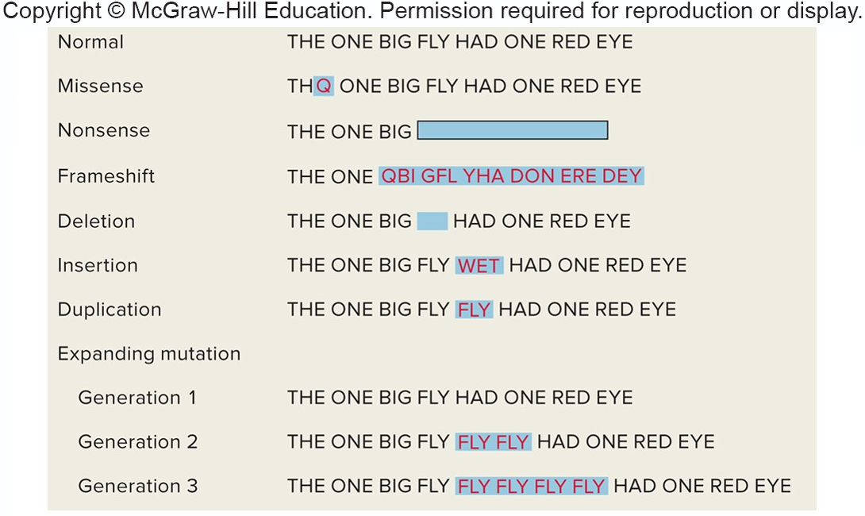
Types of Mutations (2 of 2)
Table 12.4
A sentence comprised of three-letter words analogies to the effects of mutations on a gene’s DNA sequence:

Slide 36
Point Mutations
A change of a single nucleotide
Transition = Purine replaces purine or pyrimidine replaces pyrimidine
A to G or G to A or
C to T or T to C
Transversion = Purine replaces pyrimidine or pyrimidine replaces purine
A or G to T or C
T or C to A or G

Slide 37
Consequences of Point Mutations
Missense mutation = Replaces one amino acid with another
Nonsense mutation = Changes a codon for an amino acid into a stop codon
Creates truncated proteins that are often nonfunctional
A stop codon that is changed to a coding codon lengthens the protein

Slide 38
Splice Site Mutations
Alters a site where an intron is normally removed from mRNA
Can affect the phenotype if:
Intron is translated or exon skipped
Example: CF mutation
Exon is skipped
Example: Familial dysautonomia (FD)

Slide 39
Deletions and Insertions (1 of 2)
The genetic code is read in triplets
Nucleotides changes not in multiples of 3 lead to disruptions of the reading frame
Cause a frameshift mutation and alter amino acids after mutation
Nucleotide changes in multiples of 3 will not cause a frameshift
But they can still alter the phenotype

Slide 40
Deletions and Insertions (2 of 2)
A deletion removes genetic material
Male infertility: Tiny deletions in the Y
An insertion adds genetic material
Gaucher disease: Insertion of one base
A tandem duplication is an insertion of identical sequences side by side
Charcot-Marie-Tooth disease: Tandem duplication of 1.5 million bases

Slide 41
Example: Familial hypercholesterolemia
Note: Different types of mutations can cause the same single-gene disorder Example: Familial hypercholesterolemia.

Slide 42
Pseudogenes
A DNA sequence similar to a gene but which is not translated
May have evolved from original gene by duplication and acquired mutation
Crossing over between a pseudogene and functional gene can disrupt gene expression

Slide 43
Expanding Repeats
Insertion of triplet repeats leads to extra amino acids.
The longer proteins shut down the cells.
Some genes are particularly prone to expansion of repeats.
Number of repeats correlates with earlier onset and more severe phenotype.
Anticipation is the expansion of the triplet repeat with an increase in severity of phenotype with subsequent generations.

Slide 44
Myotonic Dystrophy: A Triplet Repeat Disease

Slide 45
Copy Number Variants (CNV)
Are sequences that vary in number from person to person
Account for about a quarter of the genome
CNVs may have no effect on the phenotype or they can disrupt a gene’s function and harm health

Slide 46
Importance of Position
The degree that a mutation alters phenotype depends on:
Where in the gene the change occurs
How it affects conformation or expression of encoded protein
Examples—Hemoglobin and prions
Certain mutations exert effects while other do not

Slide 47
Table 12.5 Globin Mutations
Associated Phenotype | Name | Mutation
Clinically silent | Hemoglobin (Hb) Wayne | Single-base deletion in alpha globin gene causes frameshift, changing amino acids 139-141 and adding amino acids
 | Hb Grady | Nine extra bases add three amino acids between amino acids 118 and 119 of alpha chain
Oxygen binding | Hb Chesapeake | Change from arginine to leucine at amino acid 92 of beta chain
 | Hb McKees Rocks | Change from tyrosine to STOP codon at amino acid 145 in beta chain
Anemia | Hb Constant Spring | Change from STOP codon to glutamine elongates alpha chain
 | Hb S | Change from glutamic acid to valine at amino acid 6 in beta chain causes sickling
 | Hb Leiden | Amino acid 6 deleted from beta chain
Protection against malaria | Hb C | Change from glutamic acid to lysine at amino acid 6 in beta chain causes sickling
Notes:
Copyright © McGraw-Hill Education. Permission required for reproduction or display.

Slide 48
Not All Mutations Impact Protein Function (1 of 3)
Silent mutations are mutations that do not alter the encoded amino acid
Example:
A mutation from CAA to CAG alters the DNA, but the protein sequence remains unchanged
CAA and CAG both code for glutamine
These are called synonymous codons

Slide 49
Not All Mutations Impact Protein Function (2 of 3)
A missense mutation alters the encoded amino acid to another amino acid.
Creates a nonsynonymous codon
Some nonsynonymous mutations are conservative; Encode a chemically similar amino acid and may not alter function.
The impact of a missense mutation is not predictable from protein sequence alone.

Slide 50
Not All Mutations Impact Protein Function (3 of 3)
A conditional mutation produces a phenotype under particular conditions or environments.
Glucose 6-phosphate dehydrogenase enzyme responds to oxidants, chemicals that strip electrons from other molecules.
High levels of oxidants occur when eating fava beans or taking certain antimalarial drugs.

Slide 51
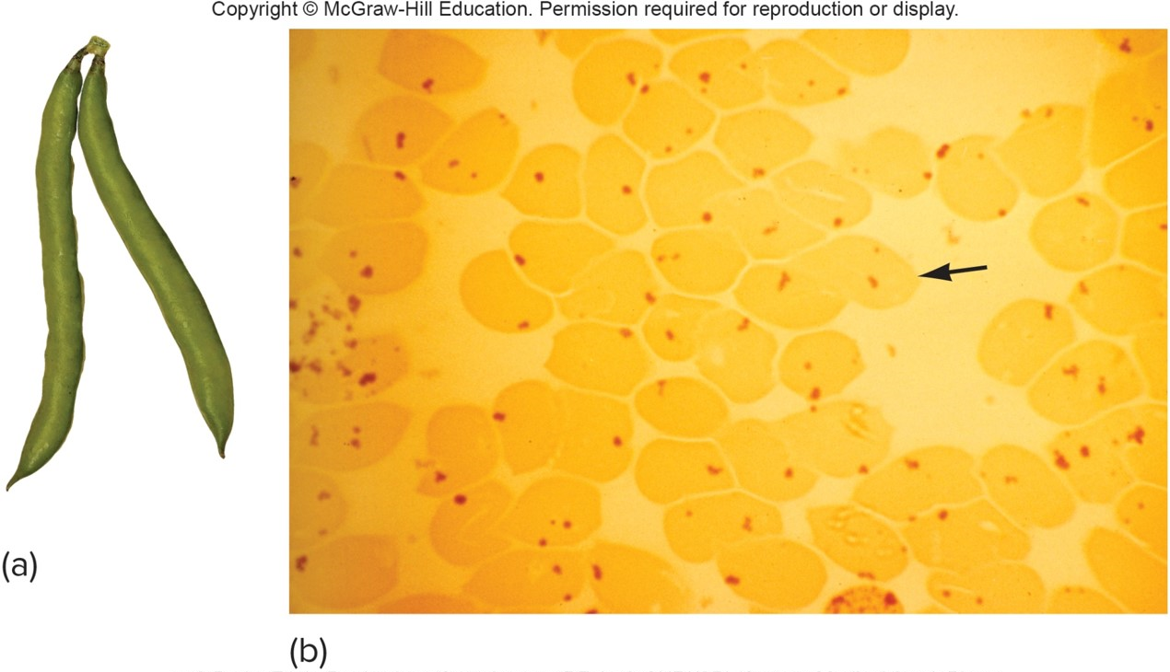
G6PD Deficiency Hemolytic Anemia
a: © Burke Triolo Productions/Getty Images RF; b; © CNRI/SPL/Custom Medical Stock Photo

Slide 52
DNA Repair
Errors in DNA replication or damage to DNA create mutations.
May result in cancer
Fortunately, most errors and damage are repaired.
Type of repair depends upon the type of damage or error.
Organisms vary in their ability to repair DNA.

Slide 53
Types of DNA Repair
In many modern species, three types of DNA repair peruse the genetic material:
Photoreactivation repair
Excision repair
Mismatch repair

Slide 54
Photoreactivation Repair
Enzymes called photolyases use light energy to break the extra bonds in a pyrimidine dimer
Enables UV-damaged fungi to recover from exposure to sunlight
Humans do not have this type of repair

Slide 55
Excision Repair (1 of 2)
Pyrimidine dimers and surrounding bases are removed and replaced
Humans have two types of excision repair
Nucleotide excision repair
Replaces up to 30 bases
Corrects mutations caused by different insults
Base excision repair
Replaces 1–5 bases
Specific to oxidative damage

Slide 56
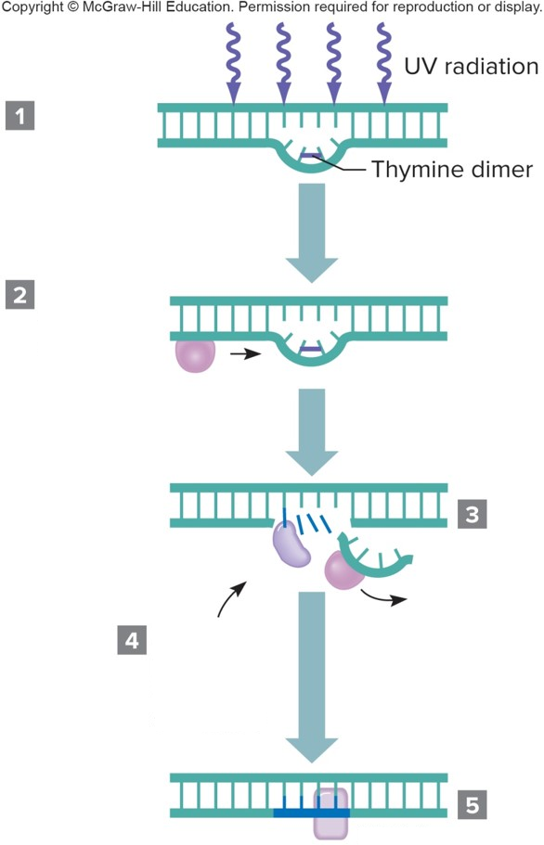
Excision Repair (2 of 2)
DNA damage
Repair enzymes arrive
Enzyme removes incorrect sequence
DNA polymerase creates new sequence
DNA ligase seals sugar-phosphate backbone

Slide 57
Mismatch Repair (1 of 2)
Enzymes detect nucleotides that do not base pair in newly replicated DNA.
The incorrect base is excised and replaced.
Proofreading is the detection of mismatches.

Slide 58
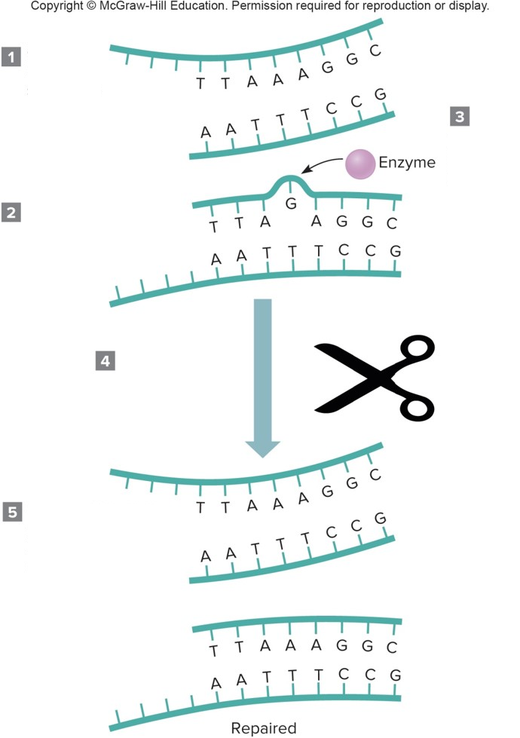
Mismatch Repair (2 of 2)
Correct DNA sequence
Mispairing causes bulge
Enzyme detects mismatch
Enzyme removes mismatched G, replaces with A
Correct sequence restored, DNA replication continues

Slide 59
DNA Repair Mechanisms

Slide 60
Failure of DNA Repair
If both copies of a repair gene are mutant, a disorder can result
The protein p53 monitors repair of DNA
If damage is too severe, the p53 protein promotes programmed cell death or apoptosis
Mutations may occur in genes encoding DNA repair proteins
Lead to overall increase in mutations

Slide 61
Repair Disorders: Trichothiodystrophy
At least five genes are involved
Symptoms reflect accumulating oxidative damage
Faulty nucleotide excision repair or base excision repair or both

Slide 62
Repair Disorders: Inherited Colon Cancer
Hereditary nonpolyposis colon cancer
Affects 1/200 individuals
Defect in mismatch repair
HNPCC gene is on chromosome 2

Slide 63
Repair Disorders: Xeroderma Pigmentosum (1 of 2)
Autosomal recessive; Seven genes involved
Malfunction of excision repair
Thymine dimers remain and block replication
Must avoid sunlight
Only 250 cases worldwide

Slide 64
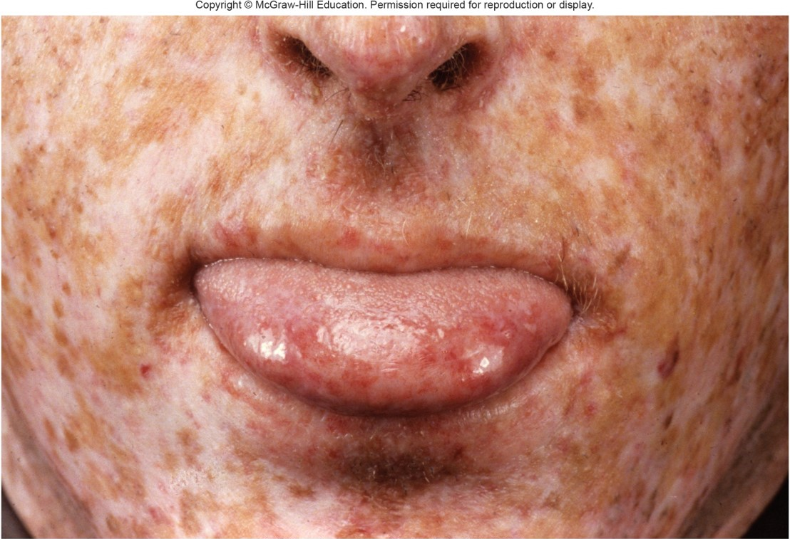
Repair Disorders: Xeroderma Pigmentosum (2 of 2)
© Wellcome Image Library/Custom Medical Stock Photo

Slide 65
Repair Disorders: Ataxia Telangiectasis
Autosomal recessive disorder
Defect in cell cycle checkpoint kinase
Cells continue through cell cycle without pausing to inspect DNA
Individuals with AT have 50 times the risk of developing over general population
Heterozygotes have a two- to sixfold increase in cancer risk

Slide 66
End of Presentation

