Slide 1
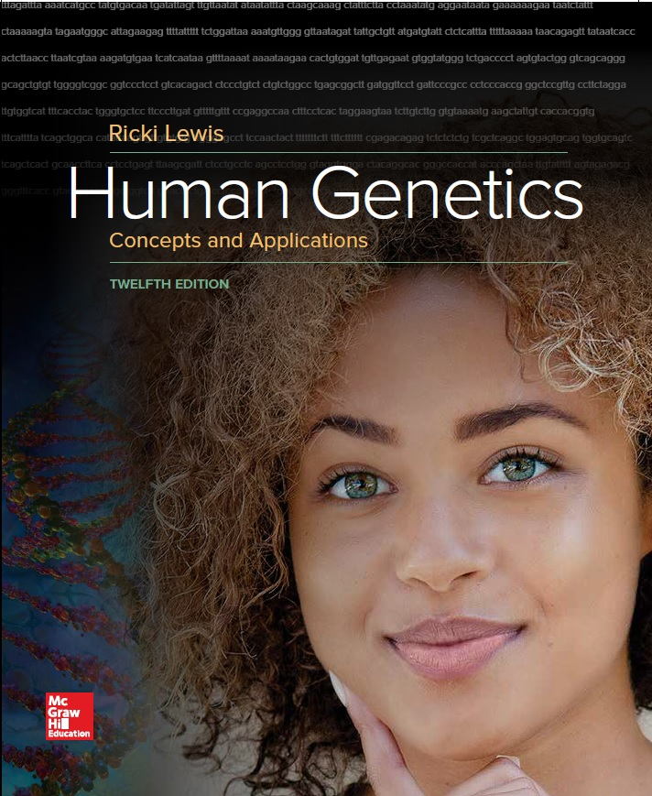
Human Genetics Concepts and Applications
Twelfth Edition
Chapter 11
Gene Expression and Epigenetics
© McGraw-Hill Education. All rights reserved. Authorized only for instructor use in the classroom. No reproduction or further distribution permitted without the prior written consent of McGraw-Hill Education.

Slide 2
Learning Outcomes
Define epigenetic.
Explain how globin chain switching, development of organs, and the types of proteins cells make over time illustrate gene expression.
Explain how small molecules binding to histone proteins control gene expression by remodeling chromatin.
Explain how microRNAs control transcription.
Explain how division of genes into exons and introns maximizes the number of encoded proteins.
Discuss how viral DNA, noncoding RNAs, and repeated DNA sequences account for large proportions of the human genome.

Slide 3
Gene Expression through Time and Tissue
Changes in gene expression may occur over time and in different cell types
May occur at the molecular, tissue, or organ/gland level
Epigenetic changes
Changes to the chemical groups that associate with DNA that are transmitted to daughter cells after cell division

Slide 4
Hemoglobin (1 of 2)
Adult hemoglobin has four globular polypeptide chains:
Two alpha (α) chains = 141 amino acids
Encoded on chromosome 11
Two beta (β) chains = 146 amino acids
Encoded on chromosome 16

Slide 5
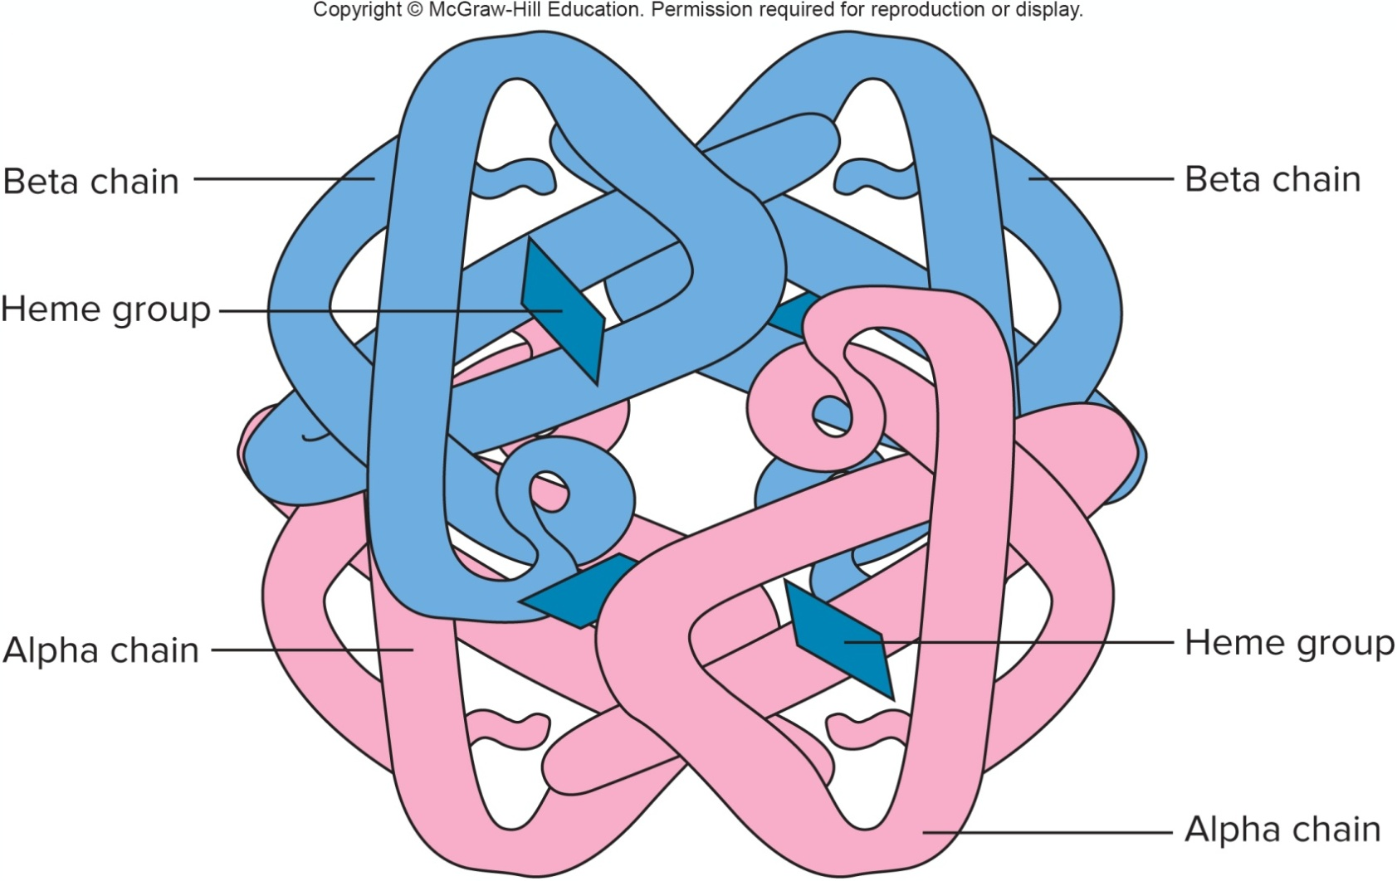
Hemoglobin (2 of 2)
Each globin surrounds an iron-containing heme group.

Slide 6
Globin Chain Switching (1 of 2)
Subunits change in response to oxygen levels.
Subunit makeup varies over lifetime.
Embryo—Two epsilon (ε) + two zeta (ζ)
Fetus—Two gamma (γ) + two alpha (α)
Adult—Two beta (β) + two alpha (α)
Adult type is about 99% of hemoglobins by four years of age.

Slide 7
Globin Chain Switching (2 of 2)

Slide 8
Changing Gene Expression in Blood Plasma
Blood plasma contains about 40,000 different types of proteins.
Changing conditions cause a change in the protein profile of the plasma.
Stem cell biology is shedding light on how genes are turned on and off.

Slide 9
Pancreas
Dual gland
Exocrine part releases digestive enzymes into ducts
Endocrine part secretes polypeptide hormones directly into the bloodstream
Differential gene expression produces either endocrine or exocrine cells.
If transcription factor pdx-1 is activated, some progenitor cells follow the exocrine pathway.
Other progenitor cells respond to different signals and yield daughter cells that follow the endocrine pathway.

Slide 10
Building a Pancreas

Slide 11
Transcriptomics and Proteomics
Transcriptomics identifies all the mRNA molecules made in a specific cell under specific circumstances.
Proteomics identifies all the proteins a cell manufactures under specific condition.
Proteins can be charted based on the relative abundance of each class at different stages of development.

Slide 12
The Diseasome (1 of 2)
It connects diseases that share genes that have altered expression.
Diseases such as obesity, hypertension, diabetes share certain gene links.
It is found that Duchenne muscular dystrophy and heart attack shares a link.

Slide 13
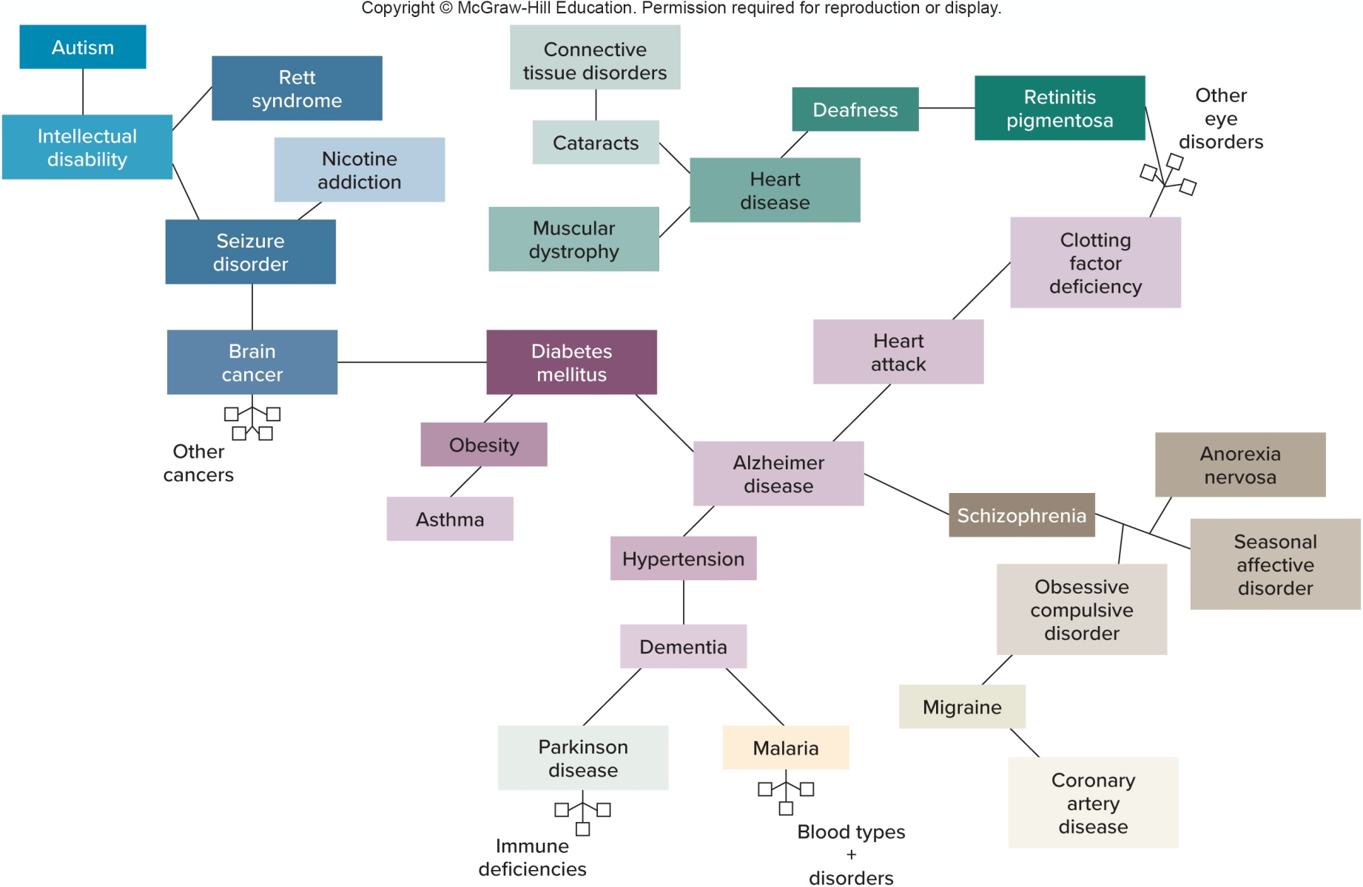
The Diseasome (2 of 2)

Slide 14
Control of Gene Expression (1 of 2)
Protein-encoding gene contains some controls over its own expression level.
Promoter sequence (mutations)
Extra copies of gene
Much of the control of gene expression occurs in two general processes.
Chromatin remodeling—On/off switch
microRNAs—Dimmer switch

Slide 15
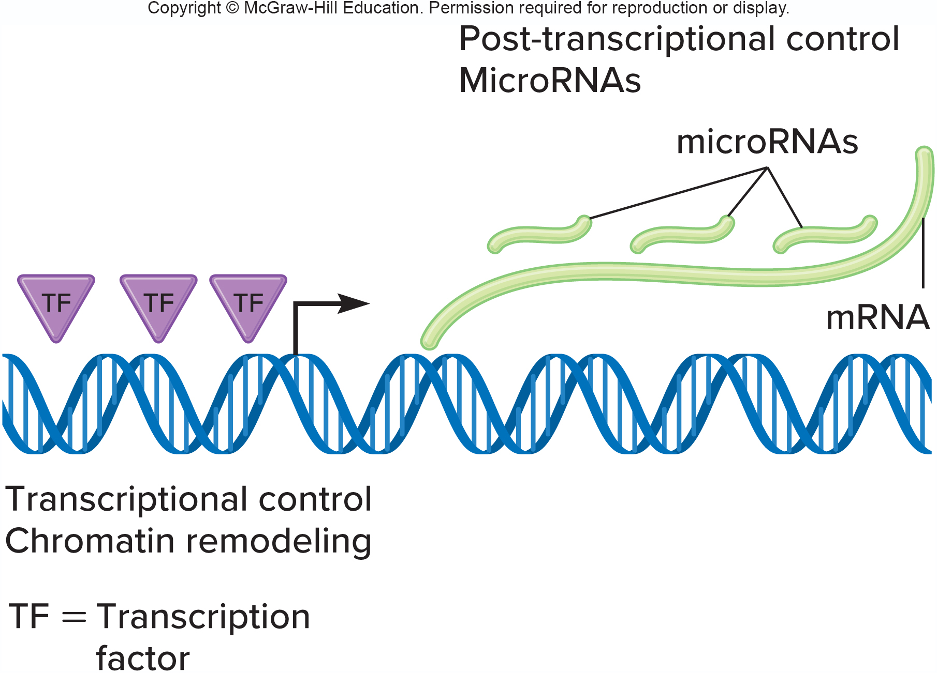
Control of Gene Expression (2 of 2)

Slide 16
Chromatin Remodeling
Histones play major role in gene expression.
Expose DNA when and where it is to be transcribed and shield it when it is to be silenced
Major types of small molecules that bind to histones.
Acetyl group
Methyl groups
Phosphate groups

Slide 17
Acetylated Histones Allow Transcription to Begin
Acetyl binding can subtly shift histone interactions in a way that eases transcription.

Slide 18
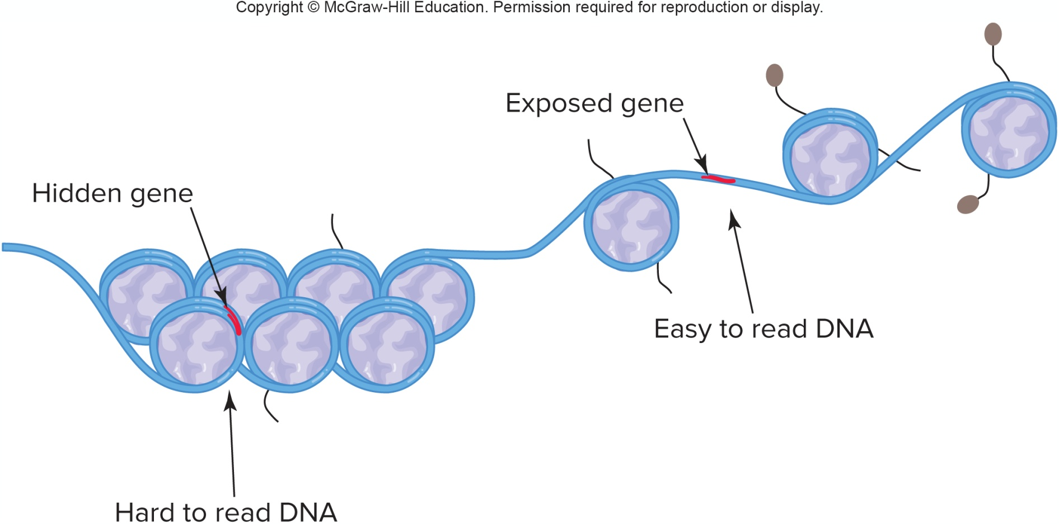
Closed Chromatin

Slide 19
MicroRNAs (1 of 2)
Belong to a class of molecules called noncoding RNAs
21–22 bases long
Human genome has about 1000 distinct microRNAs that regulate at least 1/3rd of the protein-encoding genes
When a microRNA binds to a target mRNA, it prevents translation

Slide 20
MicroRNAs (2 of 2)
Cancer provides a practical application of microRNAs.
Certain microRNAs are more or less abundant in cancer cells than in healthy ones.
Related technology is called RNA interference (RNAi).
Small synthetic, double-stranded RNA molecules are introduced into selected cells to block gene expression.

Slide 21
Maximizing Genetic Information (1 of 4)
Human genome contains about 20,325 genes.
Encode about 100,000 mRNAs, which in turn specify more than a million proteins
Several events account for the fact that proteins outnumber genes.

Slide 22
Maximizing Genetic Information (2 of 4)

Slide 23
Maximizing Genetic Information (3 of 4)
Genes in pieces pattern of exons and introns and alternate splicing help to greatly expand the gene number.

Slide 24
Maximizing Genetic Information (4 of 4)
Intron in one gene’s template strand may encode a protein on the coding strand.
Information is also maximized when a protein undergoes post-translational modifications.
Addition of sugars and lipids to create glycoproteins and lipoproteins
Another way that one gene can encode more than one protein is if the protein is cut to yield two products
Happens in dentinogenesis imperfecta
Caused by a deficiency in the two proteins DPP and DSP
Both are cut from the same DSPP protein

Slide 25
DPP and DSP

Slide 26
Most Human Genomes Do Not Encode Protein
Only 1.5% of human DNA encodes protein
Rest of genome includes:
Viral DNA
Noncoding RNAs
Introns
Promoters and other control sequences
Repeated sequences

Slide 27
Viral DNA
About 8% of our genome is derived from RNA viruses called retroviruses.
Evidence of past infection
Sequences tend to increase over time
The genetic material in the human chromosomes are called human endogenous retroviruses, or HERVs

Slide 28
Noncoding RNAs
Nearly all of the human genome can be transcribed, and much of it is in the form of noncoding RNAs (ncRNAs).
Includes rRNAs and tRNAs
Hundreds of thousands of other ncRNAs exist
Transcribed from pseudogenes
Not translated into protein

Slide 29
Repeats
Transposons are the most abundant type of repeat.
Sequences that jump about the genome
Alu repeats can copy themselves
Comprise about 2–3% of the genome
Rarer classes of repeats include those that comprise telomeres, centromeres, and rRNA gene clusters.

Slide 30
Table 11.2 Some Non-Protein-Encoding Parts of the Human Genome (1 of 2)
Types of Sequence | Function or Characteristic
Viral DNA | Evidence of past infection
Noncoding RNA genes
tRNA genes | Connect mRNA codons to amino acids
rRNA genes | Parts of ribosomes
Long noncoding RNAs | Control of gene expression
Pseudogenes | DNA sequences very similar to known genes that are not translated
Piwi-interacting RNA (piRNA) | Keeps transposons out of germline cells
Large intergenic noncoding RNAs | Between genes
Small nucleolar RNAs (snoRNAs) | Process rRNAs in nucleolus
Small nuclear RNAs (snRNAs) | Parts of spliceosomes
Telomerase RNA | Adds bases to chromosome tips
Xist RNA | Inactivates one X chromosome in cells of females

Slide 31
Table 11.2 Some Non-Protein-Encoding Parts of the Human Genome (2 of 2)
Types of Sequence | Function or Characteristic
Introns | Parts of genes that are cut out of mRNA
Promoters and other control sequences | Guide enzymes that carry out DNA replication, transcription, or translation
Small interfering RNAs (siRNAs) | Control translation
MicroRNAs (miRNAs) | Control translation of many genes
Repeats
Transposons | Repeats that move around the genome
Telomeres | Protect chromosome tips
Centromeres | Largest constrictions in chromosomes, providing attachment points for spindle fibers

Slide 32
End of Presentation

