Slide 1
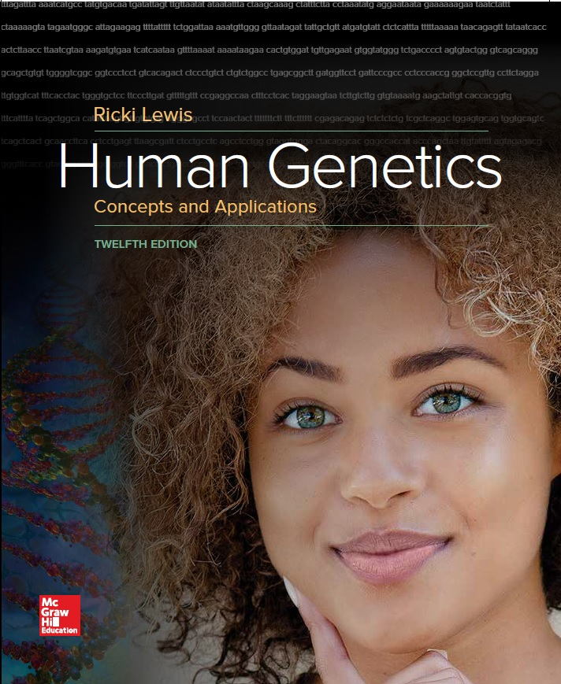
Human Genetics Concepts and Applications
Twelfth Edition
Chapter 10
Gene Action: From DNA to Protein
© McGraw-Hill Education. All rights reserved. Authorized only for instructor use in the classroom. No reproduction or further distribution permitted without the prior written consent of McGraw-Hill Education.

Slide 2
Learning Outcomes
Dietary proteins are digested into amino acids.
Genes provide instructions for linking amino acids into proteins.
List the major types of RNA molecules and their functions.
Explain the importance of transcription factors.
List the steps of transcription.
Discuss how researchers deduced the genetic code.
List the steps of protein synthesis.
Define the four components of a protein’s shape.
Explain the importance of protein folding.

Slide 3
Proteins
The 20,325 or so proteins the human has are coded by protein coding genes, termed the exome.
Proteins serve many vital functions; some of these functions are contractile, regulatory, enzymatic, structural, transport, immunity, and clotting.
Proteins are comprised of one or more long chains of amino acids called polypeptides.
There 20 naturally occurring amino acids.
Each amino acid has a central carbon atom that bonds to an amino group (NH₂) and an acidic group (COOH), a hydrogen atom (H), and a variable “R” group.
It is the R group that distinguishes the 20 types of amino acids.

Slide 4
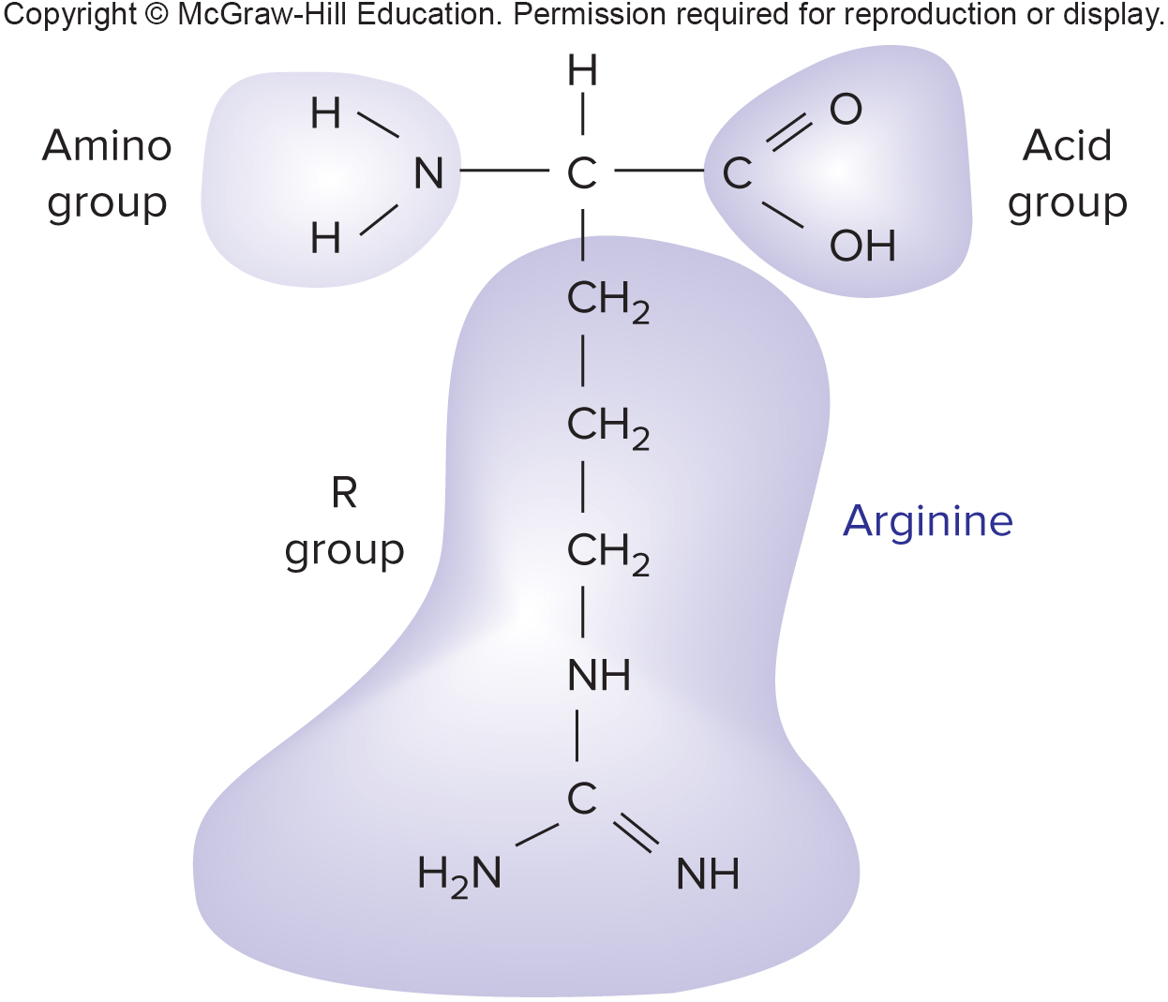
Amino Acid Structure

Slide 5
Gene Expression (1 of 2)
DNA of the human genome which encodes protein is called the exome.
However, this represents only a small part of the genome.
Much of the human genome controls protein synthesis.
Including the time, speed, and location
Genes encode 20,325 types of proteins.

Slide 6
Gene Expression (2 of 2)
Production of protein from instructions on the DNA
Gene expression requires several steps:
Transcription = Synthesizes an RNA molecule
Translation = Uses the information in the RNA to manufacture a protein by aligning and joining specified amino acids
Folding of the protein into specific 3-D form

Slide 7
Central Dogma
The directional flow of genetic information

Slide 8
RNA Structure and Types
RNA is the bridge between gene and protein.
Bases of an RNA sequence are complementary to those of one strand of the double helix, called the template strand.
RNA polymerase builds an RNA molecule.
Nontemplate strand of the DNA double helix is called the coding strand.

Slide 9
Transcription

Slide 10
Nucleic Acids (1 of 2)
There are two types of nucleic acids:
RNA
DNA
Both consist of sequences of nitrogen-containing bases joined by sugar-phosphate backbones.
However, they differ in several aspects.

Slide 11
Nucleic Acids (2 of 2)
Table 10.1 How DNA and DNA Differ
DNA | RNA
Usually double-stranded | Usually single-stranded
Thymine as a base | Uracil as a base
Deoxyribose as the sugar | Ribose as the sugar
Maintains protein-encoding information | Carries protein-encoding information and controls how information is used
Cannot function as an enzyme | Can function as an enzyme
Persists | Short-lived

Slide 12
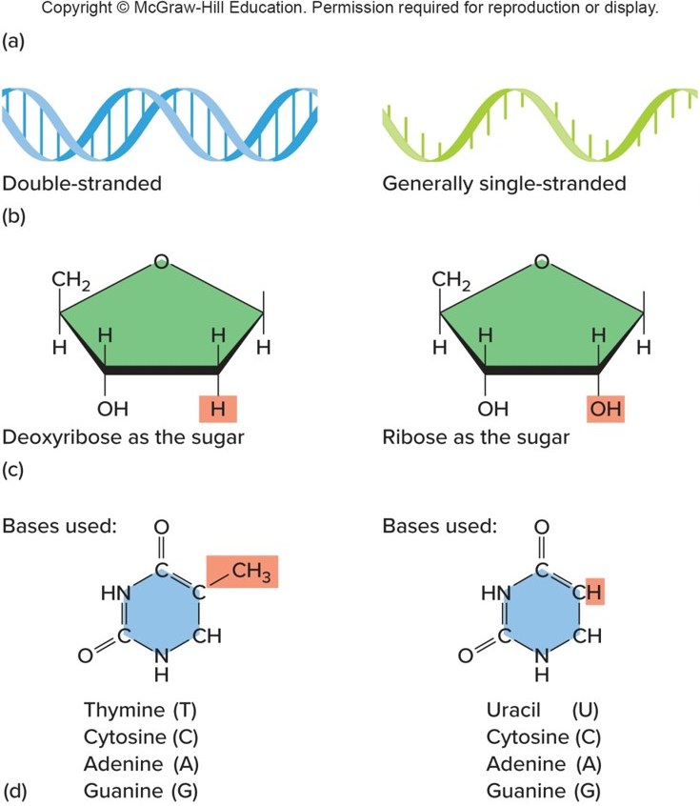
DNA and RNA Differences
DNA
Stores RNA- and protein-encoding information, and transfers information to daughter cells
RNA
Carries protein-encoding information, and helps to make proteins

Slide 13
Types of RNA
There are three major types of RNA:
Messenger RNA or mRNA
Ribosomal RNA or rRNA
Transfer RNA or tRNA
Other classes of RNA control gene expression

Slide 14
Table 10.2 Major Types of RNA
Type of RNA | Size (number of nucleotides) | Function
Messenger RNA (mRNA) | 500 to 4,500+ | Encodes amino acid sequence
Ribosomal RNA (rRNA) | 100 to 3,000 | Associates with proteins to form ribosomes, which structurally support and catalyze protein synthesis
Transfer RNA (tRNA) | 75 to 80 | Transports specific amino acids to the ribosome for protein synthesis

Slide 15
mRNA
Carries information that specifies a particular protein
Three mRNA bases in a row form a codon which specifies a particular amino acid
Most mRNAs are 500–4500 bases long
Differentiated cells produce certain mRNA molecules called transcripts
Information in the transcripts is used to manufacture the encoded proteins

Slide 16
rRNA (1 of 2)
Most rRNAs are from 100–3000 nucleotides long
Associate with proteins to form ribosomes
Ribosomes consist of two subunits that join during protein synthesis
rRNAs provide structural support
Some are catalysts (ribozymes) and others help align the ribosome and mRNA

Slide 17
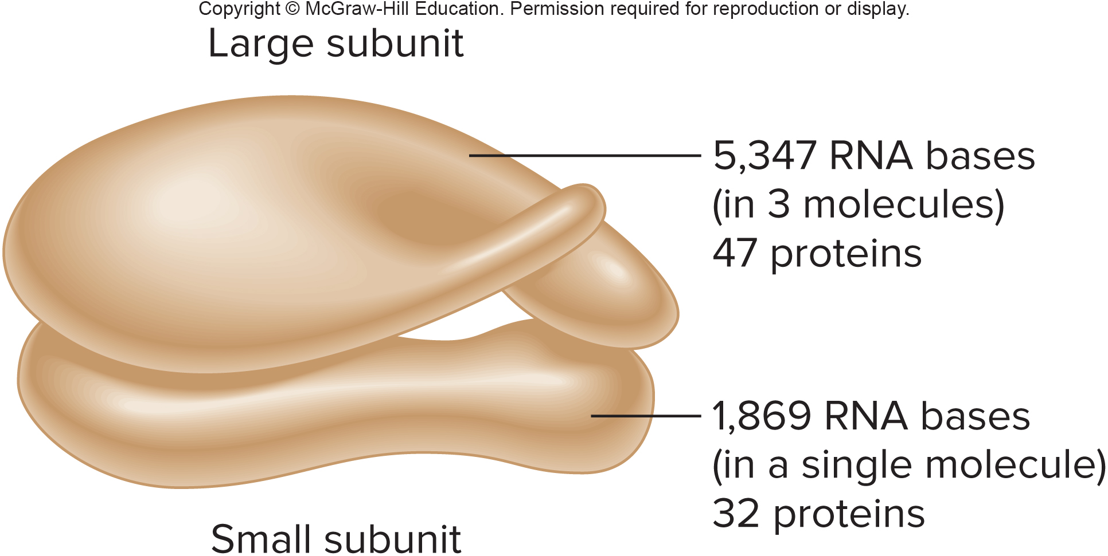
rRNA (2 of 2)

Slide 18
tRNA
Binds an mRNA codon and a specific amino acid
Only 75–80 nucleotides long
The 2-D shape is a cloverleaf shape
The 3-D shape is an inverted L
Has two ends:
The anticodon is complementary to an mRNA codon
The opposite end strongly bonds to a specific amino acid

Slide 19
Transfer RNA

Slide 20
Transcription Factors
Interact and form an apparatus that binds DNA at certain sequences
Initiates transcription at specific sites on chromosomes
Respond to signals from outside the cell
Link the genome to the environment
Mutations in transcription factors may cause a wide range of effects

Slide 21
Steps of Transcription (1 of 2)
Transcription is described in three steps:
Initiation
Elongation
Termination
In transcription initiation, transcription factors and RNA polymerase are attracted to a promoter.
RNA polymerase joins the complex, binding in front of the start of the gene sequence.

Slide 22
Steps of Transcription (2 of 2)
In transcription elongation, enzymes unwind the DNA double helix.
Free RNA nucleotides bond with exposed complementary bases on the DNA template strand.
RNA polymerase adds the RNA nucleotides, in the sequence the DNA specifies.
A terminator sequence in the DNA indicates where the gene’s RNA-encoding region ends.

Slide 23
Setting the Stage for Transcription to Begin

Slide 24
Transcription of RNA from DNA

Slide 25
Simultaneous Transcription of mRNAs
Several mRNAs may be transcribed from the same template DNA strand at a time.

Slide 26
RNA Processing (1 of 2)
In eukaryotes, mRNA must exit the nucleus to enter the cytoplasm.
Several steps process pre-mRNA into mature mRNA.
A methylated cap is added to the 5’ end.
Recognition site for protein synthesis
A poly A tail is added to the 3’ end.
Necessary for protein synthesis to begin and stabilizes the mRNA

Slide 27
RNA Processing (2 of 2)
Splicing occurs.
Introns (“intervening sequences”) are removed.
Ends of the remaining molecule are spliced together.
Exons are parts of mRNA that remain, translated into amino acid sequences.
Note that introns may outnumber and outsize exons.
mRNA is proofread and the mature mRNA is sent out of the nucleus.

Slide 28
Alternate Splicing
Mechanism of combining exons of a gene in different ways:
Cell types can use versions of the same protein in slightly different ways in different tissues

Slide 29
Messenger RNA Processing—the Maturing of the Message

Slide 30
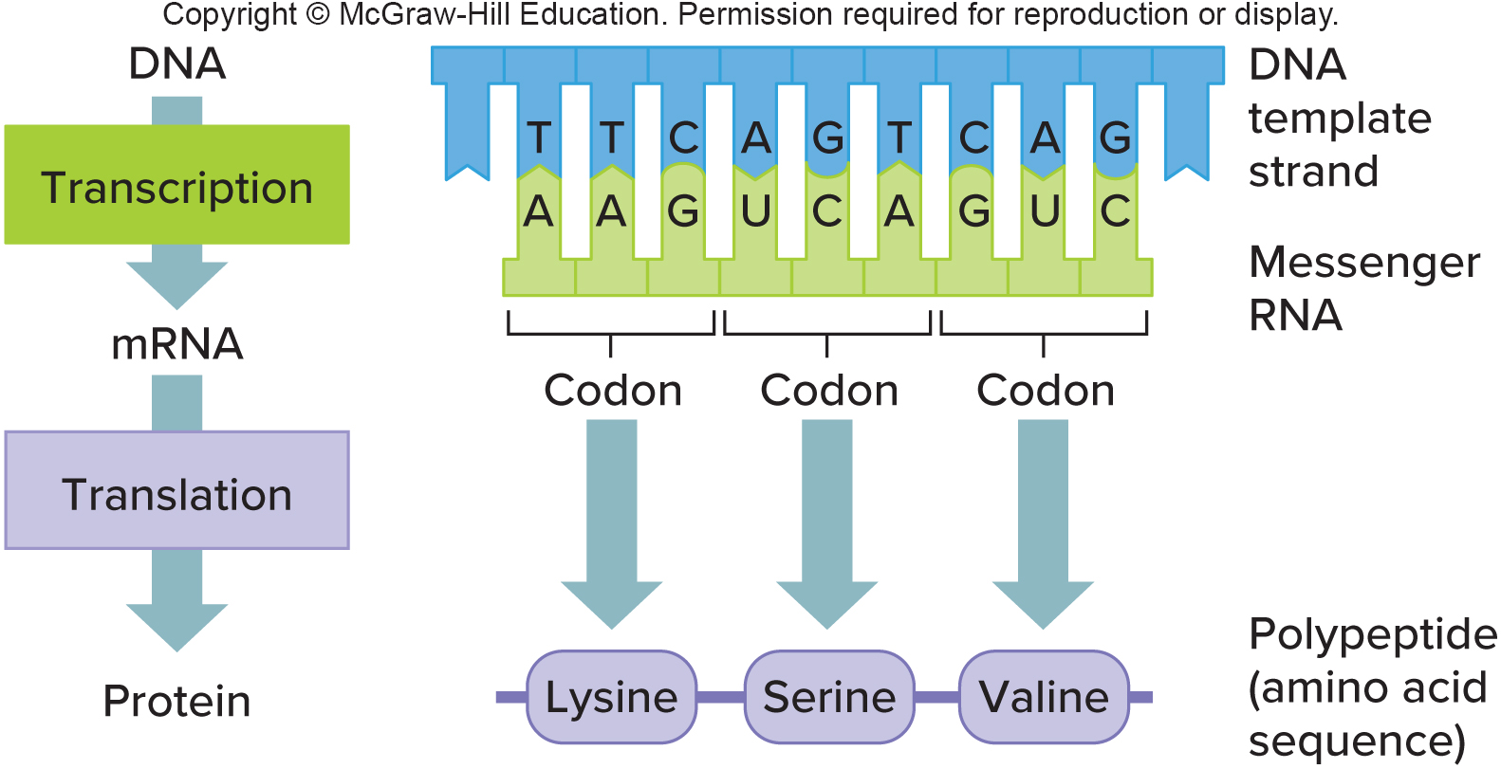
Translation
Assembles a protein using the information in the mRNA sequence
Particular mRNA codons correspond to particular amino acids
Occurs on the ribosome

Slide 31
The Genetic Code (1 of 5)
The correspondence between the chemical languages of mRNA and proteins
In the 1960s, researchers used logic and clever experiments on simple genetic systems to decipher the genetic code

Slide 32
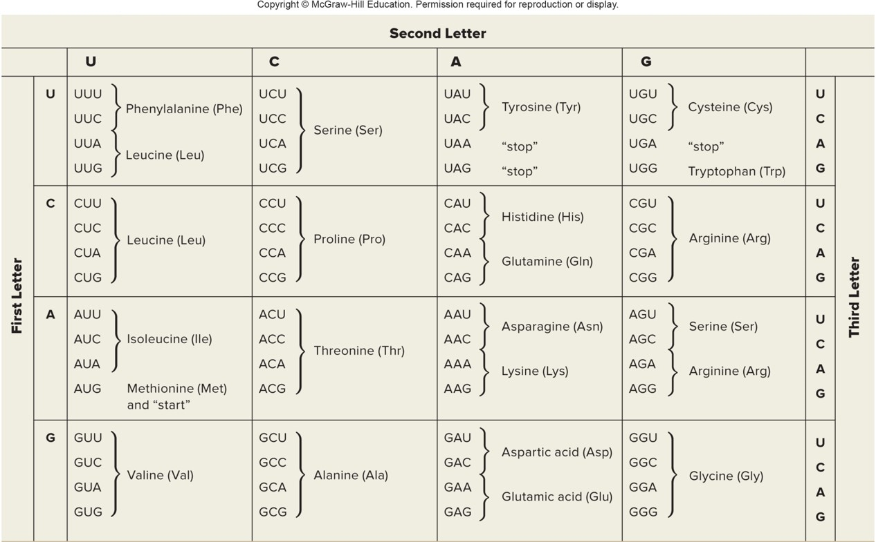
The Genetic Code (2 of 5)
Table 10.3 The Genetic code*
*The genetic code consists of mRNA triplets and the amino acids that they specify.

Slide 33
The Genetic Code (3 of 5)
It is a triplet code.
Three successive mRNA bases form a codon.
There are 64 codons.
Altering the DNA sequence by one or two bases produced a different amino acid sequence due to disruption in the reading frame.
Adding a base at one point and deleting a base at another point disrupted the reading frame between the sites.

Slide 34
The Genetic Code (4 of 5)
It is nonoverlapping.
In an overlapping DNA sequence, certain amino acids would follow others, constraining protein structure
It includes controls.
Includes directions for starting and stopping translation
An open reading frame does not include a stop codon

Slide 35
The Genetic Code (5 of 5)
It is universal.
Evidence that all life evolved from a common ancestor
Different codons that specify the same amino acid are termed synonymous codons
Nonsynonymous codons encode different amino acids

Slide 36
Three at a Time

Slide 37
Reading Frame

Slide 38
Translation—Building a Protein
Requires mRNA, tRNAs with amino acids, ribosomes, energy molecules (ATP, GTP) and protein factors
Divided into three steps:
Initiation
Elongation
Termination

Slide 39
Translation Initiation
The leader sequence of the mRNA forms H bonds with the small ribosomal subunit.
The start codon (AUG) attracts an initiator tRNA that carries methionine.
This completes the initiation complex.

Slide 40
Translation Begins as the Initiation Complex Forms

Slide 41
Translation Elongation (1 of 2)
The large ribosomal subunit joins.
GGA bonds to its complementary anticodon, which is part of a free tRNA that carries the amino acid glycine.
Two amino acids attached to their tRNAs align.

Slide 42
Translation Elongation (2 of 2)
Positions of the sites on the ribosome remain the same, cover different parts of the mRNA as the ribosome moves.
The P site bears growing amino acid chain.
The A site holds the next amino acid to be added to the chain.
Amino acids link by a peptide bond, with the help of rRNA that functions as a ribozyme.
The polypeptide builds one amino acid at a time.
Each piece is brought in by a tRNA whose anticodon corresponds to a consecutive mRNA codon as the ribosome moves down the mRNA.

Slide 43
Building a Polypeptide

Slide 44
Translation Termination
Occurs when a stop codon enters the A site of the ribosome
A protein release factor frees the polypeptide
The ribosomal subunits separate and are recycled
New polypeptide is released

Slide 45
Terminating Translation

Slide 46
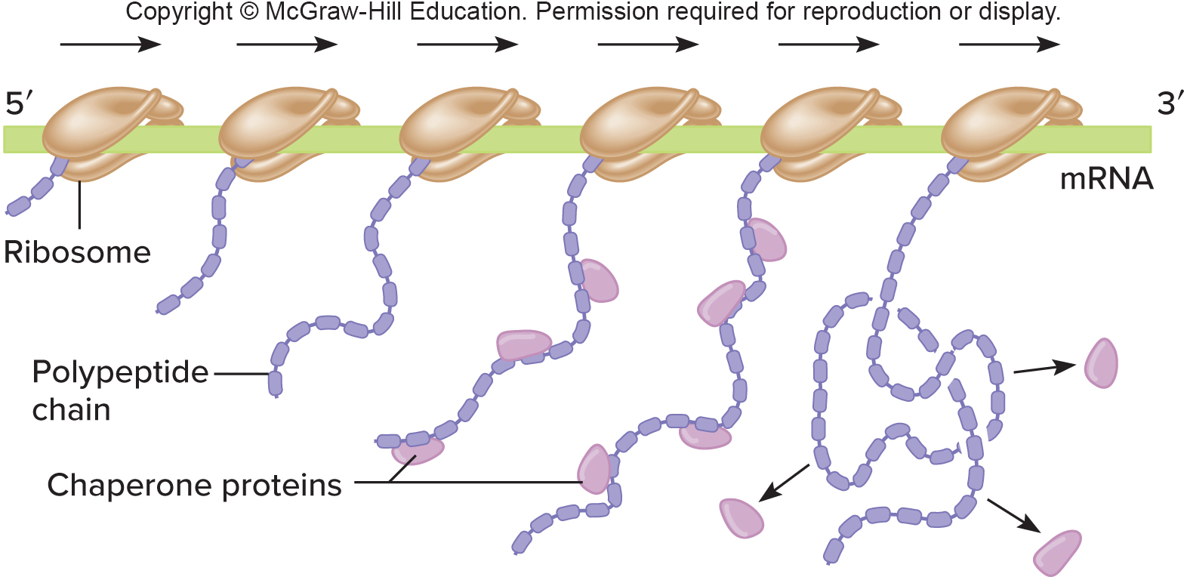
Multiple Copies of a Protein Can Be Made Simultaneously
The closer to the end of the gene, the longer the polypeptide

Slide 47
Protein Structure
Proteins fold into one or more 3-D shapes or conformations
Based on attraction and repulsion between atoms of proteins, and interactions of proteins with chemicals in the environment
There are four levels for protein structure:
Primary (1°) structure
Secondary (2°) structure
Tertiary (3°) structure
Quaternary (4°) structure

Slide 48
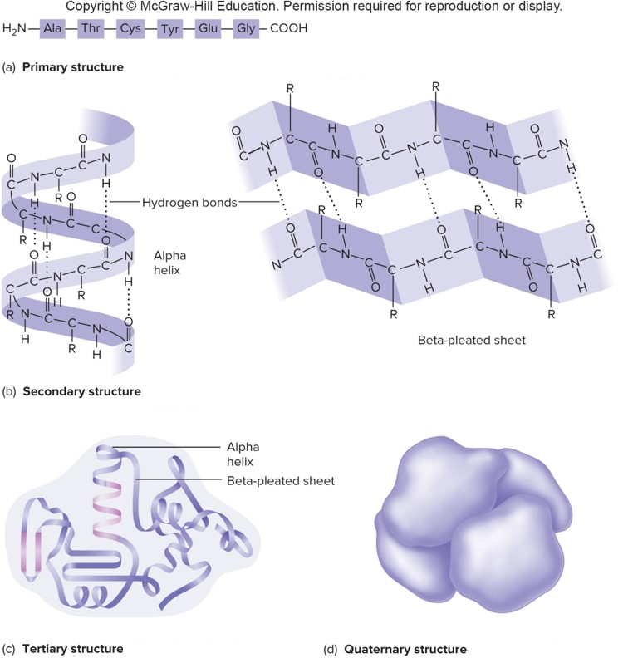
Four Levels of Protein Structure (1 of 2)

Slide 49
Four Levels of Protein Structure (2 of 2)
Primary structure-the sequence of amino acids in a polypeptide chain
Secondary structure-loops, coils, sheets, or other shapes formed by hydrogen bonds between neighboring carboxyl and amino groups
Tertiary structure-three dimensional forms shaped by bonds between R groups, interaction between R groups and water
Quaternary structure-protein complexes formed by bonds between separate polypeptides

Slide 50
Protein Folding (1 of 2)
Proteins begin to fold after the amino acid chain winds away from the ribosome.
First few amino acids in a protein secreted in a membrane form a “signal sequence.”
Leads it and the ribosome into a pore in the ER membrane
Not found on proteins synthesized on free ribosomes

Slide 51
Protein Folding (2 of 2)
Chaperone proteins
Stabilize partially folded regions in their correct form
Prevent a protein from getting stuck in an intermediate form
Developed into drugs to treat diseases that result from misfolded proteins

Slide 52
Protein Misfolding (1 of 4)
Misfolded proteins are tagged with ubiquitin.
Protein with more than one tag is taken to a proteasome, a tunnel-like multiprotein structure.
As the protein moves through the tunnel, it is straightened and dismantled.
Proteasomes also destroy properly folded proteins that are in excess or no longer needed.

Slide 53
Protein Misfolding (2 of 4)

Slide 54
Protein Misfolding (3 of 4)
Proteins misfold from a mutation, or by having more than one conformation.
A mutation alters the attractions and repulsions between parts of the protein.
Prion protein can fold into any of several conformations.
Moreover, it can be passed on to other proteins upon contact, propagating like an infectious agent.
In several disorders that affect the brain, the misfolded proteins aggregate.
The protein masses that form clog the proteasomes and inhibit their function.
Different proteins are affected in different disorders.

Slide 55
Protein Misfolding (4 of 4)
Table 10.4 Diseases Associated with Protein Misfolding
Disease | Misfolded Protein(s)
Alzheimer disease | Amyloid beta precursor protein, tau proteins
Familial amyotrophic lateral sclerosis | Superoxide dismutase, TDP-43
Frontotemporal dementia | Tau proteins, TDP-43
Huntington disease | Huntingtin
Parkinson disease | Alpha synuclein
Lewy body dementia | Alpha synuclein
PKU | Phenylalanine hydroxylase
Prion diseases | Prion protein
(All but Huntington disease are genetically heterogeneic; that is, abnormalities in different protiens cause similar syndromes.)

Slide 56
Prion Diseases
They have been found in 85 species
Scrapie in sheep
In humans
Kuru
Creutzfeldt-Jakob disease
Table 10.5 Prion Diseases of Humans
Disease
Creutzfeldt-Jakob disease
Fatal familial insomnia
Gerstmann-Straüssler-Scheinker disease

Slide 57
Prions

Slide 58
End of Presentation

