Slide 1
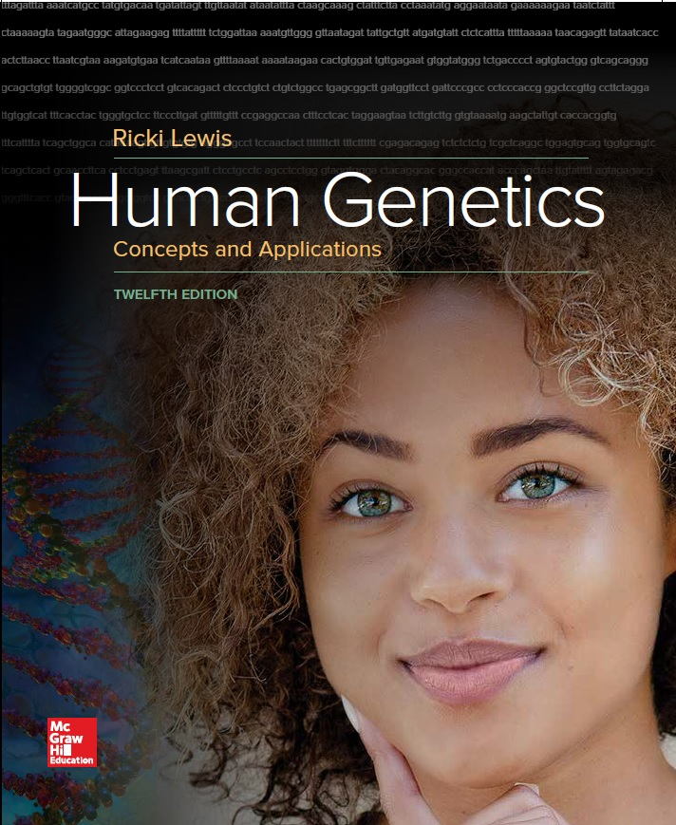
Human Genetics Concepts and Applications
Twelfth Edition
Chapter 9
DNA Structure and Replication
© McGraw-Hill Education. All rights reserved. Authorized only for instructor use in the classroom. No reproduction or further distribution permitted without the prior written consent of McGraw-Hill Education.

Slide 2
Learning Outcomes (1 of 2)
Describe the experiments showing that DNA is the genetic material and that protein is not.
Explain how Watson and Crick deduced the three-dimensional structure of DNA.
List the components of a DNA nucleotide building block.
Explain how nucleotides joined into two chains form the strands of a DNA molecule.
Describe how the great length of a DNA molecule is folded and looped.
Explain the semiconservative mechanism of DNA replication.

Slide 3
Learning Outcomes (2 of 2)
List the steps of DNA replication.
Explain how the polymerase chain reaction amplifies DNA outside cells.
Explain the basic strategy used to determine the base sequence of a DNA molecule.
Explain how next-generation sequencing improves upon Sanger sequencing.

Slide 4
DNA Is the Genetic Material
“A genetic material must carry out two jobs: duplicate itself and control the development of the rest of the cell in a specific way.”
—Francis Crick, 1953

Slide 5
History of DNA (1 of 4)
Friedrich Miescher, 1871
Swiss physician and biochemist
Isolated nuclei from white blood cells in pus
Found an acid substance with nitrogen and phosphorus
He called it nuclein
Later, it was called nucleic acid
Archibald Garrod, 1902
English physician
Linked inheritance of inborn errors of metabolism with the lack of particular enzymes

Slide 6
History of DNA (2 of 4)
Frederick Griffith, 1928
English microbiologist
Worked with Streptococcus pneumoniae bacteria, which exists in two types:
Type S (Smooth) = Enclosed in a polysaccharide capsule
Type R (Rough) = No capsule
Termed the conversion of one bacterial type into another as transformation

Slide 7
Discovery of Bacterial Transformation

Slide 8
History of DNA (3 of 4)
Avery, MacLeod, and McCarty, 1944
American physicians
Treated lysed S bacteria with protease and DNase
Only DNase prevented transformation
Thus, DNA is the transforming principle
Can convert type R bacteria into S

Slide 9
The Transforming Principle

Slide 10
History of DNA (4 of 4)
Alfred Hershey and Martha Chase, 1953
American microbiologists
Used E.coli bacteria infected with a virus that consisted of a protein head surrounding DNA
Grew a batch of virus in a medium containing ³⁵S and ³²P
Blender experiments showed that the virus transfers DNA, not protein, into a bacterial cell
Thus, DNA is the genetic material

Slide 11
Hershey-Chase Experiment

Slide 12
Discovering the Structure of DNA (1 of 5)
Phoebus Levine
Russian-American biochemist
Identified the 5-carbon sugars ribose in 1909 and deoxyribose in 1929
Revealed chemical distinction between RNA and DNA
RNA has ribose
DNA has deoxyribose
Discovered that the three parts of a nucleotide are found in equal proportions:
Sugar
Phosphate
Base
Deduced that a nucleic acid building block must contain one of each component

Slide 13
Discovering the Structure of DNA (2 of 5)
Erwin Chargaff, 1951
Austrian-American biochemist
Analyzed base composition of DNA from various species and observed regular relationships:
Adenine (A) + Guanine (G) = Thymine (T) + Cytosine (C)
A = T and C = G

Slide 14
Discovering the Structure of DNA (3 of 5)
Rosalind Franklin and Maurice Wilkins, 1952
English scientists
Used a technique called X-ray diffraction
Deduced the overall structure of the molecule from the patterns in which the X rays were deflected
Distinguished two forms of DNA
“A” form, which is dry and crystalline
“B” form, which is wet and cellular
It took Franklin 100 hours to obtain “photo 51” of the B-form of DNA

Slide 15
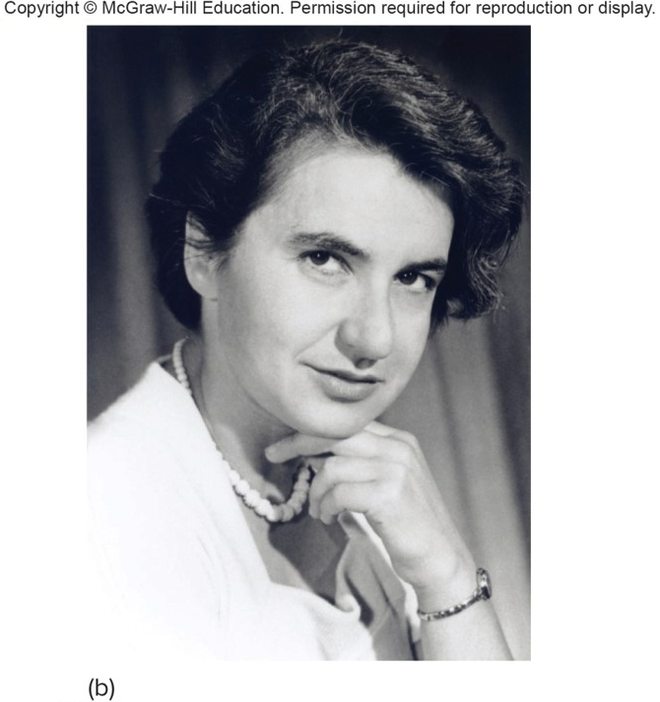
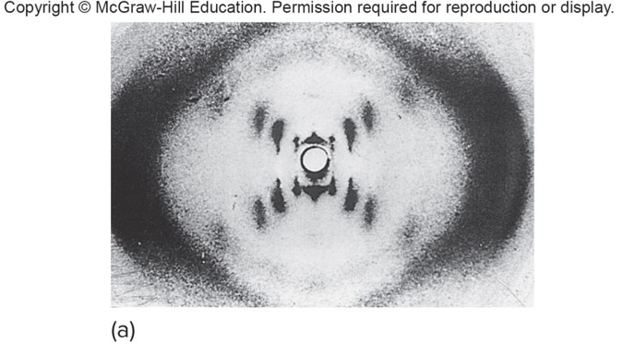
Discovering the Structure of DNA (4 of 5)
Franklin reasoned that the DNA is a helix with symmetrically organized subunits.
(a): © Science Source
(b) Rosalind Franklin 1920-1958
© Science Source

Slide 16
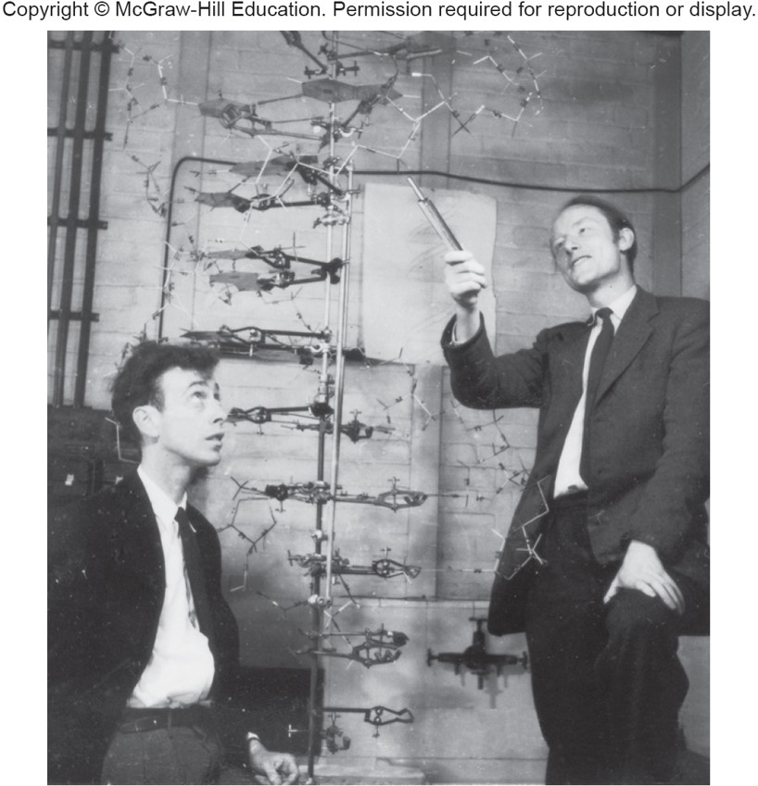
Discovering the Structure of DNA (5 of 5)
James Watson and Francis Crick
Did not perform any experiments
Rather, they used the earlier research and inferences from model building with cardboard cutouts to solve the structure of DNA
© A. Barrington Brown/Science Source

Slide 17
Table 9.1 The Road to the Double Helix
Investigator | Contribution | Timeline
Friedrich Miescher | Isolated nuclein in white blood cell nuclei | 1869
Frederick Griffith | Transferred killing ability between types of bacteria | 1928
Oswald Avery, Colin MacLeod, and Maclyn McCarty | Discovered that DNA transmits killing ability in bacteria | 1940s
Alfred Hershey and Martha Chase | Determined that the part of a virus that infects and replicates is its nucleic acid and not its protein | 1950
Phoebus Levene, Erwin Chargaff, Maurice Wilkins, and Rosalind Franklin | Discovered DNA components, proportions, and positons | 1909-early 1950s
James Watson and Francis Crick | Elucidated DNA’s three-dimensional structure | 1953
James Watson | Had his genome sequenced | 2008

Slide 18
DNA Structure (1 of 8)
Gene is a section of a DNA molecule.
Sequence of building blocks specifies the sequence of amino acids in a particular protein.
A single building block is a nucleotide.
Each nucleotide is composed of:
A deoxyribose sugar
A phosphate group
A nitrogenous base; one of four types:
Adenine (A), Guanine (G) = Purines
Cytosine (C), Thymine (T) = Pyrimidines

Slide 19
DNA Structure (2 of 8)

Slide 20
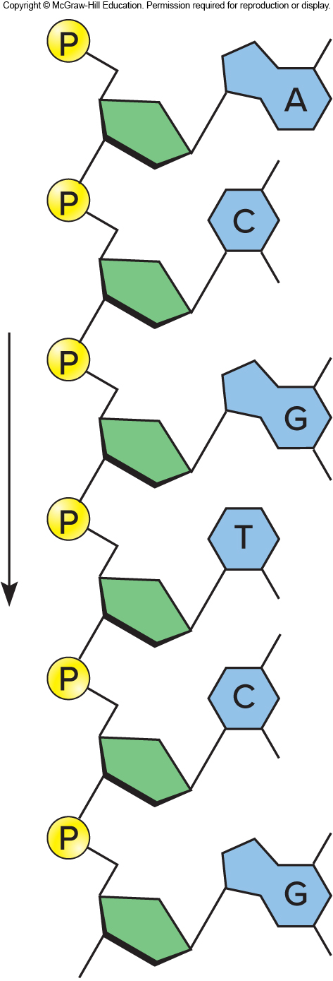
DNA Structure (3 of 8)
Nucleotides are joined into chains.
Phosphodiester bonds form between the deoxyribose sugars and the phosphates.
This creates a continuous sugar-phosphate backbone.

Slide 21
DNA Structure (4 of 8)
DNA Consists of Two Chains of Nucleotides in an Antiparallel Configuration
Two polynucleotide chains align forming a double helix.
The opposing orientation (head-to-toe) is called antiparallelism.

Slide 22
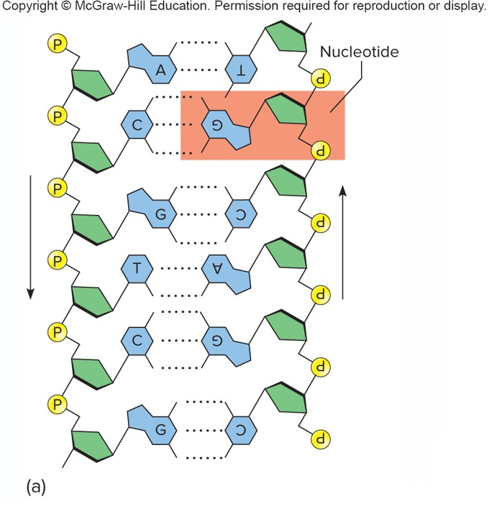
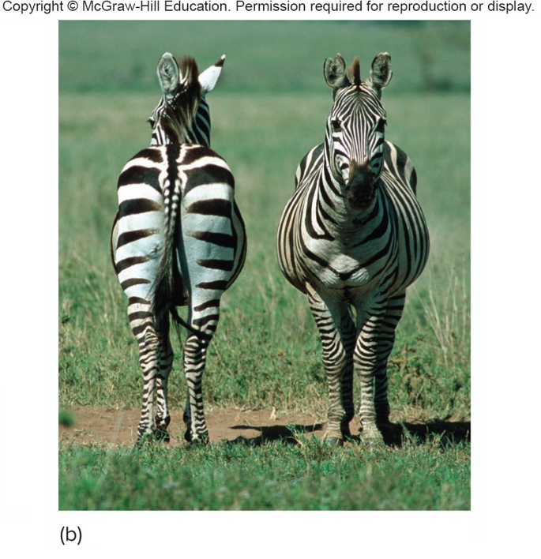
DNA Structure (5 of 8)
b: © Mark Boulton/Science Source

Slide 23
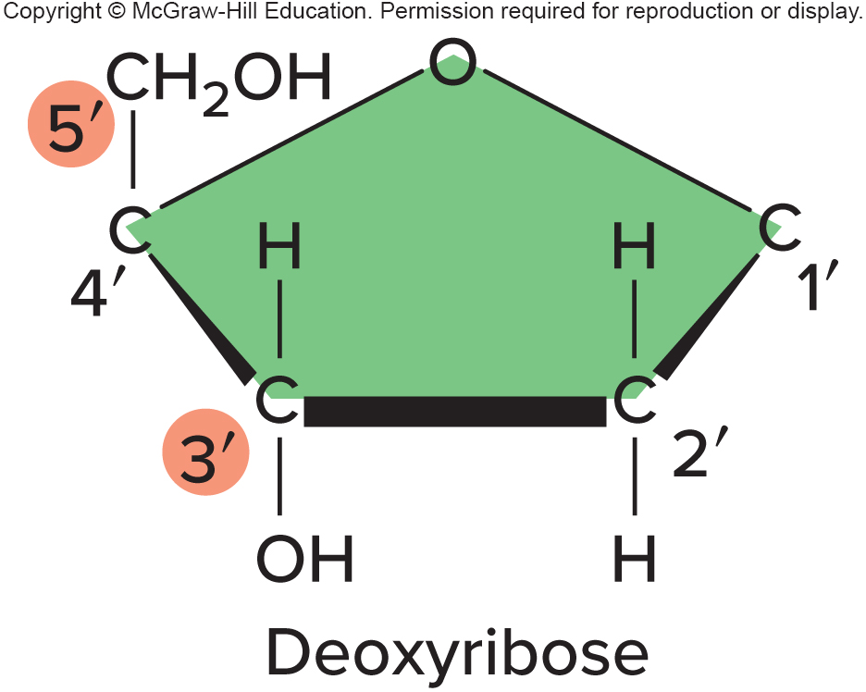
DNA Structure (6 of 8)
Antiparallel nature of the DNA double helix becomes apparent when the carbons in the sugar are numbered.
Carbons are numbered from 1 to 5.

Slide 24
DNA Structure (7 of 8)
The key to the constant width of the double helix is the specific pairing of purines and pyrimidines via hydrogen bonds
The complementary base pairs are:
Adenine and guanine
Cytosine and thymine
Hydrogen bonds hold the base pairs together

Slide 25
DNA Structure (8 of 8)

Slide 26
DNA Is Directional
Note that one strand of the doublehelix runs in a 5’ to 3’ direction, and the other strand runs in a 3’ to 5’ direction.

Slide 27
DNA Is Highly Condensed (1 of 4)
Scaffold proteins form frameworks that guide DNA strands.
The DNA coils around proteins called histones, forming a bead-on-a-string-like structure.
The bead part is called the nucleosome.
DNA wraps at several levels, until it is compacted into a chromatid.
Chromosome substance is called chromatin.

Slide 28
DNA Is Highly Condensed (2 of 4)

Slide 29
DNA Is Highly Condensed (3 of 4)
When chromatin is loose (not condensed into chromosomes that are visible upon staining), it forms loops at about 10,000 places in the genome.
An “anchor” protein called CTCF brings together parts of the DNA sequence within the same long DNA molecule to form the overall “loop-ome” structure.

Slide 30
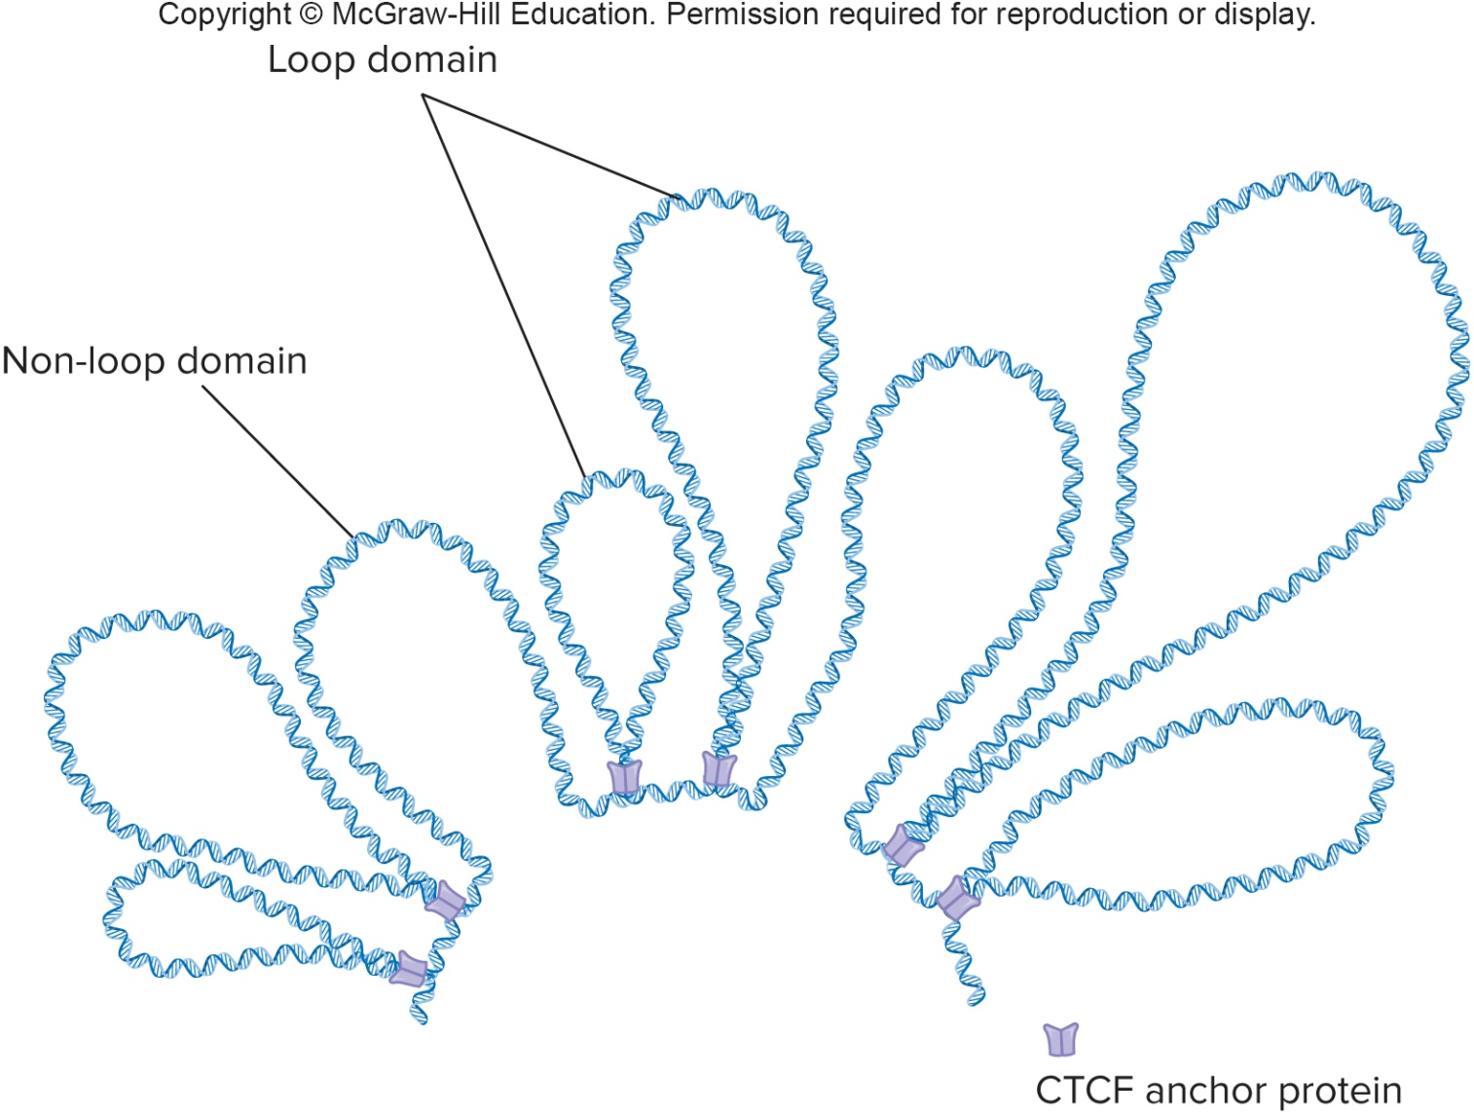
DNA Is Highly Condensed (4 of 4)

Slide 31
DNA Replication
DNA replication is semiconservative.
Two identical double helices are formed from one original, parental double helix.
Each new DNA double helix conserves half of the original.
Matthew Meselson and Franklin Stahl, 1957
Demonstrated the semiconservative mechanism of DNA replication with a series of density shift experiments
Labeled replicating DNA from bacteria with a heavy form of nitrogen and traced its pattern of distribution
Higher-density nitrogen was incorporated into one strand of each daughter double helix

Slide 32
DNA Replication Is Semiconservative

Slide 33
Steps of DNA Replication
DNA replication occurs during the S phase of the cell cycle, prior to cell division.
When DNA is replicated, it separates and hydrogen bonds holding the base pairs together break.
Two identical nucleotide chains are built from one, as the bases form pairs.
A site where DNA is locally opened is called a replication fork.

Slide 34
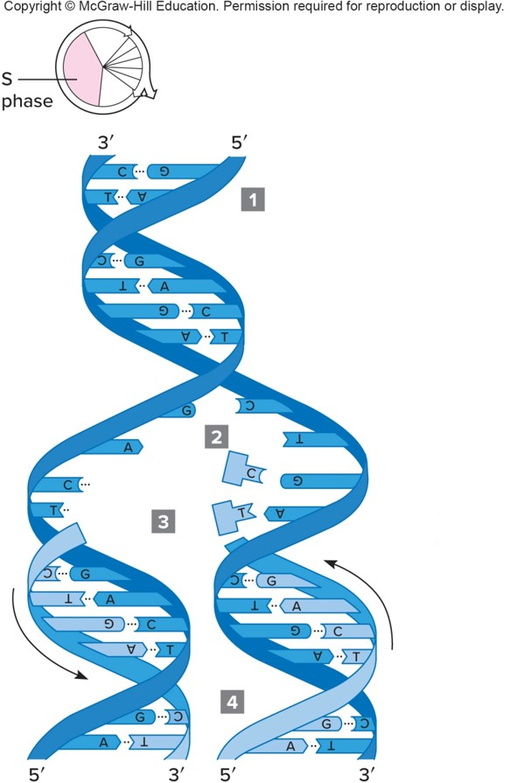
Overview of DNA Replication
Parent DNA molecule.
Parental strands unwind and separate at several points.
Each parental strand provides a template for DNA polymerase to bind complementary bases, A with T and G with C.
Sugar-phosphate backbones of daughter strands close.

Slide 35
Enzymes in DNA Replication
Enzymes in DNA replication
Helicase unwinds parental double helix.
Binding proteins stabilize separate strands.
Primase adds short primer to template strand.
DNA polymerase binds nucleotides to form new strands.
Ligase joins Okazaki fragments and seals other nicks in sugar-phosphate backbone.

Slide 36
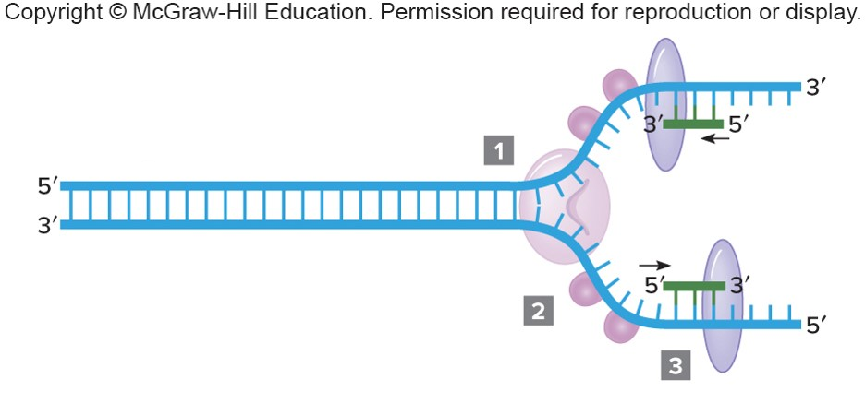
Activities at the Replication Fork (1 of 4)
Helicase binds to origin and separates strands.
Binding proteins keep strands apart.
Primase makes a short stretch of RNA on the DNA template.

Slide 37
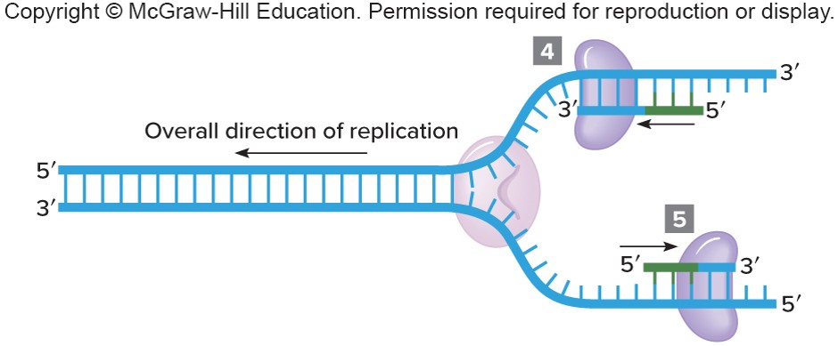
Activities at the Replication Fork (2 of 4)
DNA polymerase adds DNA nucleotides to the RNA primer.
DNA polymerase proofreading activity checks and replaces incorrect bases.

Slide 38
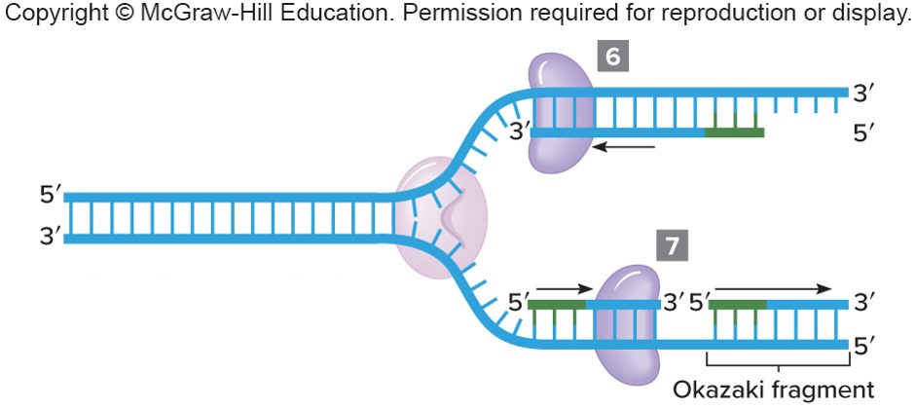
Activities at the Replication Fork (3 of 4)
Continuous strand synthesis continues in a 5’ to 3’ direction.
Discontinuous synthesis produces Okazaki fragments on the 5’ to 3’ template.

Slide 39
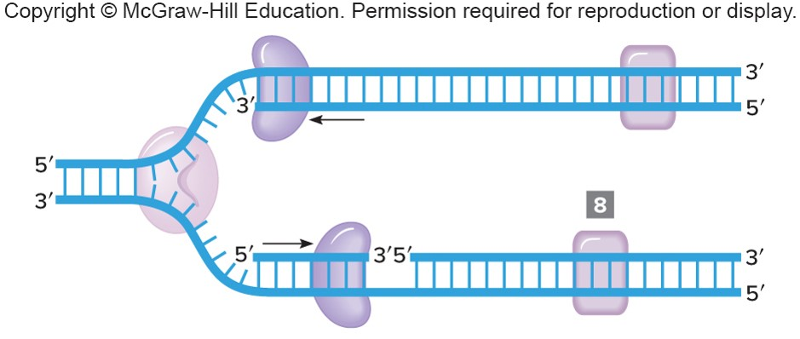
Activities at the Replication Fork (4 of 4)
Enzymes remove RNA primers. Ligase seals sugar-phosphate backbone.

Slide 40
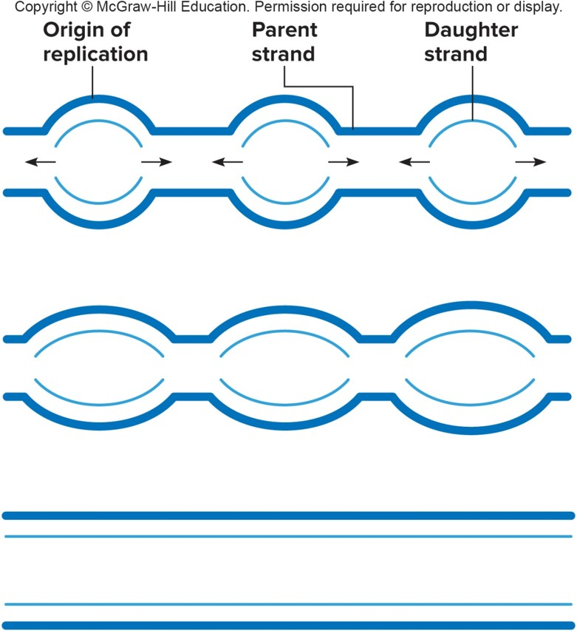
Replication Bubbles
The sites of replication resemble bubbles that coalesce as the daughter double helices form.
© James Cavallini/Science Source

Slide 41
Polymerase Chain Reaction (PCR)
DNA amplification technique
Uses DNA polymerase to rapidly replicate a specific DNA sequence in a test tube
Yields more than 10 billion copies of the target DNA sequence
Useful in forensic investigations to amplify small DNA samples

Slide 42
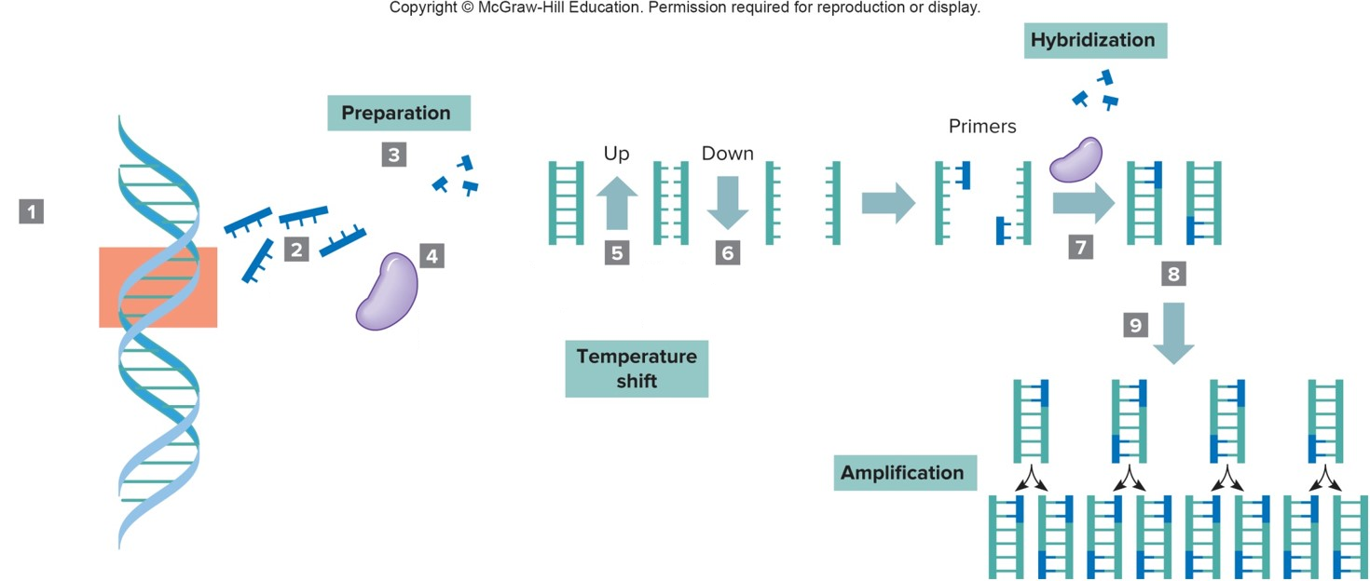
Steps in Amplifying DNA Using PCR (1 of 2)

Slide 43
Steps in Amplifying DNA Using PCR (2 of 2)
Select target sequence in virus genome.
Primers.
Preparation
Free nucleotides
Heat-resistant polymerase
Temperature shift
Target sequence (Up)
Heat separates strands. (Down)
Hybridization
Primers hybridize due to base complementarity.
DNA fills in.
Repeat process many times.
Amplification

Slide 44
Sequencing DNA (1 of 2)
Sanger sequencing
Used to:
Sequence individual genes
Check the accuracy of a selected sequenced area of a genome
Deduces a DNA sequence by aligning pieces that differ from each other by the end base
Variations label, cut, and/or immobilize the DNA pieces in different ways, greatly speeding the process

Slide 45
Sequencing DNA (2 of 2)
Next-generation sequencing
Uses massively-parallel approach
Immobilizes DNA pieces on different types of materials, to read and overlap millions of pieces at once
Speeds up DNA sequencing

Slide 46
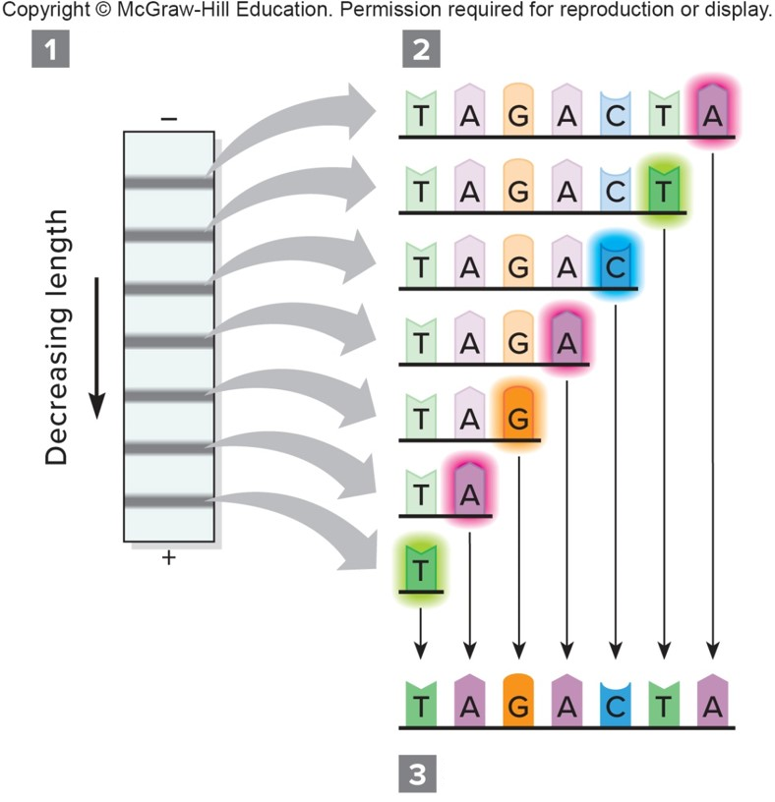
Reading a DNA Sequence
DNA fragments are ordered by size on sequencing gel.
Laser highlights end base.
Sequence is derived.

Slide 47
DNA Sequence Data

Slide 48
End of Presentation

